Slide 1
How to use the Twinspace
Training activity
C1-Short term joint staff training events
3/11-6/11.2021
Alcaniz, Spain
Project n’EURO NEST 3.0
No. 2021-1-ES-KA229-082594_6
VASILICA GAZDAC-
SCOALA PROFESIONALA TIBERIU MORARIU SALVA, ROMANIA
eTwinning ambassador

Slide 2
Topics to be discussed:
Twinspace
ICT tools
Q & A

Slide 3
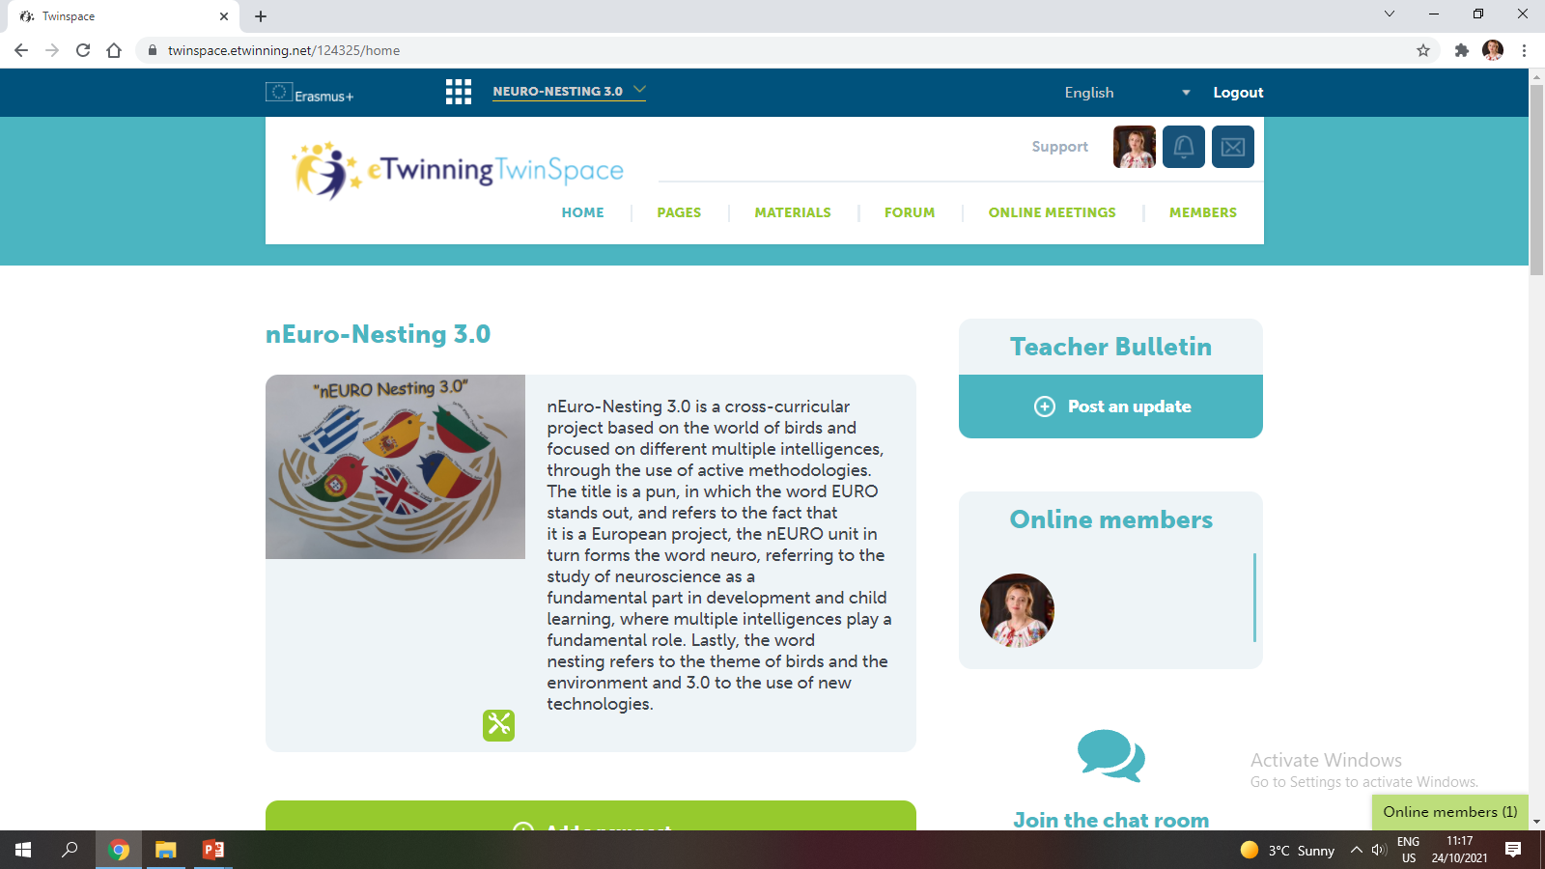
Twinspace:

Slide 4
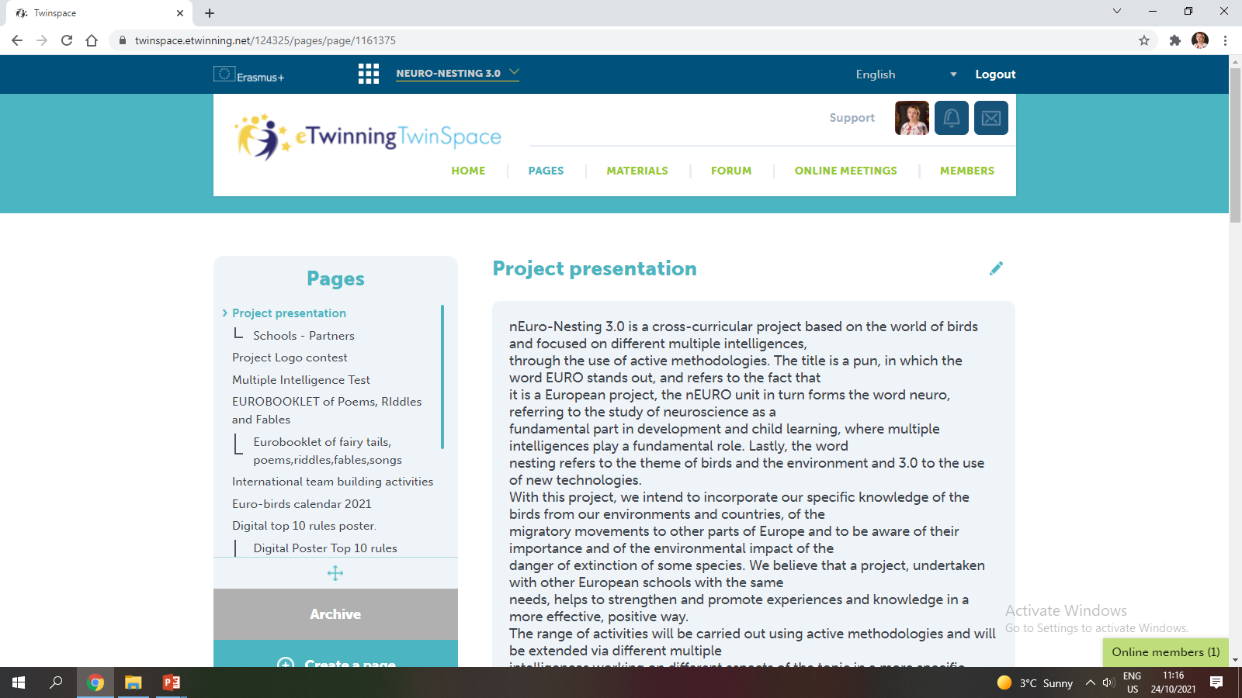
Twinspace:

Slide 5
Twinspace:

Slide 6
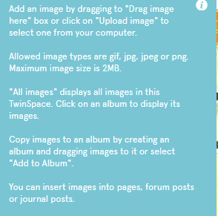
Twinspace:

Slide 7
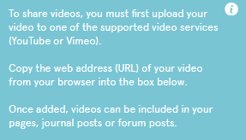
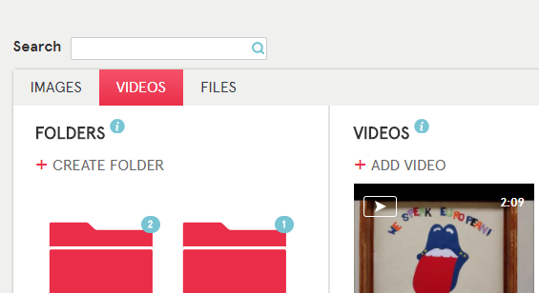
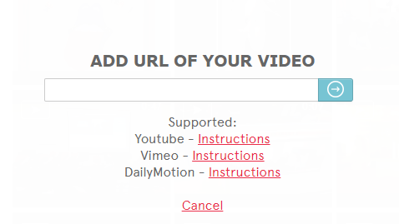
Twinspace:

Slide 8
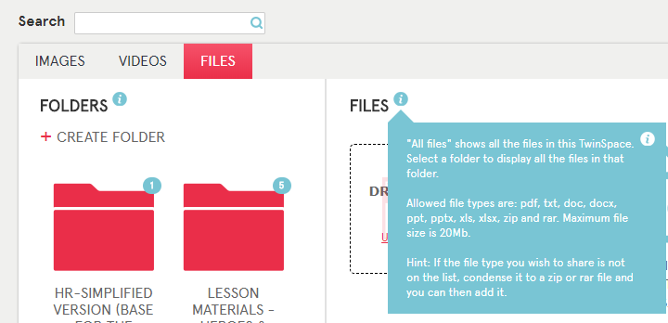
Twinspace:

Slide 9
Twinspace:
How to organise your folders...

Slide 10
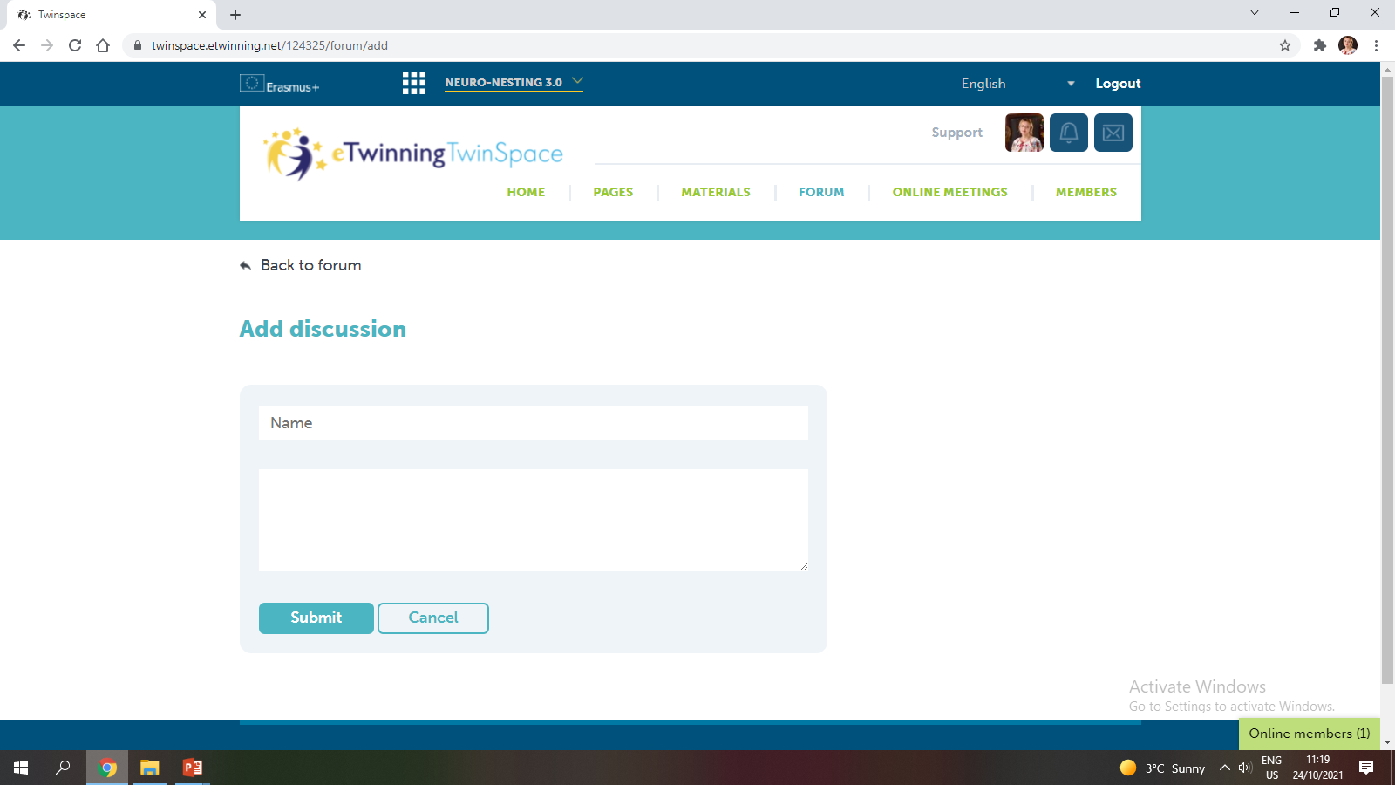
Twinspace:

Slide 11
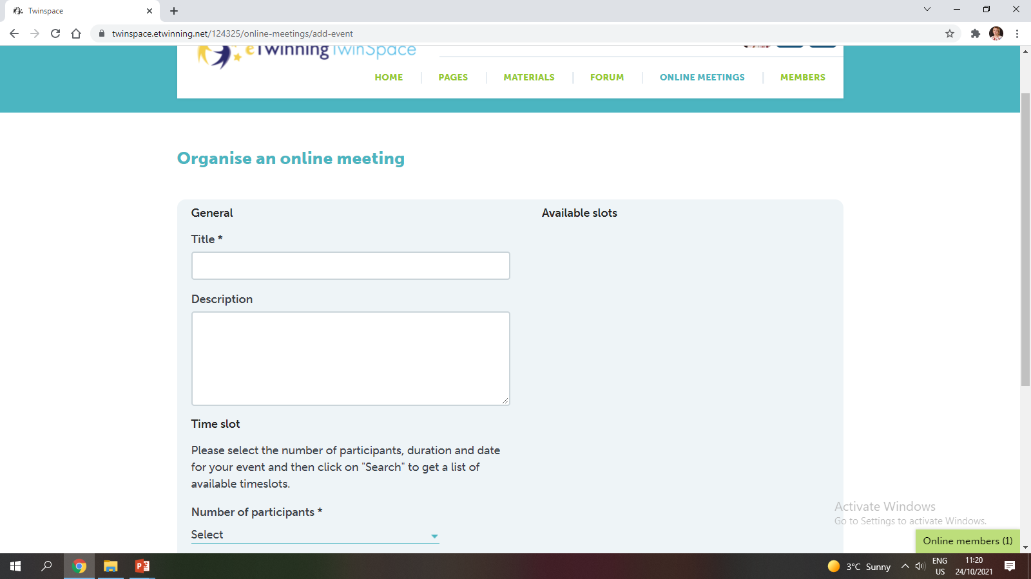
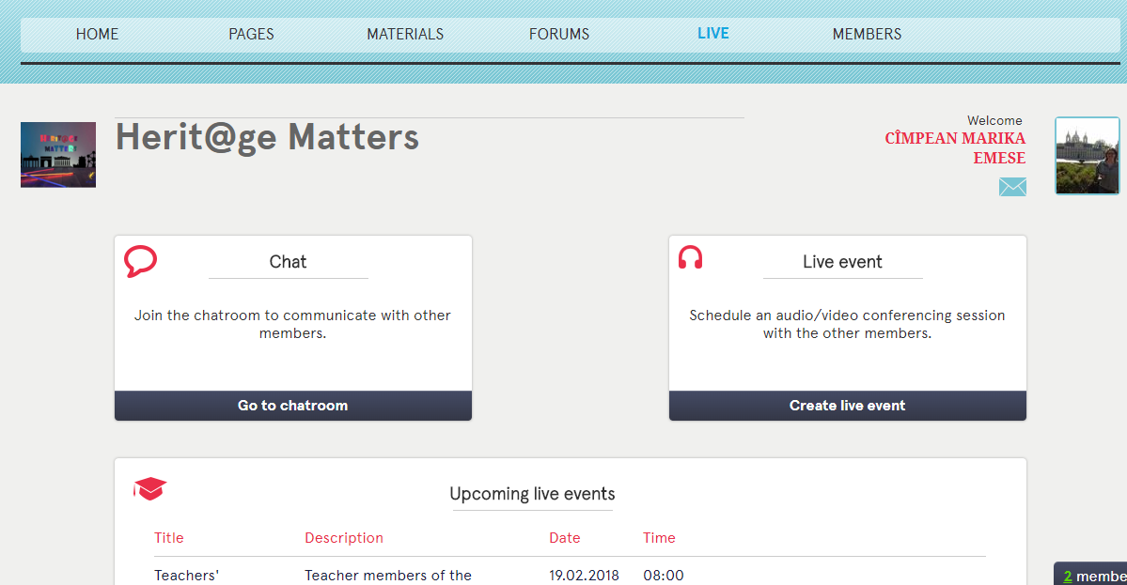
Twinspace:

Slide 12
Twinspace:

Slide 13
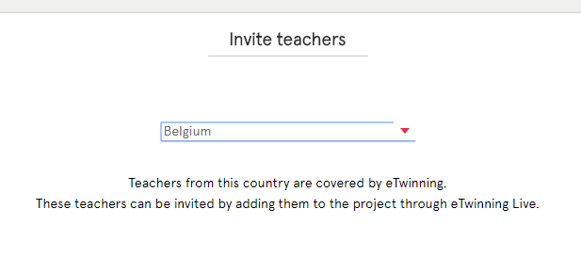
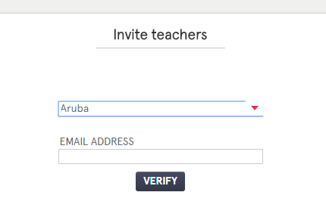
Twinspace:

Slide 14
Twinspace:

Slide 15
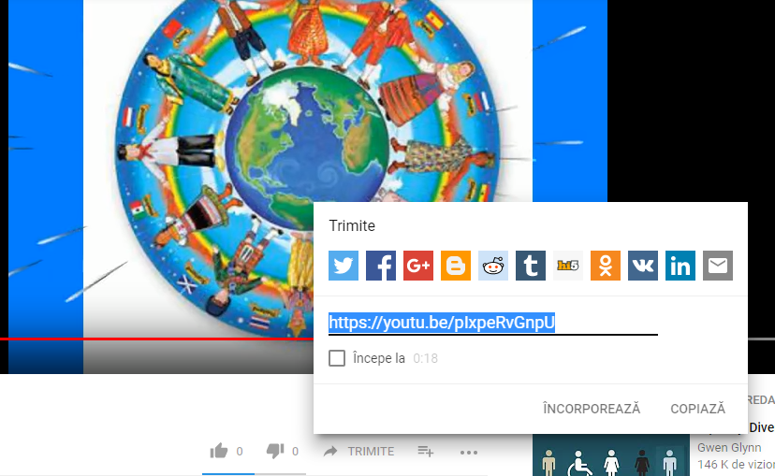
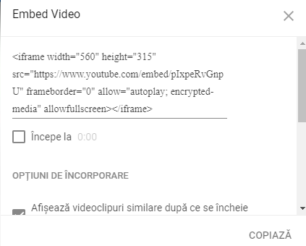
Twinspace:

Slide 16
How do I use the embed code?

Slide 17
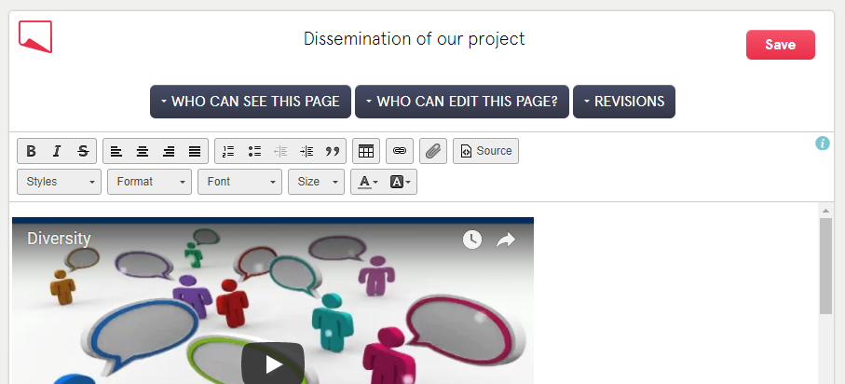
How do I use the embed code?

Slide 18
Twinspace( Q and A):

Slide 19
ICT tools

Slide 20
ICT tools

Slide 21
ICT tools

Slide 22
ICT tools

Slide 23
Feedback: Menti https://www.menti.com/6irsw4sgdi

Slide 24
Thank you!
Contact:
Vasilica Gazdac: vasilicagazdac@gmail.com
“The European Commission support for the production of this publication does not constitute an endorsement of the contents which reflects the views only of the authors, and the National Agency and Commission cannot be held responsible for any use which may be made of the information contained therein”.
☺

