Slide 1
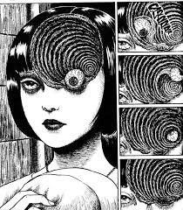
MAKING COMICS!

Slide 2
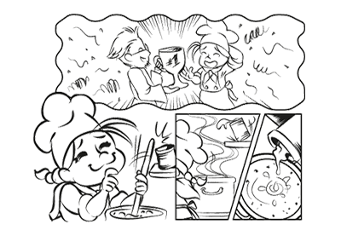
Do you want to tell a story?

Slide 3
If it’s a story-can people follow it?

Slide 4
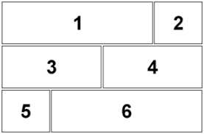
Think about the layout…

Slide 6
Should it be simple & organised?

Slide 8
Should it be colourful?

Slide 9
It can be basic – sometimes that’s easier to understand!

Slide 10
ONE image is also enough to tell a story...

Slide 11
☺

Slide 12
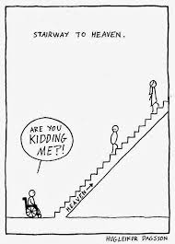
Provoking the viewer always works!

Slide 13
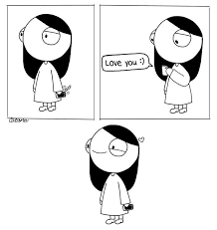
Basically: Less is more… Ludwig Mies van der Rohe (1886–1969). Phrase/motto adopted c. 1947

Slide 14
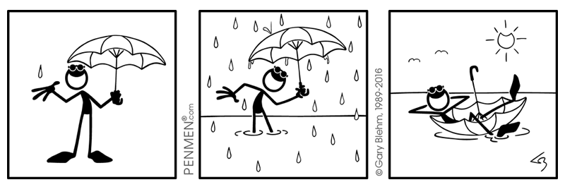

Slide 16
Even „simple“ is organised – look at the writing – it‘s NOT handwriting. Each „s“ is the same!

Slide 17
Collage or digital editing is also fun!

Slide 18
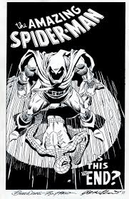
Less is a bore... A postmodernist reaction to van der Rohe’s motto by Robert Charles Venturi Jr. (born June 25, 1925)

Slide 19
But it has to be understandable! You are not making an art work. You want to educate people with your work today.

Slide 20
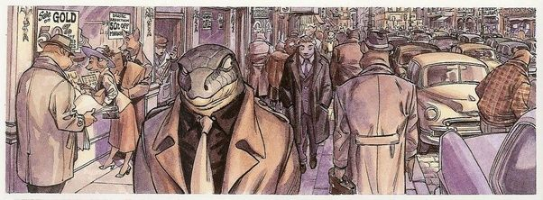
Colour is always possible...

Slide 21
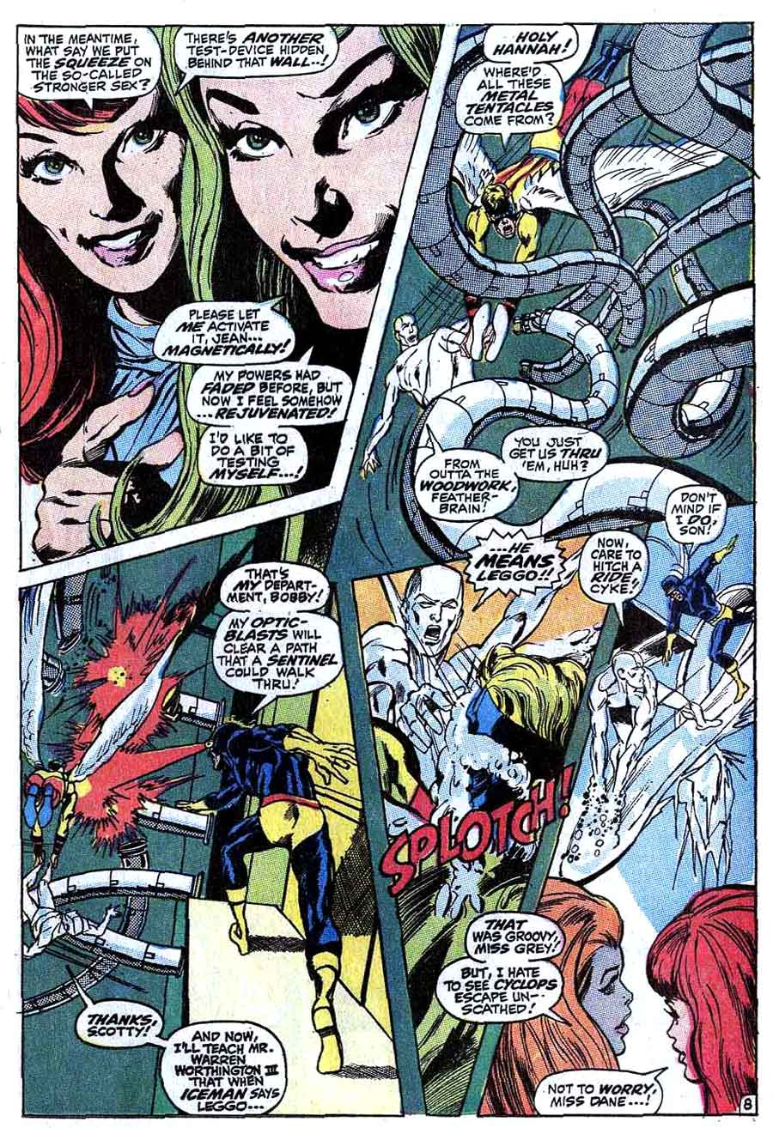
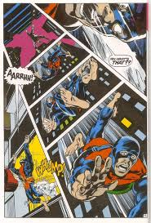
Colour and fun layouts…

Slide 22
Your focus is: sustain.me You can make a comic, cartoon, flyer, etc for ANY aspect of this project

Slide 23
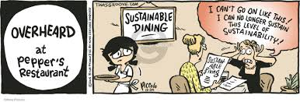
Weirdly enough, circles attract the eye…

Slide 24
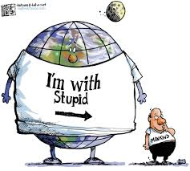

Slide 25
The main thing is that whatever you do, you finish it ☺

Slide 26
HAVE FUN!

