Slide 1
k e ž m a r o k The city where our school is located laura hangurbadžová, gabriela hangurbadžová

Slide 2
Sightseeings of town Kežmarok
Castle Kežmarok
Wooden evangelical church
Town Hall
Basilica Minor - Basilica of the Holy Cross
Historical cemetery

Slide 3
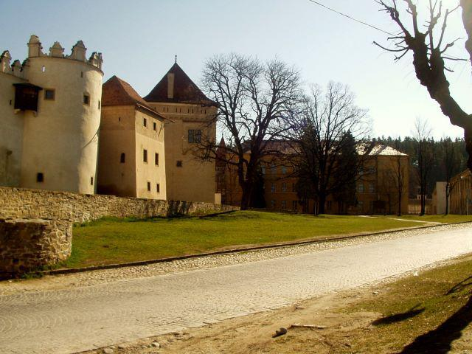
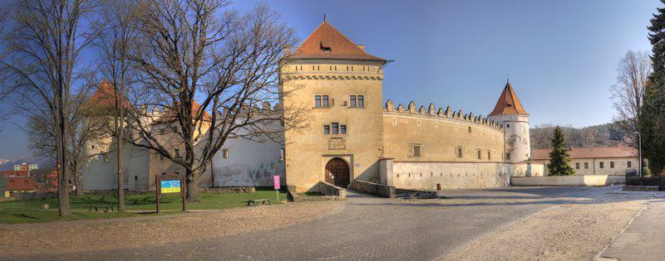
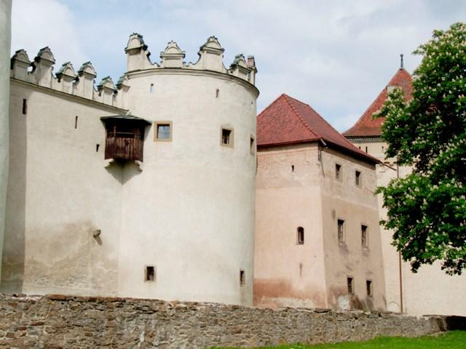
Castle Kežmarok
The castle /Thökoly château/ belongs to the so-called town castles.
It was built directly on the territory of town to protect the town from enemies.
The castle was mentioned for the first time in the year 1463 and in the year 1528 became a property of the Polish noble family Laský.
The town got the castle from its last owner Ferdinand Rueber in the year 1702. The castle was used for different purposes, for example a storehouse.
During the second half of 19th century the decision was made to open the museum in the castle, which was declassified in the year 1931.
Today the whole area is a town museum with different expositions which give evidence of the historical development since its beginning to the 20th century.

Slide 4
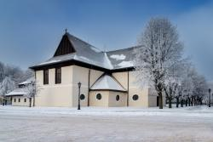
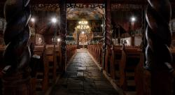
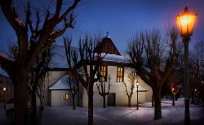
Wooden evangelical church
The wooden evangelical church was written into the List of the UNESCO World Heritage, within the scope of the enlistment of the Wooden Churches of the Slovak part of the Carpathian Mountain Area in 2008. Wooden Evangelical church is the national cultural treasure. The church comes from the time of religious bondage of Protestants. According to the assembly in Sopron the Protestants could build their churches only out of town walls without solid foundations, from wood, no towers and bells. The first church dates back to the years 1687-1688. Nowadays building is from the year 1717 and was built in incredibly short time- 3 months in baroque style. The church is sacred to the Holy Trinity.

Slide 5
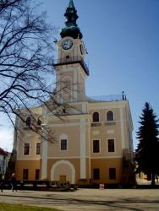
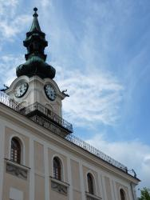
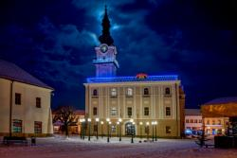
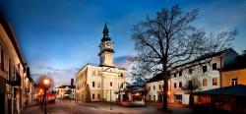
Town hall
The first Town Hall was built on the Old market street in the oldest part of the town. During the invasion of the Hussites in the year 1433 that part of the old town was burned down. The town centre has moved and a new main square was made. In its centre master Juraj from Spišská Sobota built a brand new Town Hall in the year 1641 in the gothic style.In the year 1641 under the leading of the mayor Žigmund Moes a tower was built to the Town Hall and as Juraj Bohuš writes in the year 1720: “the Town Hall is finished by crenellation and on the southern side is the arm of coat with painted picture of justice. Also the tower is decorated by moral notices. During the markets a chosen person beats the leaded drums and the town trumpeter plays the trumpet at the tower…
In the year 1779 the Town Hall burned down again and was rebuilt in the Classicistic style. The present look and the outbuilding of the second floor acquired after the next fire in the year 1922 and in the year 2002 the façade was completely renewed. The building is today the residence of mayor.

Slide 6
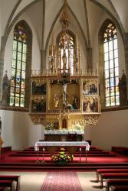
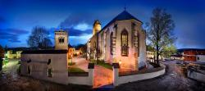
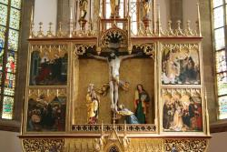
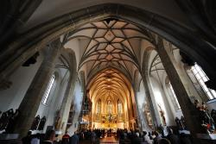
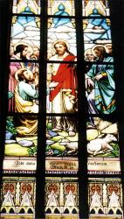
Basilica Minor - Basilica of the Holy Cross
Present Gothic church originated in the years 1444-1498. The owner of the castle Zápoľský and the town supported reconstruction. Both sponsors immortalized their coats of arms in the small entry into the church. In the interior are three different types of arch: reticule arch in the aisles, star arch in the nave and cross arch in the sacristy. The interior of the church, altars / of Apostles, Ordeals and Coronation of Madonna/ and the font are in the Gothic style from the year 1472.
Renaissance bench under the big choir comes from the year 1518 and on this bench were places only for the Mayor and the counselors.
The curiosities are both organs. The small one is from the year 1651 and is the oldest one of its kind in Slovakia that is functional. To the most precious things belongs the crucified Jesus on the main altar and was made in the workshop of Master Vit Stwosz at the turn of 15th and 16th century.
In the year 1997 was the church sanctified by The Holy Father John Paul II to the Basilica Minor.

Slide 7
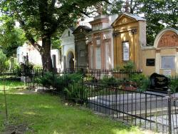
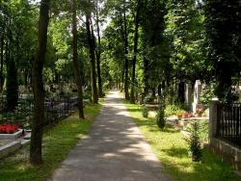
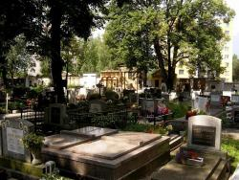
Historical cemetery
During the time of counterreformation the Protestants had to bury their decedents out of the town walls and there arose today’s cemetery in the year 1674. It slowly increased and after the year 1784 the Catholics stated to bury their decedents there as well. The oldest grave stone is from the year 1691 and belongs to the merchandiser Žigmund Reinisch.

Slide 8
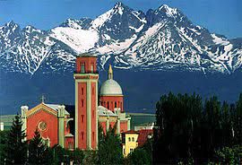
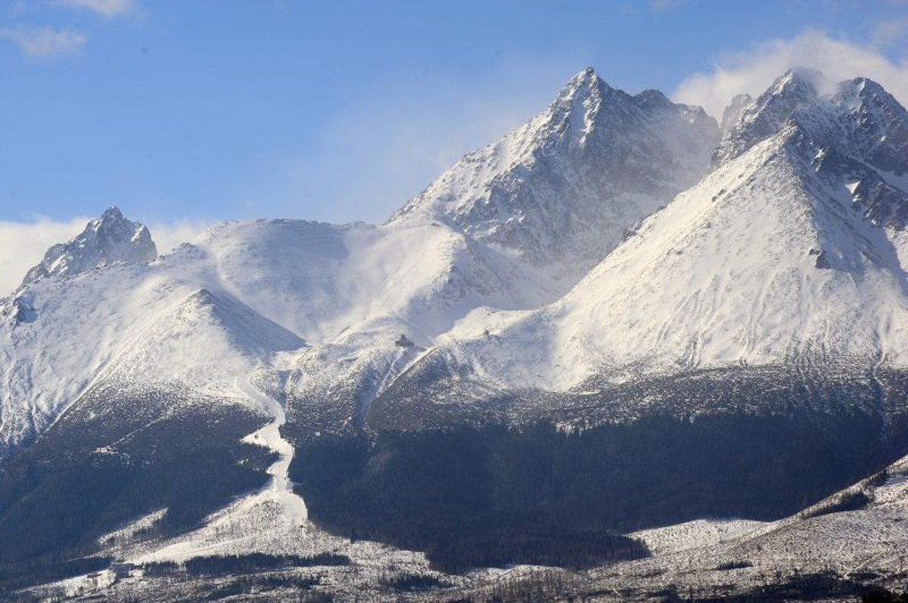
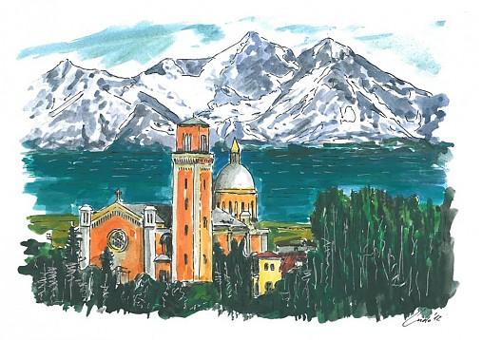
School under the high tatras
Our school is lacated not only in a beautiful historic town, but its advantage is also the proximity of the high tatras.

Slide 9
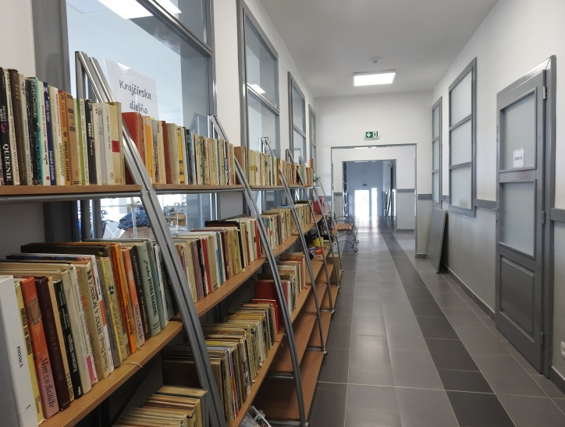
Private joint school kežmarok
The private joint school is a non-traditional secondary school with a focus on education and training in crafts and services in the form of alternative elements in teaching. We can boast of attractive trade unions open on the basis of many years of experience and interesting results. We work mainly with students from socially disadvantaged backgrounds (SZP) and marginalized Roma community (MRK).

Slide 10
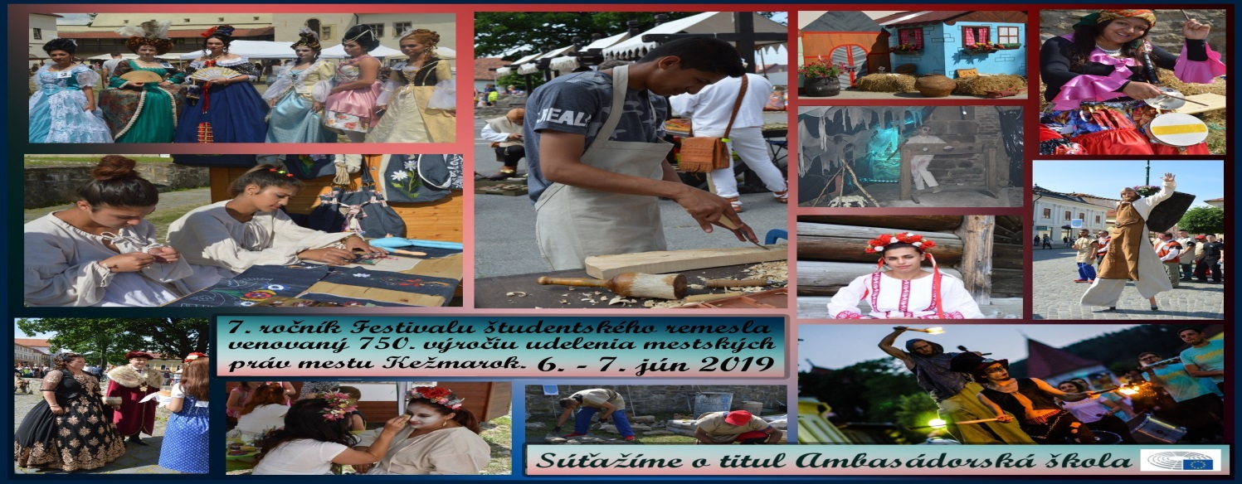
Student craft festival
From 6 to 7 June 2019, our school was the main organizer of the 7th year of the Student Craft Festival. This took place in the center of Kežmarok. The event consisted of several parts - on Thursday evening it was a fairytale lantern procession, on Friday morning it was a procession through the city in period costumes, on both days school students from all over Slovakia competed in craft competitions, on Friday it was a cultural program on the stage, accompanying events in the castle grounds, accompanying events outside the castle and the final benefit concert, which took place in the wooden articular church in Kežmarok. The offer of the festival was varied for all ages and the high number of competitors and visitors to the festival are proof that the Student Craft Festival has already become known to the general public throughout Slovakia.

Slide 11
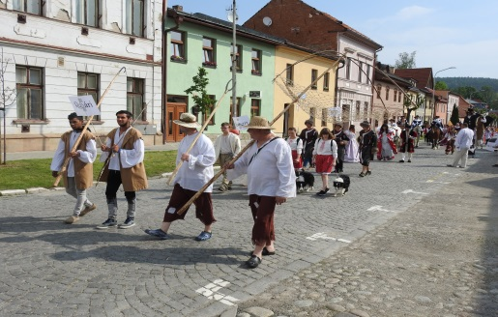
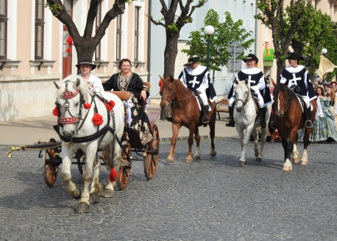
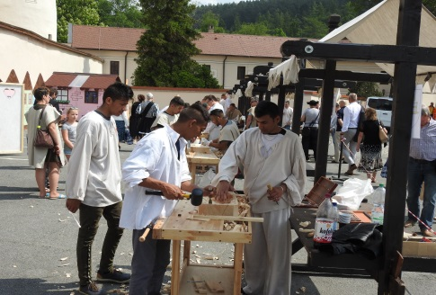
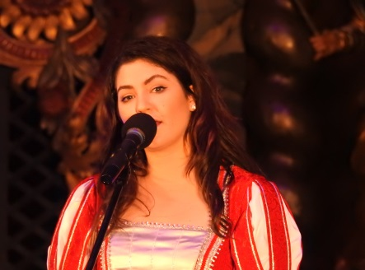
Student craft festival
The event was attended by 40 schools from all over Slovakia, from Štúrovo to Humenné. 47 teams competed in six craft competitions. We recorded more than a thousand young people who not only competed, but also took part in the organization of the main cultural program or accompanying events. At the event, we saw not only young craftsmen, but also young theater performers and singers.
The main patron of the festival this year was the Slovak singer Celeste Buckingham. It gave the festival a beautiful charm and appeal and did not refuse a single request for a photograph with a visitor during the demanding two days. Celeste was in the competition jury, helped with the organization, with direct participation she also attended both processions and at the end she sang as part of the benefit concert.

Slide 12
Thanks for paying attention.

