Slide 1
World Youth Day – Cracow 2016
Bartłomiej Pawlik 1a

Slide 2
What is the World Youth Day?
The World Youth Day is a worldwide event organized for the Catholic youth, where young people can encounter with the Pope.
The event was created by Pope John Paul II in 1985.
Since 1986 bishops used to organize a youth event annually at the diocesan level where the youth can meet their bishops. It used to take place on all Palm Sundays but since 2021 it’s organized on Christ the King Sunday.
The International World Youth Days are organized every 2 – 3 years in different countries on different continents.
WYDs (World Youth Days) were organized on all continents except Antarctida and Africa

Slide 3
Map of all international World Youth Day locations so far.

Slide 4
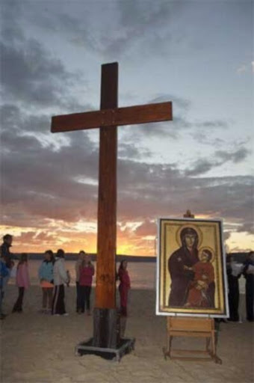
World Youth Day cross and icon
The Pilgrim Cross arrives in the next host country before the event starts.
The Cross always travels with an icon of Blessed Virgin Mary

Slide 5
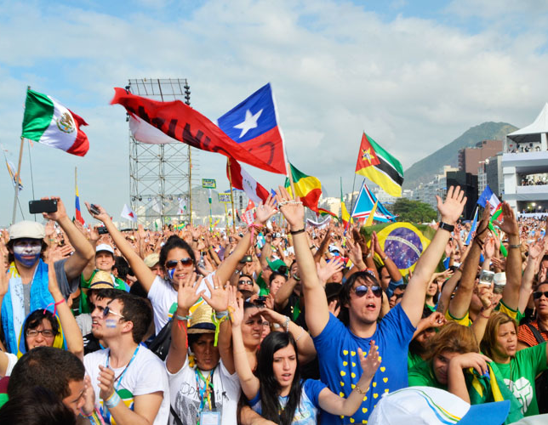
World Youth Day is celebrated very similarly to other events. The most well-known characteristic of this event is the appearance of many people from many different cultures. Flags and other national symbols from people around the world are present to show these peoples’ attendance. They can also proclaim their themes of Catholicism by e.g., singing national songs with a Catholic theme.
During the most important events people trade national items as souvenirs such as flags, crosses and shirts.
International World Youth Days and the ones on the diocesan level both have a theme which is a quote from The Holy Bible.

Slide 6
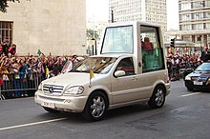
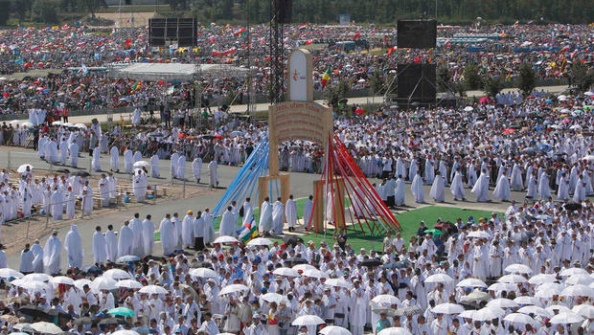
Another well known tradition is the Pope’s appearance, commencing with his arrival around the city in the Popemobile. The Pope also appears during the final Mass which ends the international WYD.

Slide 7
All International World Youth Days so far
1987 – Buenos Aires in Argentina
1989 – Santiago de Compostela in Spain
1991 – Częstochowa in Poland
1993 – Denver (Colorado) in the USA
1995 – Luneta Park (also known as Rizal Park) in Manila in the Philippines (over 5 million people participated, the largest crowd ever by the Guinness World Records, the world record was broken again by Philippines in 2015)
1997 – Paris in France
2000 – Rome in Italy
2002 – Toronto in Canada
2005 – Cologne in Germany

Slide 8
All International World Youth Days so far
2008 – Sydney in Australia
2011 – Madrid in Spain
2013 – Rio de Janeiro in Brazil (scheduled a year earlier than usually to avoid conflict with the 2014 FIFA World Cup)
2016 – Kraków in Poland (this year’s theme was "Blessed Are The Merciful, For They Shall Obtain Mercy“, tying it with the Year of Mercy which was taking place at the time
2019 – Panama City in Panama
2023 – Lisbon in Portugal, the event was originally scheduled to take place in August 2022, but the date was changed to 2023 same month because of the pandemic.

Slide 9
Catholic social online network and news site
Xt3.com was launched on 12th of June 2008. It was launched as the Official Catholic Social Network of World Youth Day. The name was a shortcut for „Christ in the Third Millennium”. It was controlled by the Archdiocese of Sydney. The site was closed in 2019.
In December 2012, the xt3 team published a ‘Gangnam Style’ Advent video: https://www.youtube.com/watch?v=vhBB5bwuzl4
Typing Xt3.com in a browser’s address bar now redirects to library.sydneycatholic.org

Slide 10
Typical schedule of events
 | Up to week before | Tuesday | Wednesday | Thursday | Friday | Saturday | Sunday
Morning | Days in the dioceses: Catechetical sessions around host and nearby dioceses | Day of official arrival and welcome for pilgrims | Catechetical session with participating bishops |  |  | Walking pilgrimage to vigil site | Closing ceremonies: Morning prayers are led by participating bishops Mass is celebrated by the Pope Next host diocese is announced by the Pope after Mass
Afternoon |  | Opening ceremonies Holy Mass is celebrated by the local ordinary of the host diocese | Afternoon shows, music, prayer and reconciliation opportunities | The Pope officially arrives at WYD and delivers his welcome address at a prayer service | Afternoon shows, music, prayer and reconciliation opportunities | Afternoon shows, music, prayer and reconciliation opportunities at vigil site
Evening |  | Evening shows, music, prayer and reconciliation opportunities |  |  | Stations of the Cross | Eucharistic Adoration
The schedule was copied from https://en.wikipedia.org/wiki/World_Youth_Day#2023

Slide 11
WYD 2016
World Youth Day 2016 was held in Cracow, Poland from 27th to 31st July. (at first the event was supposed to start from 26th July, but the date was changed
Pope Francis was the Pope at the time.
This is the second time the World Youth Day took place in Poland; the first time was in 1991.
This was the first time Pope Francis visited Middle-East Europe.

Slide 12
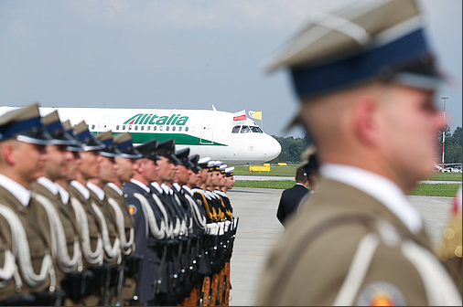
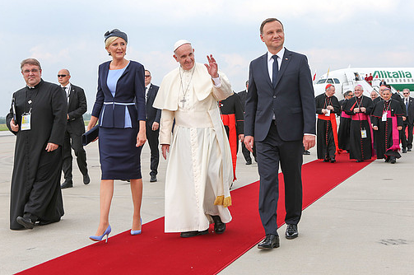
The Pope was greeted by President Andrzej Duda on the Kraków – Balice airport on 27th of July 2016
The Pope was first greeted on the Kraków – Balice airport by the president, his wife, the cardinal, etc. Accompanied by 48 polish soldiers

Slide 13
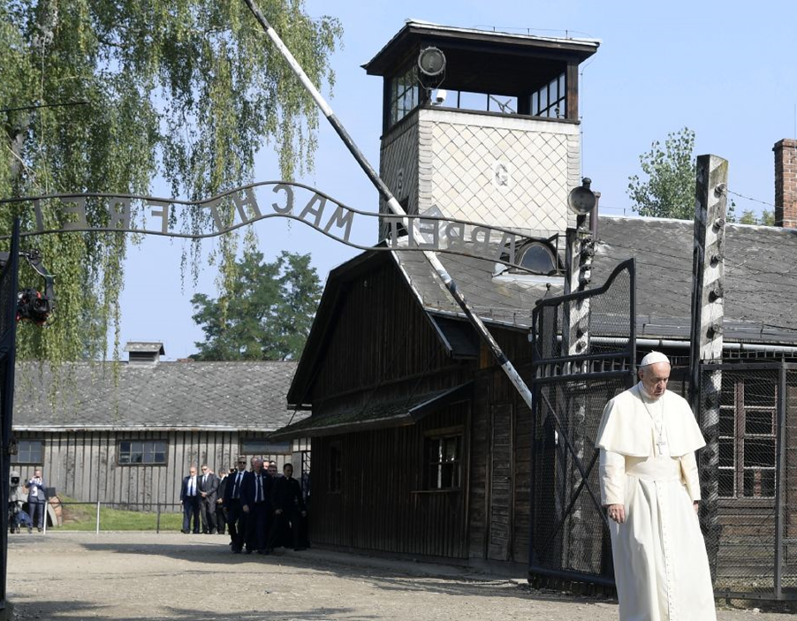
About 3 million people attended WYD 2016
The Pope apart from main events visited e.g., the sanctuary on Jasna Góra and the Auschwitz-Birkenau German concentration camp.

Slide 14
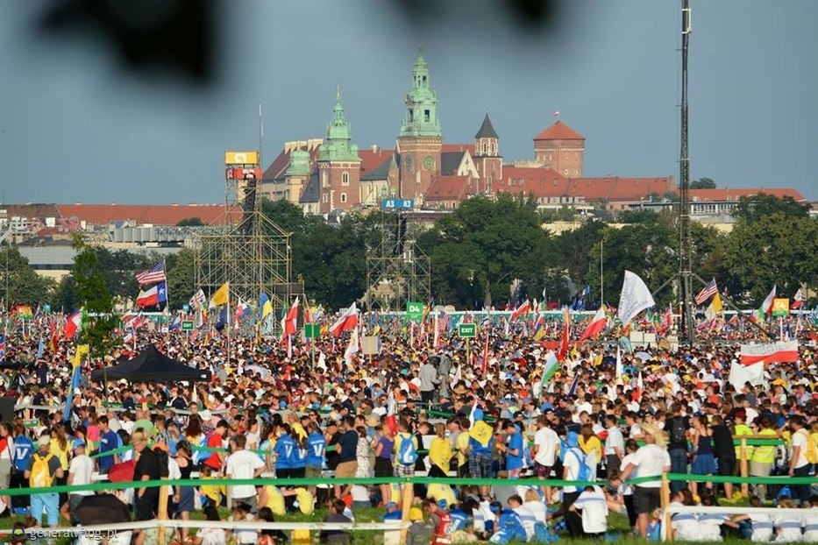
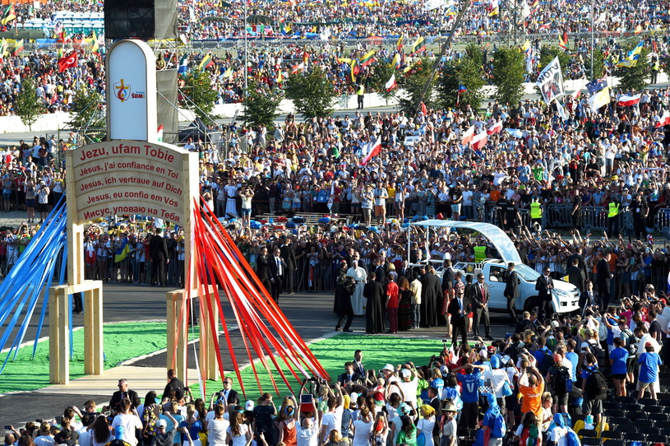
A group of Polish youth consisting of 100 people took the WYD Cross and the Blessed Virgin Mary icon from Brazilians on 13th of April 2014 (two years before the event started).
Main events were hosted at the Błonia Park and Campus Misericordiae.
Błonia Park (the Wawel castle is in the background)
Campus Misericordiae

Slide 15
The logo
The logo presents contours of Poland marked with red color, the yellow cross symbolizes Jesus Christ, and the yellow circle shows Cracow’s location. The cross is surrounded with a red and blue flame symbolizing God’s Mercy referring to the Merciful Jesus painting.
ŚDM means WYD (World Youth Day)
Kraków means Cracow

Slide 16
The End
Thank you for your attention

Slide 17
Sources:
https://pl.wikipedia.org/wiki/Plik:World_Youth_Day_locations.png
http://www.laityfamilylife.va/content/laityfamilylife/en/giovani/il-pellegrinaggio-della-croce-dei-giovani.html
https://dowym.com/world-youth-day/history/
https://en.wikipedia.org/wiki/Popemobile#/media/File:Popemobil_Mai_2007.jpg
http://thesplendorofthechurch.com/2016/08/01/3-million-crowd-the-final-estimate-of-world-youth-day-organizers-for-closing-mass-in-krakow-poland/
https://en.wikipedia.org/wiki/World_Youth_Day#2023
https://pl.wikipedia.org/wiki/%C5%9Awiatowe_Dni_M%C5%82odzie%C5%BCy
https://worldyouthday.com/about-wyd
https://misericors.org/papiez-w-polsce-przemowienie-powitalne-franciszka-na-wawelu-27-lipca-2016/
https://wiadomosci.dziennik.pl/wydarzenia/artykuly/527361,wystapienie-prezydenta-dudy-podczas-powitania-papieza-franciszka-dokumentacja.html
https://naukawpolsce.pap.pl/aktualnosci/news%2C77433%2Cwawel-najstarszy-i-mniej-zdeptany-wakacyjna-rekomendacja.html
https://www.tvp.info/46354239/biskupi-europy-o-auschwitz-nie-dla-antysemityzmu-i-manipulowania-prawda
https://general.flog.pl/wpis/11282124/sdm--blonia--brzegi--2016--krakow-
https://wydarzenia.interia.pl/raporty/raport-swiatowe-dni-mlodziezy-krakow-2016/aktualnosci/news-sdm-na-campusie-misericordiae-zamykane-kolejne-sektory,nId,2244312
https://parafia-azory.pl/index.php/swiatowe-dni-mlodziezy/269-symbolika-loga-swiatowych-dni-mlodziezy-sdm-2016
https://www.prezydent.pl/aktualnosci/wizyty-krajowe/art,100,powitanie-papieza-franciszka-w-polsce.html

