Slide 1



Slide 2









The Stop Rumours Agency (Agencia Stop Rumores) is made up of more than 260 public and private entities

Slide 3
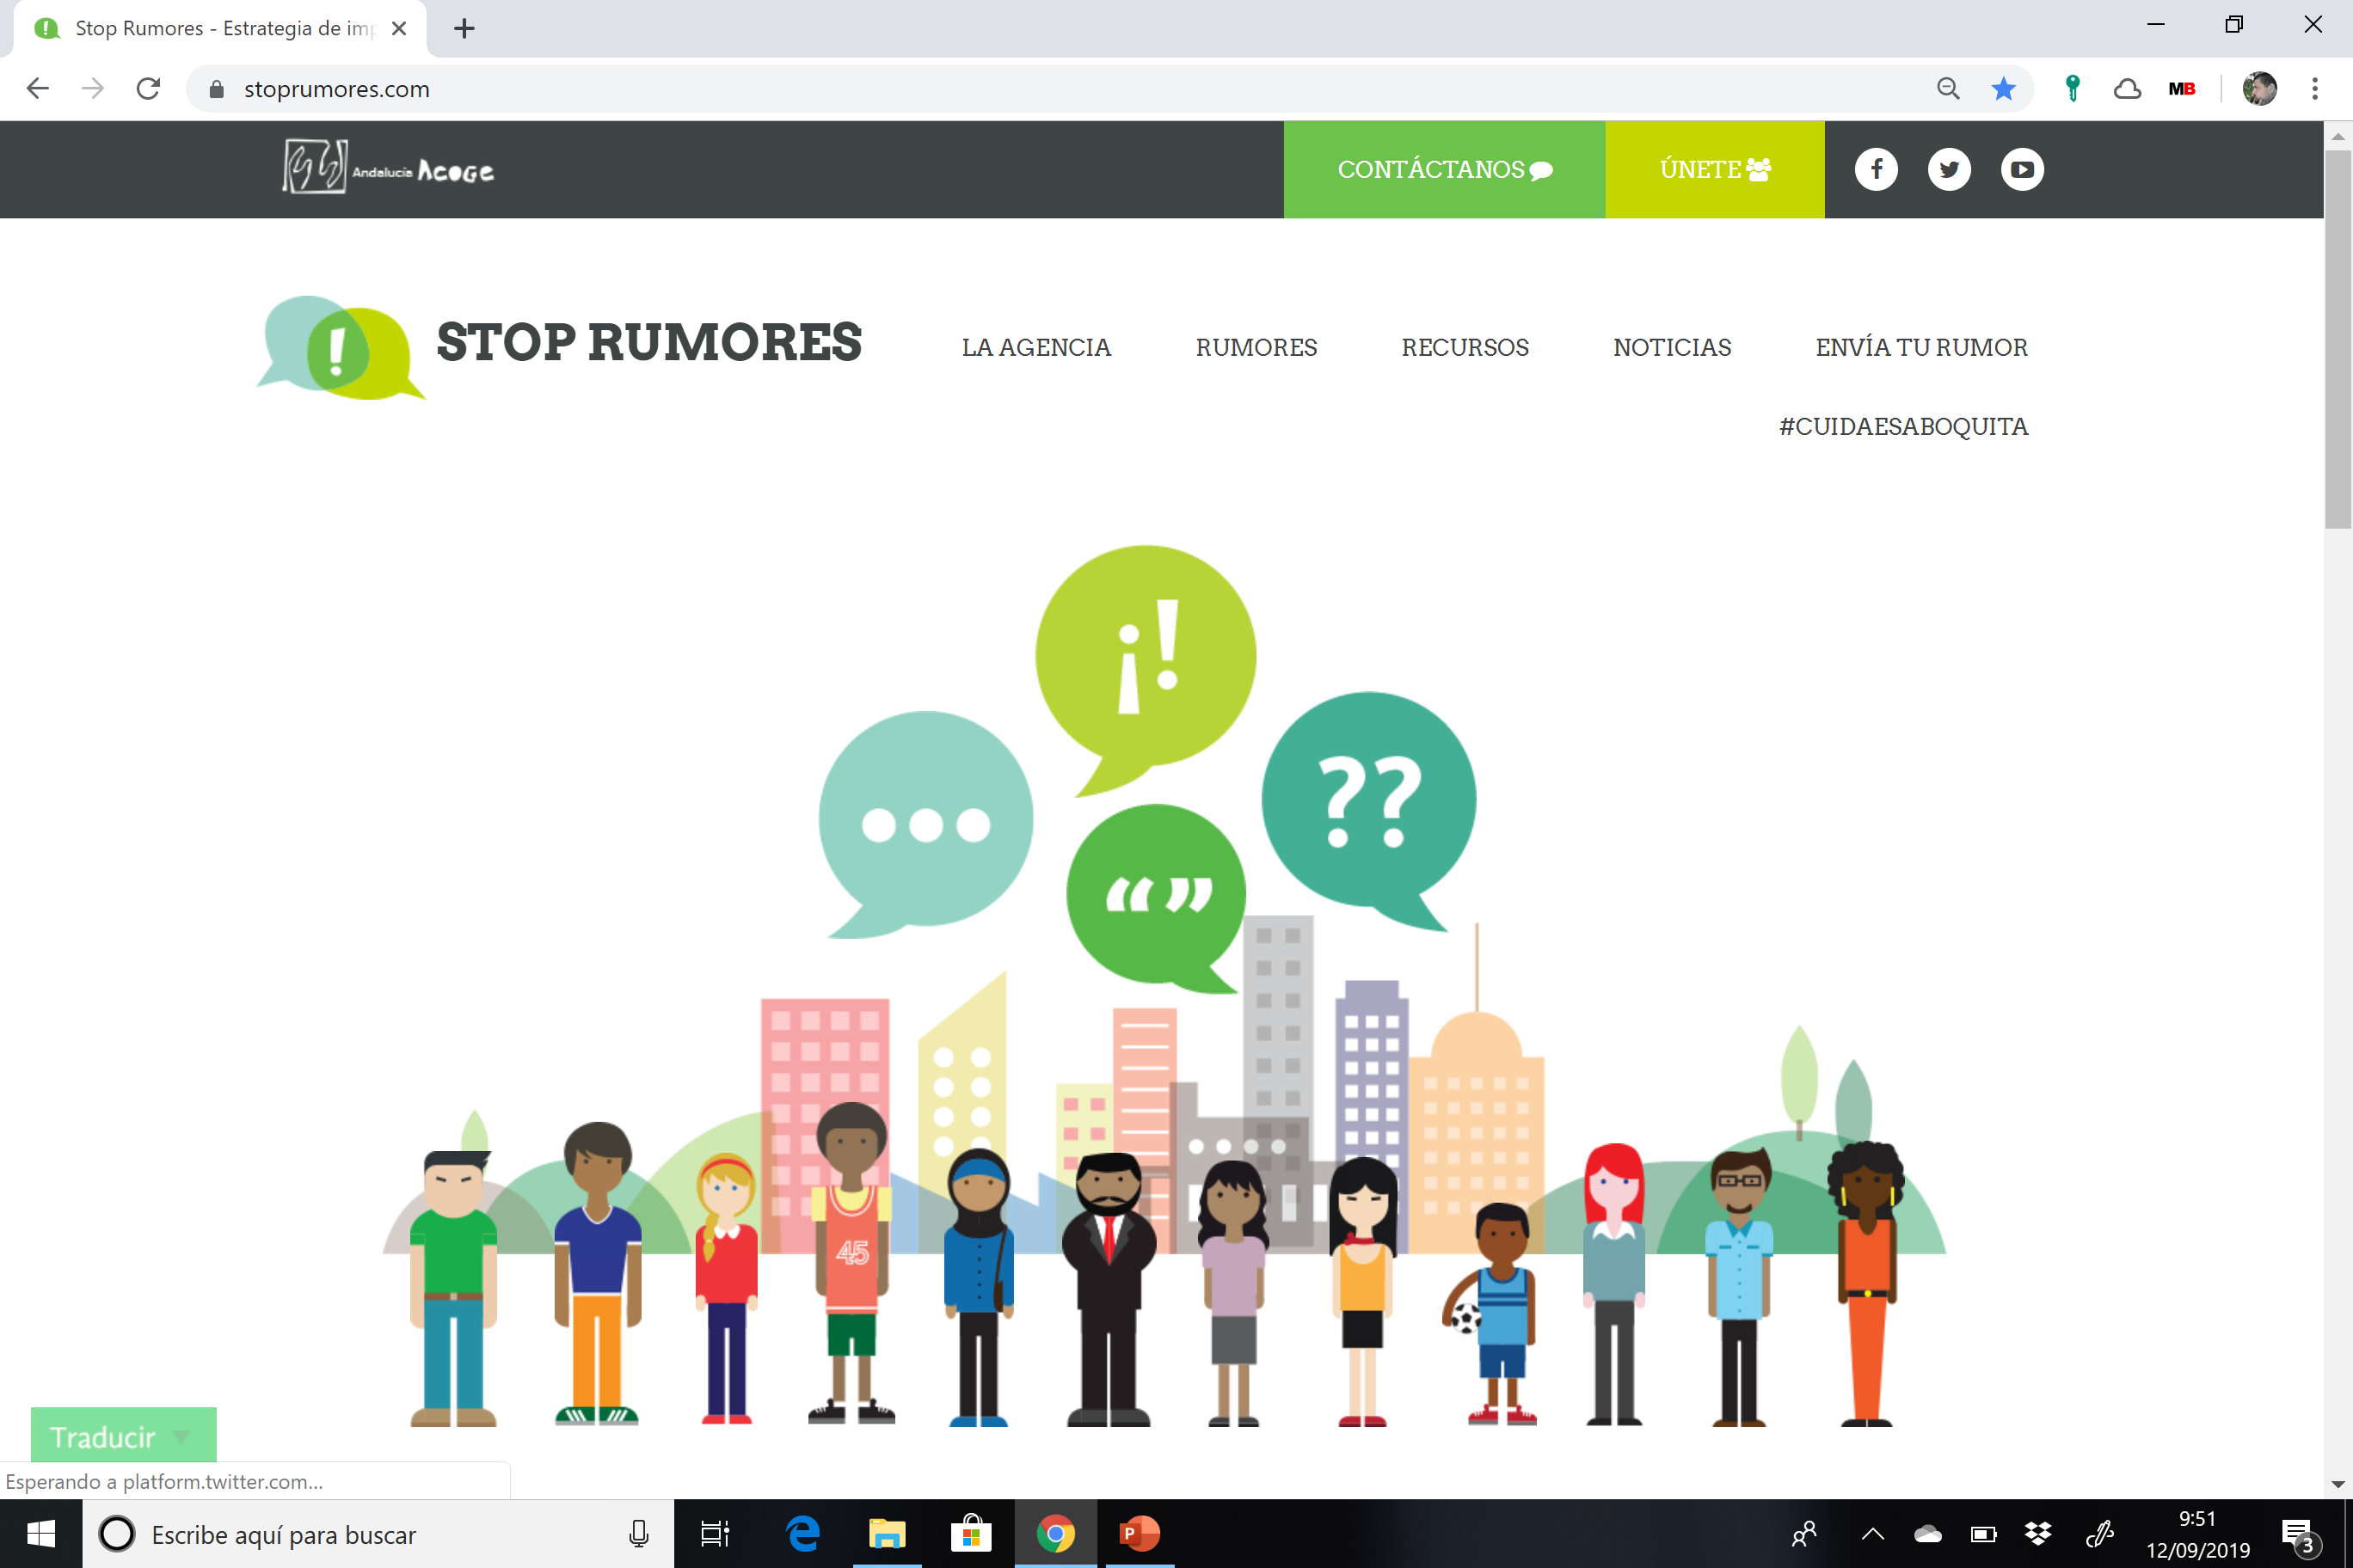
www.stoprumores.com

Slide 4

What it is
It is a communicative and social impact strategy.
Its ambition is to fight the negative rumours and stereotypes that stand in the way of harmonious coexistence among the diverse communities of Andalusia, Ceuta and Melilla.
Who promotes it
The Andalucía Acoge Federation.
Together with the associations, entities and individuals who wish to join.
How it will be done
Building a network.
Through the training and participation of Anti-rumour Agents who will adopt a proactive attitude to combat rumours in their local settings and surrounding areas.

Slide 5
What does Stop Rumours offer you?
Anti-rumour Resources: a collection of materials and tools of varying nature, conceived and created to strengthen and invigorate the work both of the Anti-rumour Agents and of the network that is created
Virtual information and participation spaces: website and spaces on social networks to fight rumours, and offer and share resources
Specific anti-rumour training for members of the various entities and associations with a special interest in volunteering – the cornerstone of our work

Slide 6
What does Stop Rumours offer you?
Ongoing advice on immigration and all that relates to rumours and misinformation
Channelling and responding to the rumours that are identified in our daily work with the collectives that we assist and those which need to be responded to positively
Broadening the networking approach together with the entities and groups that join the anti-rumour initiative, as a reflection of active citizenship for coexistence

Slide 7
What do we expect from you?
Support, publicise and collaborate with the Stop Rumours Agency
Promote the use of the Agency’s channels of information and training
Promote and motivate all those who we integrate the collaborative fabric to become Anti-rumour Agents
Promote the detection of rumours and report them to the Agency
Be an Anti-rumour Agent!

Slide 8
How to dispel a rumour?
Objective Part
Emotional Part

Slide 9
How to dispel a rumour?
Our objective must be to accompany people around us and encourage them to question the information that they receive, so that they do not just accept the first thing they hear.
To this end, effective dialogue-based communication, that avoids “preaching”, is fundamental.
It is a challenge and, as such, it needs practice; disappointments must be overcome.
Putting an end to a rumour is a long-term project.

Slide 10

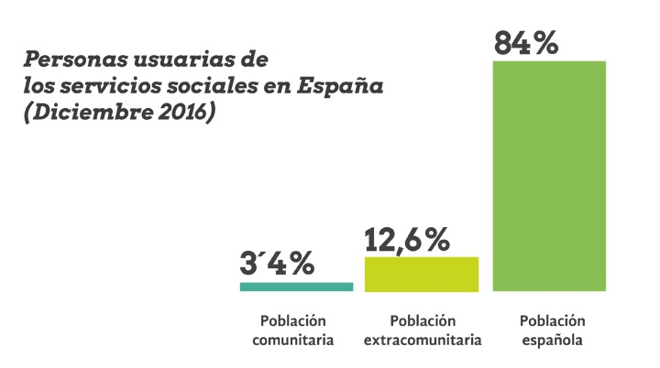

OBJECTIVE DECONSTRUCTION OF RUMOURS
People using social services in Spain (December 2016)
EU citizens
Non-EU citizens
Spanish citizens

Slide 11
Migration and health services
Migration and social assistance
Migration and trade and taxes
Migration and coexistence
Migration and employment
Migration and mixed marriages
Gender-based violence
Migration and education
Migration and school assistance
Migration and housing
Refugees
Islamophobia
The Hijab
Migration and safety
Migration and training

Slide 12
EMOTIONAL DECONSTRUCTION OF RUMOURS

Slide 13
Issues to take into account
FIND THE RIGHT MOMENT
Assess whether you have the time to develop the conversation
Decide whether the setting is appropriate to start the conversation
SHOW RESPECT
You must be willing to listen to the other person’s arguments. It is not a confrontation
End the conversation pleasantly; this will help the person to reflect on what you have talked about and help you to feel better

Slide 14
Issues to take into account
VALUE THE OTHER PERSON
Rumours are associated with our worries and fears
Try to understand and recognise the other person’s worries to achieve a better degree of receptiveness. Avoid accusations
LISTEN ACTIVELY
Active listening helps people to understand the thoughts, feelings and actions of others and give meaning to what they say
To listen, you need to stop speaking; don’t interrupt or talk over people
Ask questions

Slide 15
Issues to take into account
Your arguments must be short and clear
KEEP CALM
A positive attitude aids success in dialogue.
CATCH THEIR ATTENTION
Use familiar language
Use real and familiar examples
Control your emotions and give calm responses
If you can’t control yourself, don’t continue with the conversation, end it in the best possible way and find another time.

Slide 16
Interpersonal communication strategies

Slide 17
Interpersonal communication strategies
ASK QUESTIONS

Slide 18
Interpersonal communication strategies
INVITE CURIOSITY

Slide 19
Interpersonal communication strategies
PAY ATTENTION TO NON-VERBAL COMMUNICATION

Slide 20
Interpersonal communication strategies
USE POSITIVE LANGUAGE

Slide 21
Interpersonal communication strategies
QUESTION GENERALISATIONS

Slide 22
Interpersonal communication strategies
LOOK FOR COMMON LINKS

Slide 23

ANTI-RUMOUR AGENTS ON SOCIAL NETWORKS
#buildcoexistence
Before sharing, confirm that it is not a hoax or fake news.
Anti-rumour strategies
#AntiRumourAgent

Slide 24
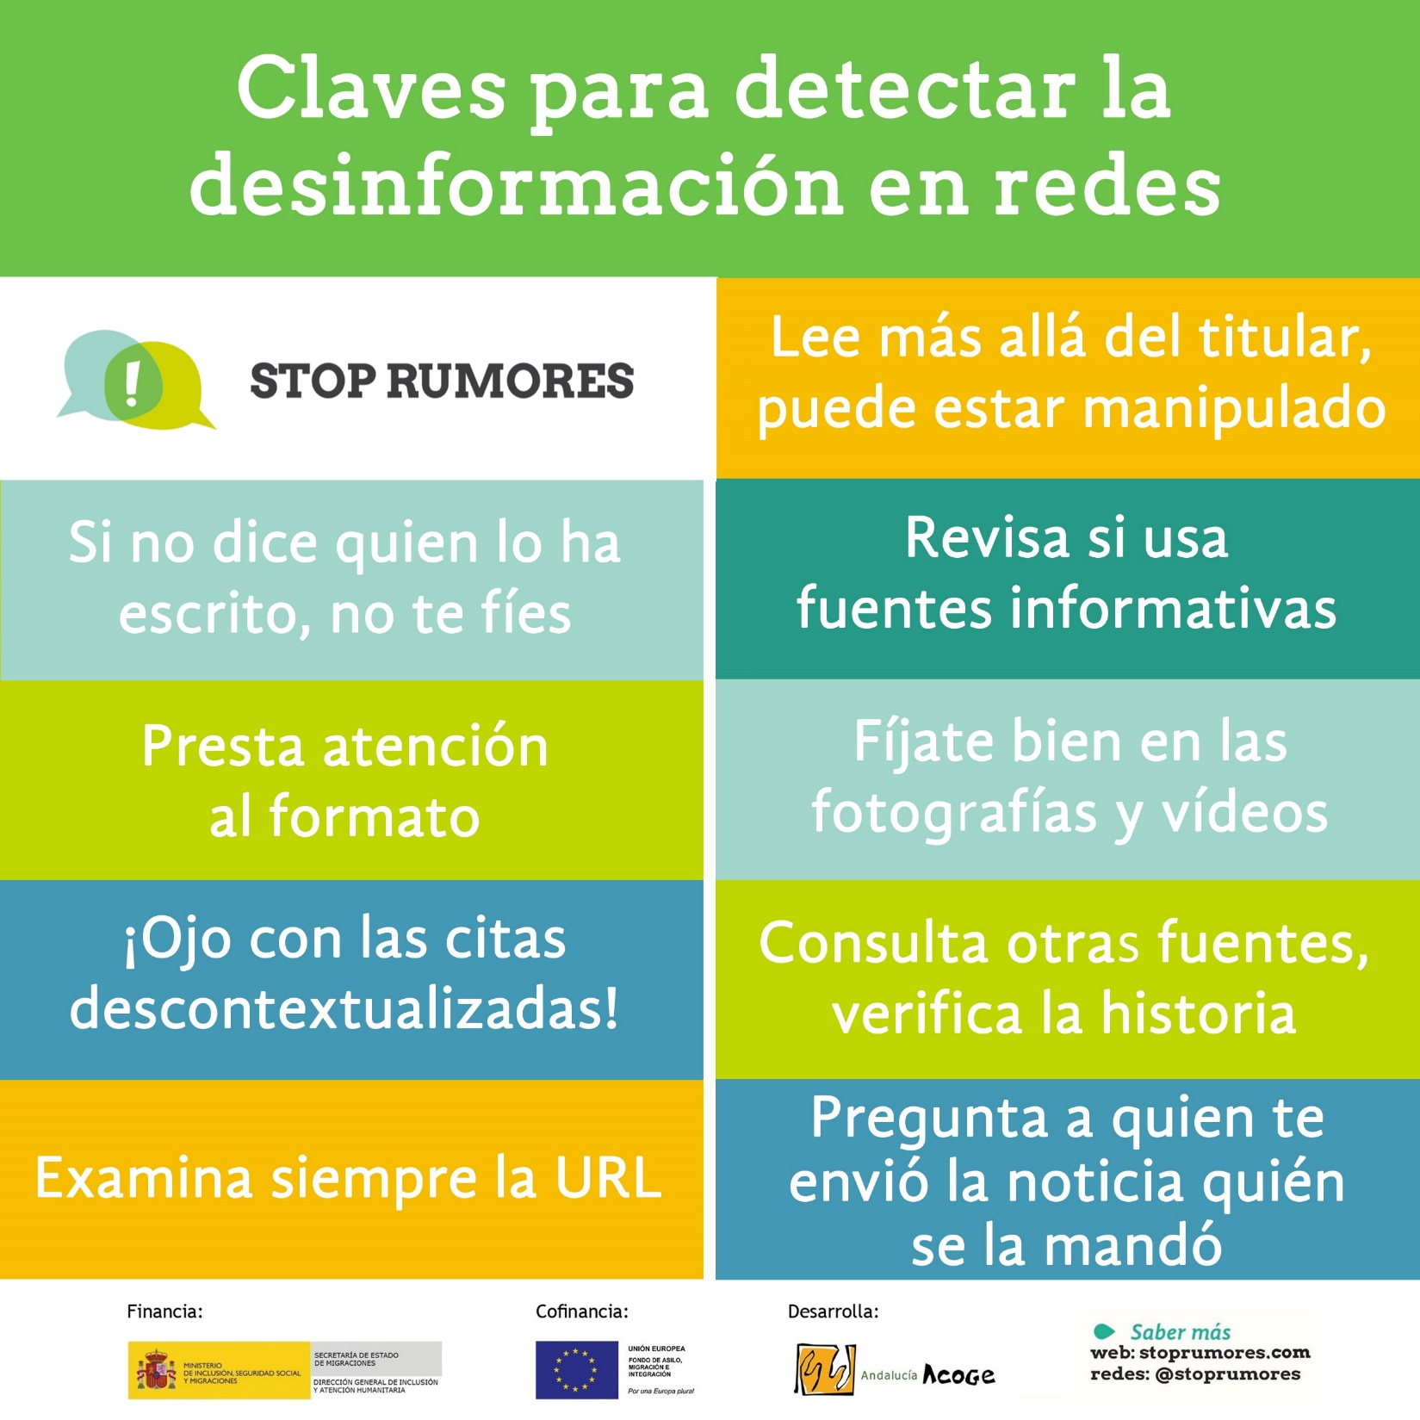
Keys to detecting misinformation
in social networks
Read beyond the headline, it may be manipulated
STOP RUMOURES
If the author is unknown, don't trust the information
Check if information sources are indicated
Pay attention to the format
Take a good look at the pictures and videos
Beware of decontextualized quotes!
Consult other sources, verify the story
Always check the URL/ source of the information
Check who shared/sent you the news
Financed:
Co-financed:
Developed:
Learn more
Twitter

Slide 25

What should you do when coming across
a news story
with a biased
headline?
false?
automatically
STOP RUMOURES
In social networks:
In traditional media:
Contact the concerned PUBLISHER
CONTACT THE AUTHOR
False news
Hate speech
Send
Report this post
reader's ombudsman
Contact the AUTHOR VIA SOCIAL MEDIA
It directs hate against a protected category (...)
Report Tweet
Block
It’s abusive or harmful
HOW TO WRITE THE COMPLAINT?
With respect.
Ethically correct.
Offering verified data to contradict the news.
professional associations or journalists’ UNIONS
Send
Report inappropriate content
Financed:
Co-financed:
Developed:

Slide 26

#AntiRumourAgent
against disinformation in social networks
Do not share if the accuracy of the content is not clear
Send the content to an anti-rumor initiative
Think before you respond
Report the content to respective social network
Provide objective data and argue constructively
Financed:
Co-financed:
Developed:
Learn more
STOP RUMOURES

Slide 27


And don't forget to follow us on our social networks, you can look for us as

