Slide 1
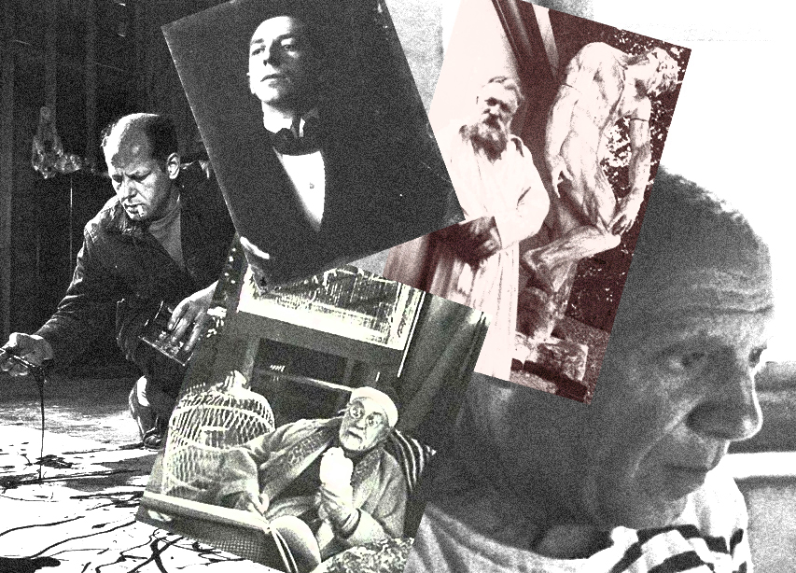
‘’Art and Special needs’’
(Dyslexia)

Slide 2
Do you feel that your mind works differently as compared to those around you? Well, if you have dyslexia, it probably does.
Chances are, if you have dyslexia, you navigate by landmarks, not by streets when you’re driving a car.
When you’re asked to describe an object, you look at that object from every possible direction, not just straight on.

Slide 3
Dyslexia, also known as reading disorder, is characterized by trouble with reading unrelated to problems with overall intelligence.
Different people are affected to varying degrees.
Problems may include difficulties in spelling words, reading quickly, writing words, "sounding out" words in the head, pronouncing words when reading aloud and understanding what one reads. Often these difficulties are first noticed at school.

Slide 4
For artists, dyslexia can be a blessing in disguise. Most dyslexics tend to think in images as opposed to words, this due in part due to the activation of portions of the brain - which is a many adults don’t often use.
Children, as they play, are calling on these same portions of the brain - a good explanation for their phenomenal imaginations.
With age, many stop exercising these regions, but dyslexics spend their entire lives processing life through pictures and comparisons.

Slide 5
As for a “picture thinker,” a single picture may be sufficient to describe a complex concept that would require hundreds or thousands of words to describe.

Slide 7
The famous photographer Ansel Adams was a dyslexic. Ansel possessed an uncanny ability to capture entire stories and concepts in a single image. In the mind of a dyslexic, a picture is worth a thousand words.

Slide 10
The secret of Leonardo da Vinci and Pablo Picasso's success may have been down to their dyslexia, scientists have claimed.

Slide 11
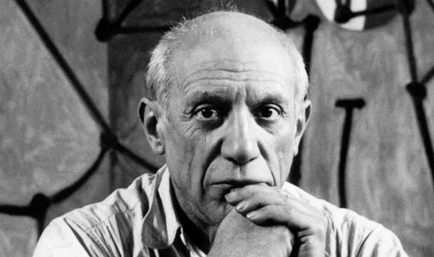

Slide 12
The famous artists suffered from dyslexia, the inability to see words written properly, which is thought to affect as many as one in 12 children. Scientists, however, believe that it may be the difference between drawing scribbles and producing works of art.
Researchers from Middlesex University think they have explained the reason behind some of the world's most recognized artworks, such as the Mona Lisa.

Slide 13
Dr Nicola Brunswick, who led the research, said: "Many dyslexic people prefer to work out problems by thinking and doing rather than speaking. This could help dyslexic men develop the kind of skills they need to succeed in the artistic and creative worlds."

Slide 14
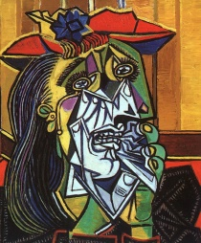

Slide 15
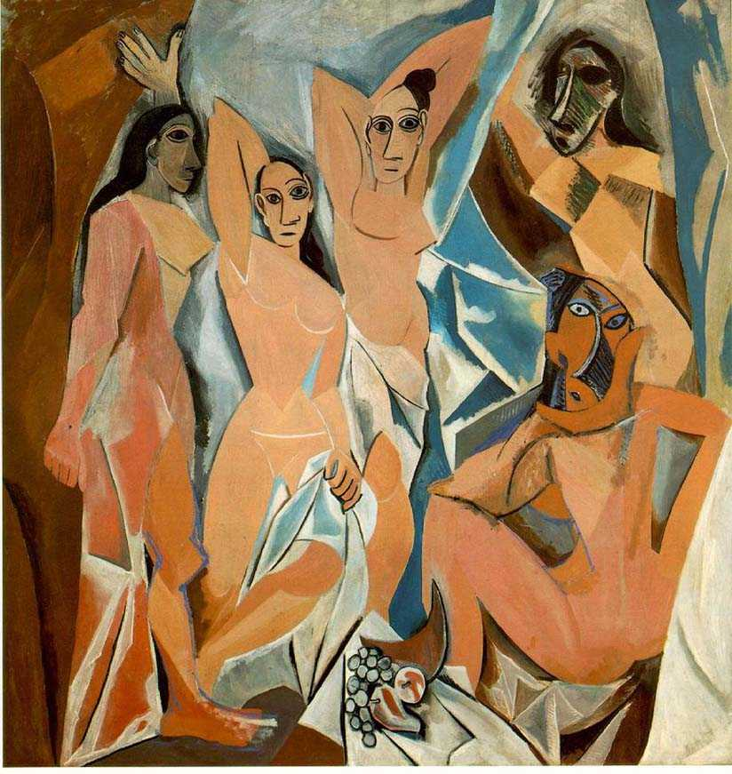

Slide 16
August Rodin

Slide 17
The encouragement and support of August Rodin’s father for his son’s severe dyslexia was acknowledged in the founding of the Rodin Remediation Academy in 1984 to promote multi – disciplinary research on development dyslexia.

Slide 18
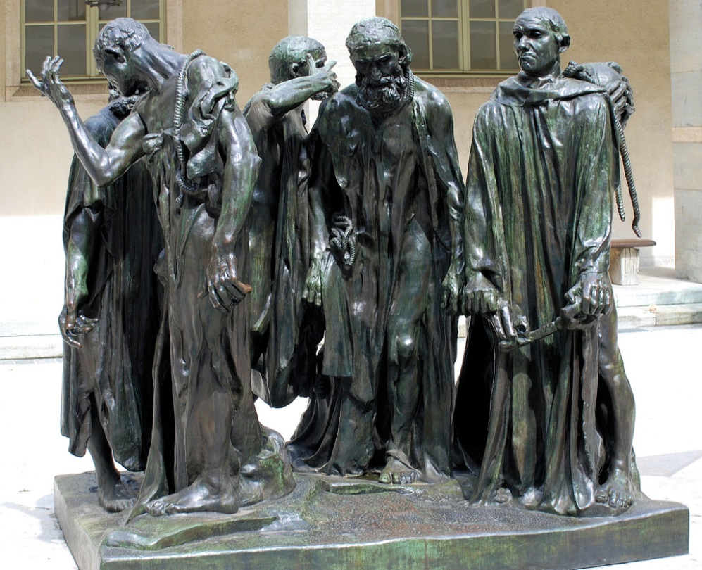

Slide 19
Robert Rausenberg

Slide 20
Robert Rausenberg who has been described as the greatest living painter, describes his early years of struggling to learn. ‘’Sometimes I felt dumb. I felt like everyone knew I was dumb. I’ m dyslexic, quite seriously dyslexic – I still have trouble reading – so I hate school. It was the worst period of my whole life, the first 12 years of growing up.

Slide 21
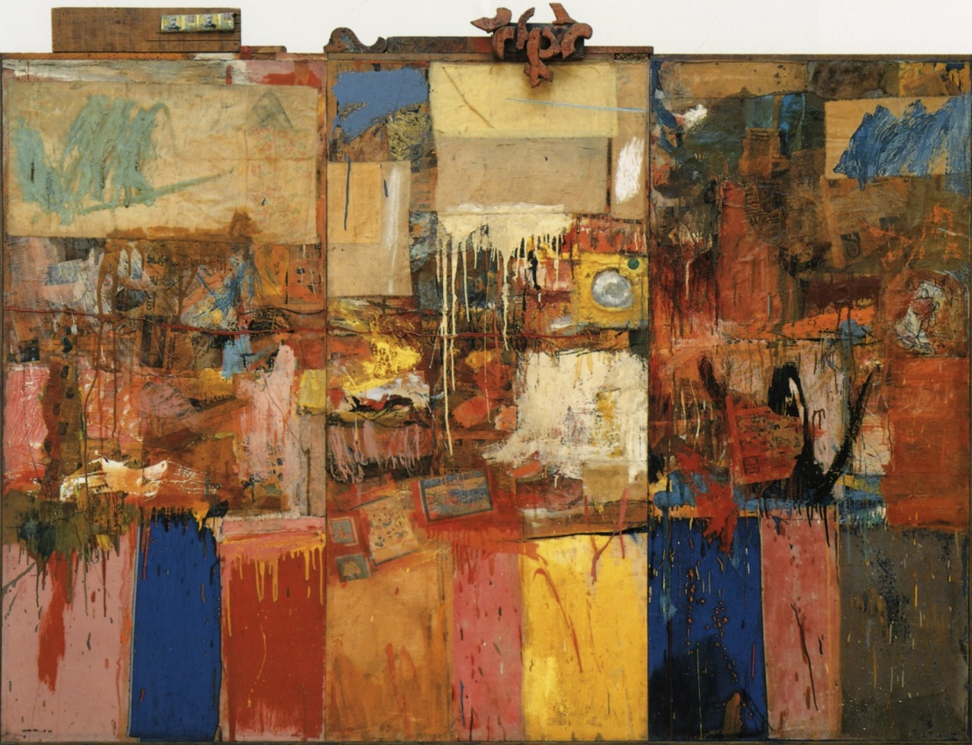

Slide 22
Art teachers responsibilities for students with dyslexia
It is art teachers responsibilities to provide a suitable differentiated subject curriculum, accessible to all students, that provides each with the opportunity to develop and apply individual strengths.
Recognition of and sensitivity to the range and diversity of the learning preferences and styles of all students.
Selection or design of appropriate teaching and learning programs that match the range of all students abilities, within the curricular framework of the school.

Slide 23
Understanding that, while dyslexia is not linked to ability, able dyslexic students may persistently underachieve because of this.
Acceptance that some students with dyslexia may require additional support within the context of their subject and to consult with colleagues and specialists to determine how best to provide this.

Slide 24
Art subjects provide with dyslexic students with an opportunity to excel since many things are required in pictures rather than words.
Dyslexic people often become very successful in the fields of:
Architecture
Interior or exterior design
Painting/ drawing/ sculpture
Photography

Slide 25
Significant strengths of dyslexic students may include.
Strongly developed spatial awareness
Multi-dimensional thinking and perception
Ability to visualize a 2D diagram in 3D
Ability to imagine how an image would appear from another perspective
Ability to view pictures/ diagrams proportionally
Vivid imaginations resulting in uniquely creative solutions

