Slide 1
Video editing workshop
Cyberlink Powerdirector 15
Rudolf Mód

Slide 3
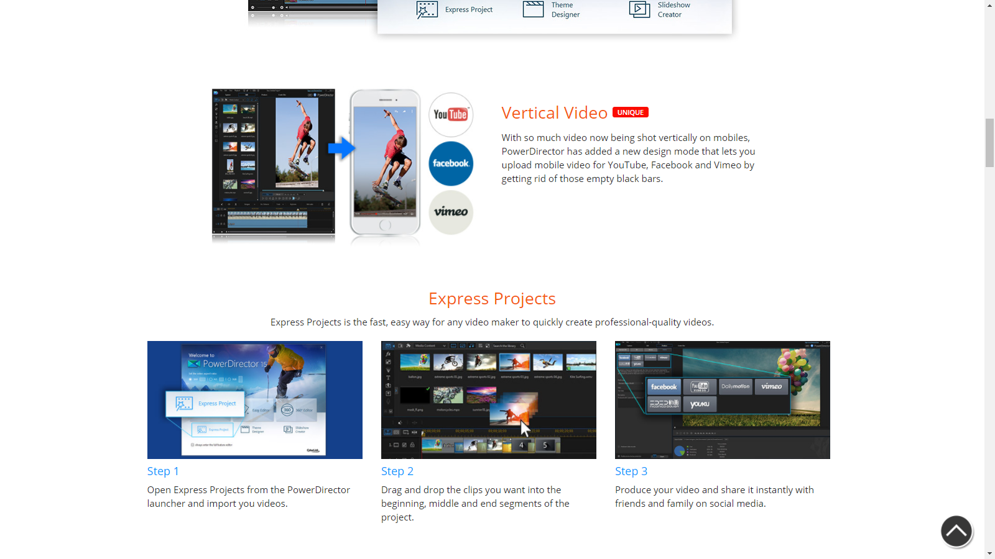

Slide 4
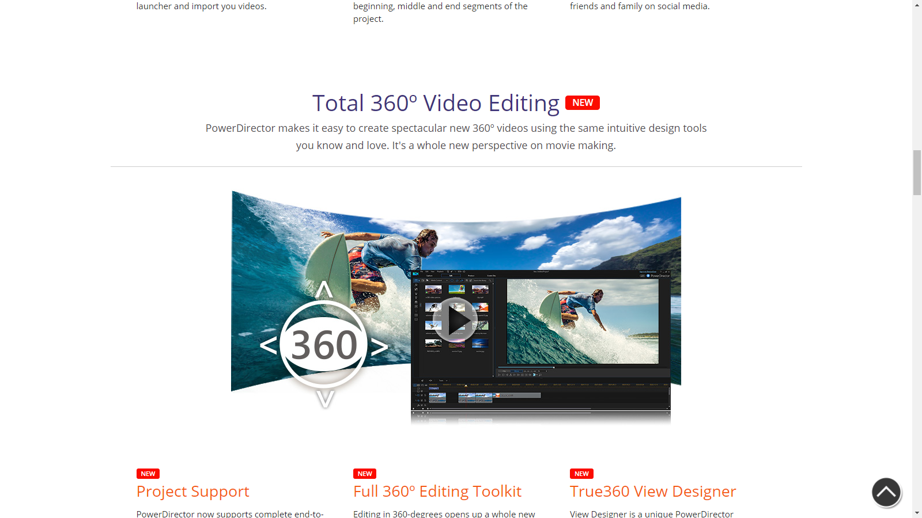

Slide 5
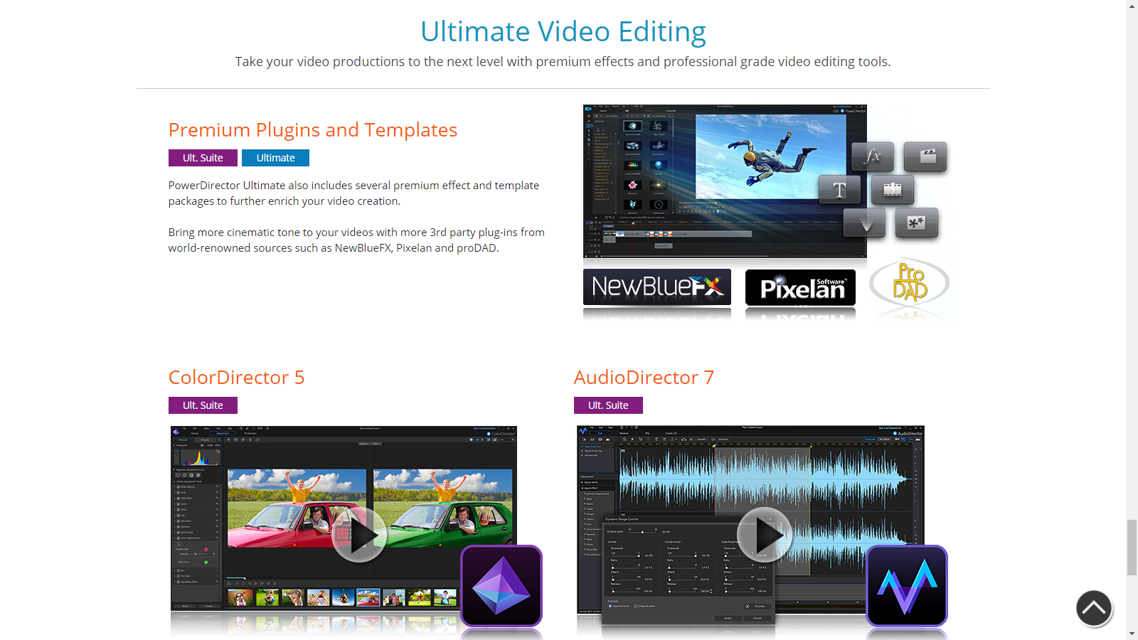

Slide 7
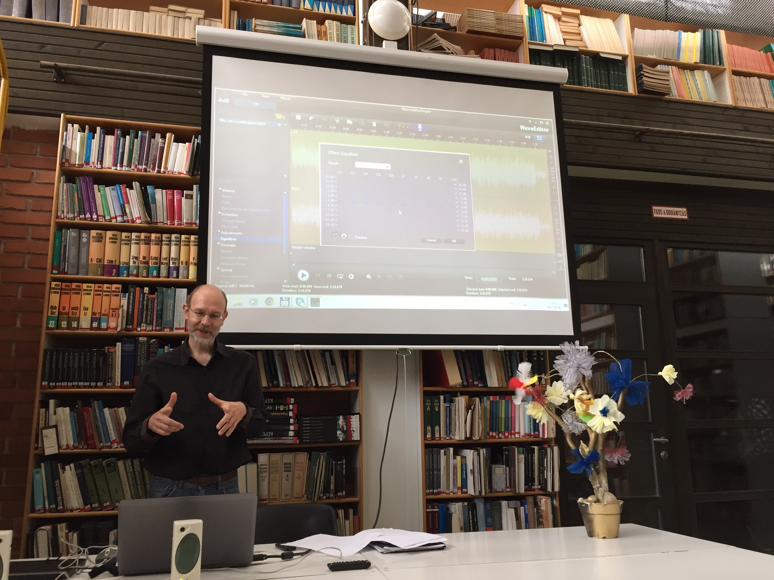

Slide 8
