Slide 1
Internet and websites
"Creative Ways of Teaching:
Recycling Art and Entrepreneurial Attitude”
2015-1‐ES01-KA219-015525
Nikos Skoulidis
Diapolitismiko Gymnasio Evosmou

Slide 2
Topics
Google Mail
Google Drive
Internet
Wikis

Slide 4
Google Mail
In Private (incognito) Window
Account Name
Mailing Lists
Auto Replying Mails
Send with Delay - Canceling
Forwarding Mails
Filtering Mails

Slide 5
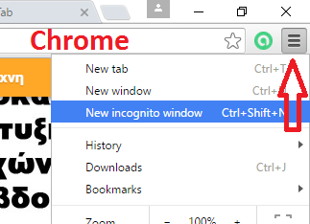
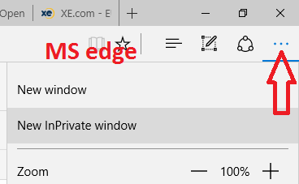
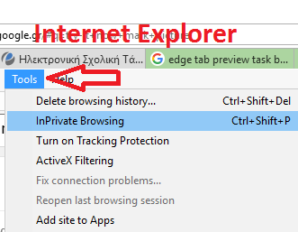
In Private (incognito) window
Please, open an In Private Window
and connect to your gmail

Slide 6
Google Mail: Account Name
Did you know?
Gmail ignores the dots (.) in account name
nikos.kse is equivalent to nikoskse
Sending an email to n.i.k.o.s.k.s.e@gmail.com will be delivered to the same account
But it is different for all others
Example: You can use it to create multiple accounts in a site
Please, send me an email with as many dots as you want
Try it now!

Slide 7
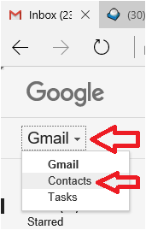
Google Mail: Mailing Lists
Did you know?
You can organize your contacts in groups
To easily send mails to many persons with similar interests
How to:
Click Gmail (left top)
Select Contacts

Slide 8
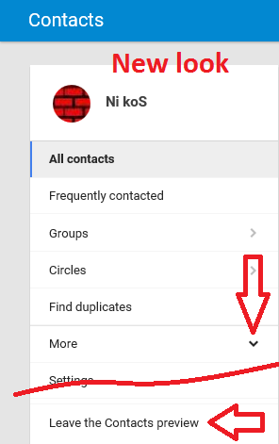
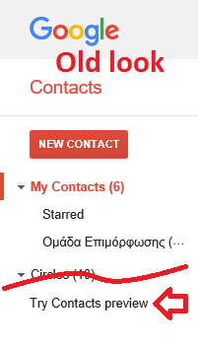
Google Mail: Mailing Lists
If you want to
switch style…

Slide 9
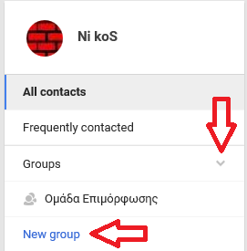
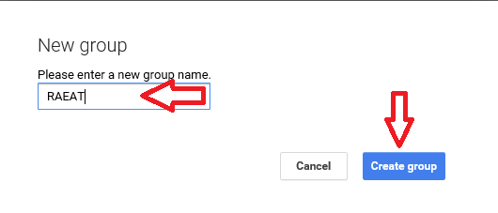
Google Mail: Mailing Lists: New Style
Create a group
Click Groups
Click New group
Set the name of
new group
Click Create group

Slide 10
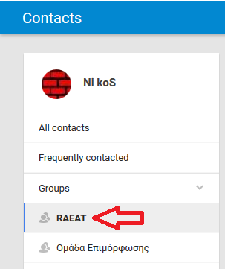
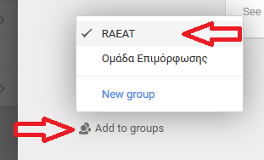
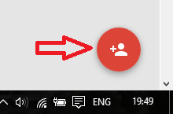
Google Mail: Mailing Lists: New Style
Populate a group
Select the group
Select a contact to add
Populate a group (alt)
Select a contact, then
Select the group/groups to add to

Slide 11
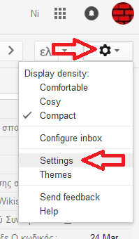
Google Mail: Auto Replying
Did you know?
You can answer to an email when you are on vacation
How to:
Click Gear
Select Settings
Scroll down to bottom
Try it now!

Slide 12
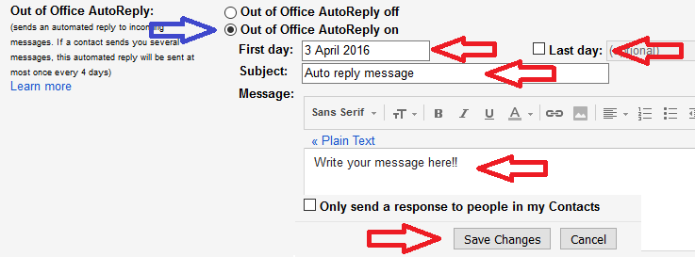
Google Mail: Auto Replying
Select First day and (optionally) Last day
Write the Subject and your Message
Click Save Changes
The Out of Office AutoReply on, is set automatically
When back, set Out of Office AutoReply off
Try it now!

Slide 13
Google Mail: Send with Delay - Canceling
Did you know?
You can cancel a message that has been sent
How to:
Go to Settings
Scroll down to Undo Send and Enable it
Now, you can Undo send
Try it now!

Slide 14
Google Mail: Forwarding
Did you know?
You can forward all your messages to another mail
How to:
Go to Settings
Select Forwarding and POP/IMAP tab
Add an address to forward your messages

Slide 15
Google Mail: Forwarding: Add address
Set the email address
And confirm
A mail is sent to the address and the recipient must accept by clicking on a link
After the confirmation, you Verify the address

Slide 16
Google Mail: Forwarding
Enable forwarding
Select to who (if more than one address set)
Select the action to take for the forwarded messages
Usually Keep Gmail’s copy in the Inbox
When not needed any more, Disable forwarding

Slide 17
Google Mail: Filtering
Did you know
You can screen and sort incoming mails and direct them to different folders and/or to forward to different recipients
How to:
Go to Settings
Select Filters and Blocked Addresses tab and click Create a new filter

Slide 18
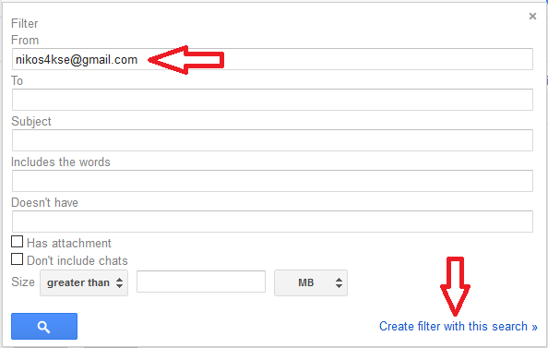
Google Mail: Filtering: Creating filter
Define the criteria (usually the sender – can be a group)
Click Create filter with this search

Slide 19
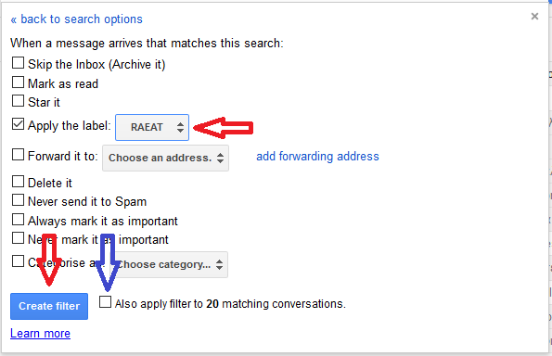
Google Mail: Filtering: Creating filter
Determine the action (e.g. Apply the label)
Optional:
apply filter
to existing
mails
Click Create filter

Slide 20
Google Drive
Features
Accessing
Configuring
Working with

Slide 22
Internet
Scheme – OSI model
Protocols
Numbering
Naming
Routing

Slide 24
Wiki
History
What is
Where to build
How to build
Syntax

