Slide 1
The Business Plan
The business Canvas - Explanation and Examples

Slide 2
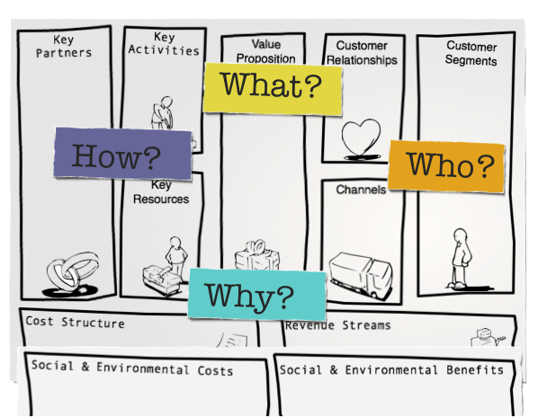

Slide 4
The business canvas
Click below to open the link

Slide 5
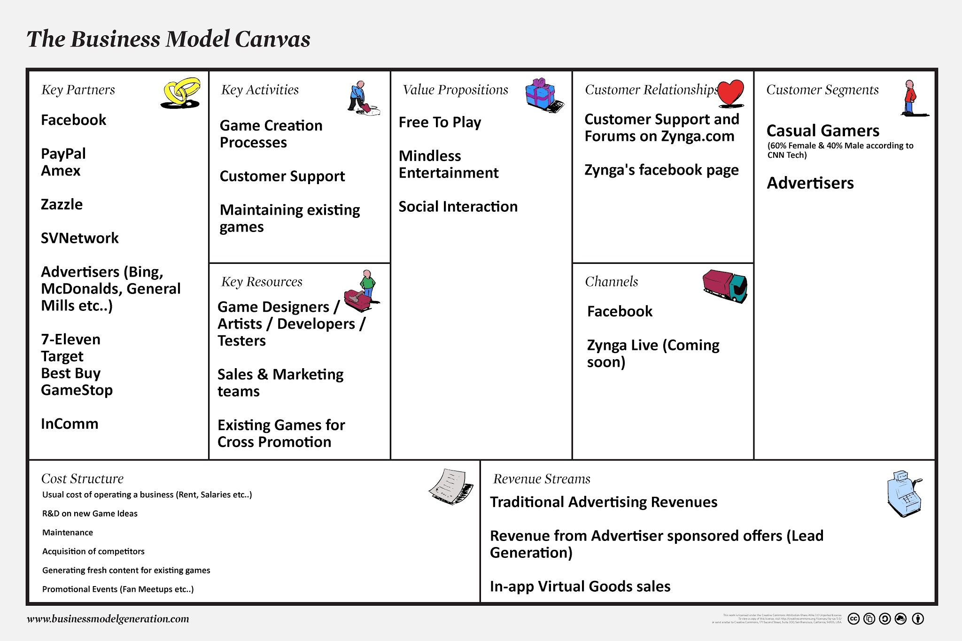
Zynga.com
example

Slide 6
The Nespresso Example
Summary
Click below to open the link to the videos

