Slide 1
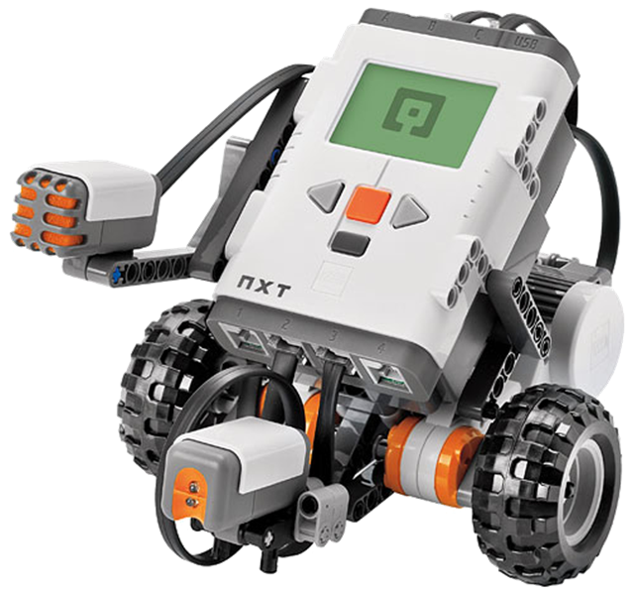
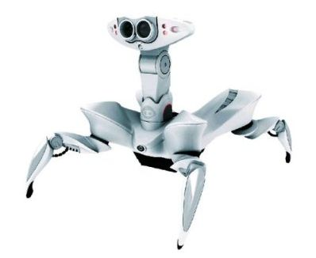
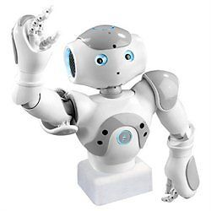
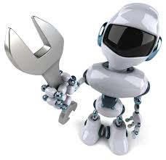
Robotics and ICT workshop

Slide 2
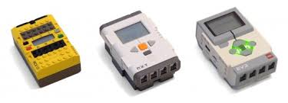
LEGO robotics – „generations“

Slide 3
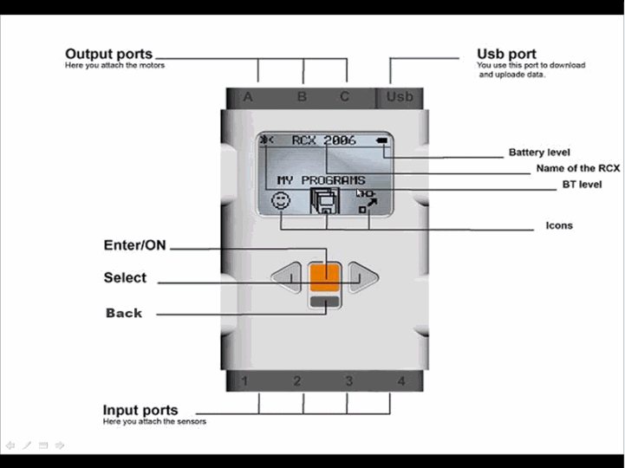
Lego robotics – „NXT brick overview“

Slide 4
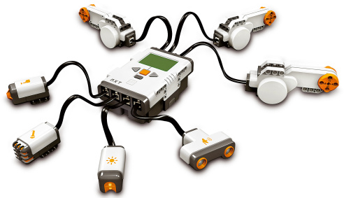
LEGO robotics – „inputs/outputs“

Slide 5
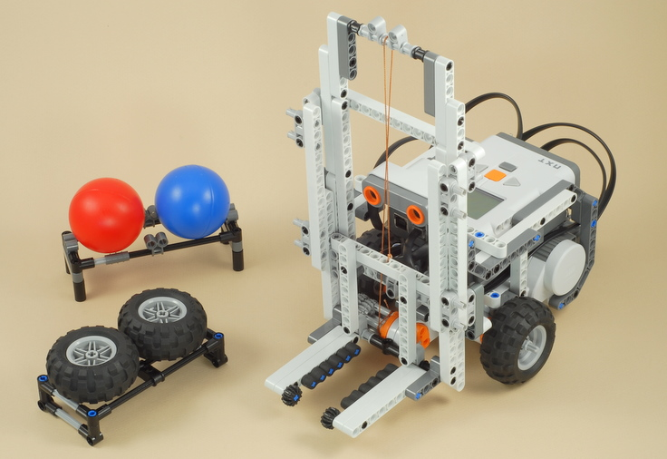
NXT Forklift

Slide 6
NXT Forklift – tasks:
Move the can up/down
Wait until the can is being placed on the forklift and then move it up and down again
Move the vehicle forward/backward
Turn the vehicle to the right/left
Wait until the can is being placed on the forklift, then move the can up, move the vehicle to the right and move forward (20 cm)

