Slide 1
HELLO!!!
Hello
everyone
from
Italy!

Slide 2
Our December is white !
Every year before Christmas in our school we do a very nice workshop with pupils and their parents. Of course this year we have chosen to use the white color !!!

Slide 3
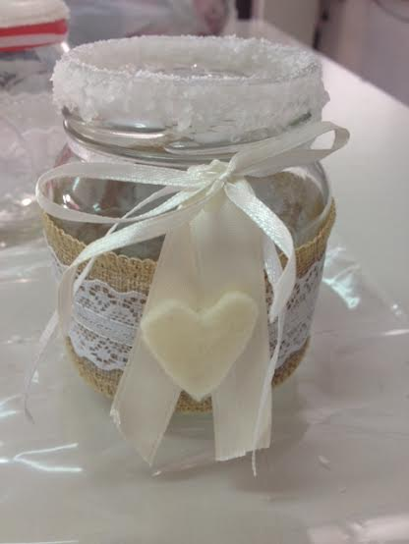
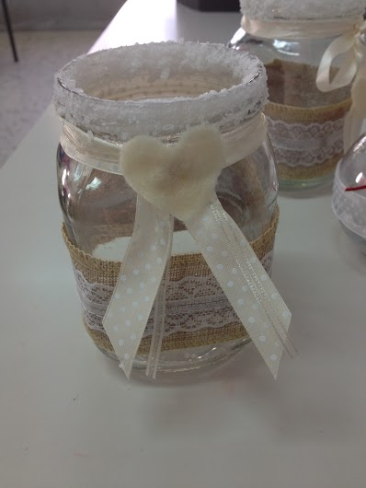

Slide 4
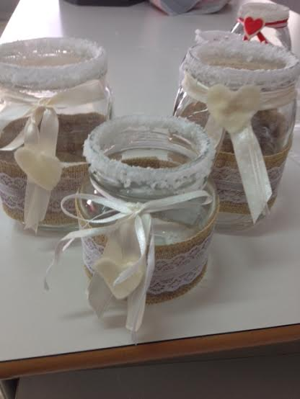
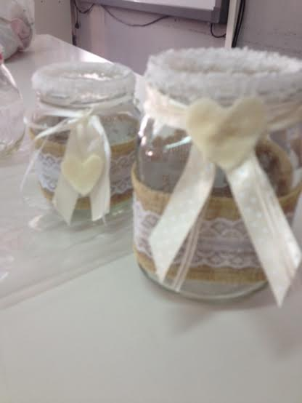

Slide 5
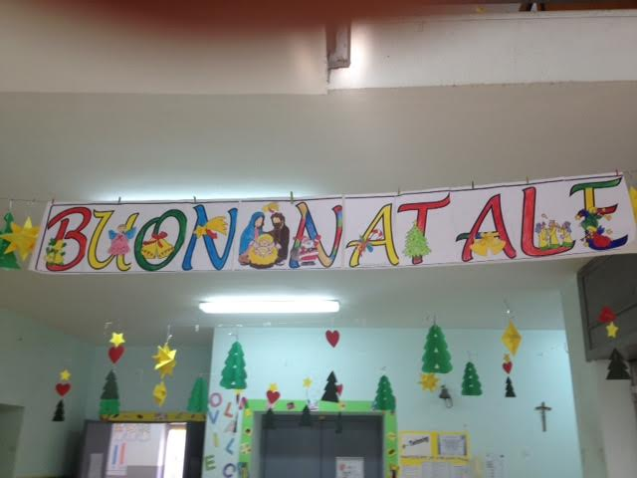
Bye-Bye! See you soon in 2016!

