Slide 1
COLOURS OF AUTUMN

Slide 2
ALL THESE ARE OUR WORKS AND PHOTOS ABOUT AUTUMN

Slide 3
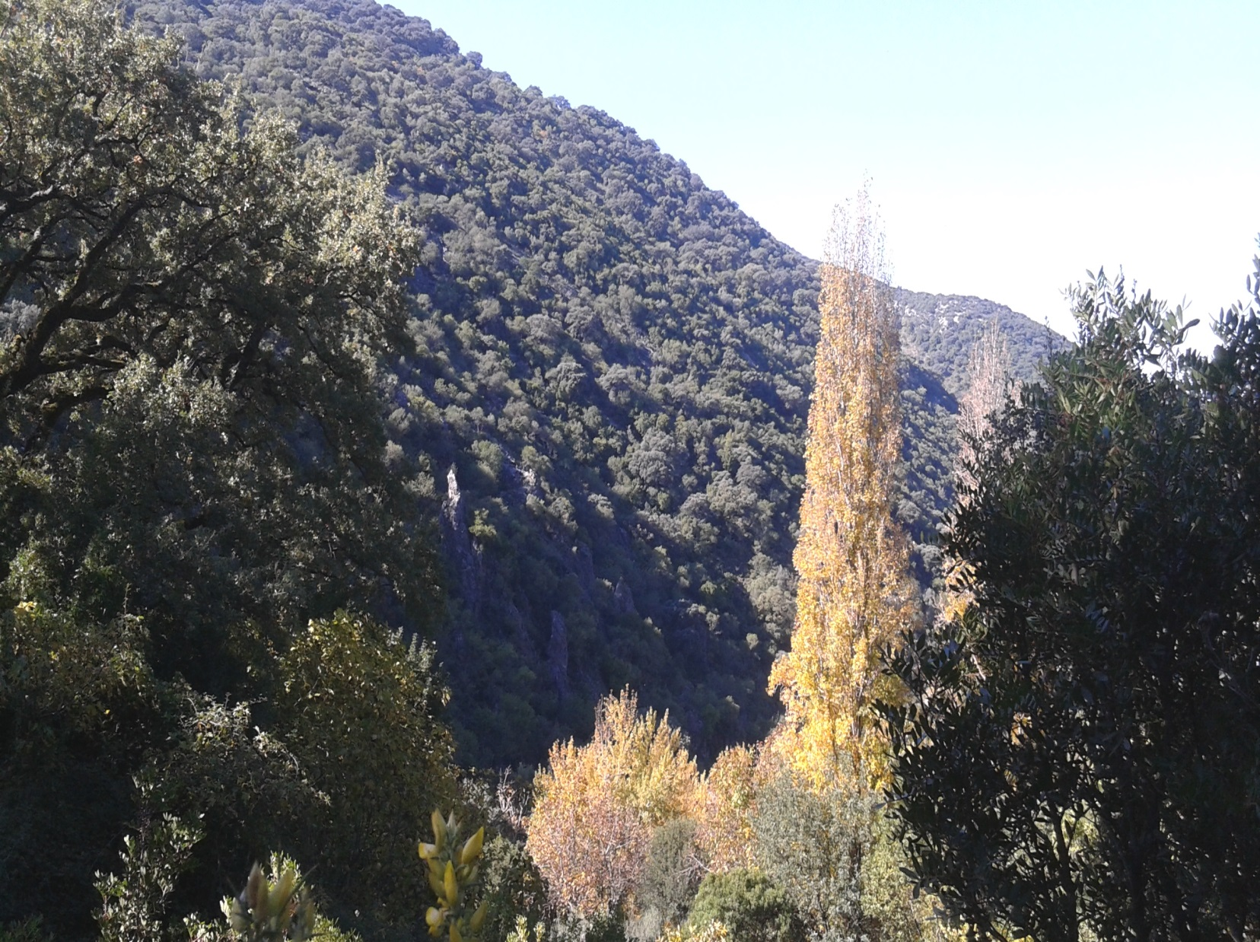

Slide 4
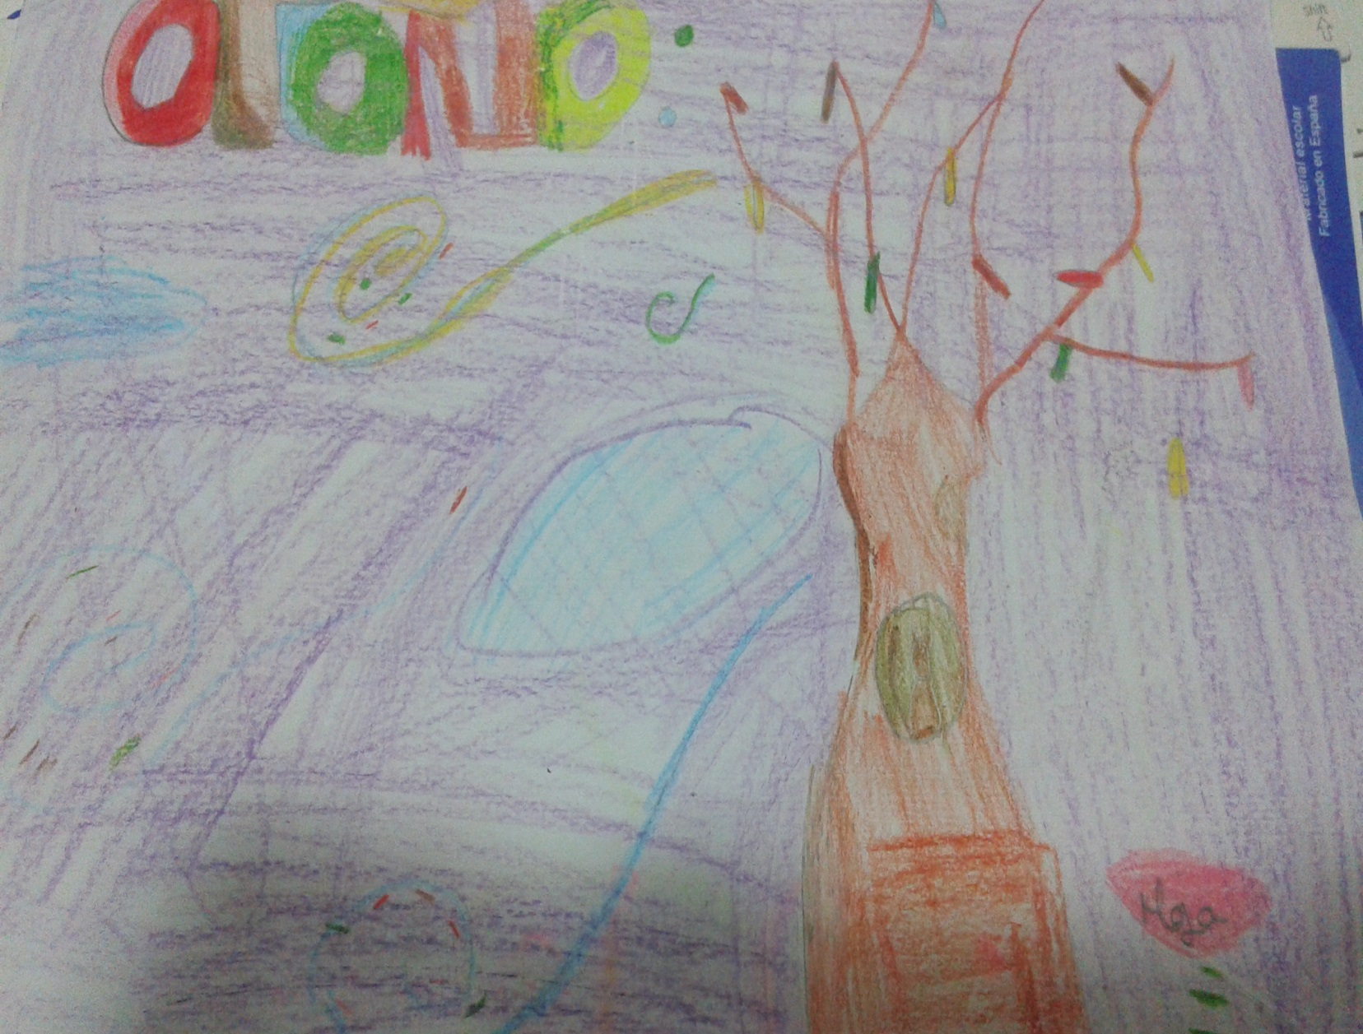

Slide 5
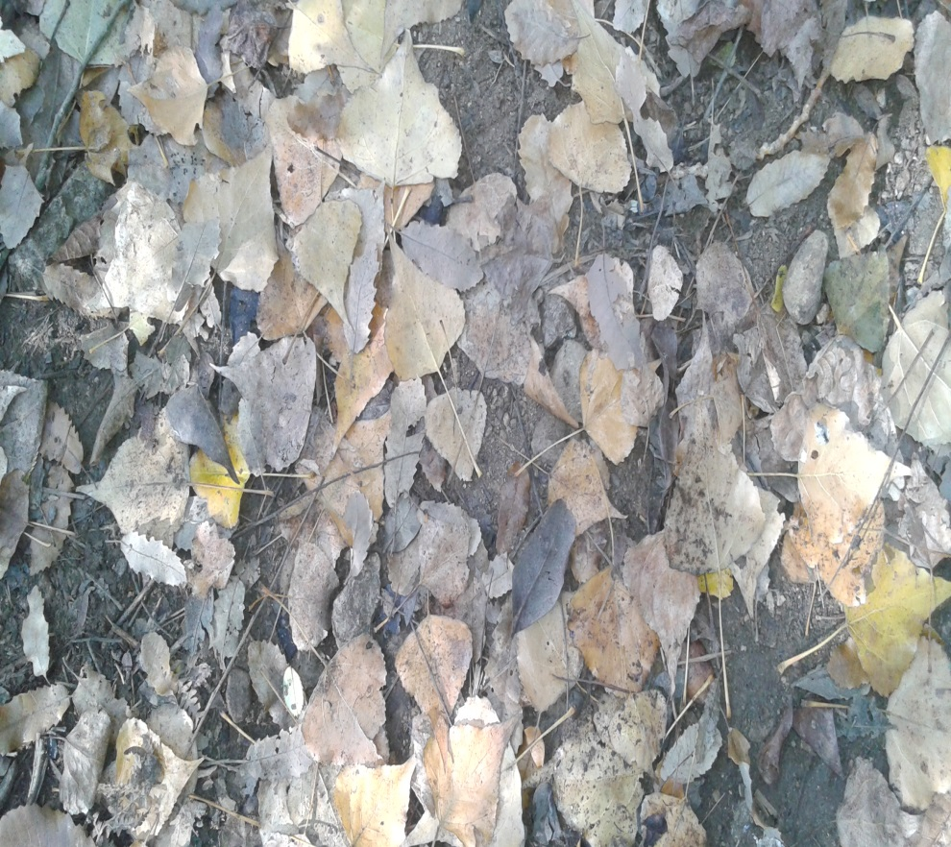
ORANGE, BROWN, YELLOW LEAVES
IT IS WONDERFUL!!!
IT IS FUNNY WHEN WE WALK ON THEM.

Slide 6
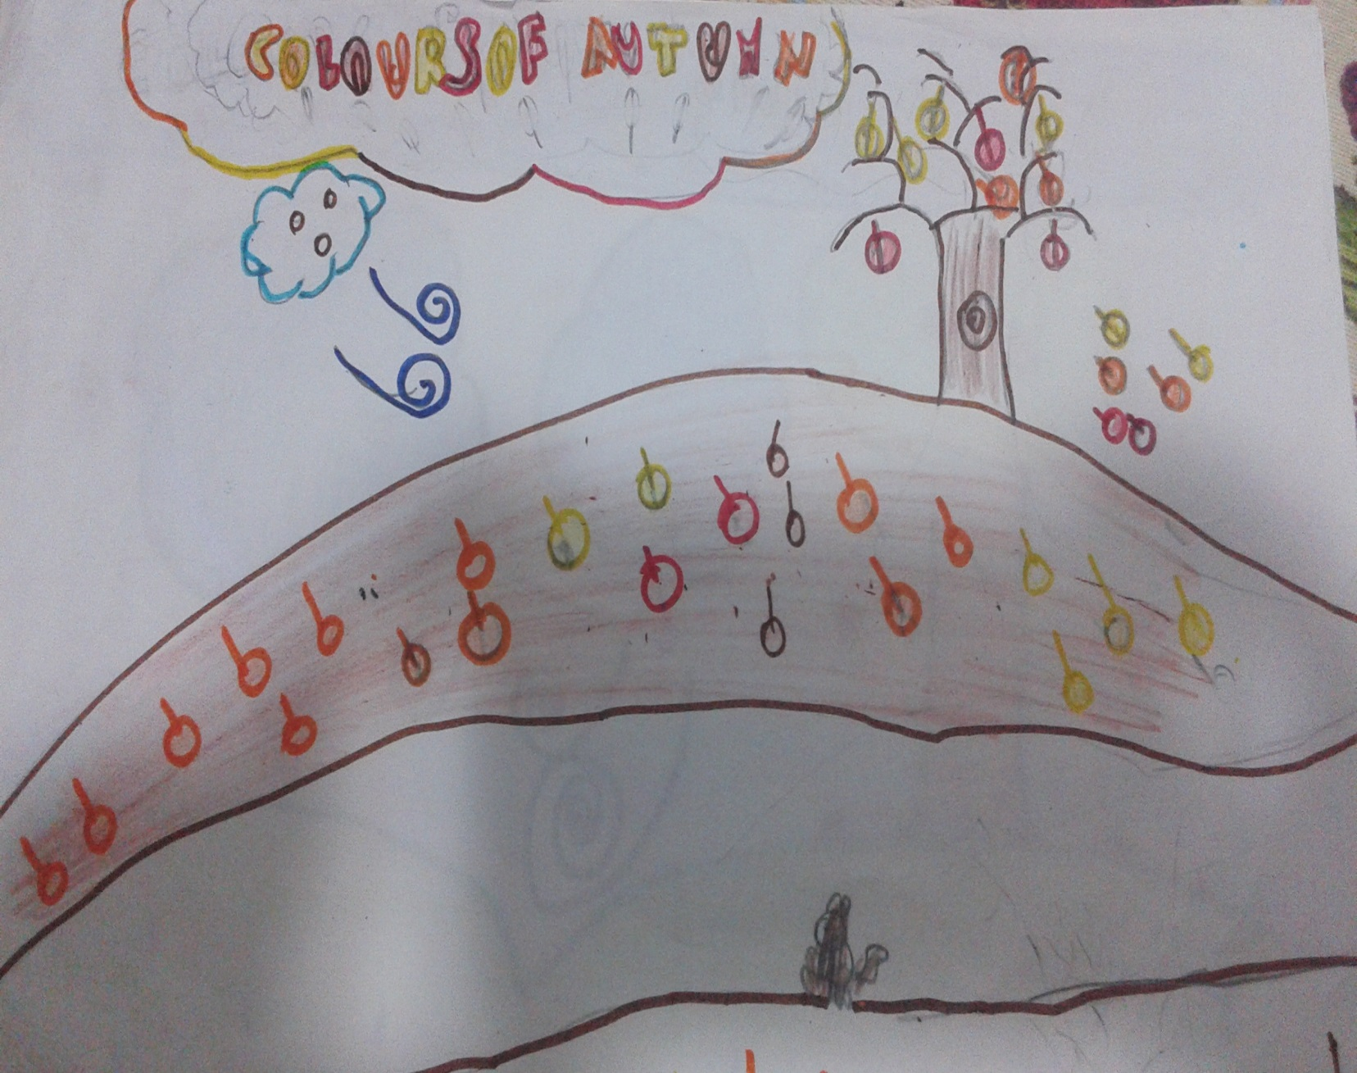

Slide 7
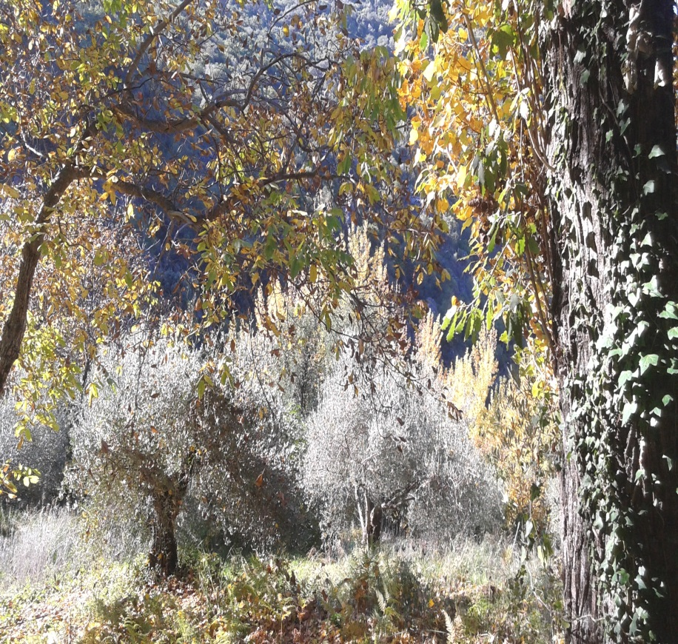
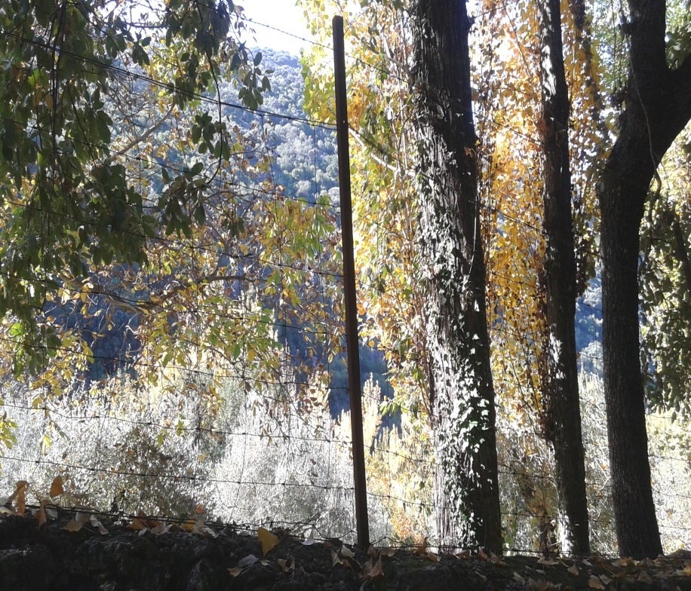
COUNTRYSIDE

Slide 8
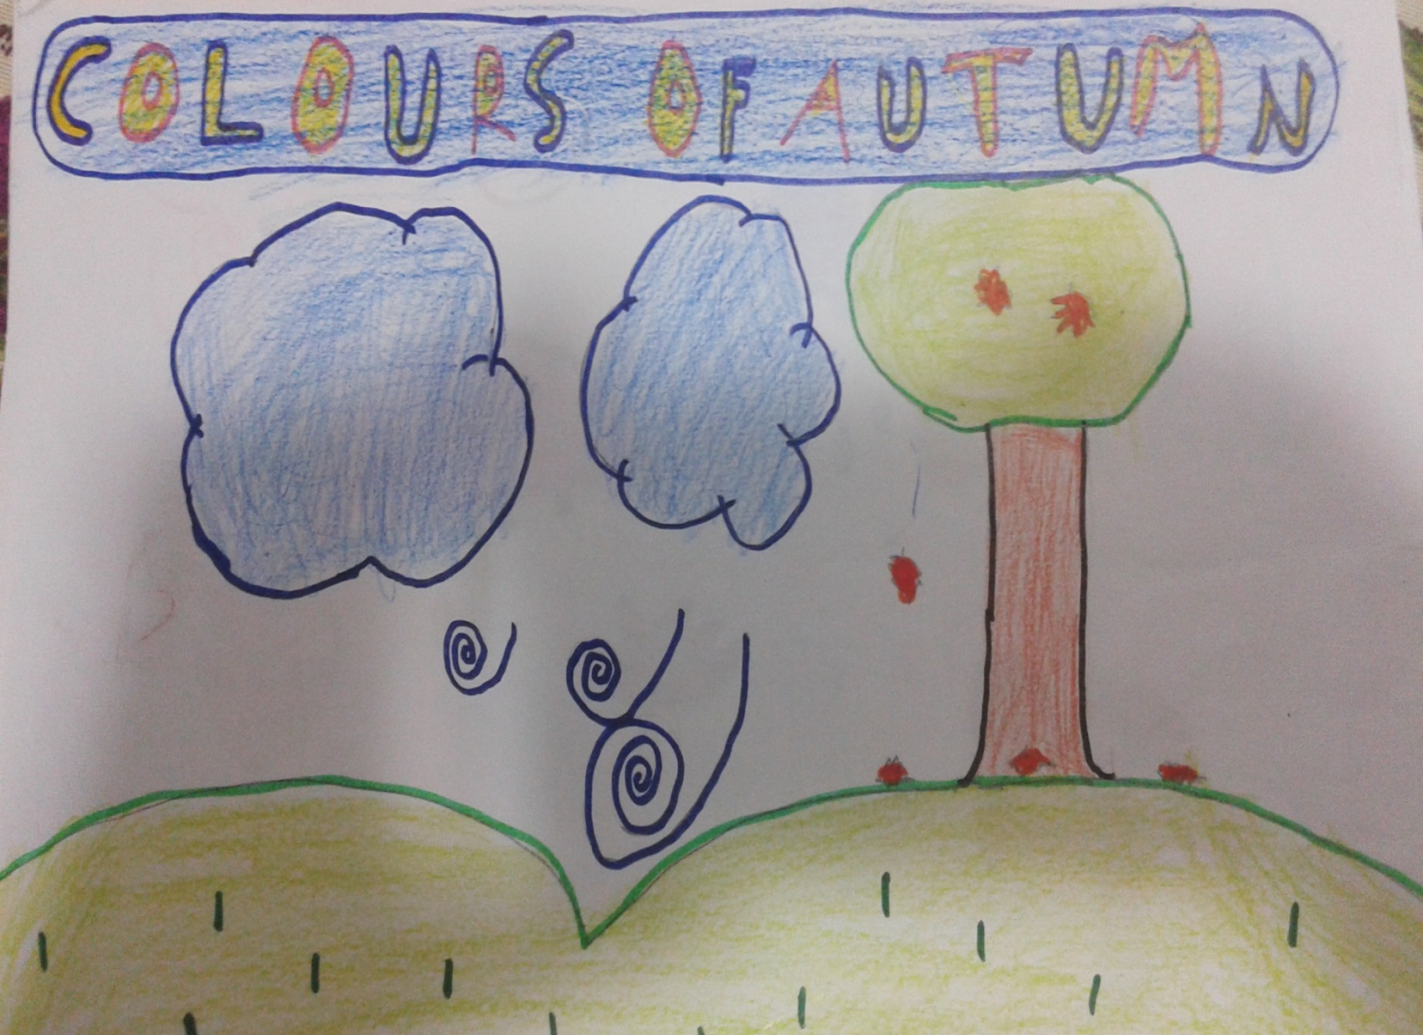

Slide 9
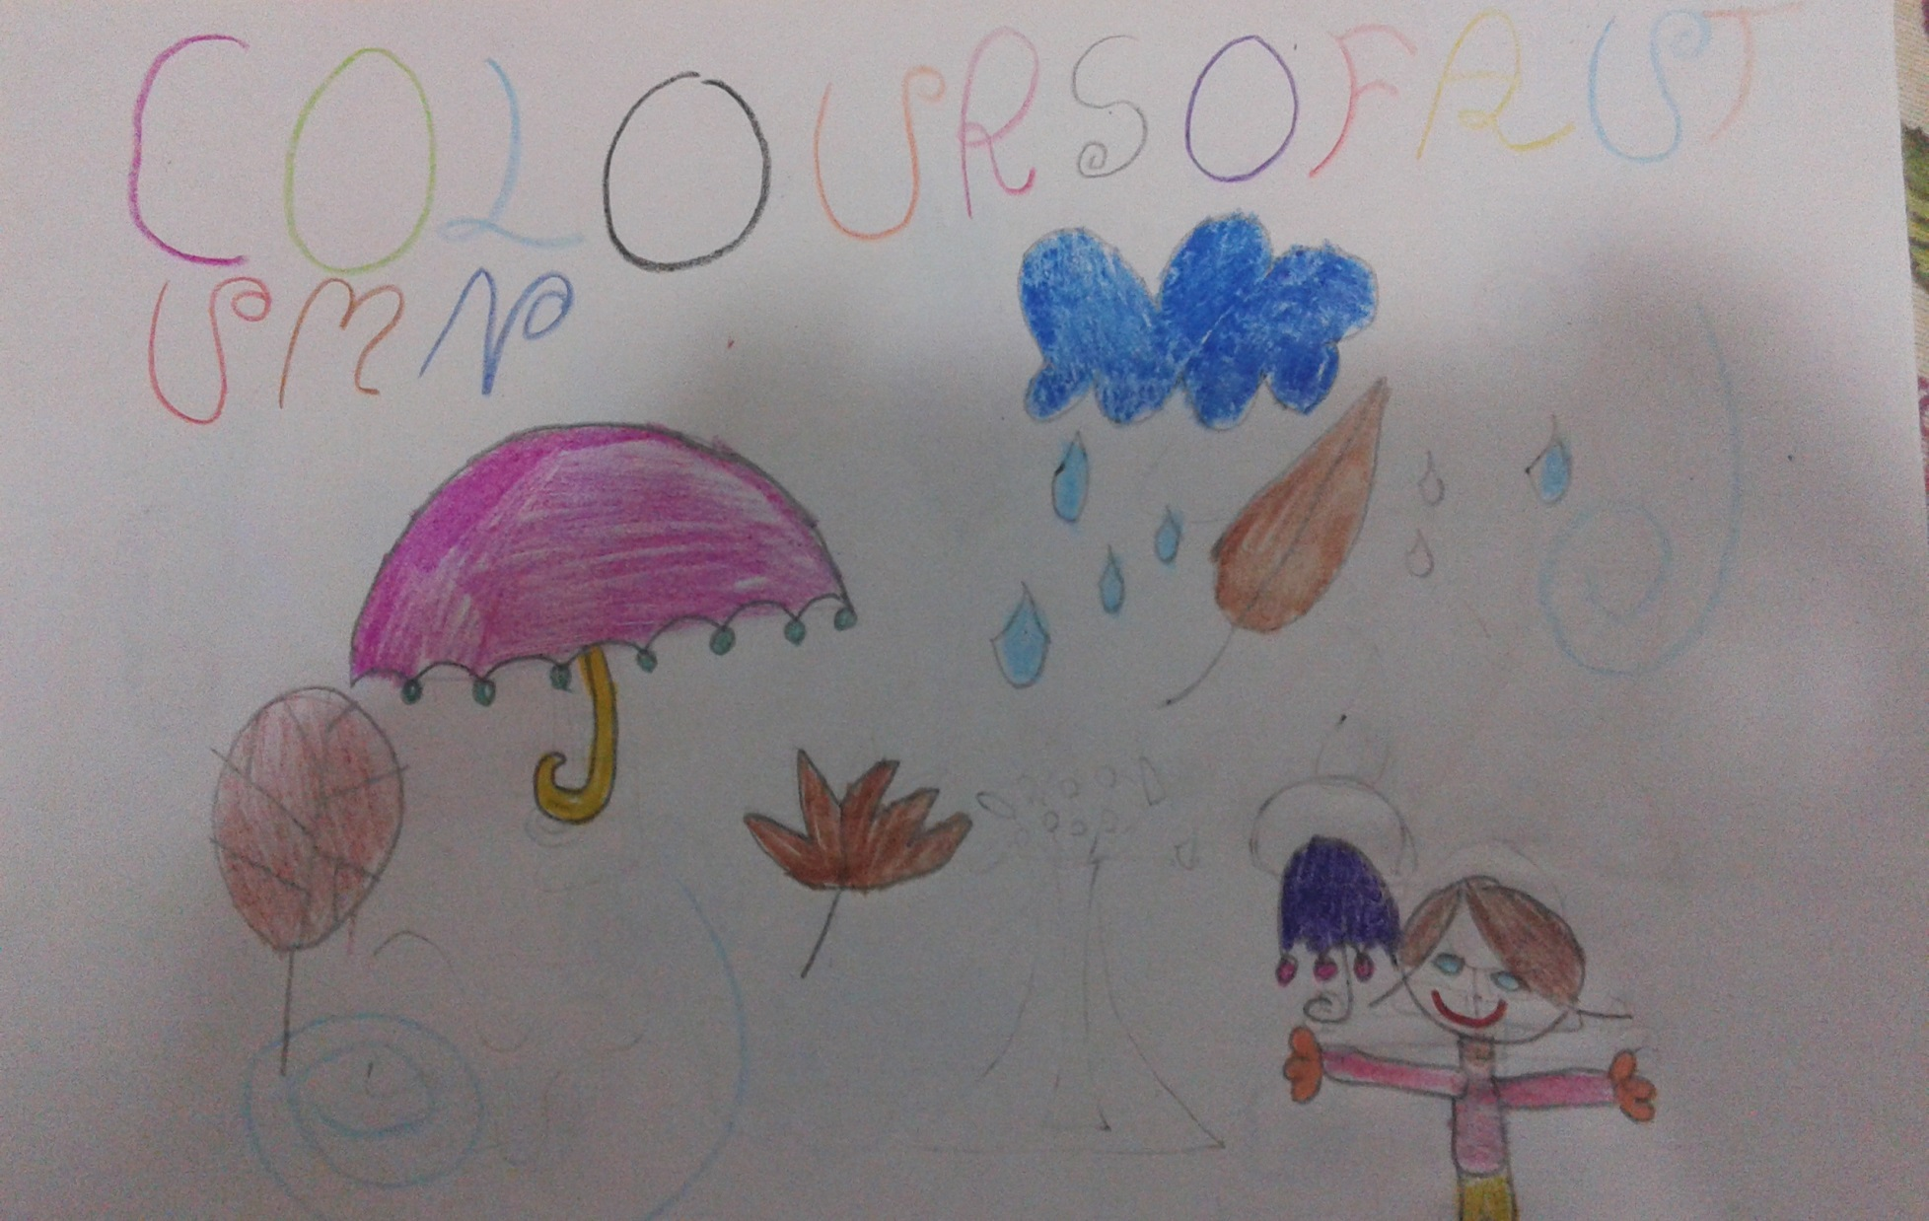

Slide 10
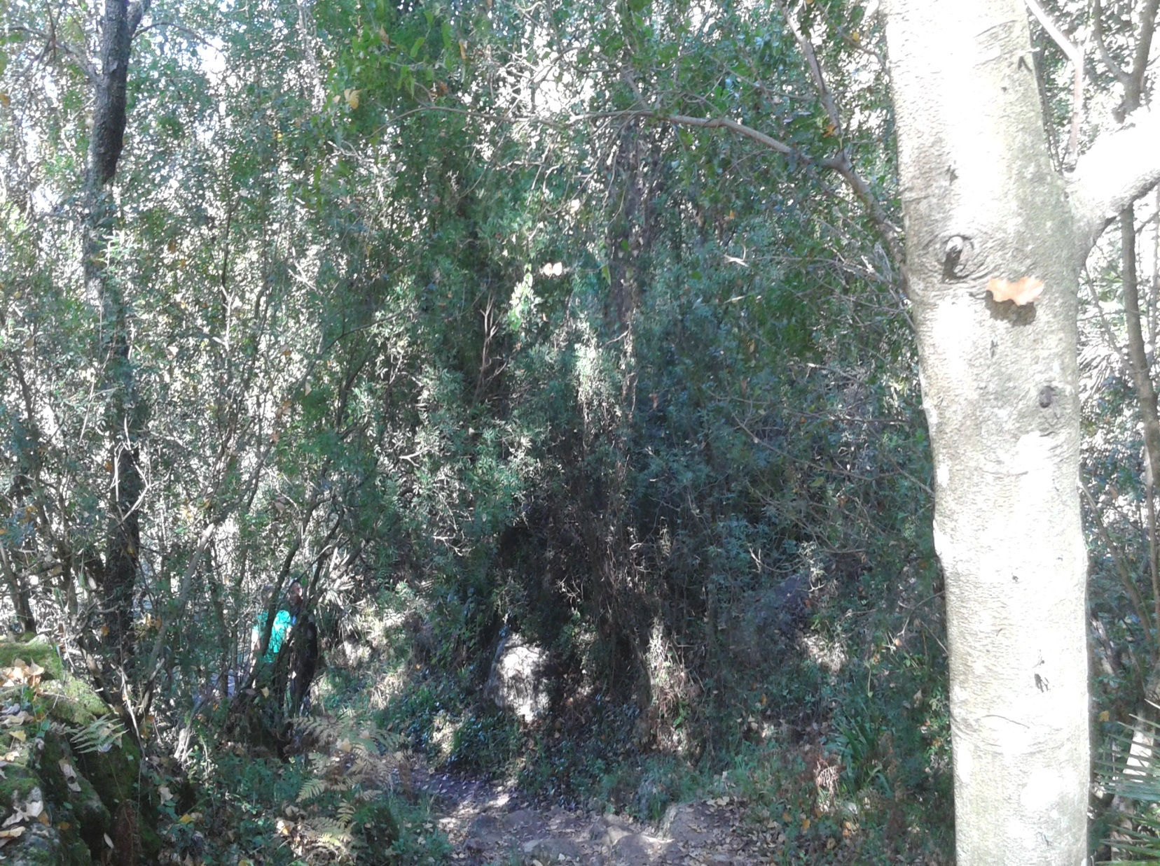

Slide 11
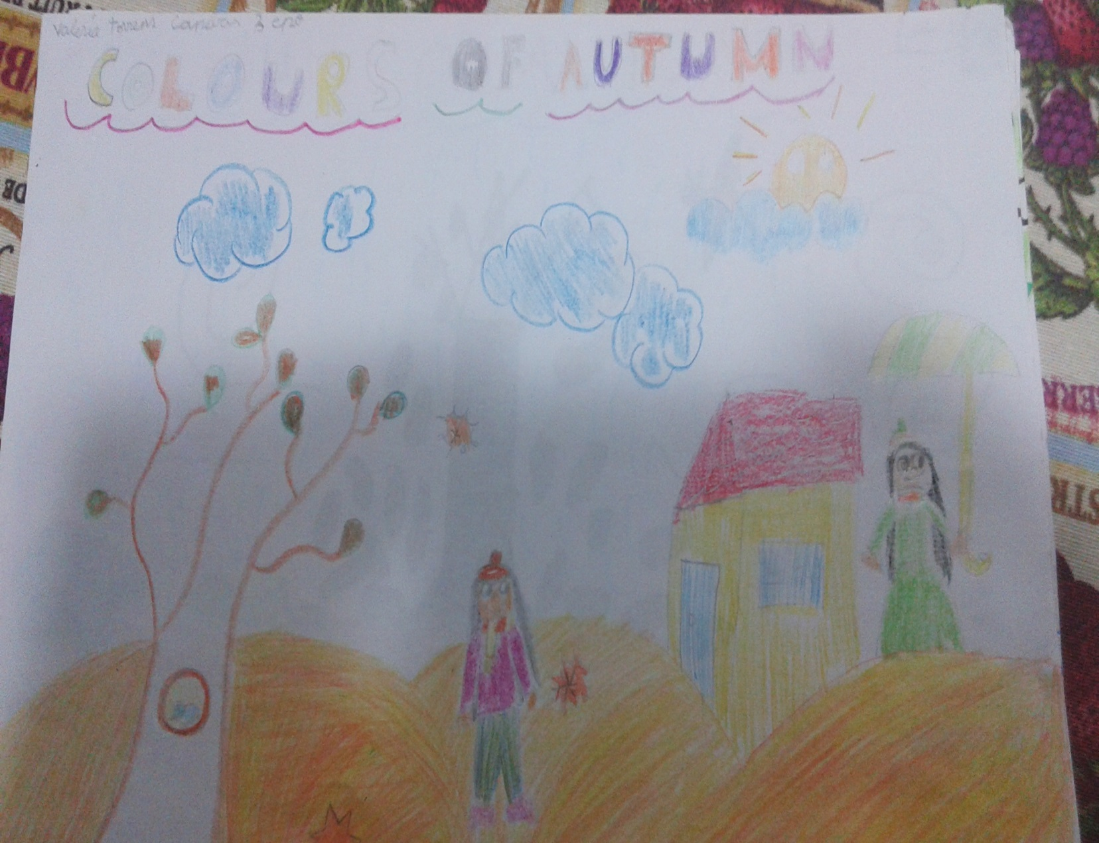

Slide 12
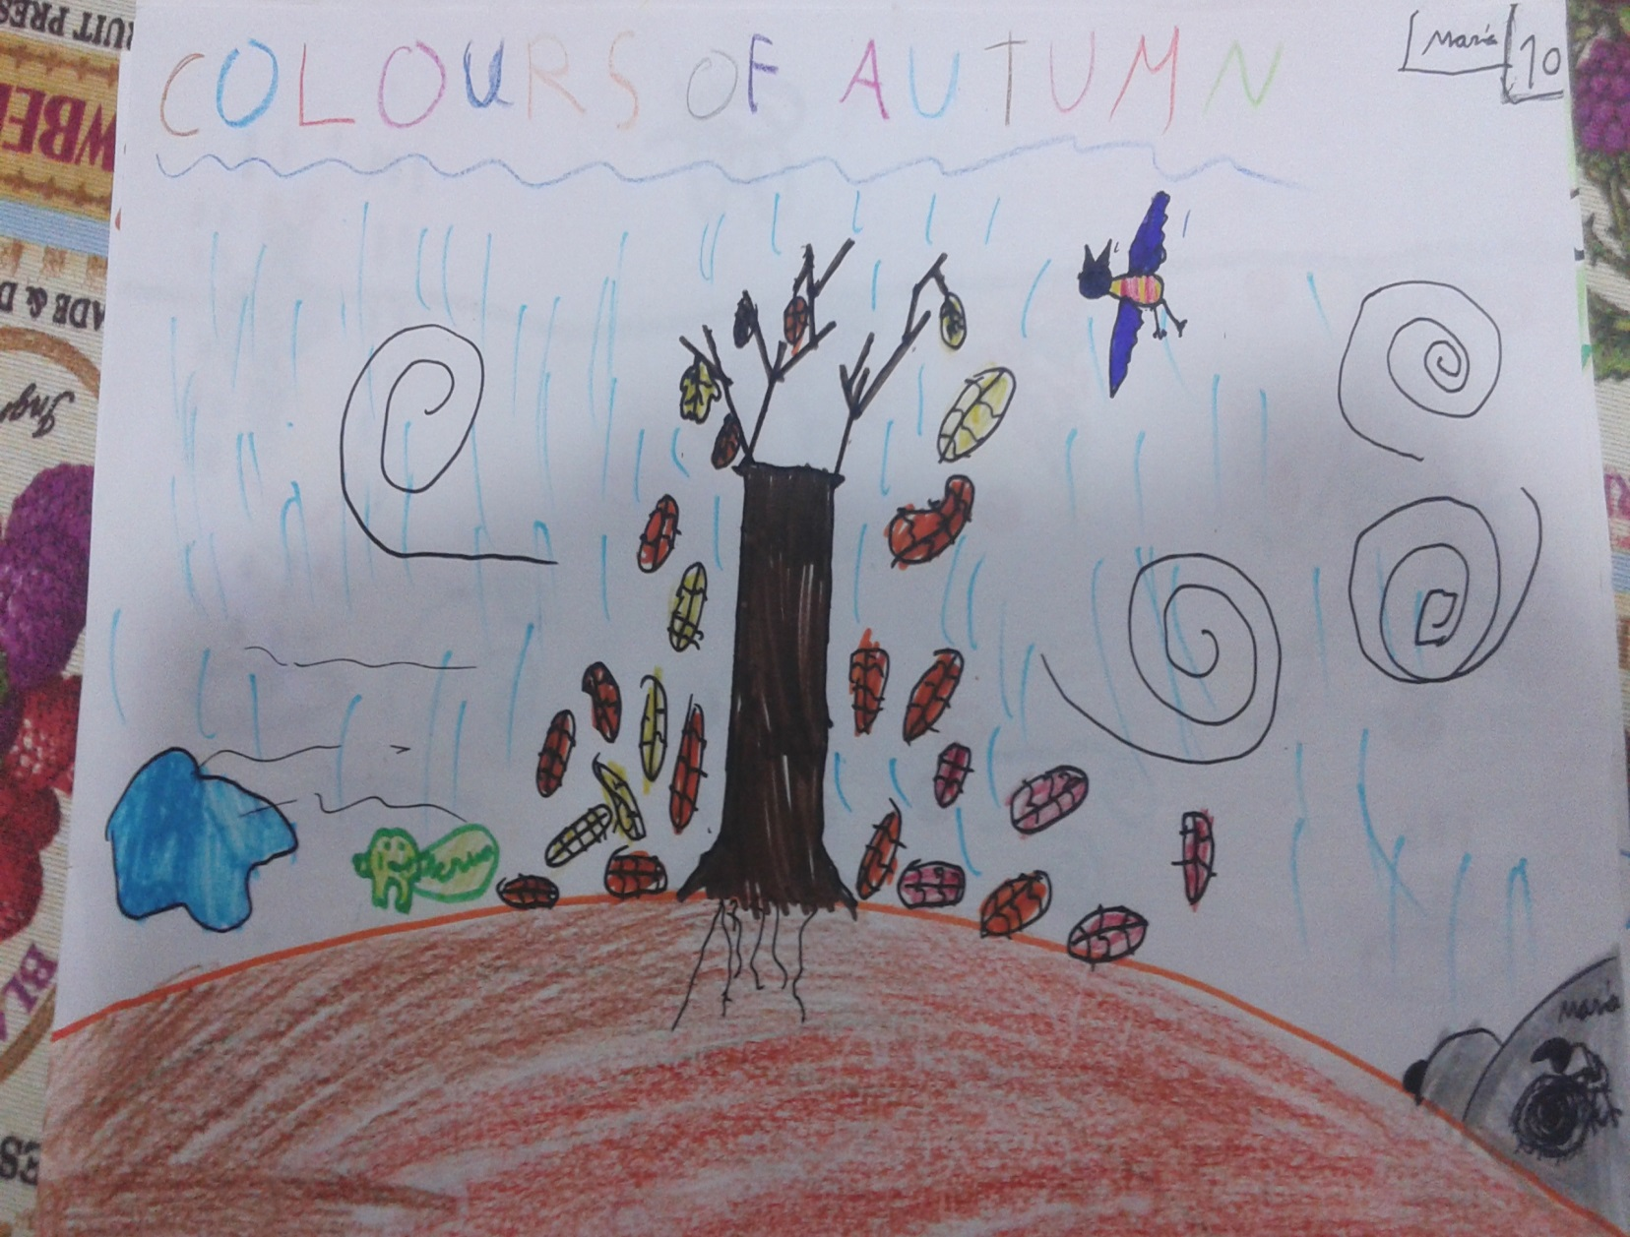

Slide 13
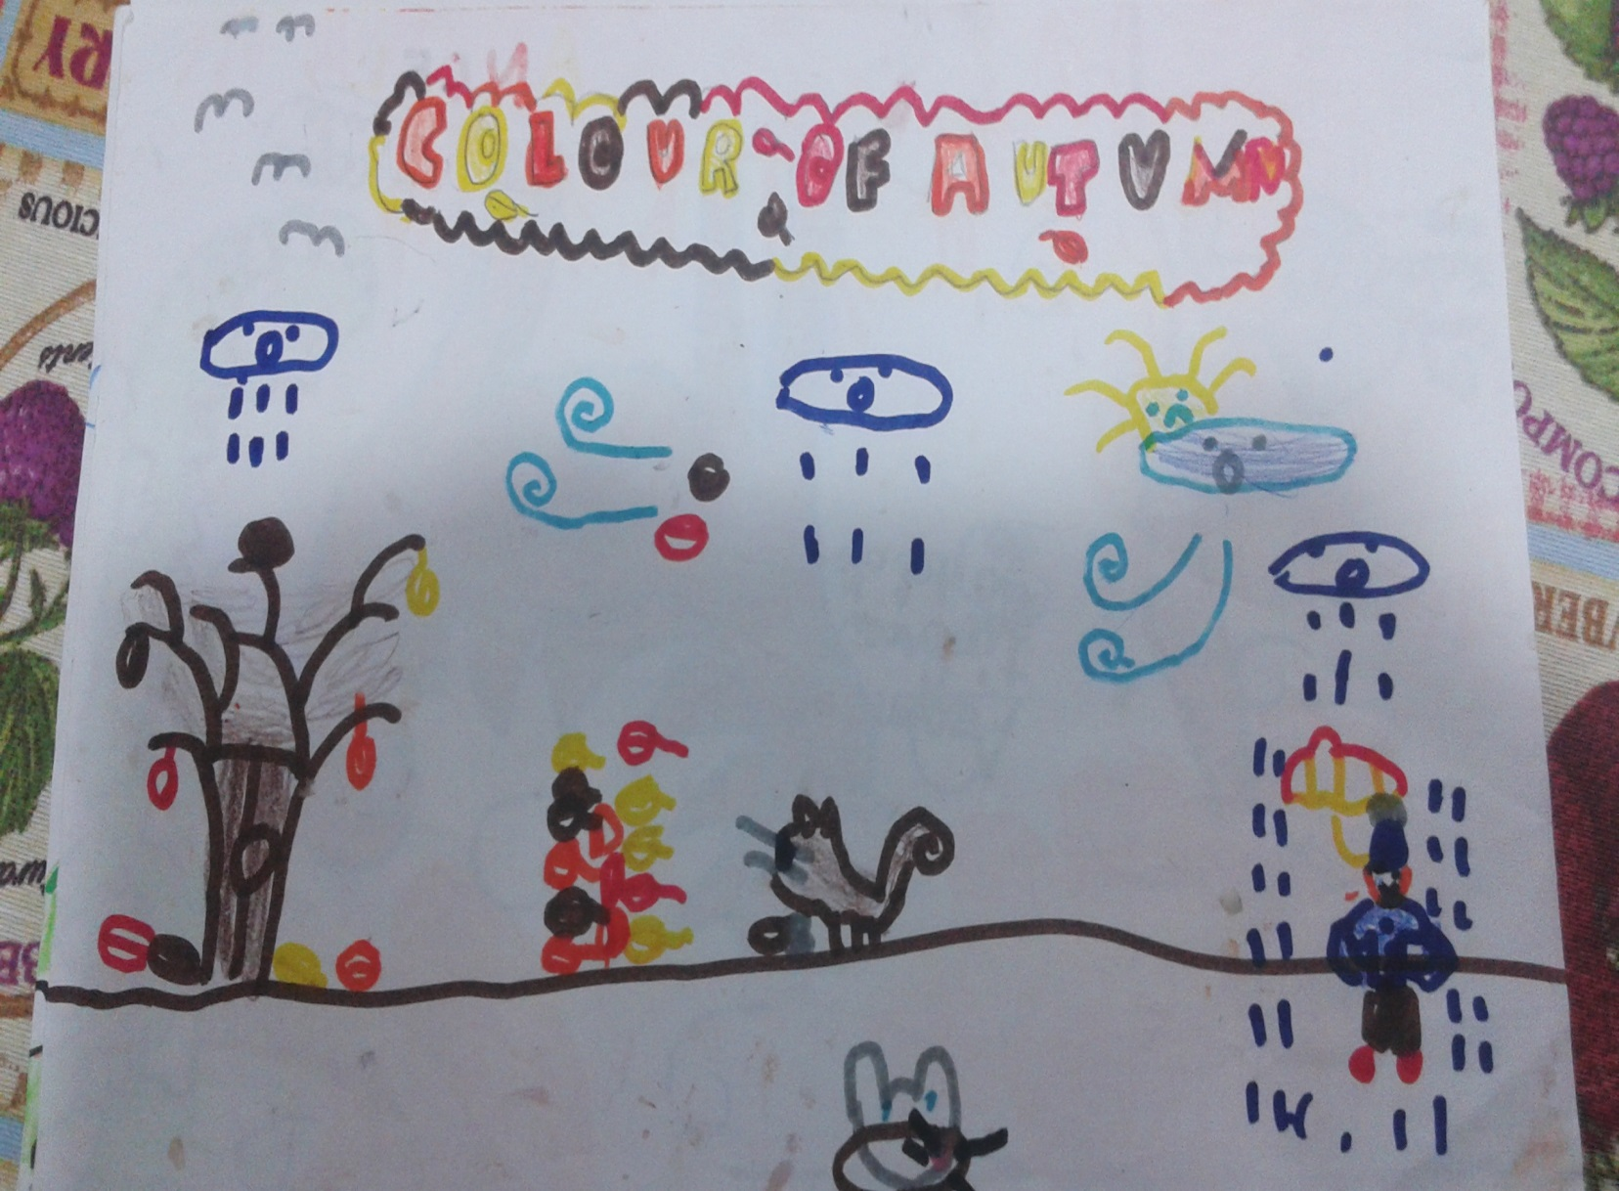

Slide 14
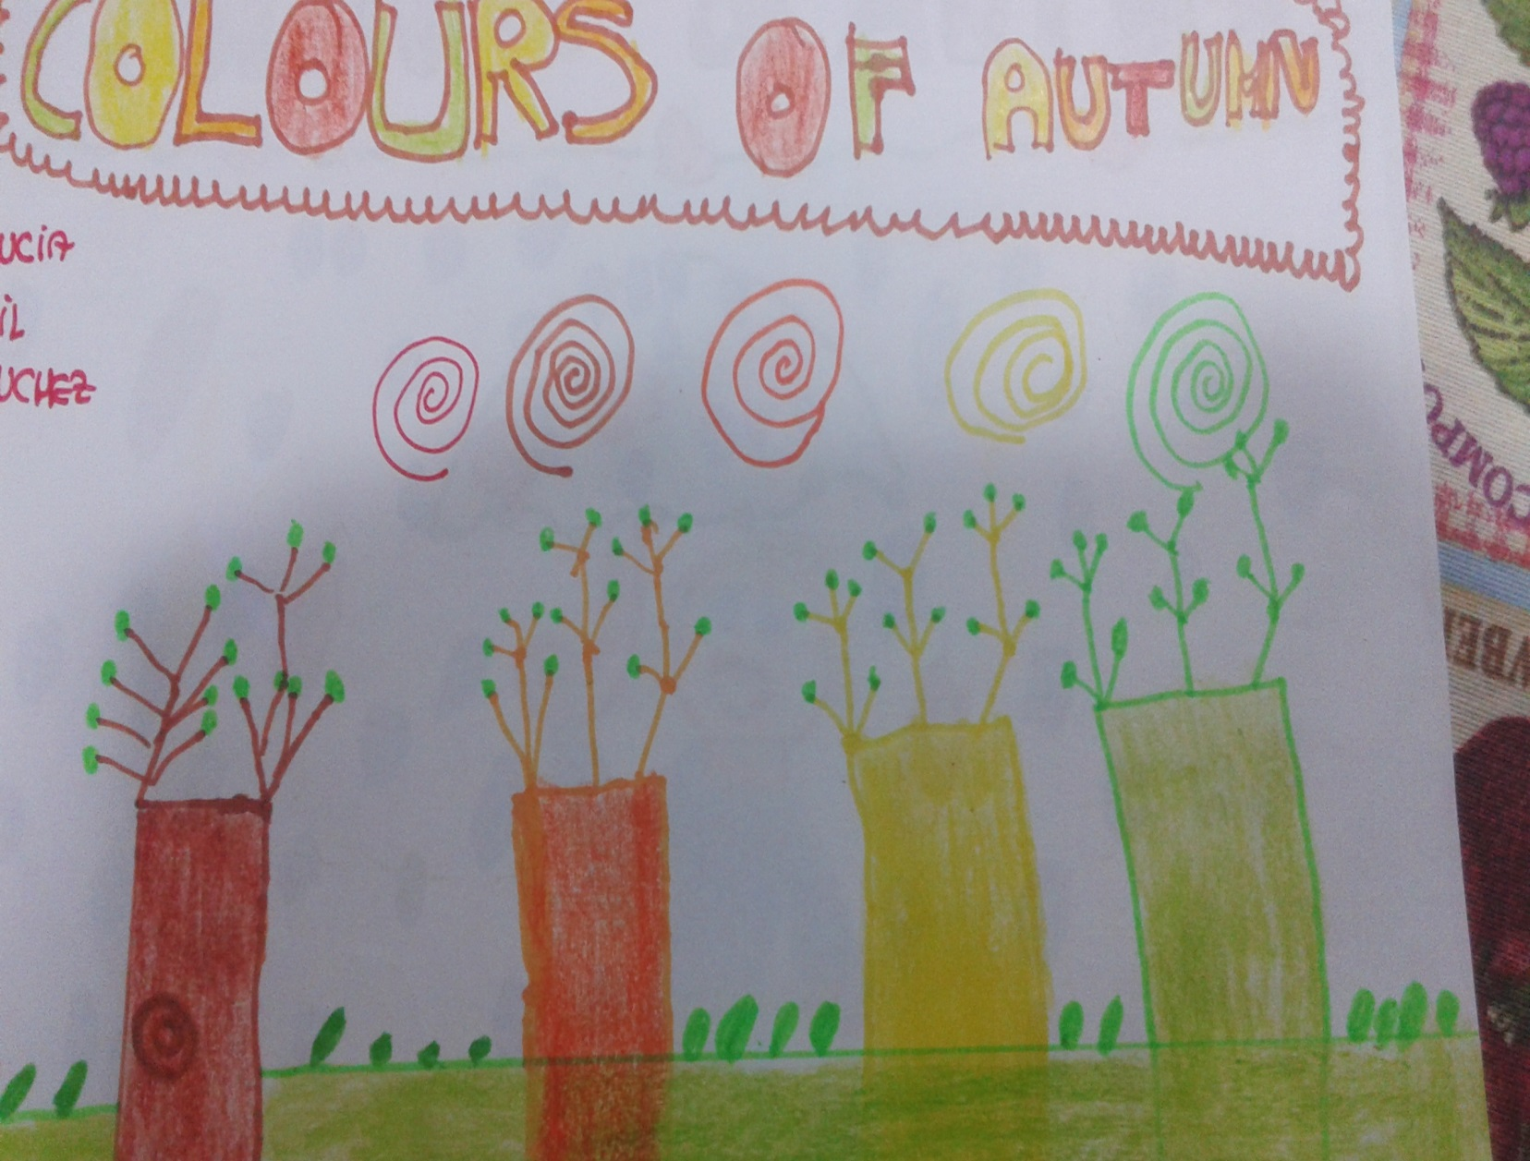

Slide 15
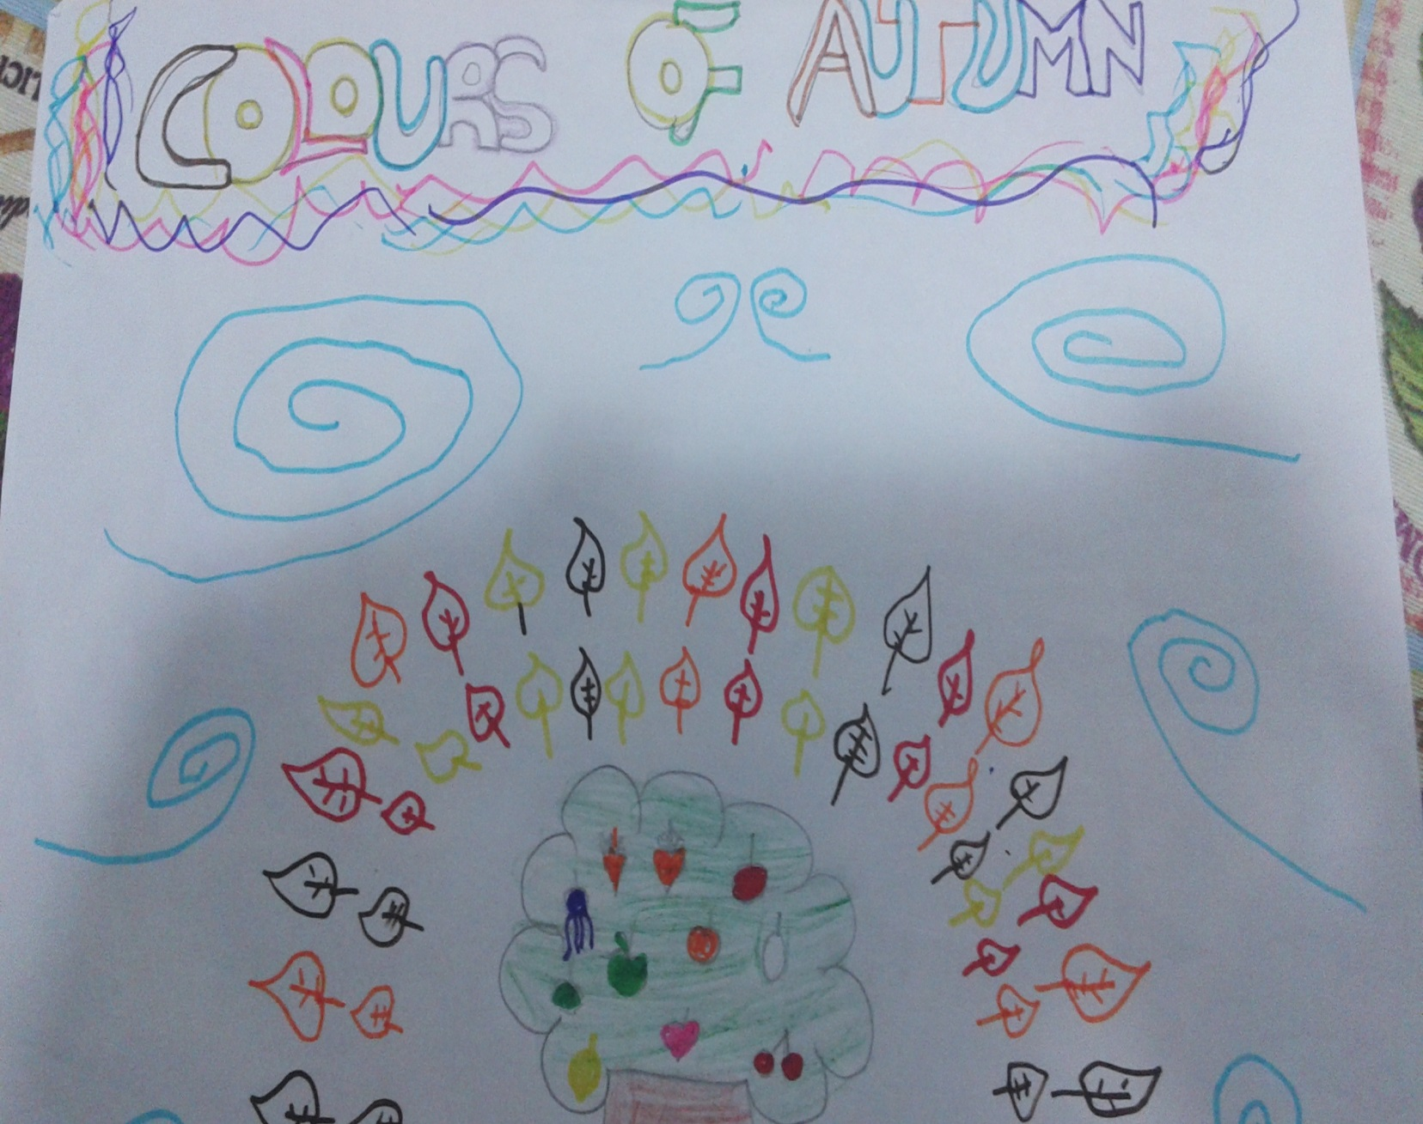

Slide 16
AUTUMN IS WONDERFUL

