Slide 1
1ST Experimental primary school of athens
A presentation by A’ class students and Ms G. Selimi

Slide 2
Marasleion experimental primary school

Slide 3
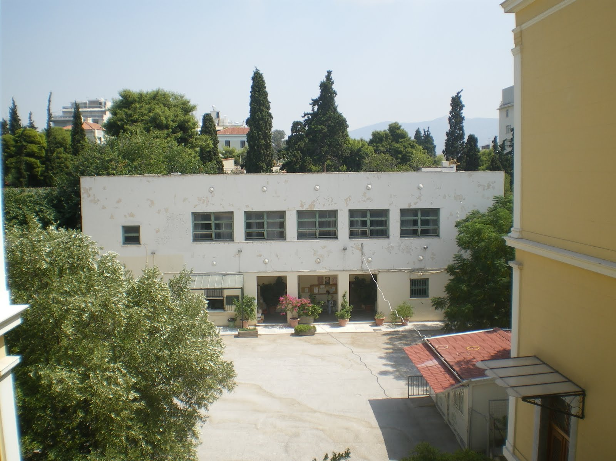
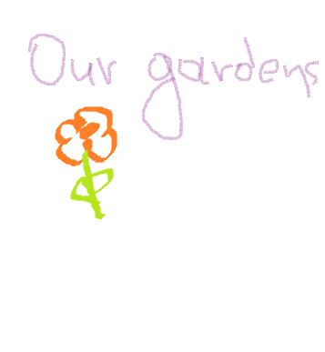
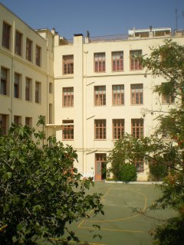
Our school is located at the centre of Athens but, luckily enough, children have a lot of green space filled with trees and grass at their disposal.

Slide 4
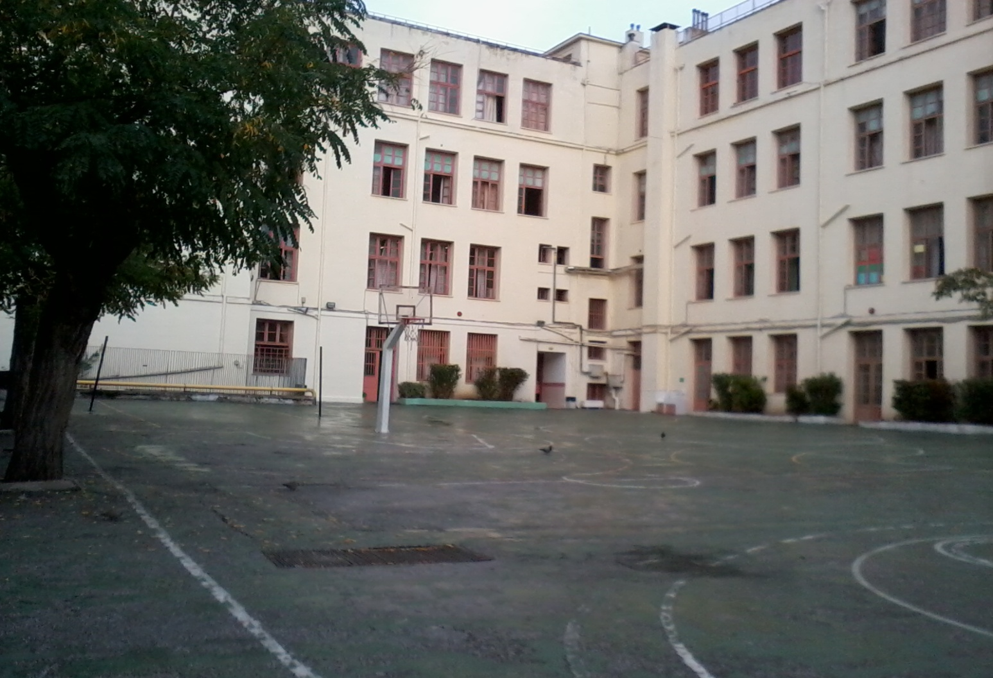
There is a basketball court

Slide 5
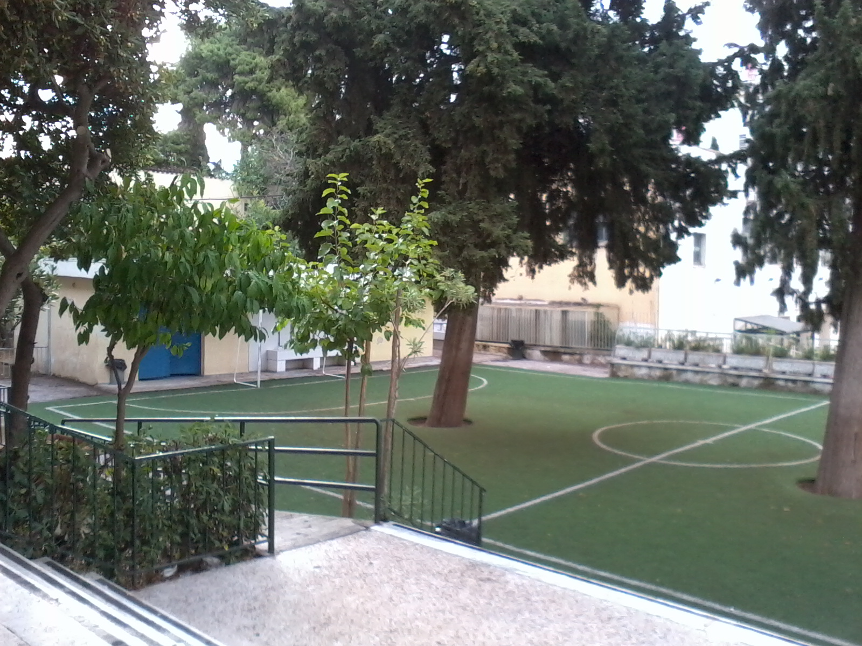
and a football field for our young players.

Slide 6
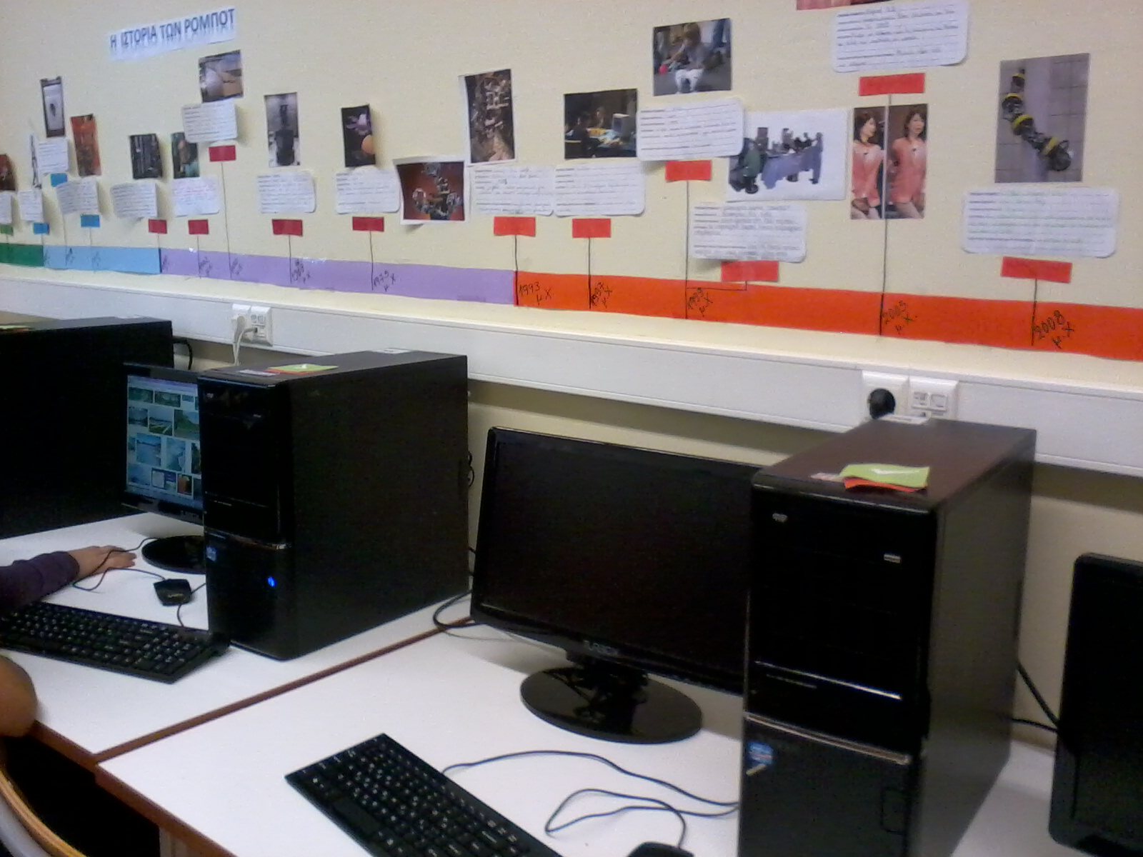
This is our computer lab.

Slide 7
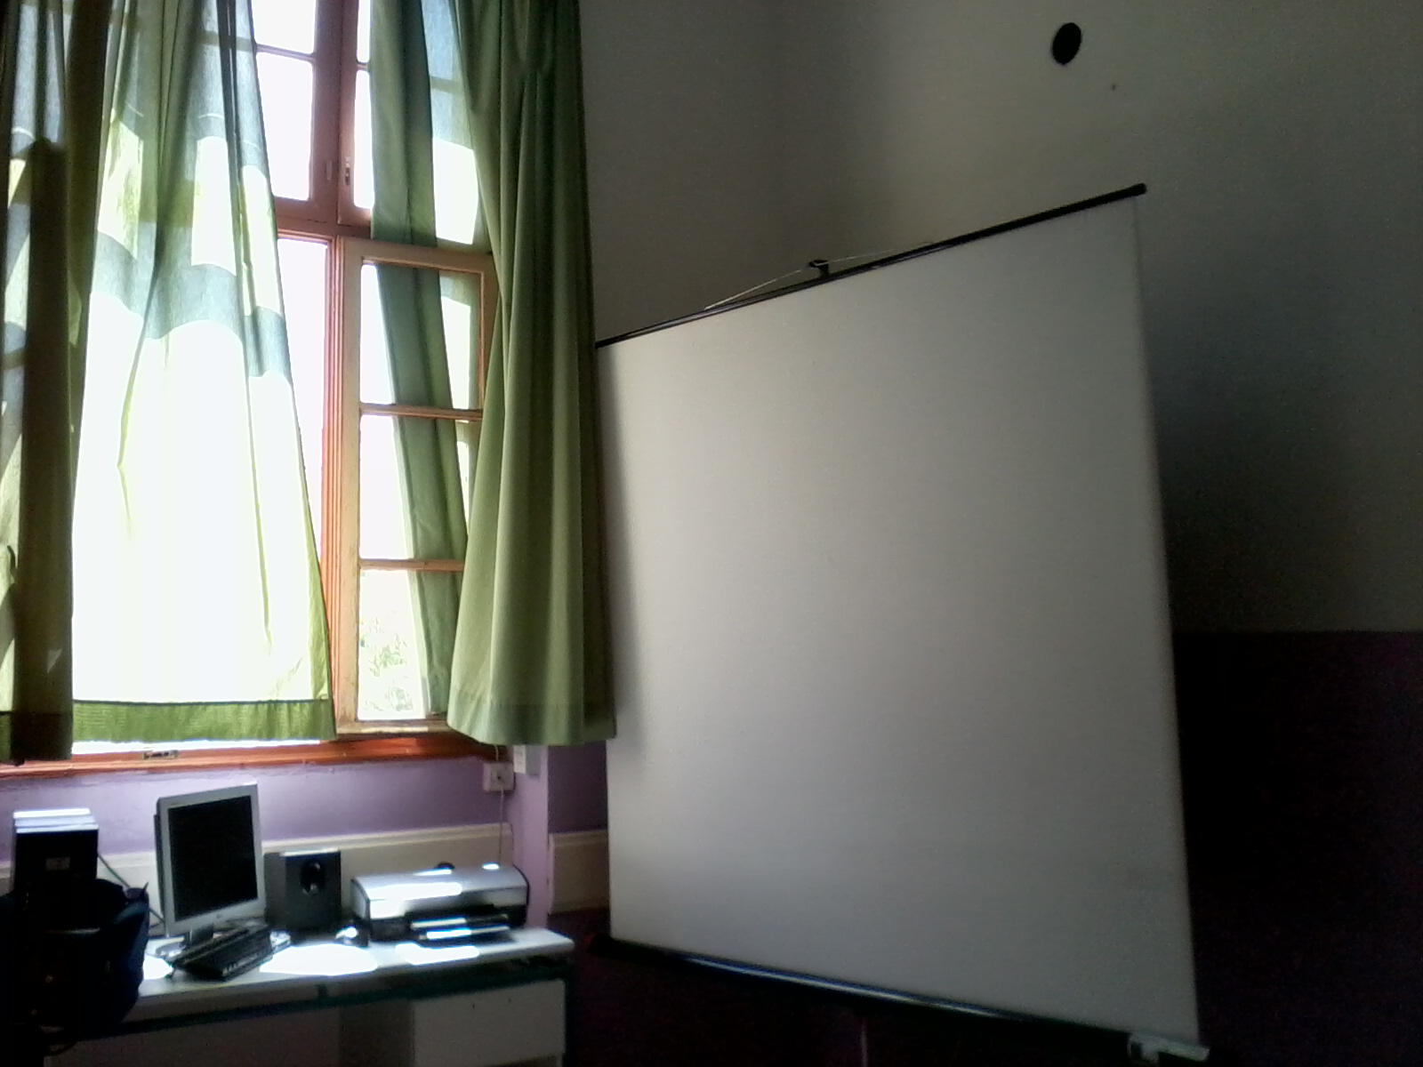
Most classes have a computer, a projector or whiteboard to use on a regular basis.

Slide 8
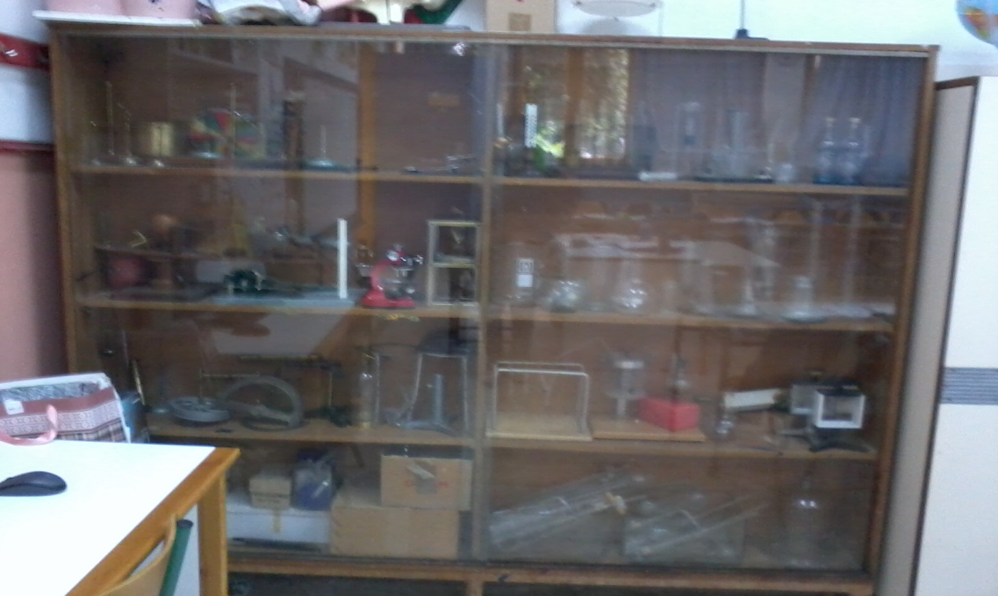
Students of the last two grades perform experiments during Science class, so there’s always plenty of equipment available.

Slide 9
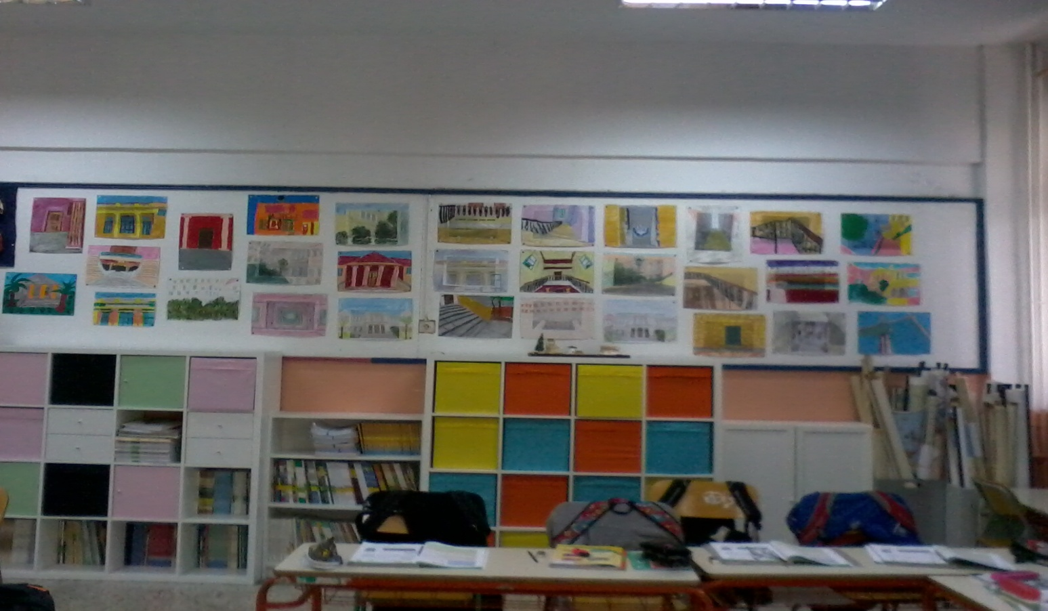
Arts class is everybody’s favourite; naturally all classes are decorated with students’ brilliant artistic products.

Slide 10
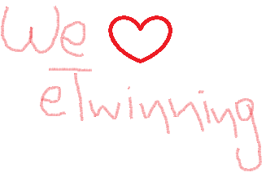
Our school is a place where we try to learn
a bit more about the world and enjoy ourselves while doing so.
Our participation in eTwinning guarantees a joyful and colourful
school year!

