Slide 1
JEREZ DE LA FRONTERA
THIS IS NAME OF THE PLACE WHERE WE LIVE. WE HOPE YOU WILL LIKE IT

Slide 2
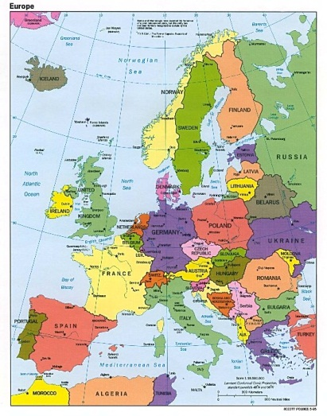
EUROPE

Slide 3
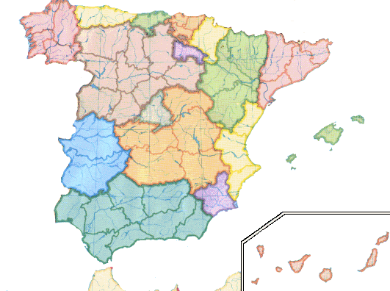
SPAIN

Slide 4
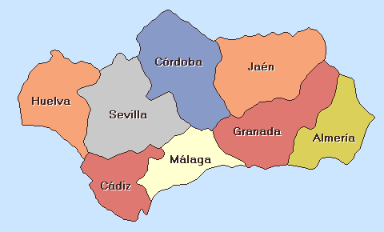
ANDALUCIA

Slide 5
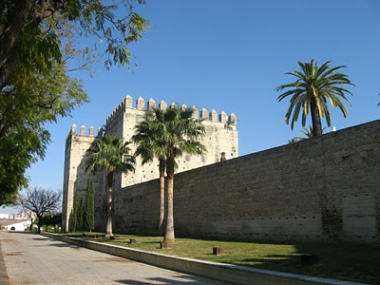
JEREZ
JEREZ IS A CITY WHICH IS IN THE SOUTH OF SPAIN. I T IS A VERY BEAUTIFUL CITY NEAR CADIZ.

Slide 6
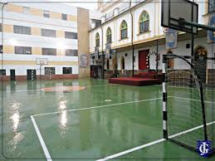
THIS IS OUR SCHOOL
ORATORIO PADRE TORRES SILVA

Slide 7
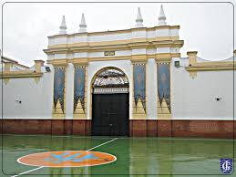
We are about 300 pupils in the school.
Preschool
- primary
- secondary
(from 3 to 16 years old)

Slide 8
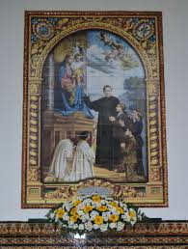
OUR SCHOOL IS RELIGIOUS.

Slide 9
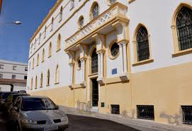
It is not very big school, but we like it.

Slide 10
We all hope you will like it.

