Slide 1
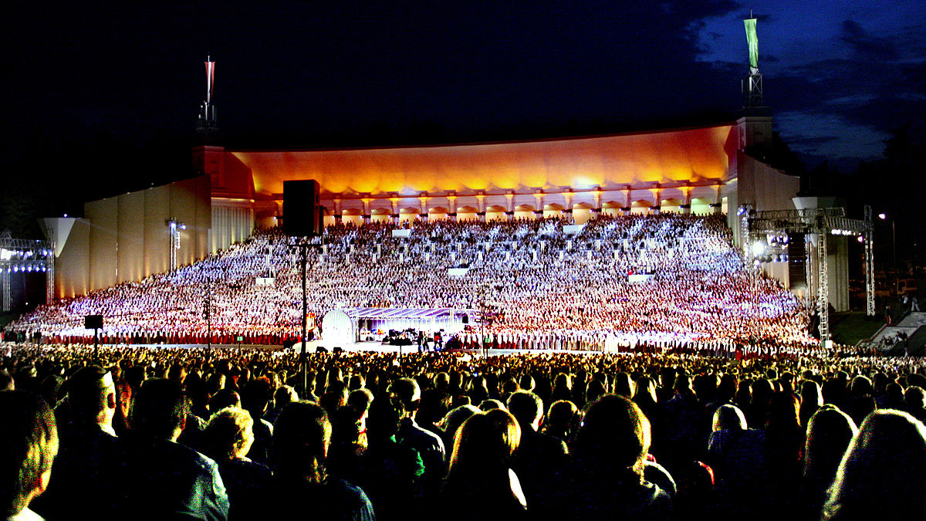
LATVIAN FOLK SONGS
Agate Ž, Anna M.S, Lauma V, Katrīna L, Katrīne L. 9.B
This Photo by Unknown author is licensed under CC BY-SA.

Slide 2
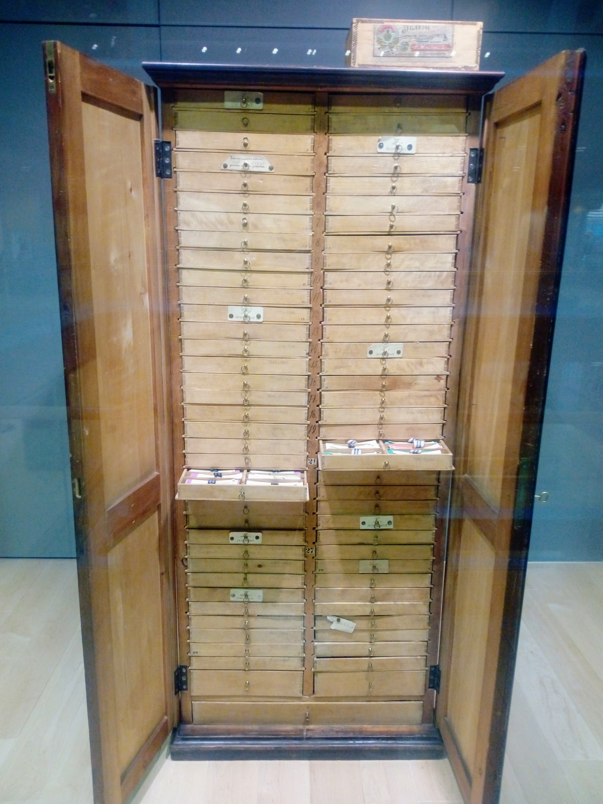
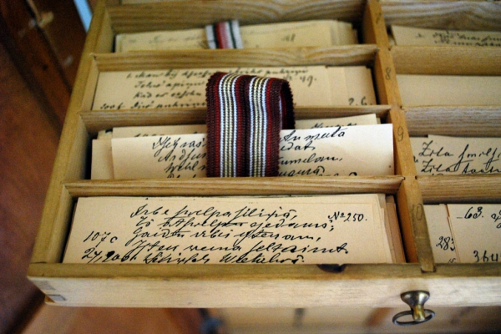
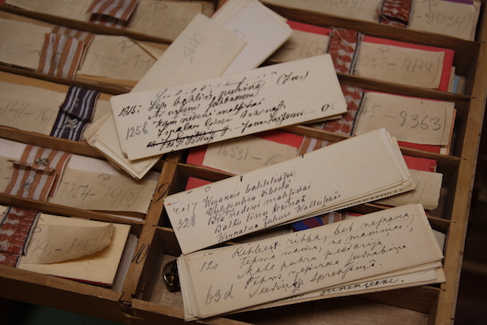
Cabinet of Folksongs- Dainu skapis
The Dainas (Lat­vian Folk songs) are lit­tle qua­trains of an­cient Lat­vian wis­dom cap­tured in song. Cre­ated well over a thou­sand years ago, Dainas were part of cel­e­bra­tions, daily work, re­flec­tions on life pre­served in oral form. There are more than 1.2 mil­lion Dainas, with ref­er­ences to them in all forms and lay­ers of cul­ture, from the­atre plays to every­day con­ver­sa­tions. The col­lec­tion of Dainas un­der the name “The Cab­i­net of Folk songs” is in­scribed in the UN­ESCO Mem­ory of the World Program. Today you can find Dainas in the «Dainu skapis» which is located in The National library of Latvia.

Slide 3
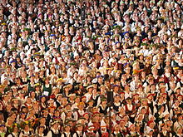
The history
The first collections of Latvian folk songs, which were compiled by two German men, were published in 1807. Despite the wave of modernization in the 19th century, Latvians managed to preserve their tradition of Dainas, mostly because it was passed on from generation to generation.
The central role of dainas in Latvian life has long been viewed as one of the distinguishing features of Latvian culture. It describes the three essential elements of this uniquely Latvian phenomenon: tradition, literature and symbolism.
TU ESI LATVIJA Šo pašu svētāko Tu neaizmirsti: vai celies debesīs, vai jūras dzīlēs nirsti, vai draugu pulkā dali savu prieku, vai viens pats satiecies ar pretinieku - Tu esi Latvija!
/dzejoļa autors Ojārs Vācietis/
This Photo by Unknown author is licensed under CC BY-SA.
This Photo by Unknown author is licensed under CC BY-SA.

Slide 4
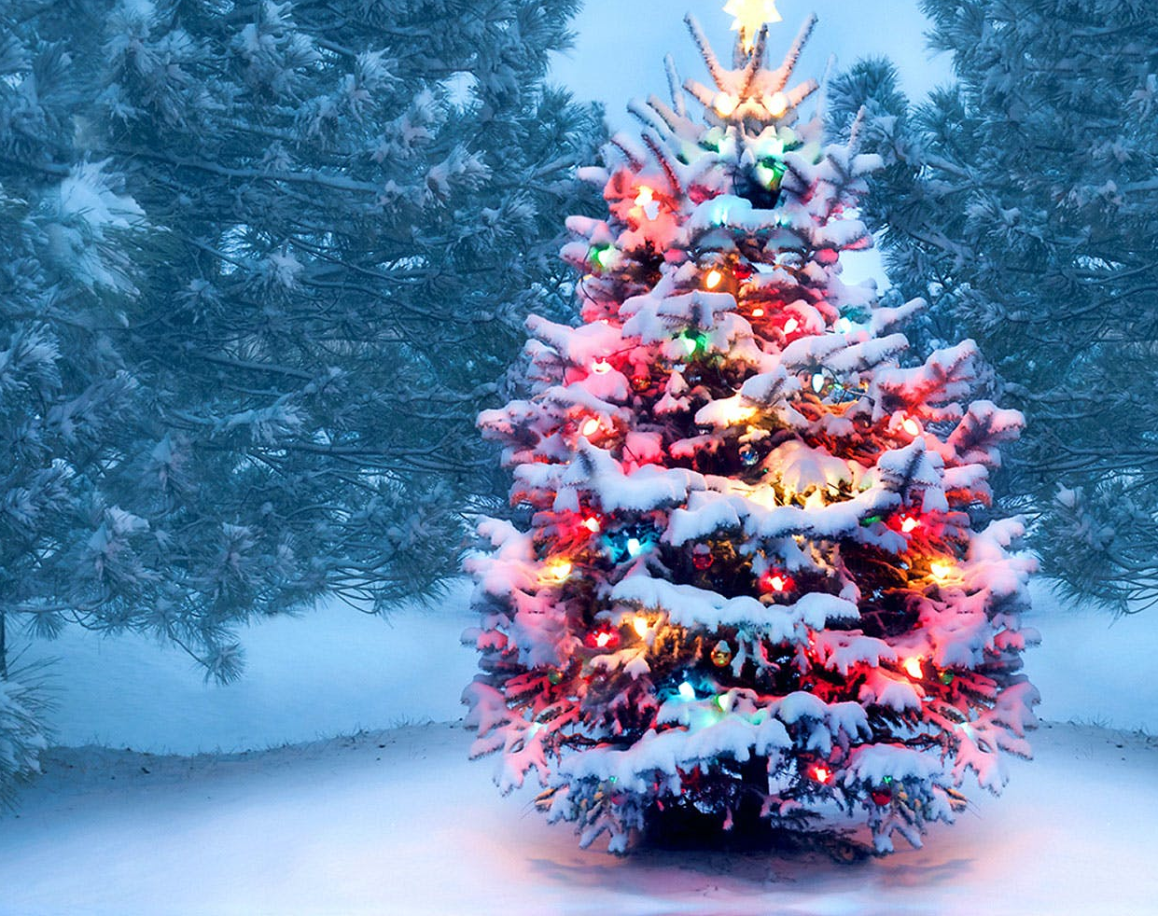
Ziemassvētki , also Ziemsvētki is an annual festival in Latvia which observes the winter solstice and birth of Jesus Christ.Latvians around the world celebrate it from 24 to 26 December. 24th December is Ziemassvētku vakars(Christmas eve), 25th December is Pirmie Ziemassvētki (First Christmas), while 26th December is Otrie Ziemassvētki (Second Christmas). Christianity traditionally celebrates the birthday of Jesus Christ on 25th December, according to the Julian calendar.
Ziemassvētki - Christmas
My children gypsies,
Where will we spend the night?
One in the pine tree, one in the spruce tree, one on the side of the road.
Rich Christmas day
Came from Riga:
Three hundred armed butlers.
Kas tie tādi ziemas svētki, Pastaliņu plēsejiņi: Trīs dieniņas, trīs naksniņas Pastaliņas kājiņā.
Ai dārgie Ziemssvētki, Ko jūs labu atnesiet? Puišus treknus, zirgus liesus, To jūs labu atnesiet.

Slide 5
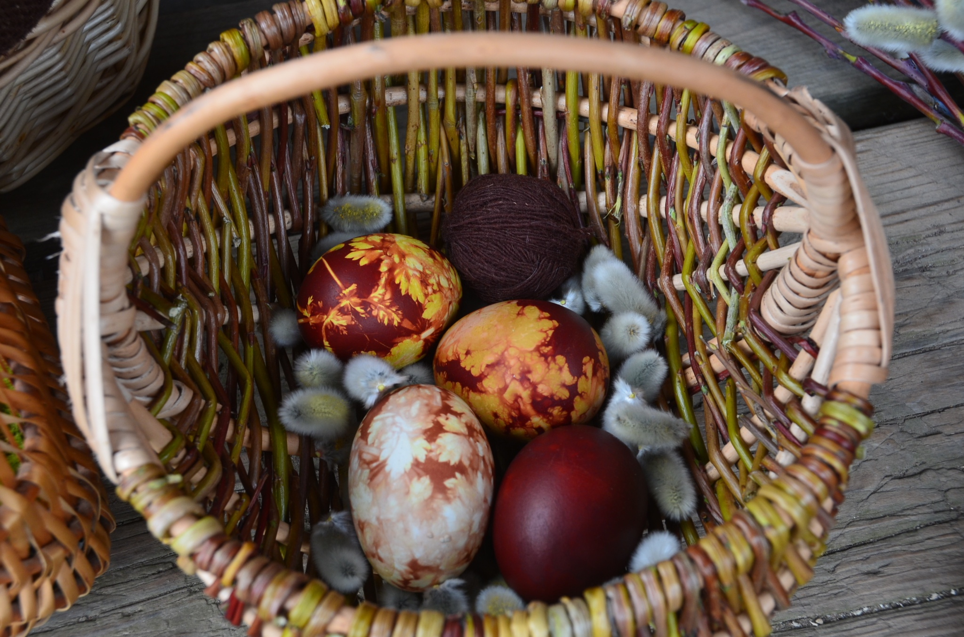
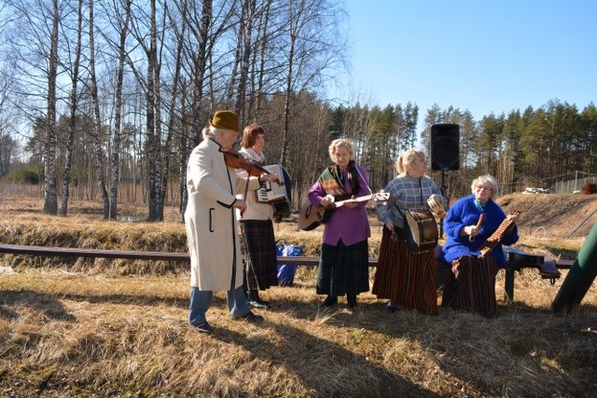
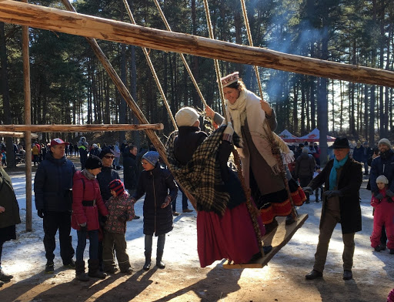
Folk songs of spring solstice
Spring solstice is celebrated with a lot of traditions like swinging, egg activities, lots of singing and there are many folk songs about the traditions and activities done in the spring solstice.​
Here are a few of them:
Latvian version:
English version:
Nāc nākdama, liela diena, Visi bērni tevi gaida, Visi bērni tevi gaida, Aiz vārtiem sasēduši.
Spīdi nu, saulite,​ Ābeļu dārzâ,​ Tur mūsu bāliņi​ Šupoles kāra.​
Shines, the sun,
In the apple tree garden,
There our boys,
Hanging the swings

Slide 6
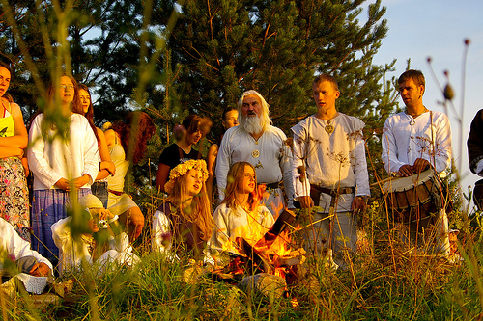
Δ Folk songs of Summer solstice Δ
When celebrating summer solstice or Līgo, you can never forget the traditional songs and games. The words for these almost always have started out as old folk poems, passed on from generation to generation. Later these dainas have become songs, sung all Līgo night. They are incredebly hard to translate, but trust me, they make sense in latvian.
This is how a daina sounds in latvian:
Es sasēju lielu sieru, Jāņu dienas gaididama; Jāņu dienu izdaliju Pa maziemi gabaliem.
This is now translated to english:
I made a big cheese,
Solstice day expecting;
At soltice day I divided it up
In little pieces.
This is a great folk performance to check out https://youtu.be/A2r-uspx6LM

Slide 7
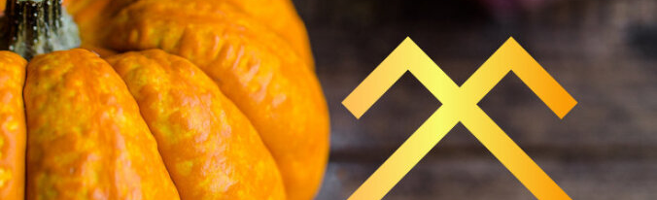
Miķeļi or Miķeļdiena is a Latvian autumn equinox and annual harvest festival and market. Many Latvians have never celebrated a holiday such as Miķeļi, therefore most songs and poems are new to listeners. It is ironic that so many Latvians are familiar with only a couple dozen tunes when there is so much wealth in Latvian folklore. Many folk songs go unheard and unsung. Miķeļi is a very old tradition celebration and thus have many, many folk songs. A few of them:
Miķeļa day
Let me, mother, go to the market,
Let Mara, Mikelis!
Mara went to watch,
Mikelis went to listen.
Kas tur spīdēj' kas tur mirdzēj
Mana staļļa pakaļā?
Mīkālīts zirgu dīda
Ar sidraba iemauktiem
Meitas gaida Miķeļdienas
Kā saulītes uzlēcot;
Kādu vellu nu gaidīs-
Miķeļdiena pagājusi?
Es izcepu kukulīti,
Vidū dūru caurumiņu;
Es mielošu Miķelīti
Caurumainu kukulīti

Slide 8
Used literature
This Photo by Unknown author is licensed under CC BY-SA
dainuskapis.lv/
tautasdziesmas.lv/tag/lieldienas
tautasdziesmas.lv/tag/ligo
http://www.svetvietas.lv/mi%C4%B7e%C4%BCi.html
https://www.latvia.eu/traditions-culture/latvian-folk-songs-dainas#:~:text=Dainas%20has%20a%20history%20of,national%20distinguishing%20characteristic%20long%20before.

Slide 9
Thank you for your attention!

