Slide 1
LATVIAN FOLK MUSIC
TUANA, MAIJA, LĪZE, ROBERTS, LINDA J.

Slide 2
Content
What is Latvian Folk Music ?
Latvian Folk Music development
The ancient Layer
The new Layer
Folklore Ensemble Movement
New and old folk music (comparison)

Slide 3
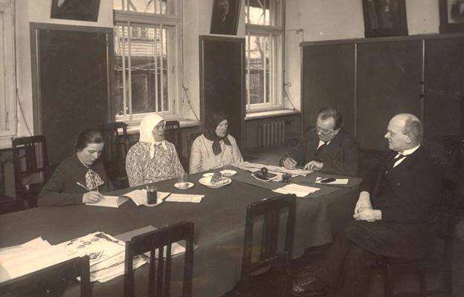
What is Latvian folk music ?
Latvian folk music has historically been a set of Latvian agricultural and minority’s music-making practices and music styles.
Since the 20th century, it also includes practices developed in the work of folklore ensembles.
Documented since the 19th century. 60s. It distinguishes between the old and the new layer.

Slide 4
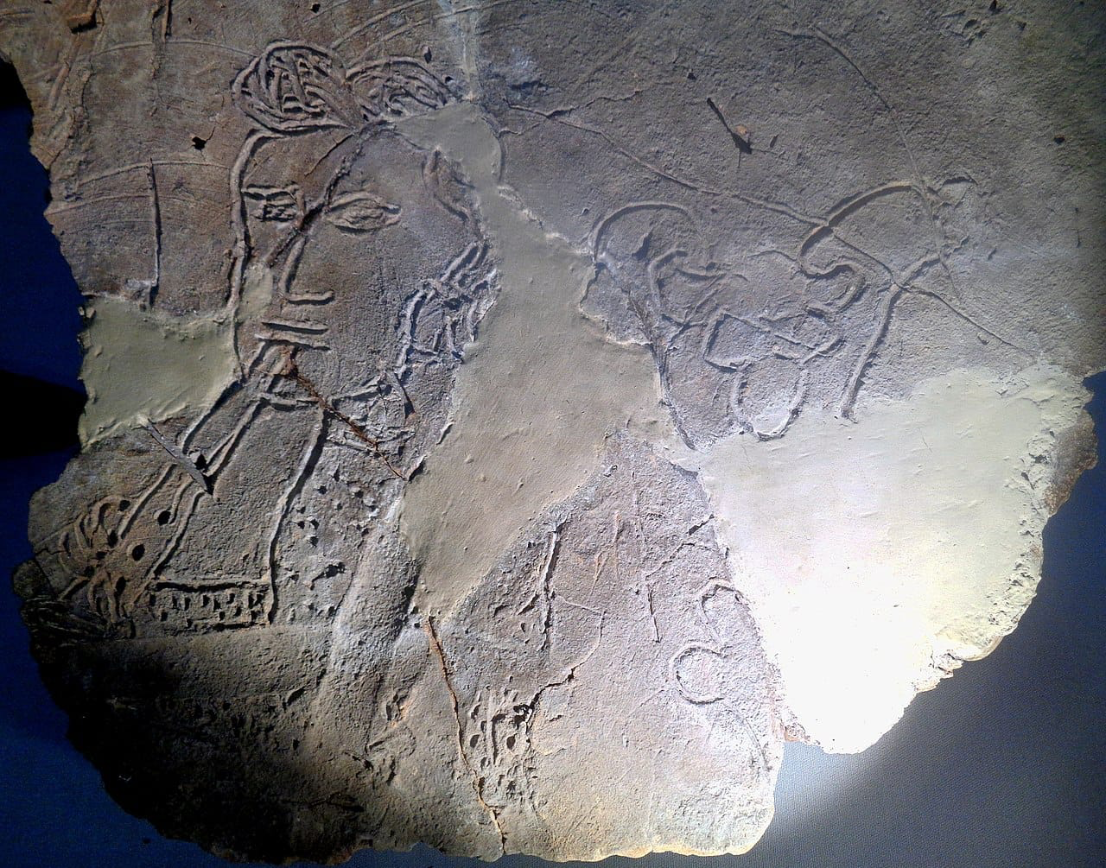
Latvian folk music development
In the beginning of making music in the 13th and 14th century, the cities required a certain amount of professionalism, provided mainly by German-educated musicians.
The earliest music in the experience of locals came to the church.
17th /18th century
19th century
20th / 21st century

Slide 5
The ancient layer
The styles of the ancient layer are rooted in the pre-Cristian culture of the Baltic’s and are closely connected with the ancient family, anniversaries and work.
Melodies are usually narrow scope, modal and only with classical lyrics. The central style of the ancient layer is the spoken melodies (recitative), in which the melody and rhythm are influenced by the flow of speech.
Choral songs are annual customs are also an important ancient style, the best-known type is Līgotnes.
The ancient layer also includes many small stylistic units – open-air and slow-singing spring melodies with bourdon accompaniment in Kurzeme and similar to that, North Latgale manure talks, as well as Dienvidlatgale mowing songs and others.

Slide 6
The new layer
•Started to form around 18th century’s second half
•New melodies are usually in major, medium or wide volume.
•The melodies of the new layer are much more independent of customs and, unlike the old ones, stick to a certain text.
•The distinctive style of the new layer is ziņģes.
•Often the authorship is often known.
•The transition follows with the cultural phenomenon šlāgeris.
As a result of the long-term interaction of the old and the new layer, a wide interlayer has formed, consisting of melodies with mixed elements of old and new origin. In Latgale, similarly to folk songs, partly in oral tradition, there are some types of Catholic music - the ofīcijs of the dead (popularly called salmas, salmis, etc.), which is a psalmodic prayer for the dead, and Catholic songs

Slide 7
New and old folk music (comparison)
Old folk music
New folk music
When it started:
The oldest written documentations of Latvian folk songs that have survived are dated 1584 and 1632.
Melodies:
Melodies in old folk music were usually modal and only with classical lyrics. The central style of old folklore music is the spoken melodies.
The Dainas (Latvian Folk songs) Created well over a thousand years ago, Dainas were part of celebrations, daily work, reflections on life preserved in oral form.
When it started:
It is assumed that the new form of folk music began to form in the 18th century.
Melodies:
The melodies of the new folk music are much more independent of customs and, unlike the old ones, stick much more closely with a certain text.
In the second half of the 18th century, Old Stender's books "New News" (1774) and "News Lutes" (1789) are considered as relative reference points of new folk music.

Slide 8
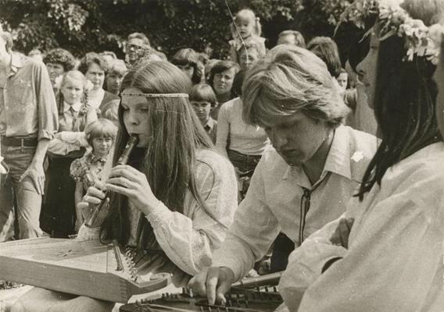
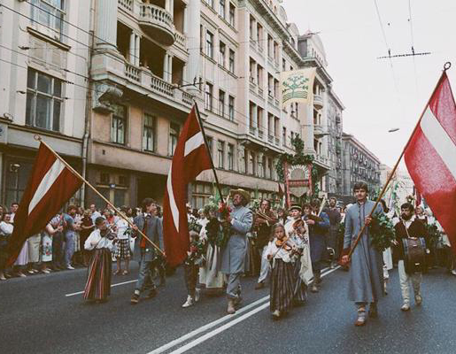
FOLKLORE ENSEMBLE MOVEMENT
In the late 1970s, the folklore ensemble movement originally emerged in the cities.
The aim was to make music in the untouched forms of stylization and music, that at the time, still existed in the countryside.
After the changes caused by the Soviet occupation in Latvia, the movement was aimed at strengthening national and cultural identity.

Slide 9
SOURCES
https://enciklopedija.lv/skirklis/27966-latviešu-tautas-mūzika
https://enciklopedija.lv/skirklis/27966-latvie%C5%A1u-tautas-m%C5%ABzika
https://enciklopedija.lv/skirklis/27875-m%C5%ABzika-Latvij%C4%81
https://lv.wikipedia.org/wiki/M%C5%ABzika_Latvij%C4%81#M%C5%ABzi%C4%B7i

Slide 10
Thanks for your attention

