Slide 1
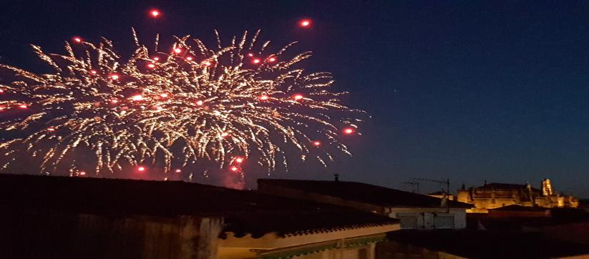
PLASENCIA LAND OF HERITAGE

Slide 2
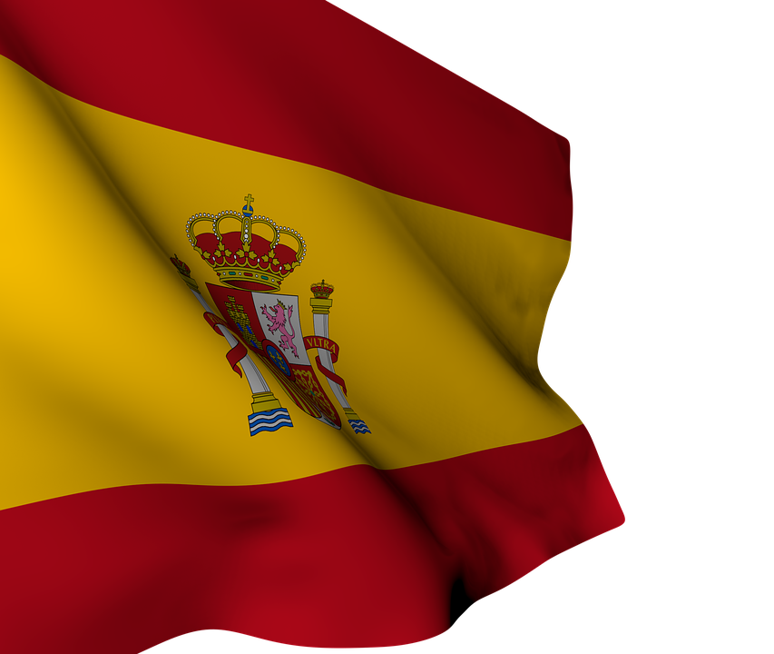
SPAIN
Spain is our country. It is famous because of our gastronomy, bullfighting and flamenco music. But there are also many monuments to see and museums to visit like El Parque Gaudi in Barcelona and El Retiro in Madrid.
Spain’s economy is the thirteenth largest in the world and it relies much on tourism and agriculture. Our country is the second most visited country in the world, thanks to our fantastic weather and the kilometres of coast. The most visited places in Spain are the Alhambra in Granada, The Sagrada Familia in Barcelona, the Mosque in Cordoba, the Prado Museum in Madrid, the Guggenheim Museum in Bilbao and the Cathedral in Seville.

Slide 3
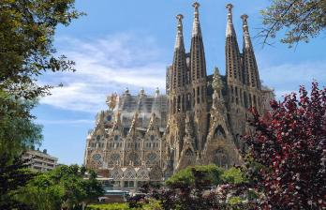
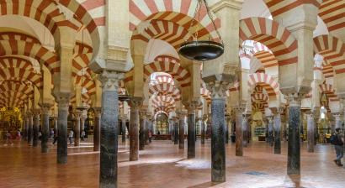
SPAIN’S MOST VISITED PLACES
ALHAMBRA (Granada)
Sagrada Familia (Barcelona)
Mezquita (Córdoba)

Slide 4
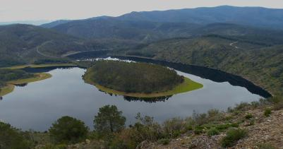
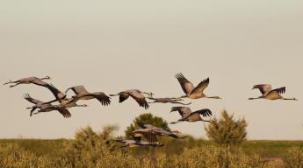
PLASENCIA (Extremadura)
Our autonomous community, Extremadura, is located in the centre west of our country. It is made up of two regions, Cáceres and Badajoz. Plasencia, our city, is in the north of Cáceres. It is not a dry area as many people think. We are surrounded by rivers, natural gorges and mountain ranges, so there is a lot of green. There are 40,141 inhabitants in what people call “La perla del Jerte”, “the pearl of the River Jerte”

Slide 5
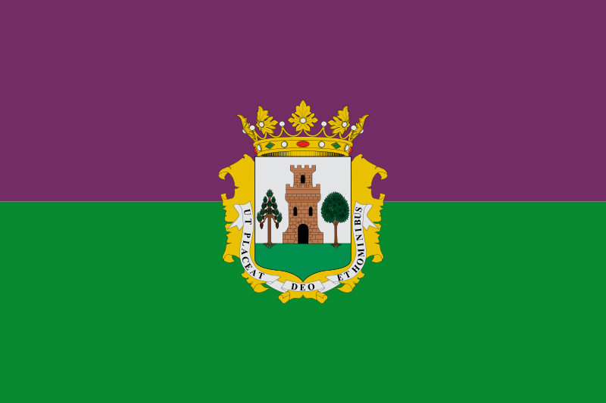
PLASENCIA’S FLAG AND ETYMOLOGY
FLAG: it is divided into two parts, with Plasencia’s badge in the middle; its top part is magenta and its low part is green.
MOTTO: It was created by Alfonso VIII for Plasencia at the end of the 12th century. The motto is written in Latin. It says: “Ut placeat Deo et hominibus”; that means: “To please God and humans”
BADGE: It is one of the oldest badges of the province. Alfonso VIII described it like:
“In a silver field, a golden tower, accompanied by an uprooted pine tree on its right, and an, also uprooted, holm oak on its left. On the top, an open royal crown”. The badge also has the city’s motto on it.
Ut placeat Deo et hominibus
ETYMOLOGY: The name of Plasencia comes from its motto, specifically from the Word “placeat” (to please).

Slide 6
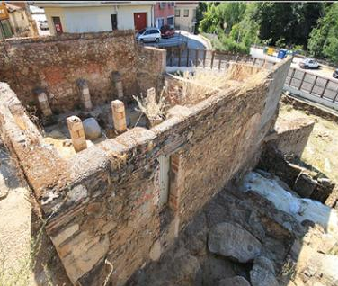
BEFORE ALFONSO VIII
•Near the city there is an archeologycal site of the Neolithic or the age of bronze, called Boquique cave.
•Plasencia has been inhabited by different Pre-Roman nations like Celts or Vettones.
•During the Roman Empire there was a military base, due to the ``Vía de la Plata´´, whichis an old way that joins the north and the south of the Iberian peninsula.
•Next, it became an Arabic fortress.
•Some ruins of an Arabic tower have been found next to the Trujillo bridge and little countryside houses next to it. And a church of Saint Mary with a mill is mencioned, too.

Slide 7
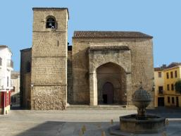
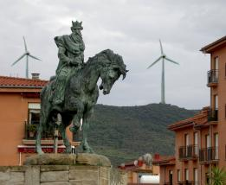
Plasencia after Alfonso VIII
Plasencia's history started in 1186, when king Alfonso VIII of Castile founded the city after conquering the place from the Almohades. There is an Alfonso VIII statue galloping a horse in his honor.
San Nicolás church
In this era many convents, churches, hospitals, and the cathedral, later called "Old Cathedral" were built.

Slide 8
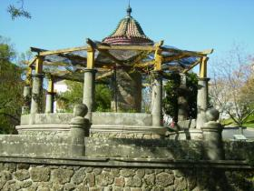
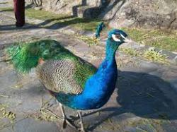
History: the 20th century
In the Spanish Civil War, Plasencia was
not subject to dispute between the two sides.
The prisoners of the republican side
were later employed in forced labour to
build the park of Los Pinos.
The second half of the twentieth century
was a period of extraordinary development
for Plasencia. In the same period it doubled
its population

Slide 9
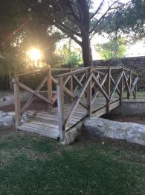
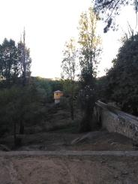
PINOS PARK
The City Hall of Plasencia wanted to building a tank of water in 1903, with a capacity of 1250 m3.
In October 1918 they started to plant some pines and other trees. In 1937 the City Hall of Plasencia through its Managing Commission created The Pinos Park.

Slide 10
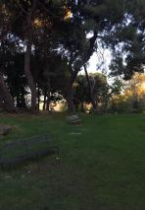
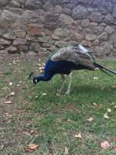
In 1991 the Extremadura’s Comittee gave it the honour of zoo but nowadays it is not a zoo. Our city hall wants to transform it into a place where you can walk and the main characteristic will be the water. We don't have the new idea on a physical design yet so the Park that we have is a huge green zone where there are birds such as peacocks or ducks and you can walk around them but only if you respect the animals because the Pinos Park is their home and we are only visitors.

Slide 11
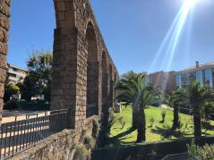
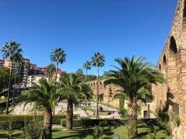
ACUEDUCT OF PLASENCIA
It is one of the most representative monuments in Plasencia. It is located on the north side of the town, near the old encampment.The origin of this historical monument is not Roman. It is from the medieval age. It was built in the 16th century. The acueduct took water from the mountain range of Cabezabellosa and El Torno.
The acueduct went from the range to the fortress of Don Luis de Ávila and Zúñiga, near Plasencia, where there was a tank of water and that water went from the tank to public fountains.

Slide 12
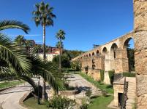
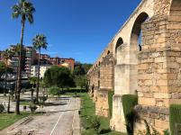
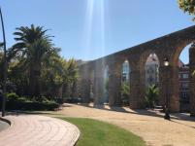
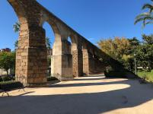
ACUEDUCT
It is made of semicircular arches and keystones. Its height is 18 meters in their highest point and its Length is 300 meters.
During tha Spanish Civil War, bombs destroyed many arches. Nowadays we still have 55 arches, seven of these 55 arches are on the Virgen del Puerto's hospital.

Slide 13
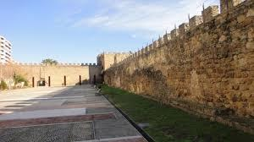
TORRE LUCÍA
It's the oldest building of Plasencia. It was built about the 10th or 11th century and it had an important mission, because when someone saw any enemy or Plasencia was attacked, people lit a fire on their towers to report their allies from the attack.
And the merchants came to Plasencia to sell their products and stayed save.

Slide 14
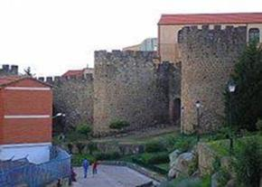
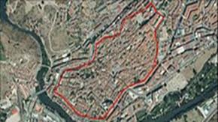
THE WALLS AND THE DOORS
People started to built the walls in the year 1178. But the wall wasn't totally built until the year 1196. The surface of the whole wall is 26,3 ha. The wall tour is disrupted by eight doors, called, Saint Anton´s door, Santiago´s door, the Door of El Clavero, Talavera´s door, Trujillo´s door, Coria´s door, Sun´s door, and Berrozanas´door.

Slide 15
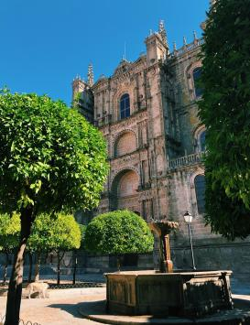
CATHEDRALS
Plasencia’s cathedral is one of the city’s most popular architectural landmarks and it is actually made up of two cathedrals: The old cathedral and the new cathedral.
In this photo you can see the new one. Its construction began in 1498 but it wasn’t completed until 18th century.

Slide 16
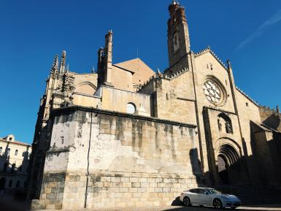
CATHEDRALS
This is the old one. It began in the 13th century and it was restored in the 15th century. This cathedral is a fusion of two architectural styles:
Romanesque
Gothic
Nowadays It is mainly a museum.

Slide 17
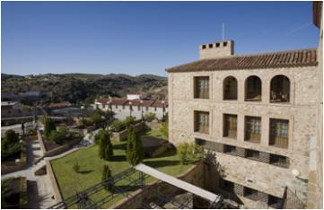
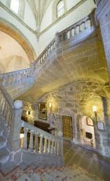
PARADOR
·The Parador of Plasencia is an old
gothic style convent built in the 15th
century.
·It was built on the banks of the Jerte
river and founded by the Zuñiga family.
·The Parador has many interesting places to see, but one of the most important is the “Ladder Flow”, which is unique in the world.

Slide 18
MAIN SQUARE
It is located in the centre of Plasencia, in the ancient and historical part of the city.
The most prominent part of the square is the Town Hall,situated in the back part of this photo.
In the Main Square you can also find many benches, clothes shops, bars and restaurants.

Slide 19
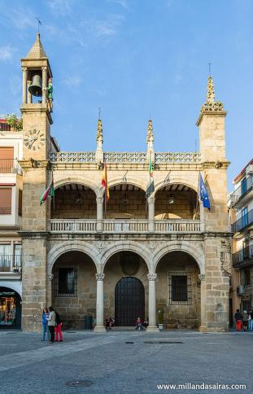
TOWN HALL
It is located in the Main Square. The Town Hall is Renacentist. It was built in 1523, and rebuilt in 1966.
In the highest tower you can see a big bell and next to it you can see an sculpture of a man. He is called Abuelo Mayorga.

Slide 20
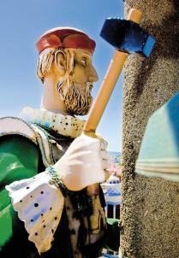
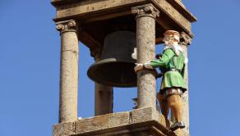
ABUELO MAYORGA
It was built in the 13th century. It is placed in the highest tower of the Town Hall in the Main Square. Next to it there is a big bell. Every hour, Abuelo Mayorga rings the bell, hitting it slowly with a hammer that he carriess in his hand.Abuelo Mayorga has become a characteristic icon of Plasencia.

Slide 21
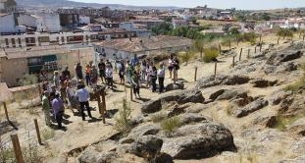
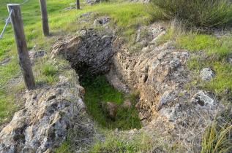
JEWISH CEMENTERY
Plasencia’s Jewish cementery was built in the 12th century and it was used until 1492
This Jewish cementery is located
outside the city, in the area of
El Berrocal.
They built it there because it was oriented to Jerusalem

Slide 22
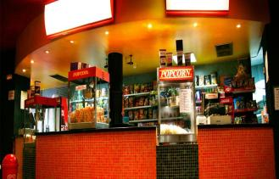
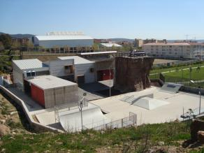
ENTERTAINMENT
⧫In a city like Plasencia, there are few places dedicated to entertainment.
For instance, the cinema and the theatre, which have improved throughout the years. ⧫However, a few years ago, a couple of organisations were created to aim teenagers to develop their artistic side.
-The Factoria focuses on the physical part, with activities such as rock climbing, parkour and hip-hop.
-The Casa de la Juventud was also created for this goal and it offers, for example, painting and IT lessons. There are many other workshops and they are getting really popular among teenagers.

Slide 23
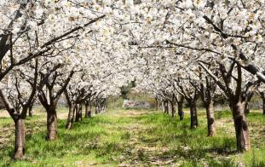
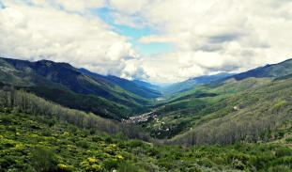
THE JERTE VALLEY
Next to Plasencia there is a river called the Jerte River that flows along the Jerte Valley. This valley is famous because of our cherries. The villages that surround the Jerte Valley harvest the cherries and then they sell them around the whole world. The best season to come to visit the Jerte Valley is in spring because the cherry trees blossom and you can see the mountains like a big mountain full of snow because the cherry trees’ flowers are white.

Slide 24
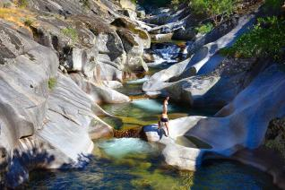
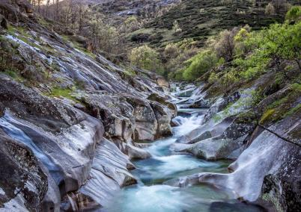
NATURAL GORGES
Also many tourist come in summer to visit the naturals pools that the river makes along the Jerte Valley to spend the whole day with their family and take a picnic. The most famous one is called Los Pilones.

Slide 25
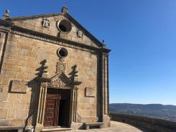
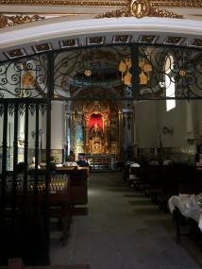
VIRGEN DEL PUERTO HERMITAGE
It is a beautiful building of the 18th century. On the main facade we can see a pediment with an oculus in the centre, an a shield on each side, the shield of Plasencia and the shield of Los Marqueses de Mirabel.
The main altar of the sanctuary of the Virgen del Puerto has a curved altarpiece at both ends, has 3 columns on the sides and is of the classic and golden style

Slide 26
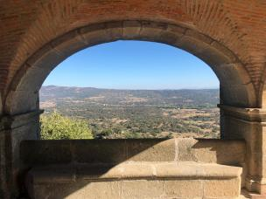
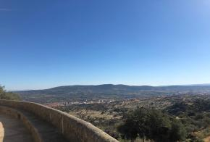
THE EXTERIOR OF “LA VIRGEN DEL PUERTO”
The exterior of the hermitage is built as a stone wall with a walk around the entire hermitage and allows you to contemplate spectacular landscapes. You can see the pasture, the city of Plasencia and the beginning of the Jerte Valley
It is located in the meadow of Valcorchero in a spectacular place of cork oaks. It is built right in the port of the old medieval road that linked the city of Plasencia with the Roman road of the Vía de la Plata

Slide 27
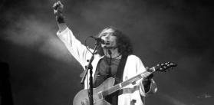
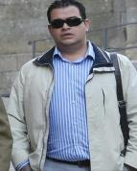
WELL-KNOWN PEOPLE
Extremoduro is a Spanish rock band created by Roberto Iniesta, who is from Plasencia . The band is considered as one of the most important ones in Spain .“ La ley innata” and “Material defectuoso ” are some of their most important projects and they have won several awards .
Inés de Suárez conquered Chile and she was the first woman going to America
Juan Mora is a bullfighter.
There is a Spanish reality show that follows the life of some gipsy families called “ The Gipsy Kings “ . One of the families is from Plasencia , so many of the scenes are recorded in our city .
Enrique Tornero Hernández is a paralympic swimmer that won 3 medals in the Paralympic Games between 1996 and 2000 .

Slide 28
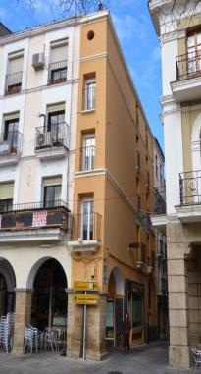
Some curious facts
The narrowest house in Spain
It is a three-floor house painted in
yellow vanilla.
You can see it in the Plaza Mayor, on
the corner of Los Quesos Street

Slide 29
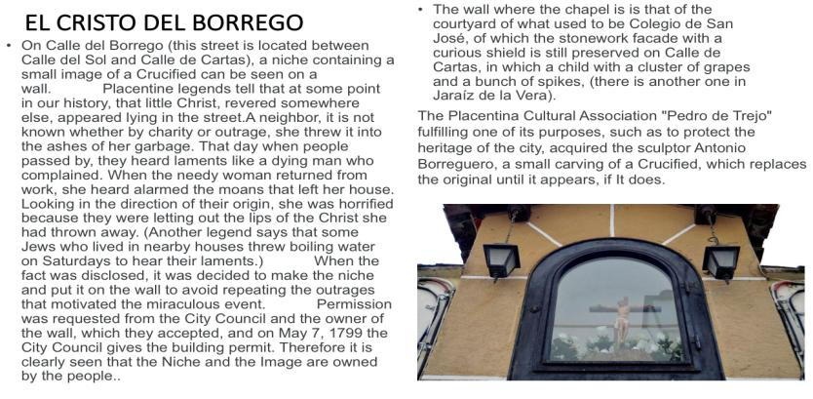
SOME CURIOUS FACTS

Slide 30
SOME CURIOUS FACTS

Slide 31
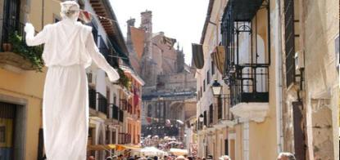
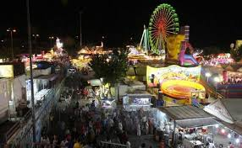
MARTES MAYOR AND FERIAS
In the Martes Mayor market we can find the best selection of agricultural products, fruits, vegetables, etc. We also find handicrafts, sweets, spirits, and all kinds of typical products ...
The Ferias usually coincide with the second weekend of June. Children can enjoy with the "cacharritos", also installed in the Berrocal. There are cheerful “cañas” in the downtown area in the morning with comparsas, charangas and peñas..

Slide 32
Our school: Perez Comendador School
This High School is at 20 “Virgen del Puerto” avenue in Plasencia.
It is made up of several buildings where different classroom are located.
Pérez Comendador High School is named in honour of Enrique Pérez
Comendador, a sculptor who born in Hervás, in 1900.
He got lots of awards. He was married to a famous French
painter called Madeleine Leroux.
Our library is called Madelein Leroux.

Slide 33
The following studies are taught at our High School: General Certificate of Secundary Education (GCSE), General Certificate of Education(GCE), Vocational Education and Taining(VET), Certificate of Higher Education (HNC), related to health, administration and finance, food and pastry, construction projects and clinical diagnostic laboratory.
Since 2004, It has had a bilingual section and
has participated in Erasmus projects,
“Peer support programme” and the “Lobo” project to prevent bullying.

