Slide 1
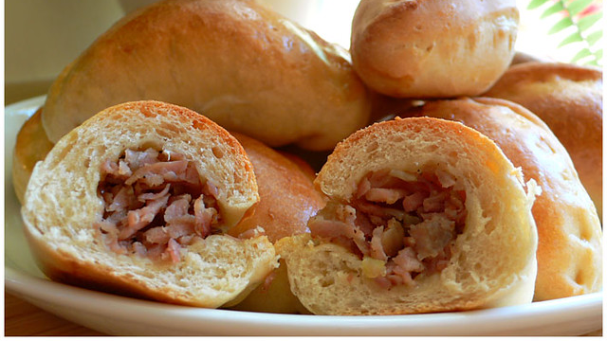
Latvian Cuisine

Slide 2
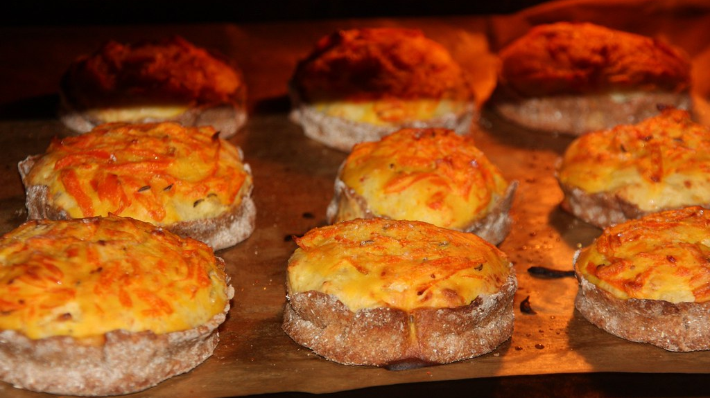
Latvian food characteristics
Latvian food is generally quite fatty and uses few spices. A lot of dishes consist of ingredients like pork, sausages, onions, potatoes, wheat and fish.
Latvia is much richer in milk products than other Western countries.
Fish is one of the main foods in latvia due to the location next to the baltic sea.

Slide 3
History of latvian holiday food
Ancient latvians had 4 main holidays. In every holiday they had specific holiday dish.
In easter they ate colored eggs and boiled peas.
In midsummer or St. Johns day they ate cumin cheese and barley porridge and they drank beer.
In Michaelmas or St. Michael's day they ate ram meat and scones.
In Christmas they ate grey peas and pig snout, beans and blood sausage.

Slide 4
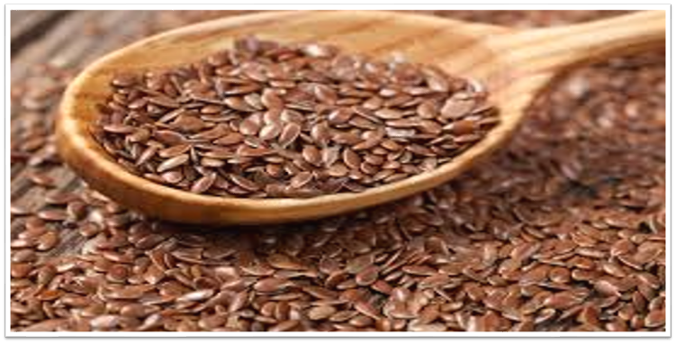
Latvian cuisine 1000 years ago
main raw materials :
Grain crops
Vegetables
Linseed
Livestock and wild animal meat
more than 25 different types of fish
Spices
Snacks

Slide 5
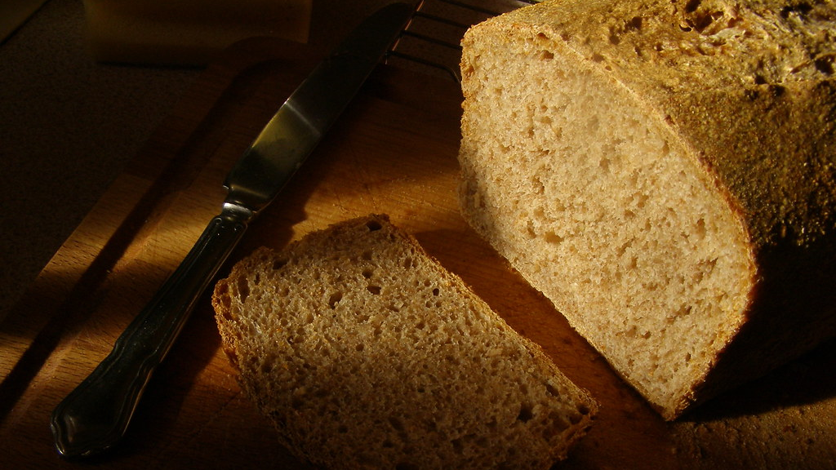
Latvian traditional cuisine favorites
Rye flour bread in Latvia tastes like nowhere else in the world, moreover, rye bread is served at almost every Latvian Dish as an additive. Potatoes, which are prepared and served in different ways - both as a food supplement and as a main course - are an equally common ingredient in many Latvian dishes.
Meat dishes
Desserts
Drinks

Slide 6
Modern Latvian cuisine
Latvian cuisine is characterized by dishes that can be significantly different from those that were eaten several centuries ago on farms.
Porridge, sandwiches and fried or boiled eggs are often eaten for breakfast.
Lunch dish should ideally consist of three dishes - soup, second dish and dessert.
For dinner, thin or thick pancakes are often baked, which are eaten with sour cream, jam or honey.

Slide 7
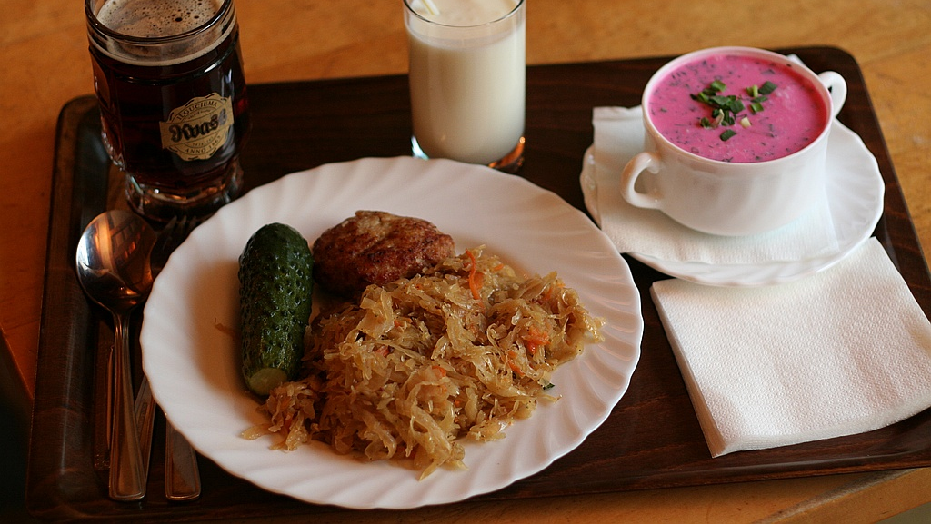
Cold soup
Cold soup is a dish that Latvians love on a hot summer day. It has almost no calories, it is refreshing and it is is very simple to prepare. Beetroots, cucumbers, dill , boiled eggs and kefir. I don’t really eat this soup that much but I like it.

Slide 8
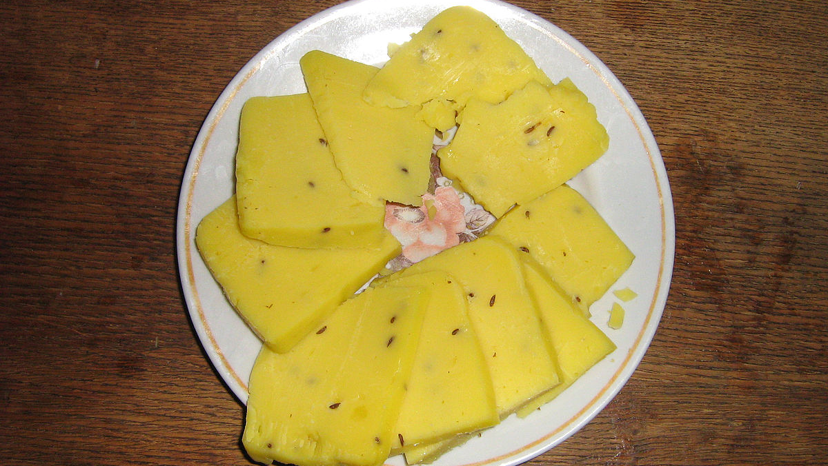
Thank you for your attention

