Slide 1
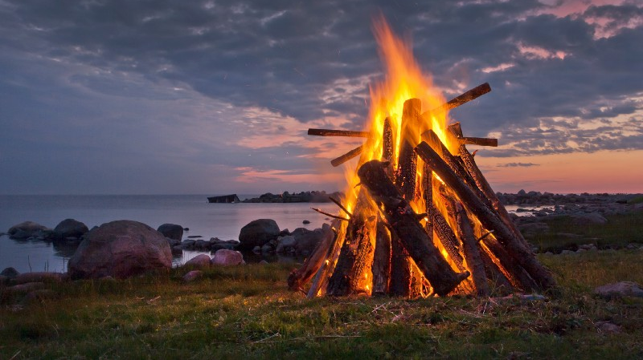
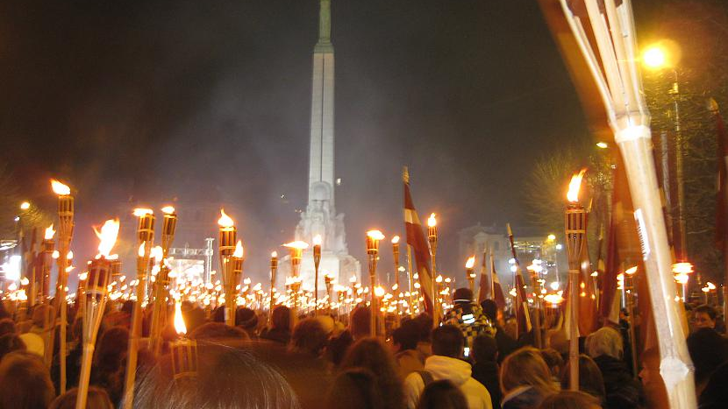
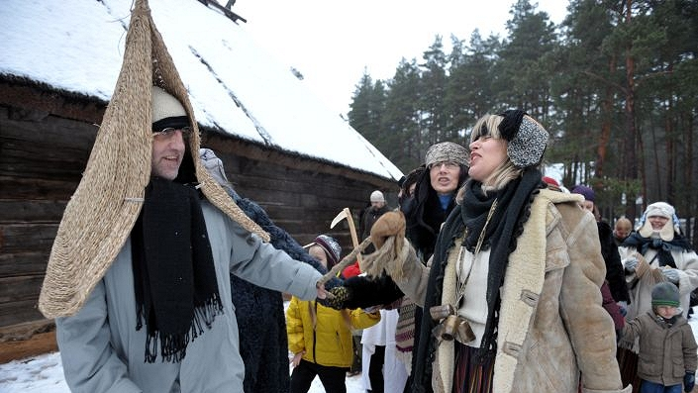
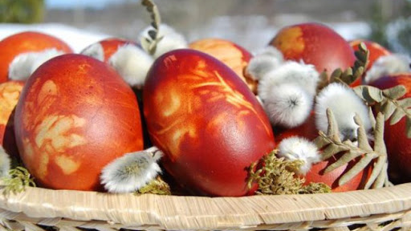
Latvian National Holidays
Edgars J, Monta I, Mētra L, Rudolfs P, Gustavs S.

Slide 2
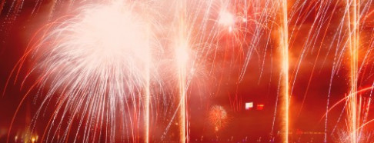
Latvian Holidays
In Latvia there are many national holidays, but we described:
Spring solstics
Jāņi (Midsummer)
Lāčplēša war order day of service
Christmas

Slide 3
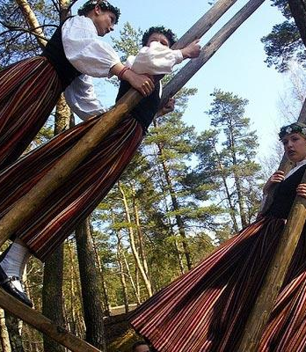
Spring solstics
There is no set exact date for spring solstics but people celebrate it between april 4 and may 8. Generally this is a Christian holiday but over time many Latvians have started to celebrate it. Before spring solstice there is also Silent week (Klusā nedēļa), Pussywillow sunday (Pūpolsvētdiena), Green thursday (Zaļā ceturtdiena), Big friday (Lielā piektiena) and Silent saturday (klusā sestdiena). On spring solstics day, we paint eggs hide and then find, roll and eat them, swing play games and sing.

Slide 4
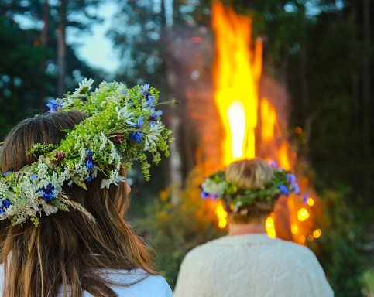
Jāņi (Midsummer)
Jāņi (midsummer) is an annual Latvian festival celebrating the summer solstice. Although astronomically the solstice falls on 21 or 22 June, the public holidays—Līgo Day and Jāņi Day—are on 23 and 24 June. The day before Jāņi is known as Līgosvētki.
Latvians sing, dance, eat and are merry during Jāņi. Cheese with caraway seeds, meat patties and beer are a must for every table. People light bonfires, jump over them and celebrate until the sunrise.
Romantic couples leave the crowd to look for the “flower of the fern”, which is alleged to bloom only in the night of Jāņi.
Women traditionally wear flower wreaths, while men have theirs made of oak leaves or twigs.
https://youtu.be/5u4lPgn73oc

Slide 5
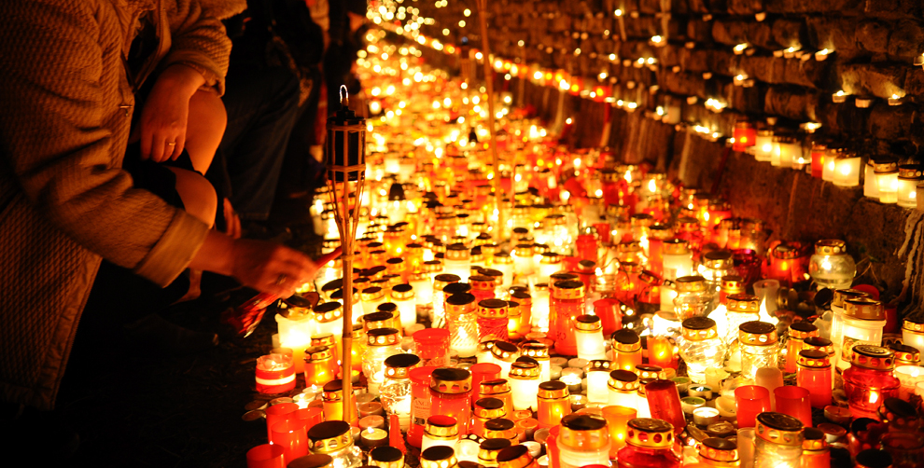
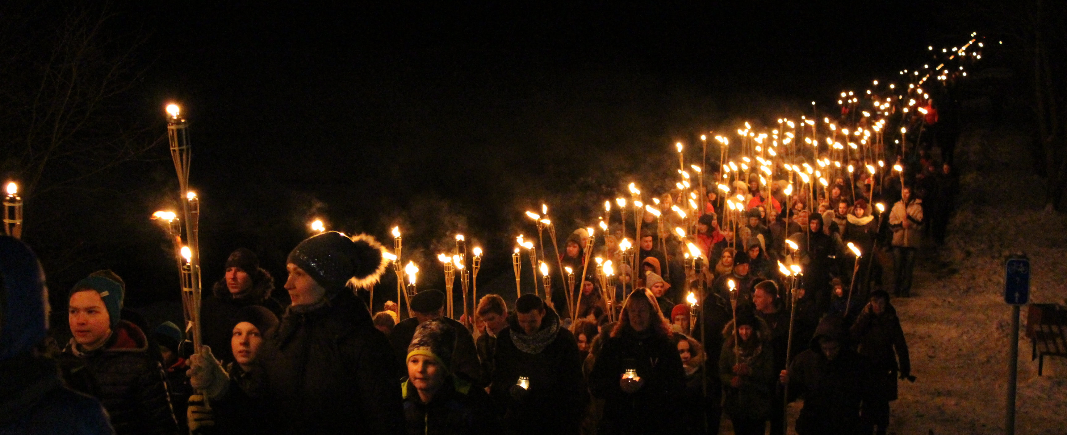
Autumn holidays
In Autumn there are a lot of holidays that are celebrated like Veļu time and Lāčplēša day, but today i want to write particularly about Lāčplēšu day. It was first celebrated in November 11th 1920. when the Lāčplēša war order day of service. One of the oldest traditions on this day is that since year 1988 people gather up and light small candles next to Riga castle wall.
In historical event the Russians tried to invade Latvia in 1919 although the invaders were completely expelled from Latvia only at the end of the year, the liberation of Riga on November 11 is also symbolically considered a victory in Latvia's freedom struggles. A year after that it became holiday in memory of fallen solders and claiming freedom over the country.

Slide 6
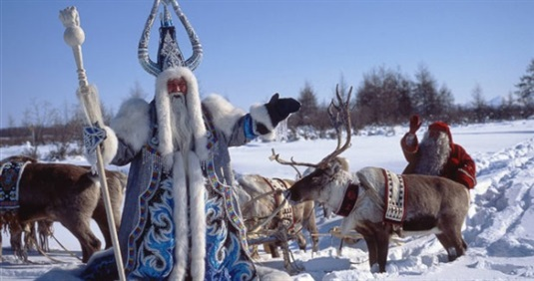
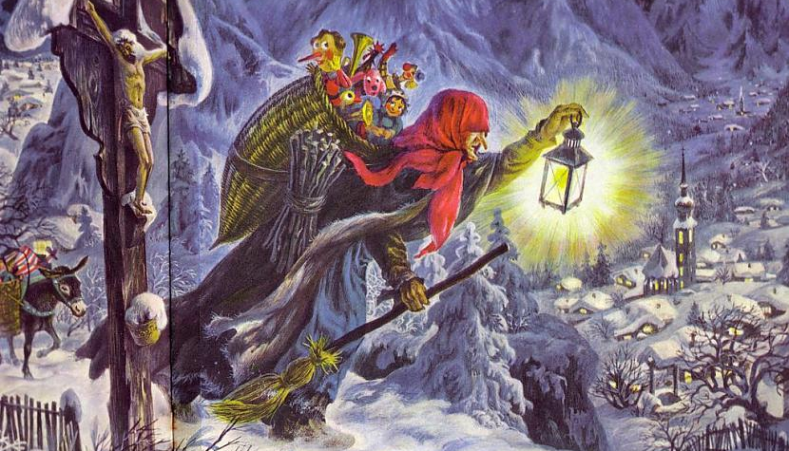
Christmas for christians
A very beautiful holiday in Latvia is Christmas. It is more a Christian holiday nowadays, but ancient Latvians celebrated the Winter Solstice. In Latvia Christmas celebration is a mix of ethnic, religious and modern traditions.
Christian festival celebrating the birth of Jesus. December 25 has become widely accepted as the date of Jesus birth.
Before the holiday, many Christians lent, go to church on the holidays. The time before Christmas is a time of silence, reflection, and forgiveness, it is a time to tidy up the inner world of each person.

Slide 7
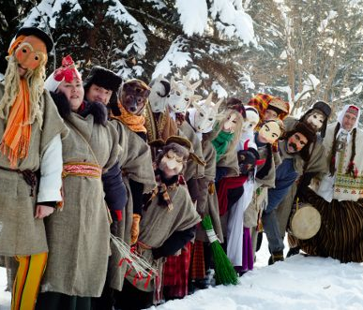
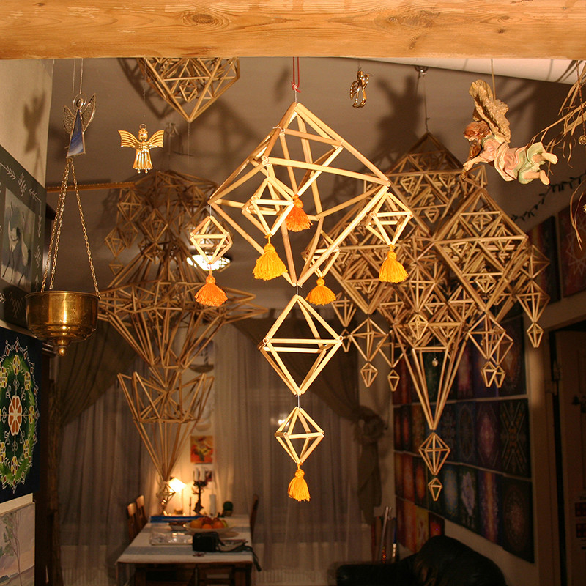
Christmas with Ķekatas
The Winter Solstice occurs when one of the Earths poles has its maximum tilt
away from the Sun. According to pre-Christian Latvian pagan traditions it is the
rebirth of the Sun.
This holiday Latvians have their own traditional food - boiled peas with bacon. On
Christmas Eve, they must be eaten to eat all the tears of the previous year and to be
gone.
Typical ethnic Christmas traditions include participation in “ķekatas” or
mumming. Mummers, who are costumed and wear masks of animals and such
macabre figures as living corpses and death, bring blessing to the households,
encourage fertility, and frighten away evil spirits.
One more tradition is ragging the Yule log. The dragging and subsequent burning
of the Yule log symbolizes incineration of last year problems and misfortunes.
https://www.youtube.com/watch?v=PUz4LawbY5g&amp;feature=emb_logo

Slide 8
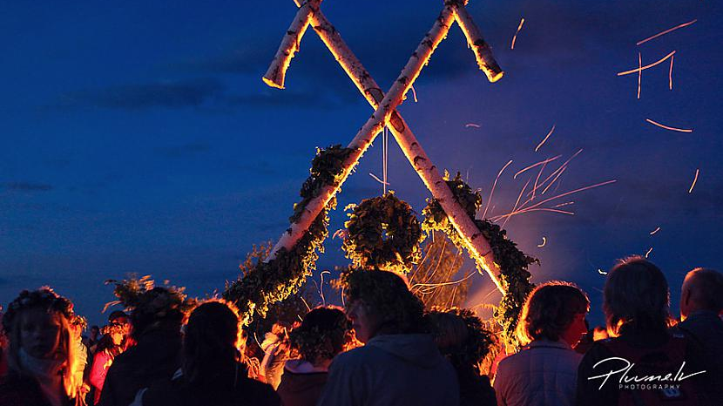
Thanks for your attention!

