Slide 1
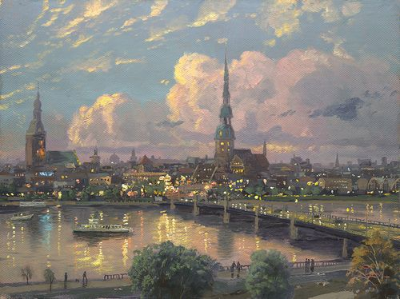
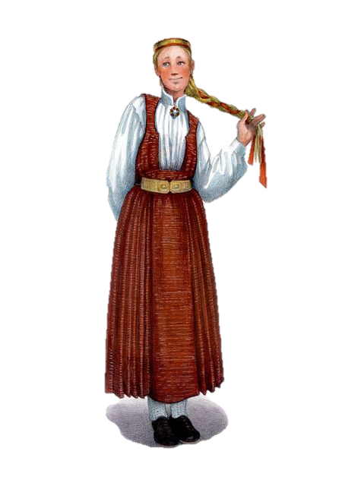
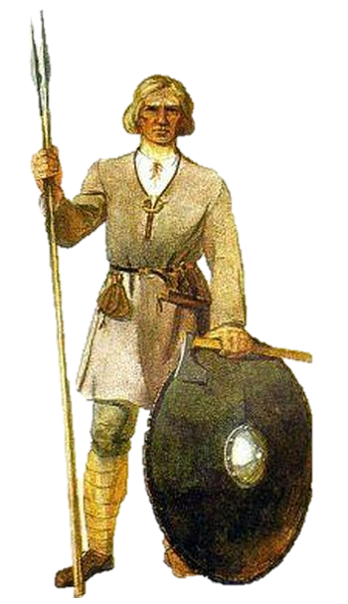
Traditional garments of Latvia
Made by: Elizabete Prauliņa, Elza Andersone, Alise Prokofjeva, Sofija Krūmiņa, Agita Bērziņa

Slide 2
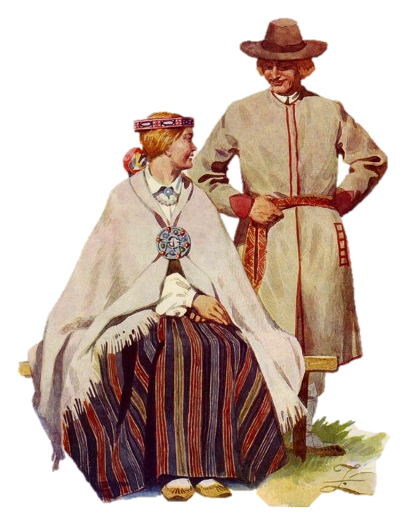
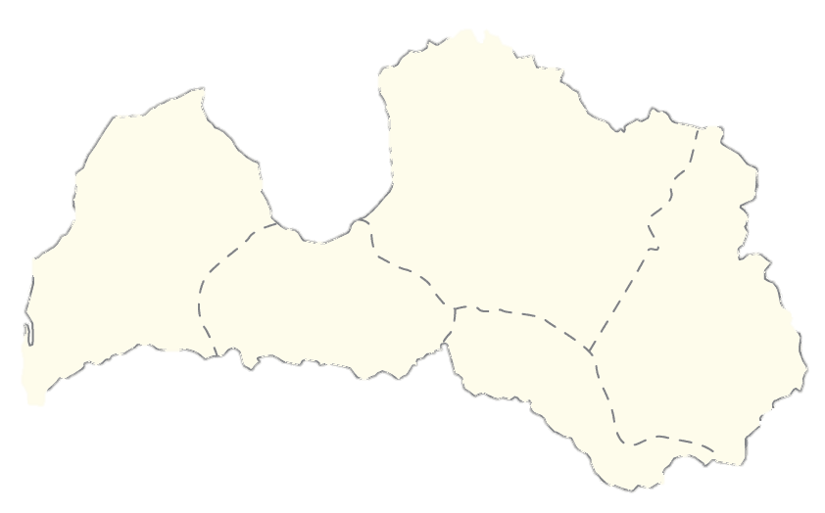
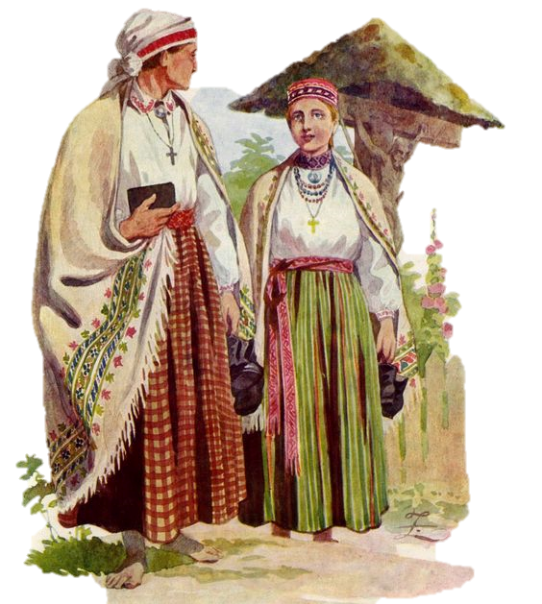
Overview
There are five regions of Latvia. Each possessing their unique traditional garment elements
They’re our national value and cultural heritage
These outfits play a major symbolic role in our countries folklore and history.
( A map of Latvia & its historical regions )
Courland
Vidzeme
Semigallia
Selonia
Latgalia

Slide 3
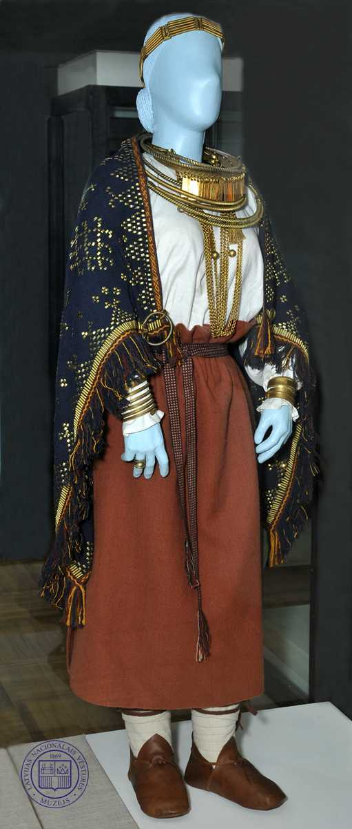
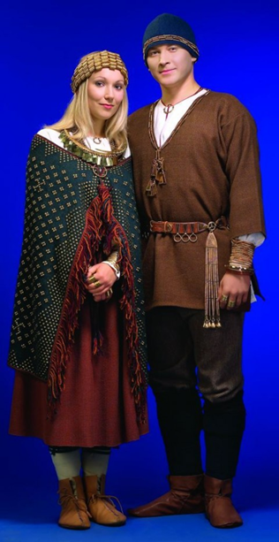
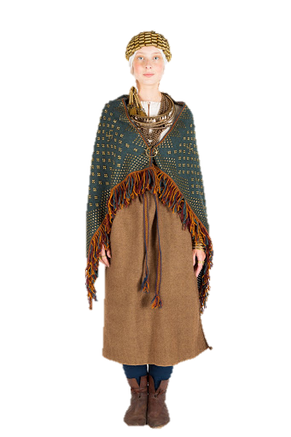
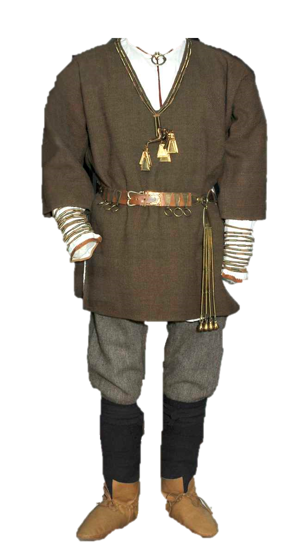
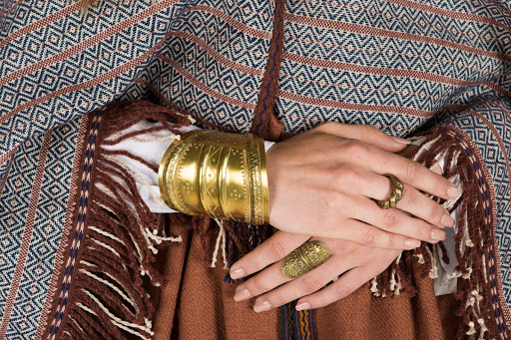
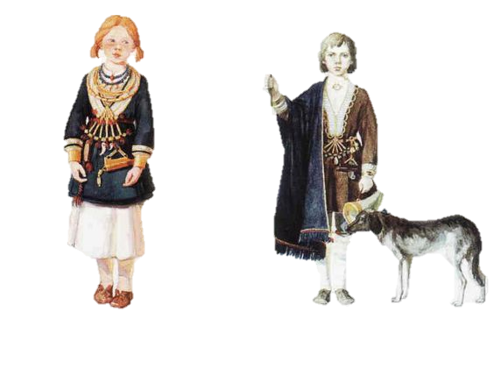
The History
(7th - 13th centuries)
Archaeological garnments
Linen and wool
Bronze jewelery

Slide 4
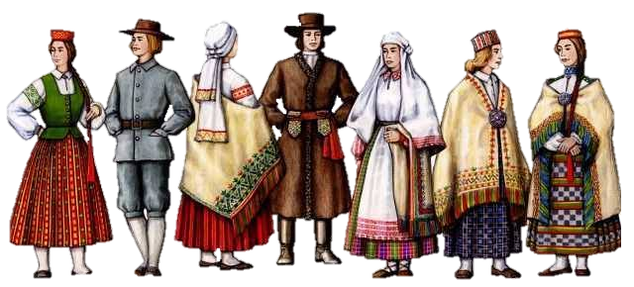
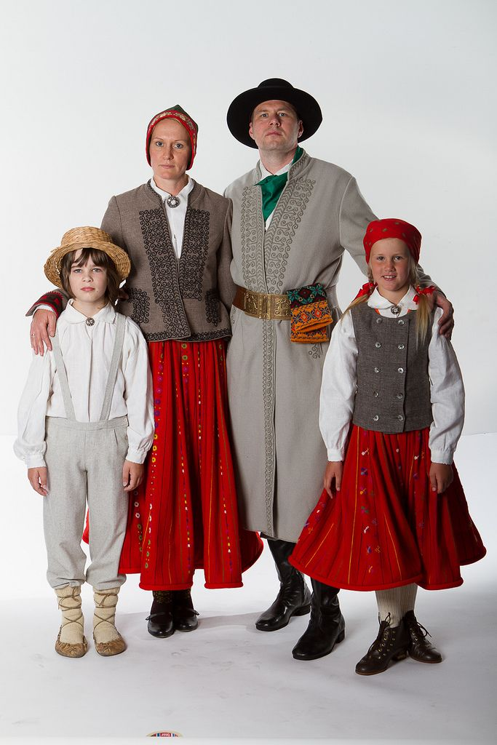
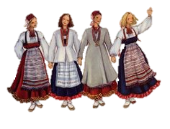
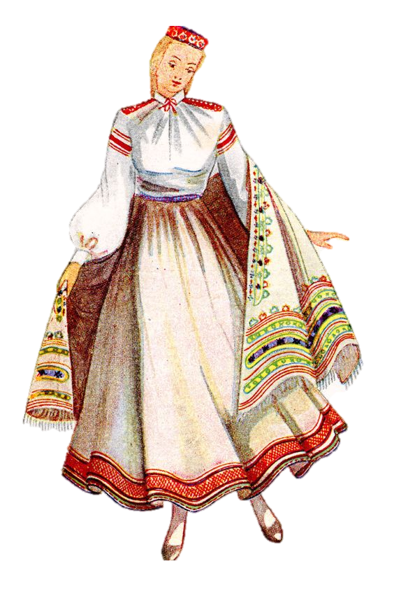
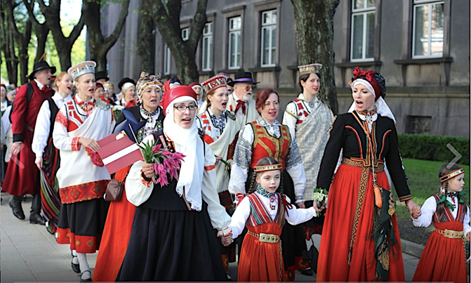
The History
(18 th - 19 th century)
Ethnographic Traditional garnments
German influence
( no bronze jewlery)

Slide 5
Symbols
Double cross
1.
Over centuries traditional garments have evolved reflecting local culture and its changes
Austras cross
Jumis
Lunar cross
Auseklis
Mārtiņa sign

Slide 6
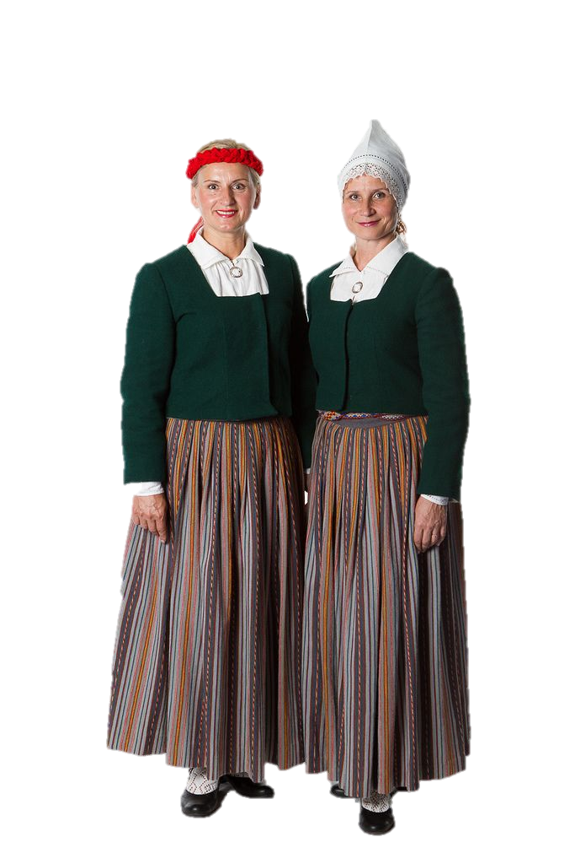
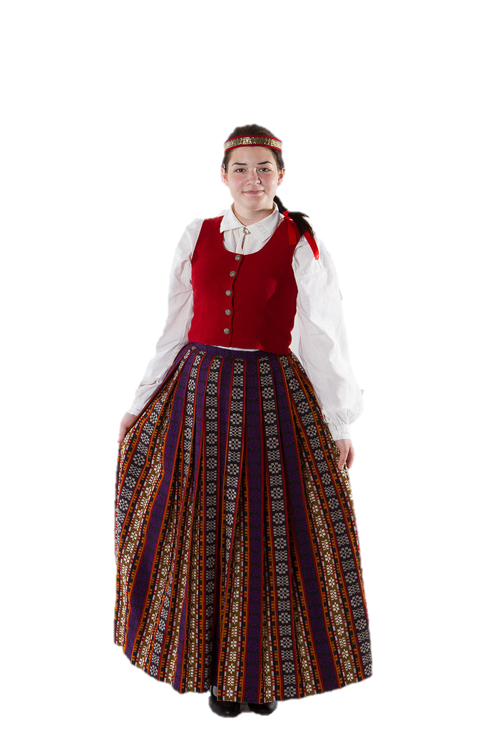
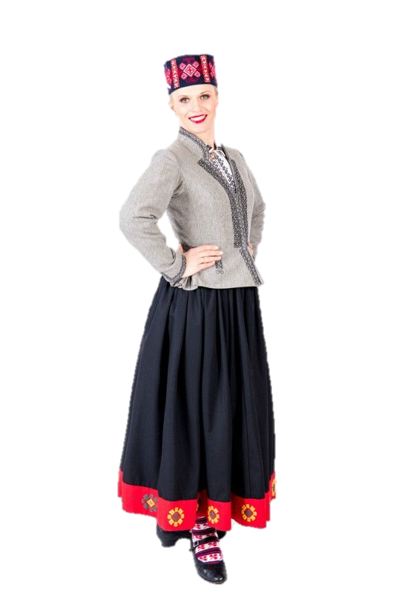
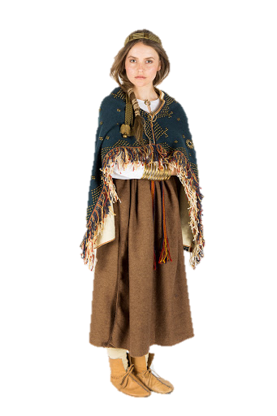
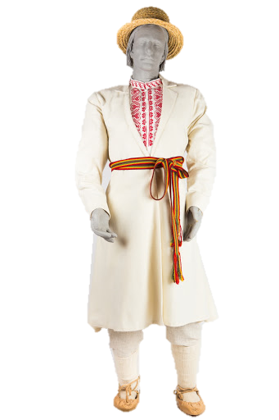
Regional Differences
Latgalia
Courland
Vidzeme
Semigallia
Selonia
Latgalia
Courland
Vidzeme
Semigallia
Selonia
Patterns, plain colours at the hemline with symbols
Flower and colour patterns
Plain colour or checkered pattern
Hemlines have striped/ checkered paterns, aren’t colourful
Small, checkered patterns. Symbols are colourful

Slide 7
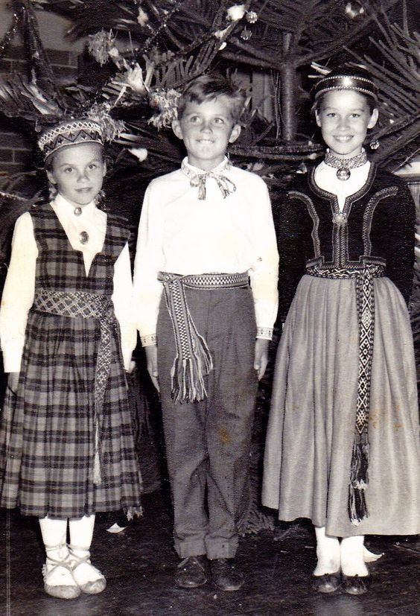
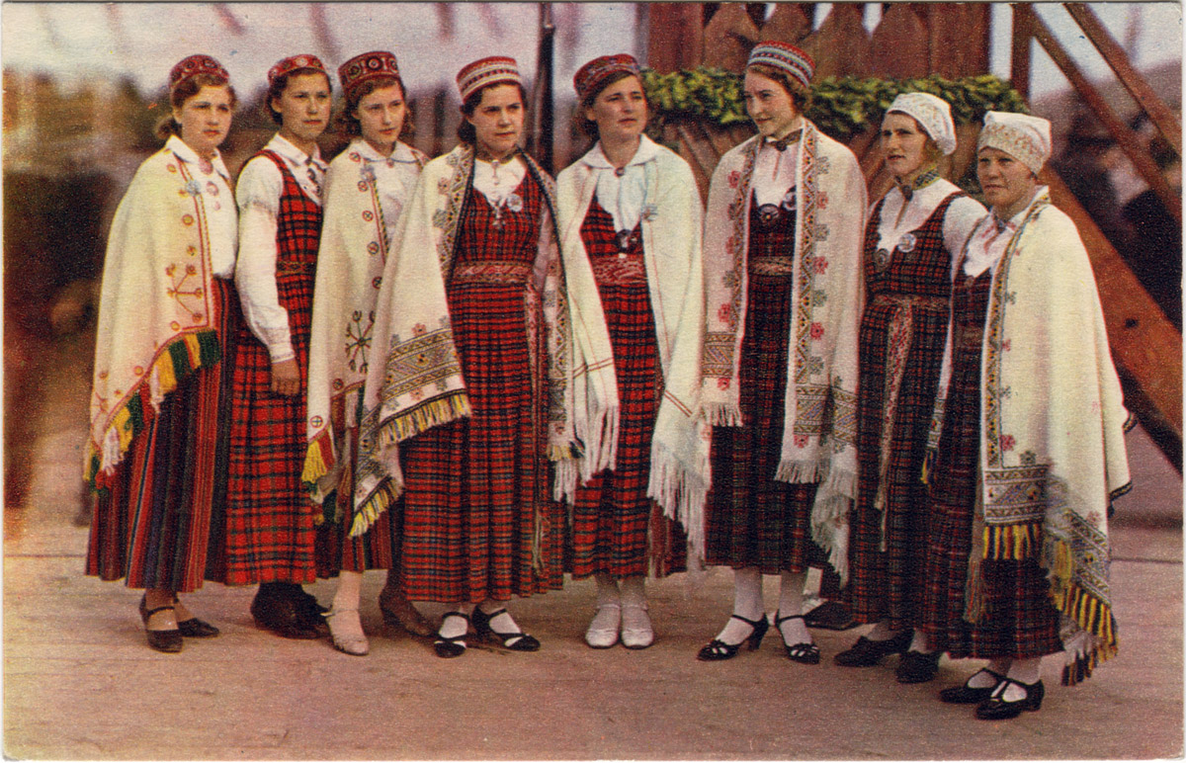
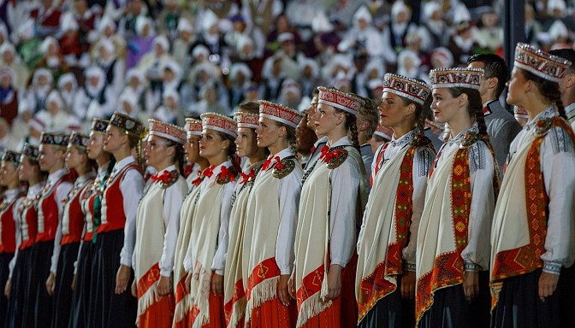
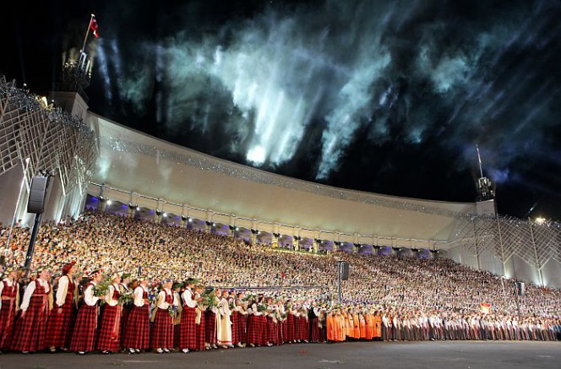
The use of traditional garments
Today many people in Latvia wear these garments both on private and public events
1.
The traditional garments are usualy worn on events with cultural significance :
2.
The first time they were worn as a sybol was at the song and dance festival. The tradition still stands to this day.
Independence Day (18th November)
Summer solstice (20th/21st/22nd June)

Slide 8
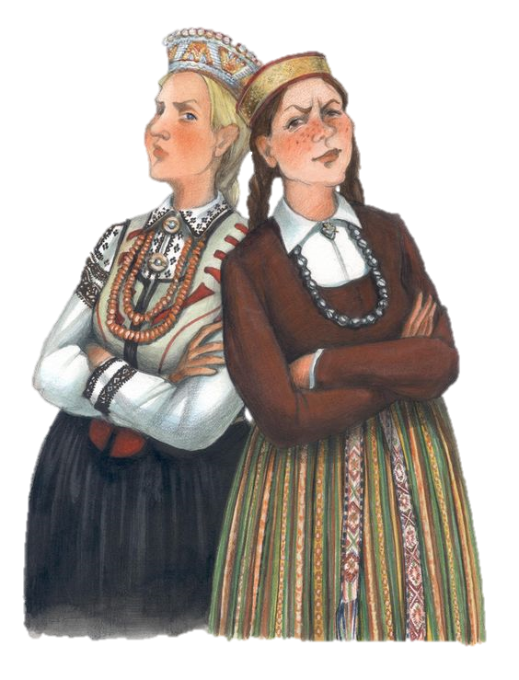
Sources
https://www.latvia.eu/lv/traditions-culture/latvian-folk-dress
http://valoda.ailab.lv/kultura/kultura/lktaut01.htm
http://www.lnmm.lv/lv/apmekle/izstades/7708-rihards-zarins-18691939-ko-latvijas-mezi-salc
https://slideplayer.lv/slide/15551909/
http://www.katramsavutautasterpu.lv/tautasterpi/
https://www.latva.lv/tautas-terpi
https://www.fashionmuseumriga.lv/kaleidoscope/latvian_traditional_costume/

Slide 9
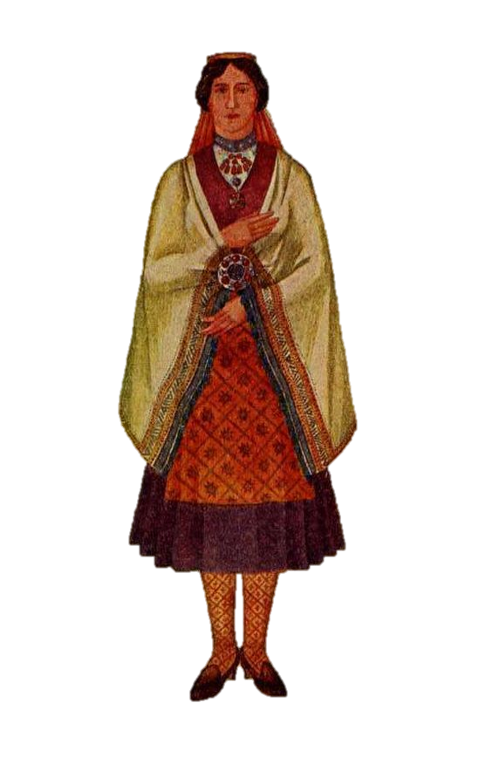
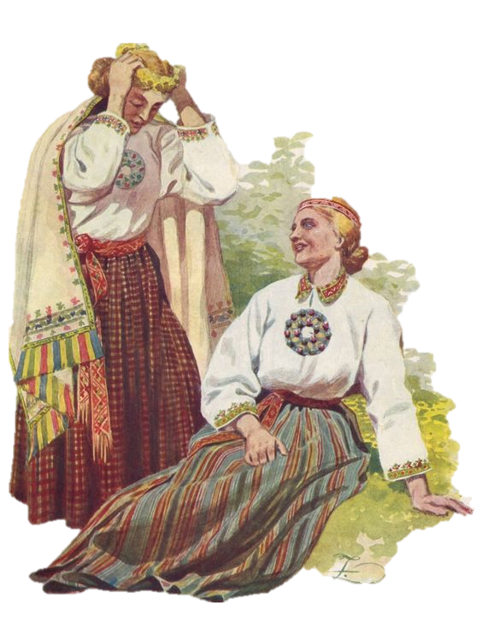
Thank you for your attention!

