Slide 1
Erasmus Plus Azione K2 Cultural heritage: a precious treasure to be preserved, shared and passed on to future generations
Local Traditions and Festivals

Slide 2
The Festival of
Sant’Antuono
ITALY

Slide 3
OVERVIEW:
Festival of Sant’Antuono
Bottari
Pastelessa
The parts of the festival
Raffle

Slide 4
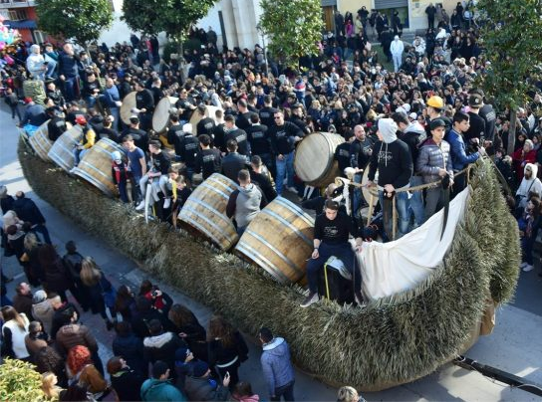
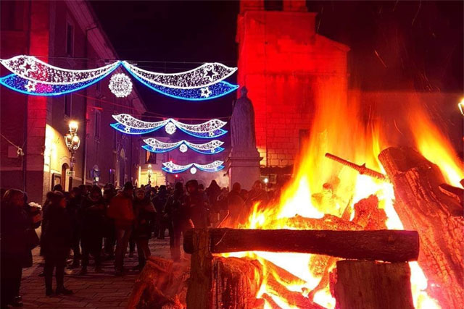
Festival of «Sant’Antuono»
The festival in honour of Sant’Antuono (or Sant’Antonio Abate) is the most important and certainly the most heartfelt festival in Macerata Campania a little town near Caserta
It represents a historical, cultural, artistic-folkloric moment of the entire citizenship and is celebrated on January 17th each year.
A mix of religiosity, folklore, traditions and popular participation, the festival of Sant'Antonio
The event is characterized both by moments dedicated to the cult of the Saint, and by moments of pure and historical popular folklore.
The cult is understood as devotion and veneration, the local inhabitants pay as a tribute to Sant’Antonio Abate
It is characterized by folklore with the typical and incomparable parade of the "Battuglie di Pastellessa", or "Carri di Sant'Antuono" on which there are the so-called "Bottari di Macerata Campania", which reproduce the ancient local music from the homonymous name the "Pastellessa" (or "Pastellesse").

Slide 5
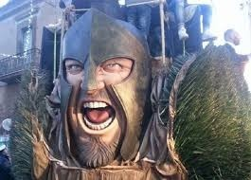
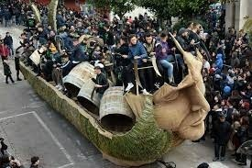
Bottari»
A traditional local festival
The “bottari”, take roots from ancient habits strongly related to agricultural traditions of “Terra di Lavoro”; in ancients times, Macerata, was, above all, an agricultural and artisanal community, where the work in the land required the use of a rich range of equipment and tools, made by local craftsmen who, to prove their solidity, beat the barrels with hammers and with iron tools.
https://youtu.be/Nh054FlHU20

Slide 6
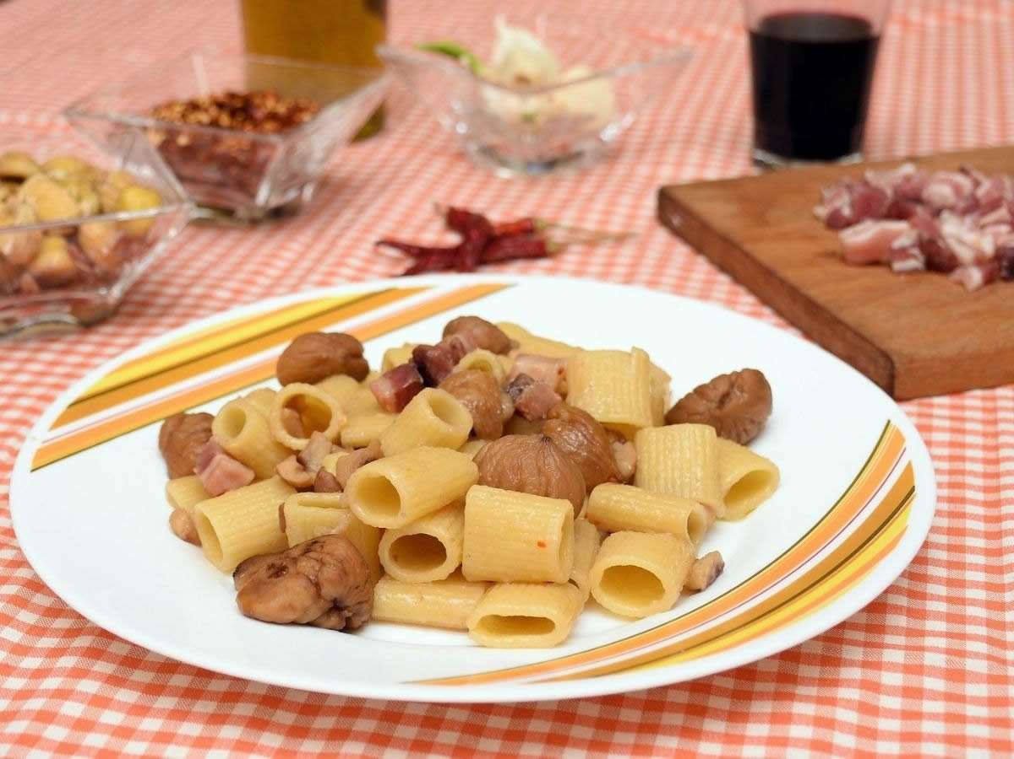
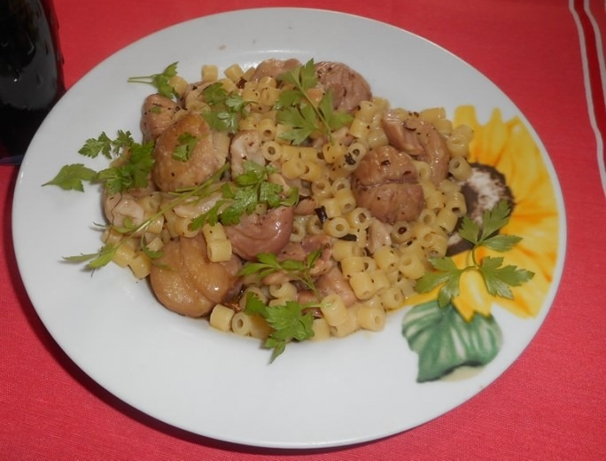
PASTELESSA
Macerata Campania is a small town in the province of Caserta, renamed of “pastalessa”, or pasta with boiled chestnuts recognised as “Intangible cultural heritage”, of Macerata Campania, where the the festival (which has been held since 1300) of Sant Antonio Abate or “Sant Antuon”, as the people from Macerata call him, ended; during the celebrations a parade of the “Battuglie di Pastellessa”, that is allegorical carriages on which the “Bottari” of Macerata perform, is held.

Slide 7
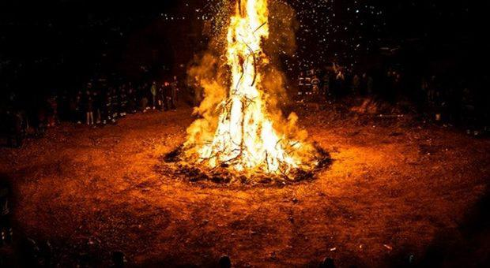
The parts of the festival
The festival in honor of Sant’Antuono is characterized by four moments linked to the devotion and folkloristic tradition of Macerata:
-the fire (Cippo di Sant’Antuono)
-the parade of the Sant’Antuono chariots or the Battuglie of Pastellessa
-the fireworks
-the raffle

Slide 8
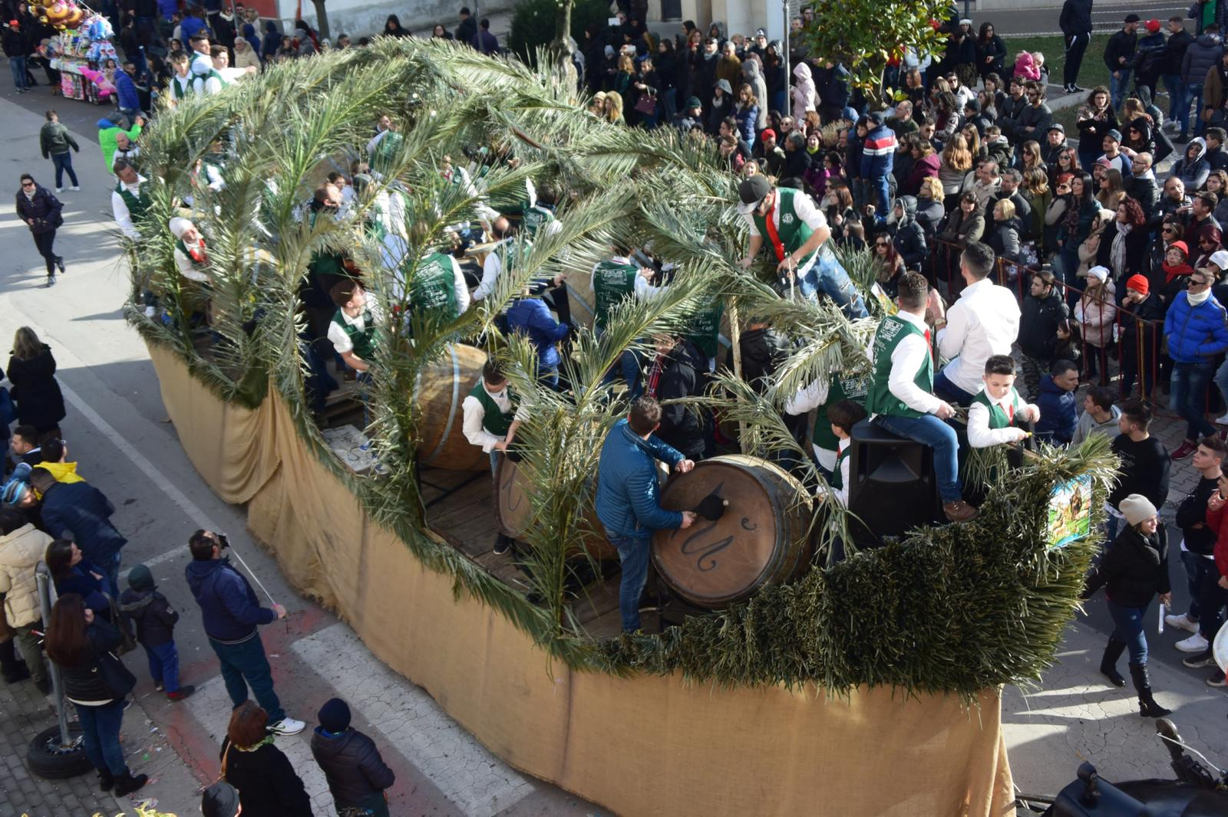
RAFFLE
The (raffle) is the ending moment of all the folkloristic events of the festival dedicated to Sant’Antuono. The festival ends with the auction of all the goods collected during the procession of the saint or offered previously by the population. The proceeds are used to finance a part of the expenses for the festival organization. Here we find the man who sells the goods (riffatore), who with his gestures sells the gift collected in honor of the saint,…

Slide 9
Conclusion
Keeping traditions alive is important for teaching the next generation about a past
that does not have to be lost.
Traditions have to be passed down from one generation to the next as treasures.
Tradition reinforces values.
Tradition enables us to celebrate diversity, and unite as a country.
Tradition serves as an avenue for creating memories that can last for ever
Tradition offers an excellent way to keep people near each others.

