Slide 1
Textile recycling
Lucía González, Iria Ventoso, Uxía García, Marta Paz, Hugo Cortés and Alejandro Fernández.

Slide 2
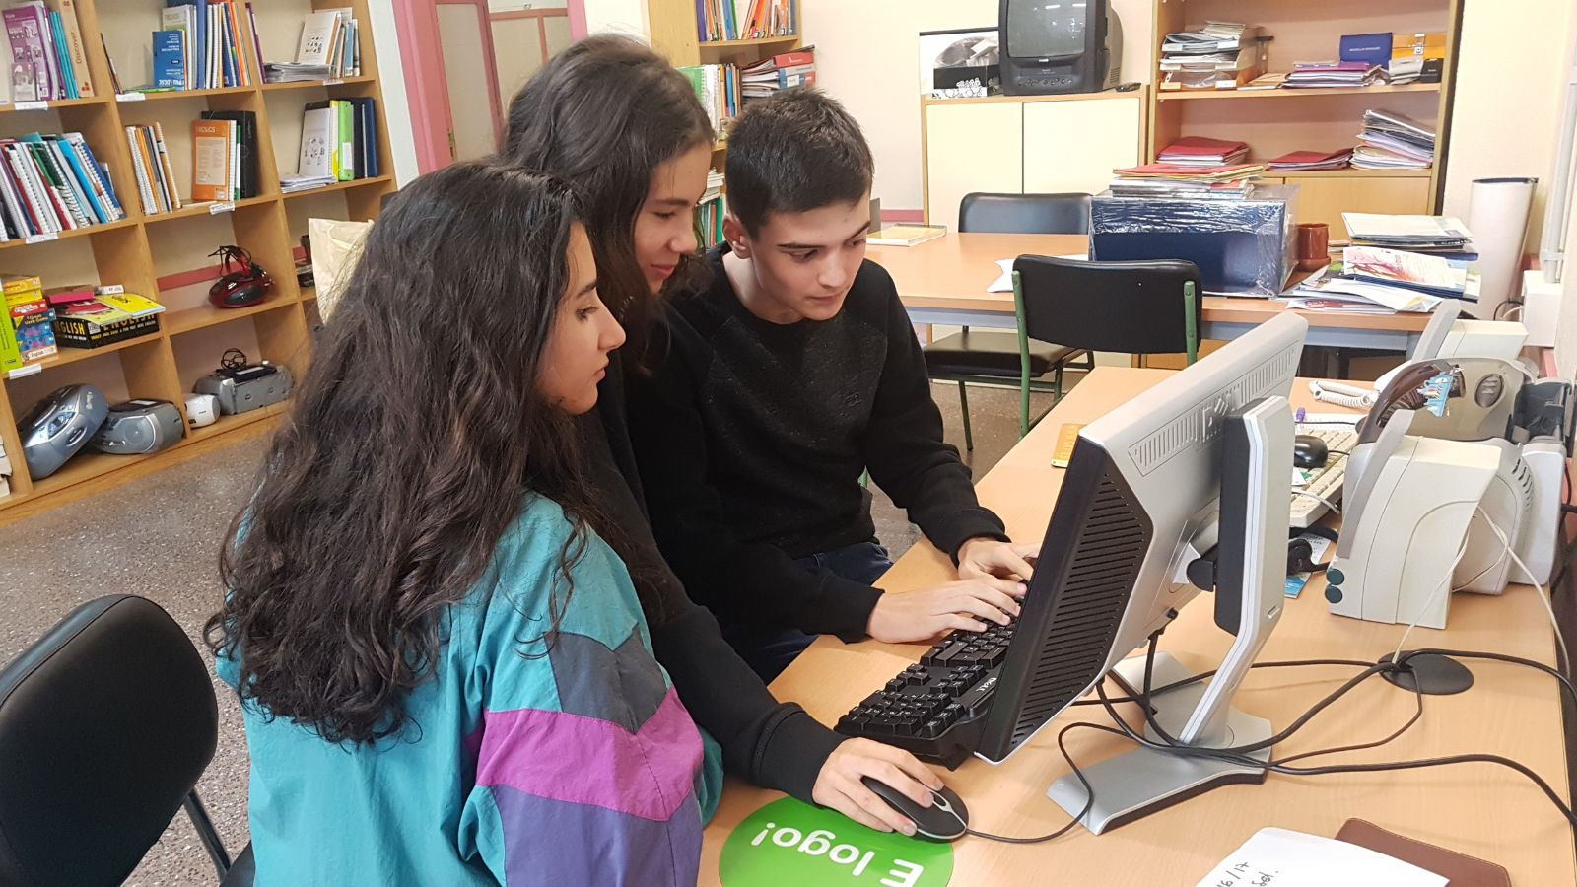
BRAINSTORMING
We searched some ideas on Pinterest App.
We discarded a few of them because of their difficulty.

Slide 3
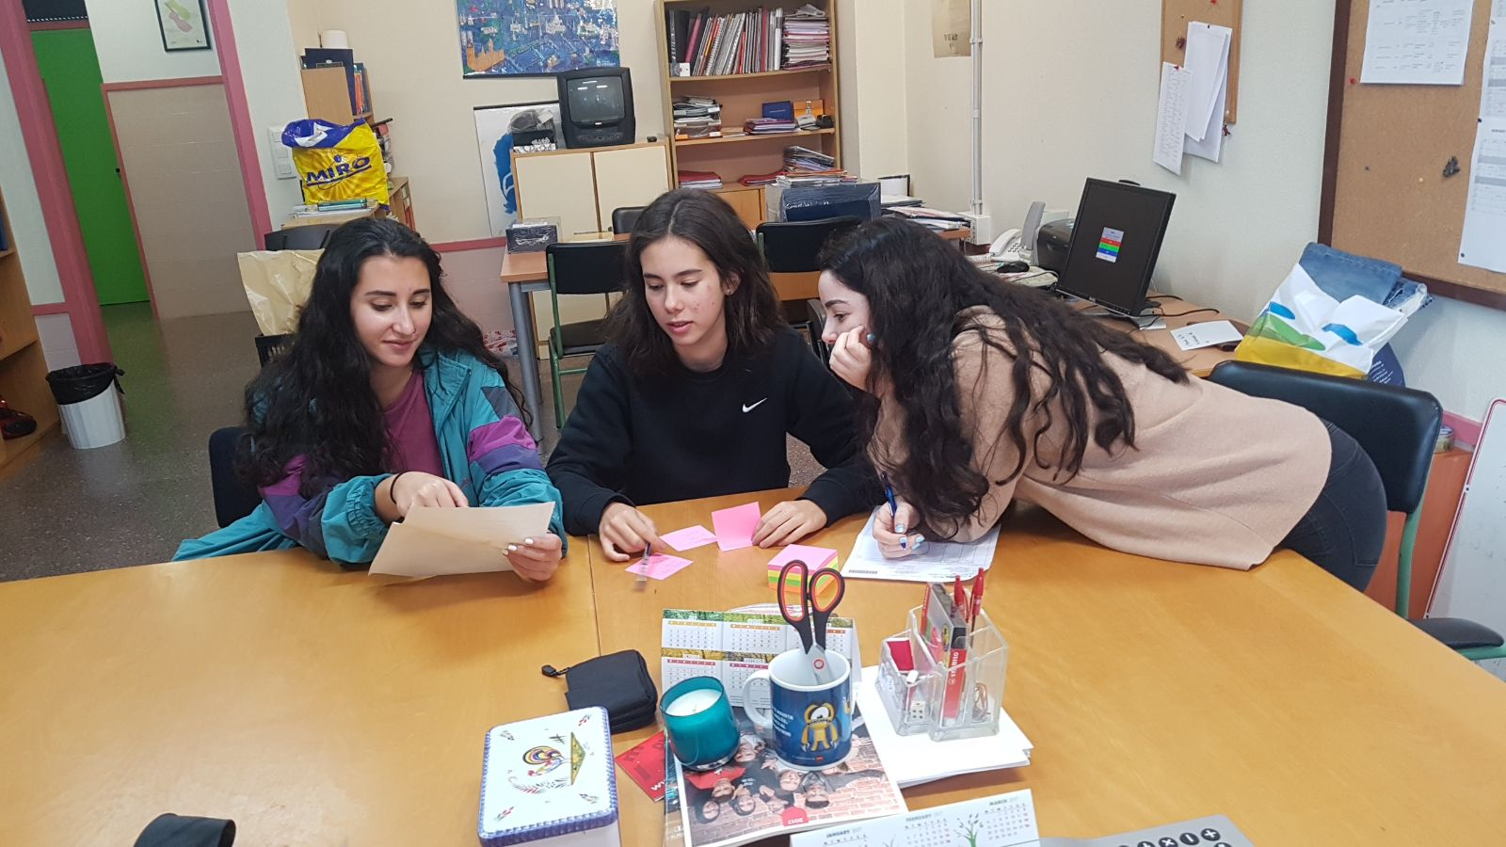
3. We chose two options:
A dress or a skirt made of ties
A waistcoat made with old jeans

Slide 4
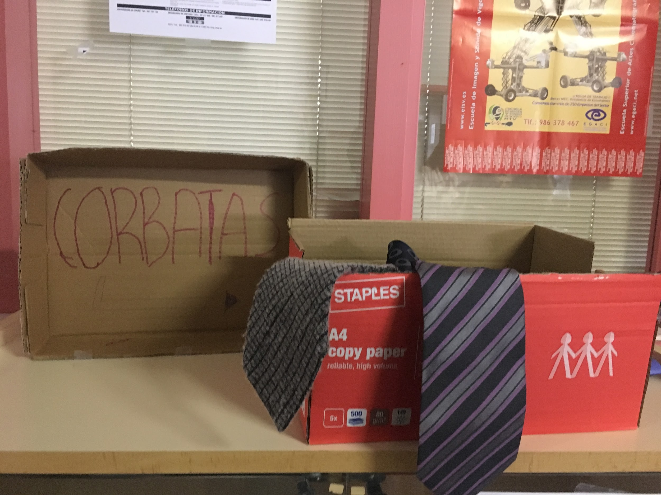
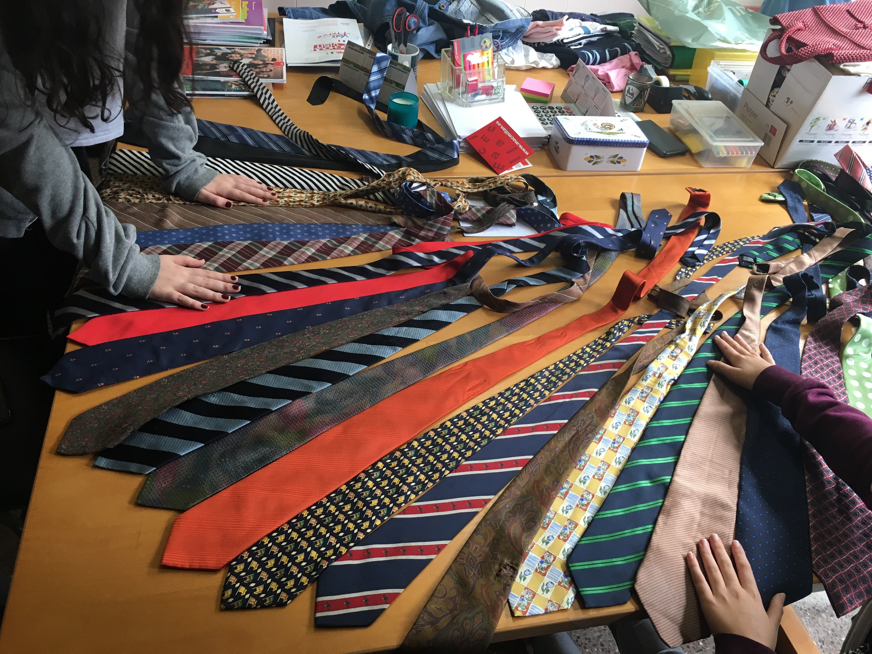
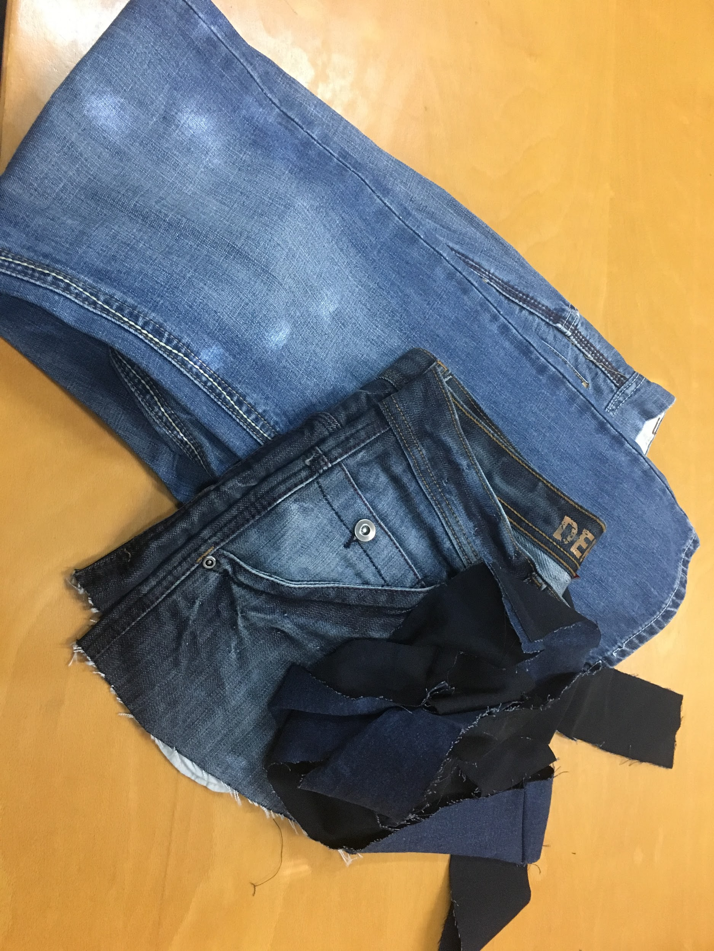
COLLECTING THE MATERIALS
We asked several teachers and students to bring us all the useless ties and jeans that they had.

Slide 5
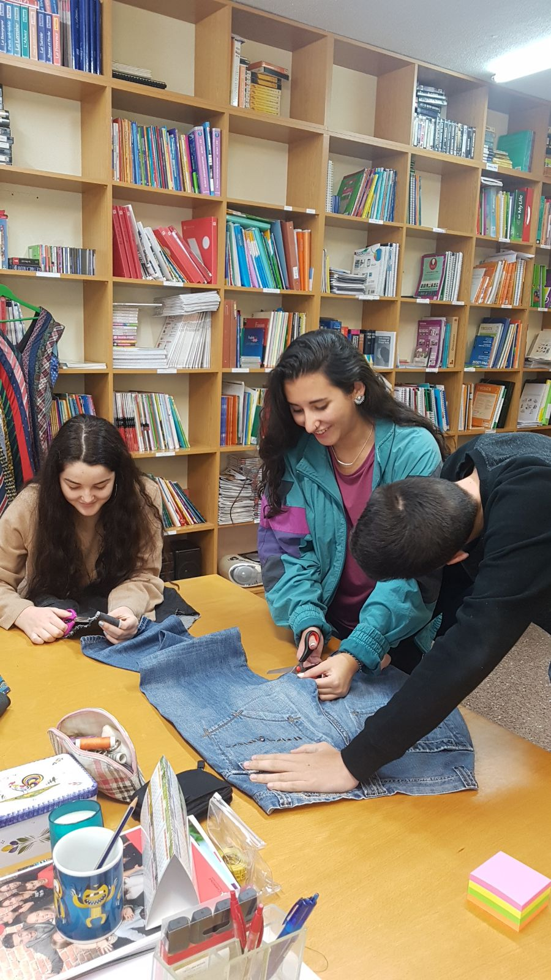
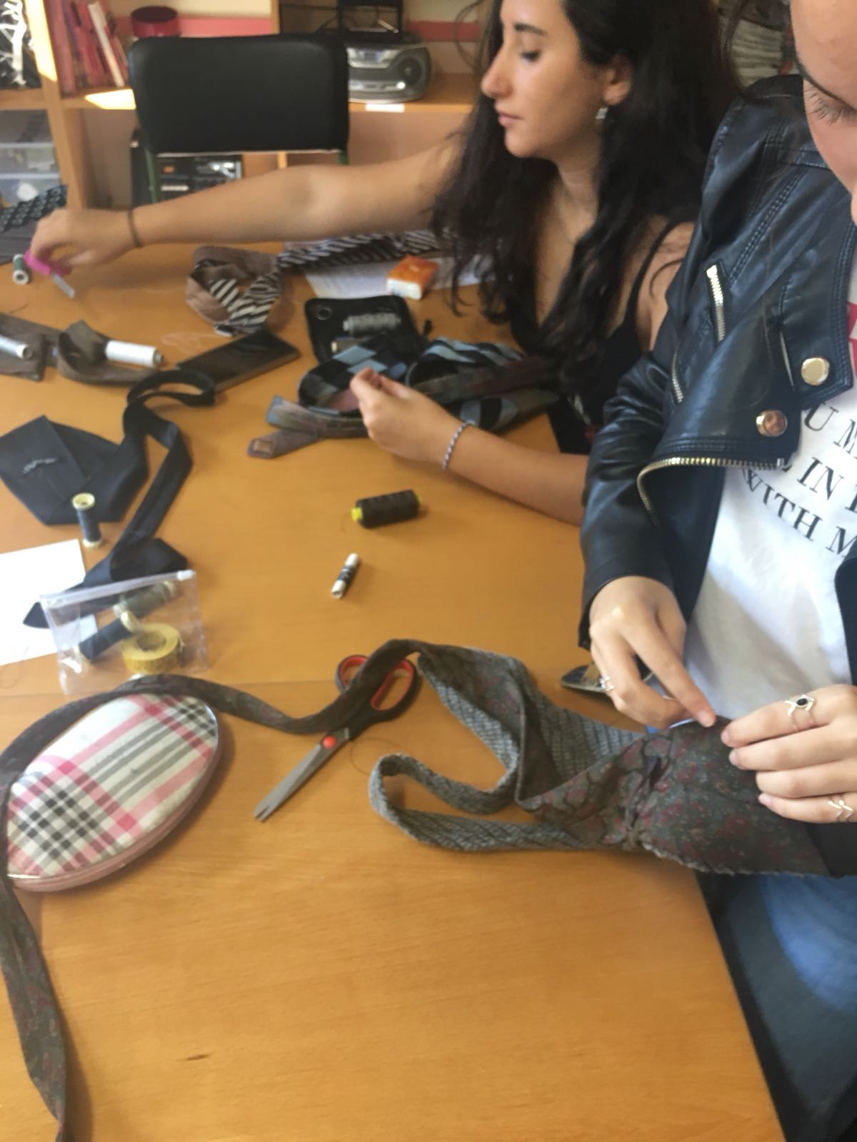
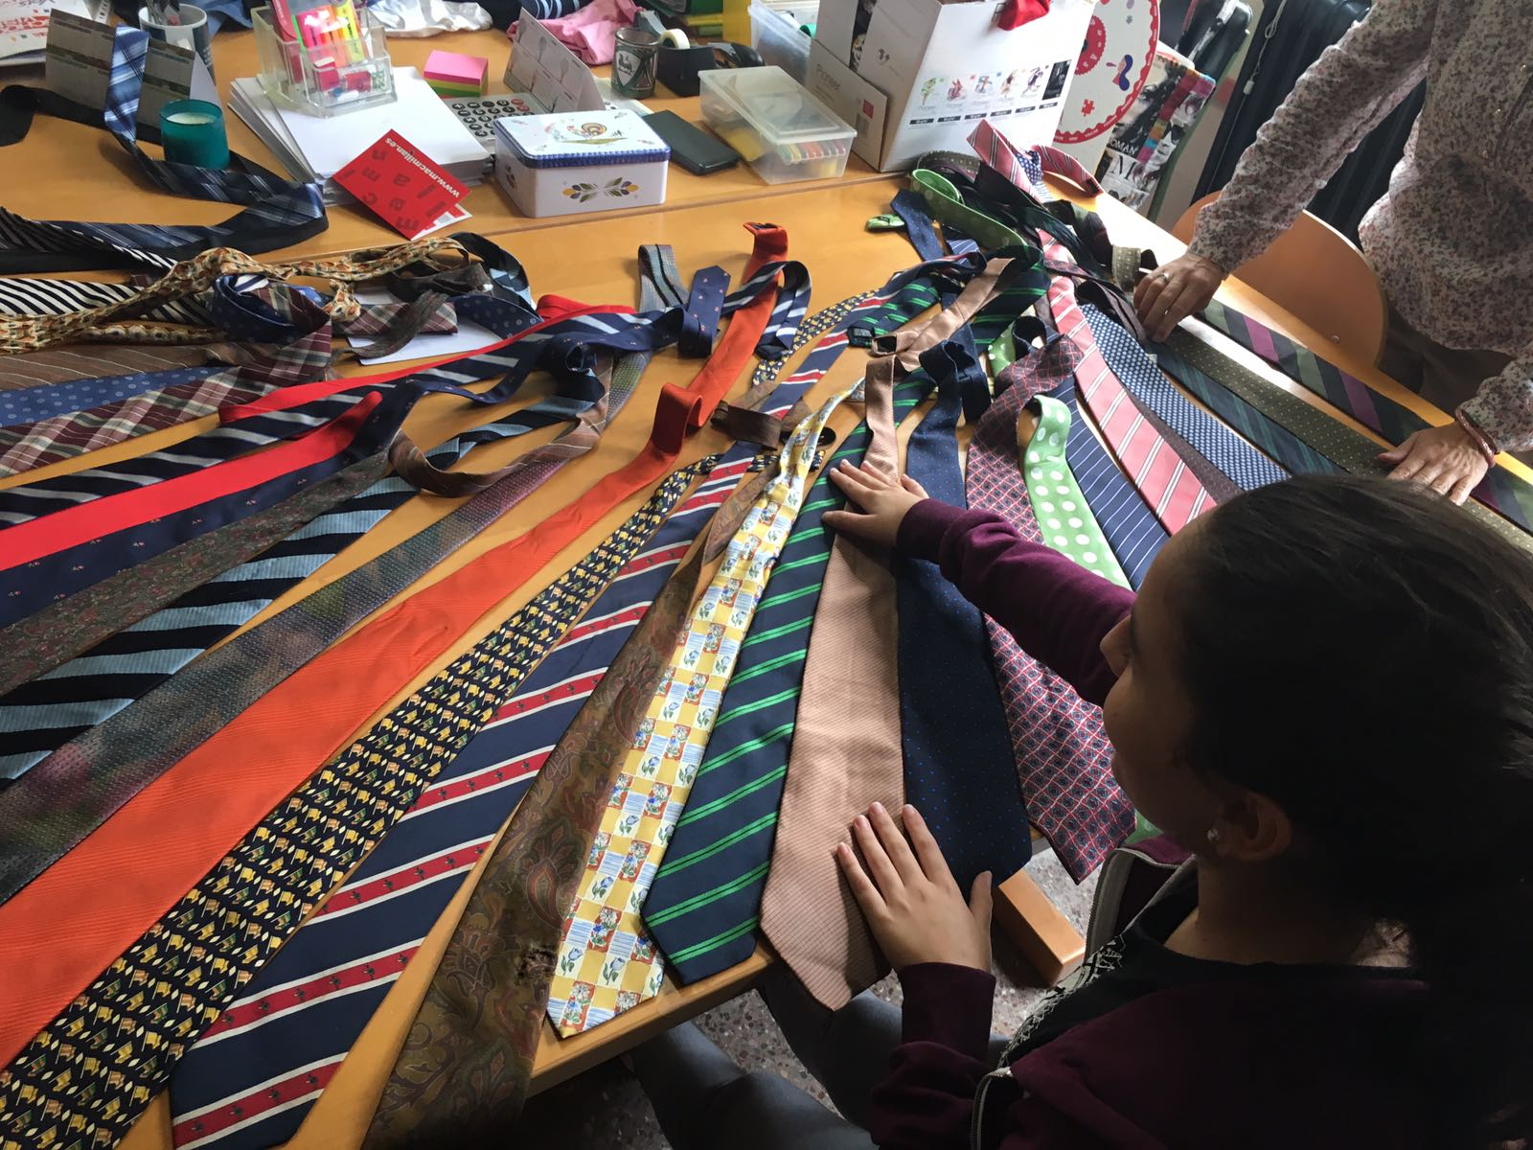
Transformation of materials
We have sewed ties to recycle them to do another clothes

Slide 6
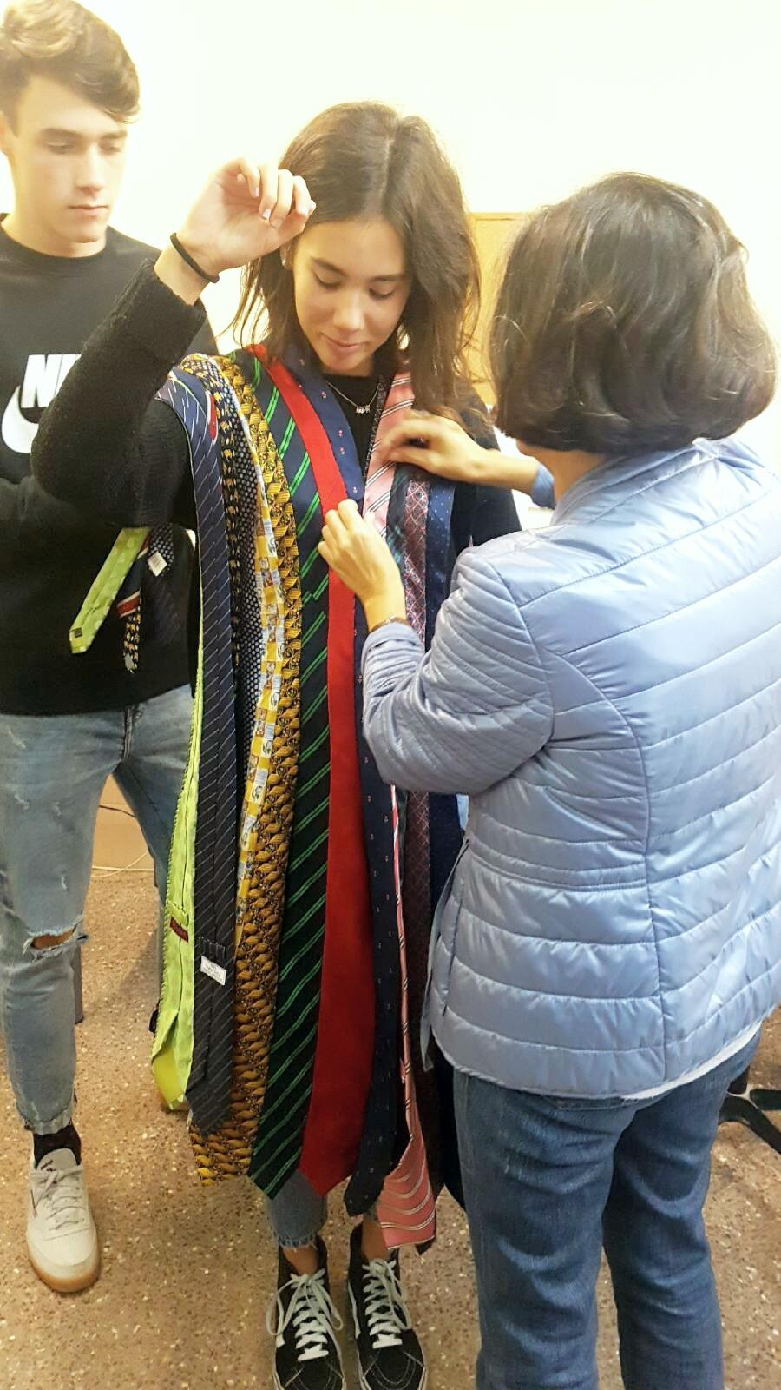
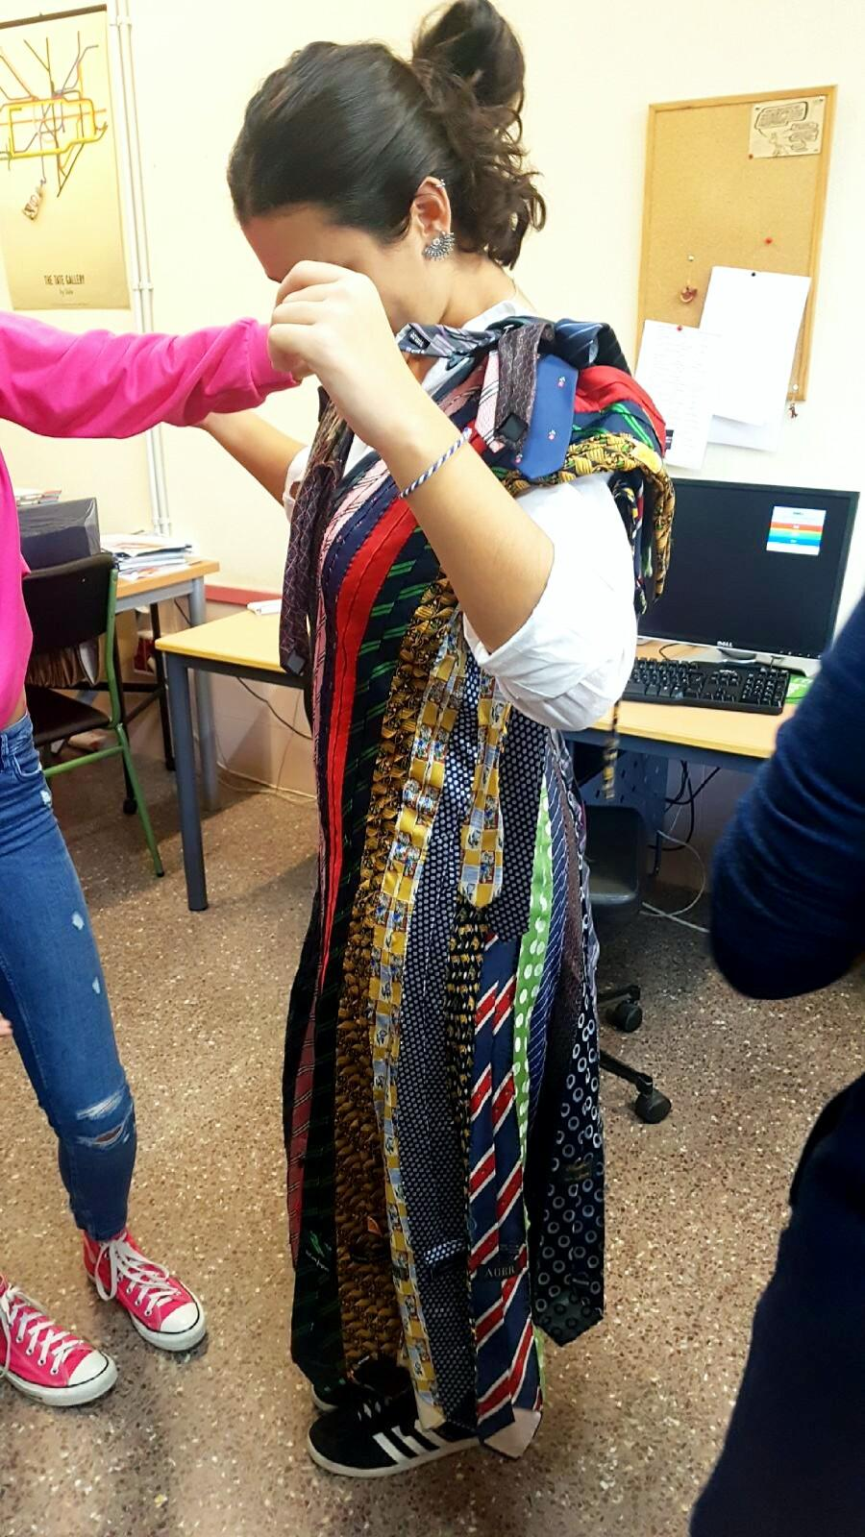
MEASURING AND TRYING THE DRESS ON
We had to decide who was going to wear the dress

Slide 7
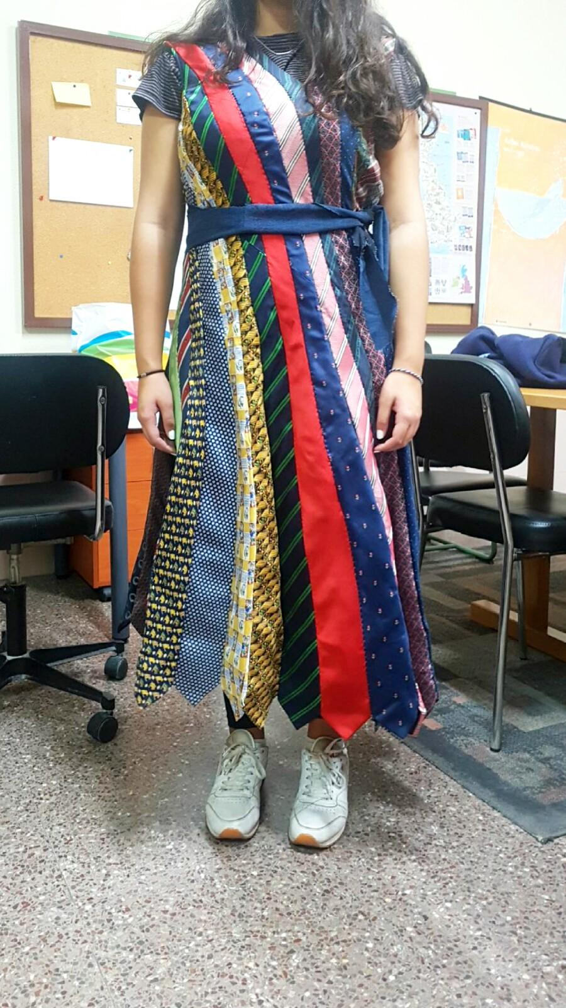
END RESULT

Slide 8
We got some old jeans.
Then with a marker we drew where we had to cut.
We cut the jeans and made the waistcoat.

Slide 9
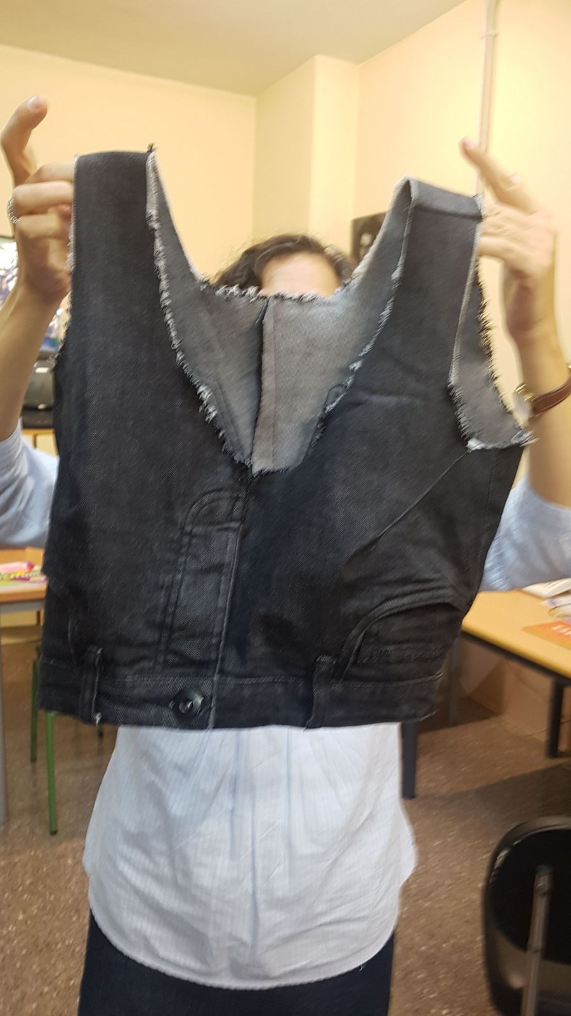
END RESULT

