Slide 2
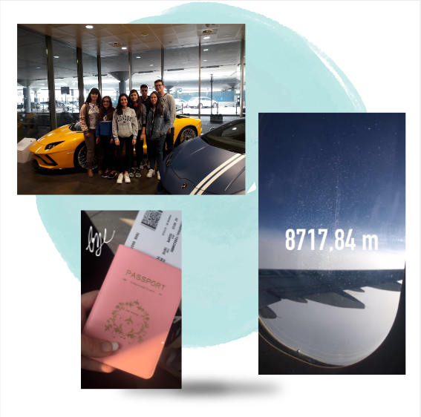
Couldn’t be a better arrival
DAY 1
Arrivals
Meet with our families

Slide 3
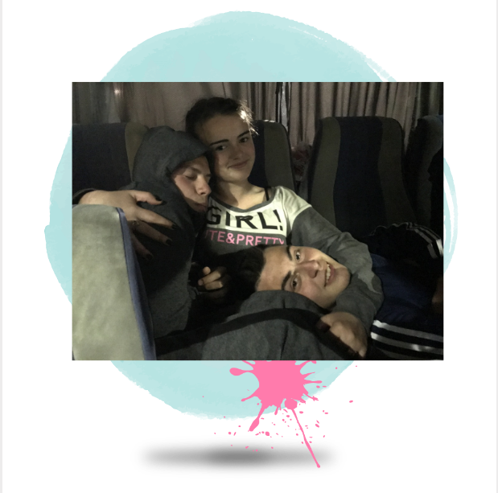
Not for everyone
DAY 1
What a cute baby
Shut up, I’m trying to sleep
I’m adopted :D

Slide 4
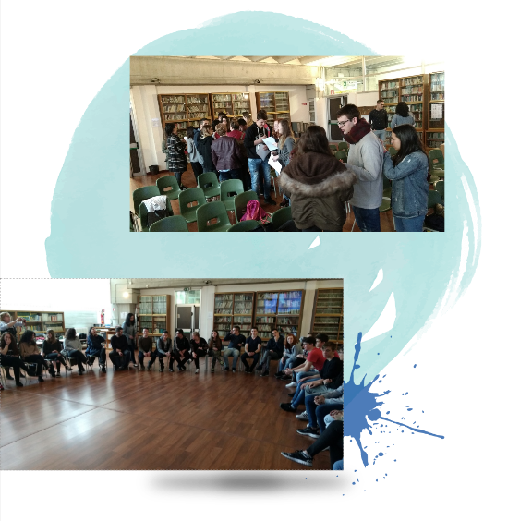
Ice-breaking games
DAY 2
Getting to Know each other

Slide 5
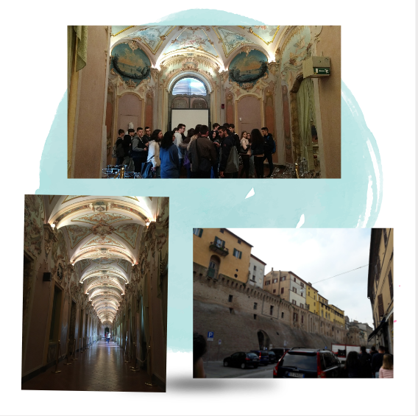
Visit to Jesi
DAY 2
Visit to the theatre
Historical places

Slide 6
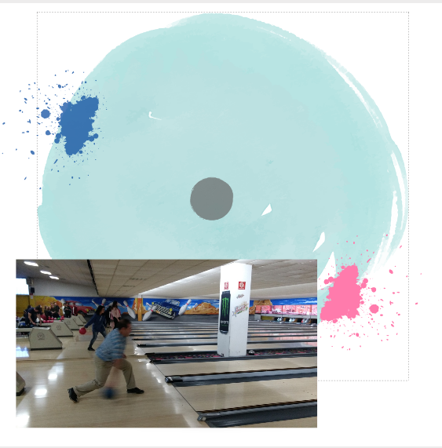
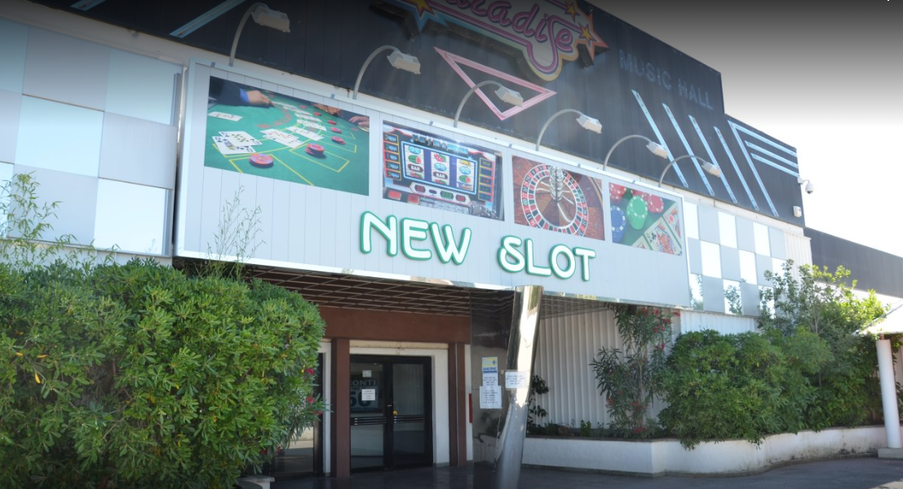
Free time in Paradise
DAY 2
Bowling
Eating pizza
Was it a strike or not?

Slide 7
Visit to Frasassi caves
DAY 3
Amazing views
Freezing caves

Slide 8
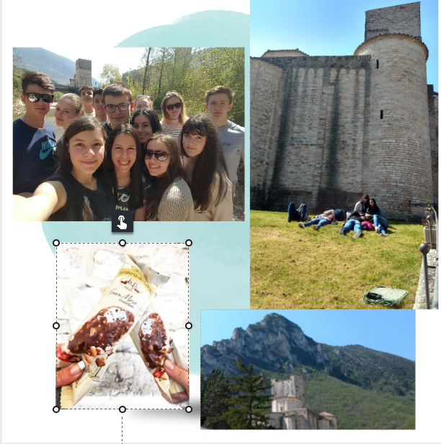
Break time
DAY 3
Do you have Wi-fi?
Chilling
Enjoy the time with friends

Slide 9
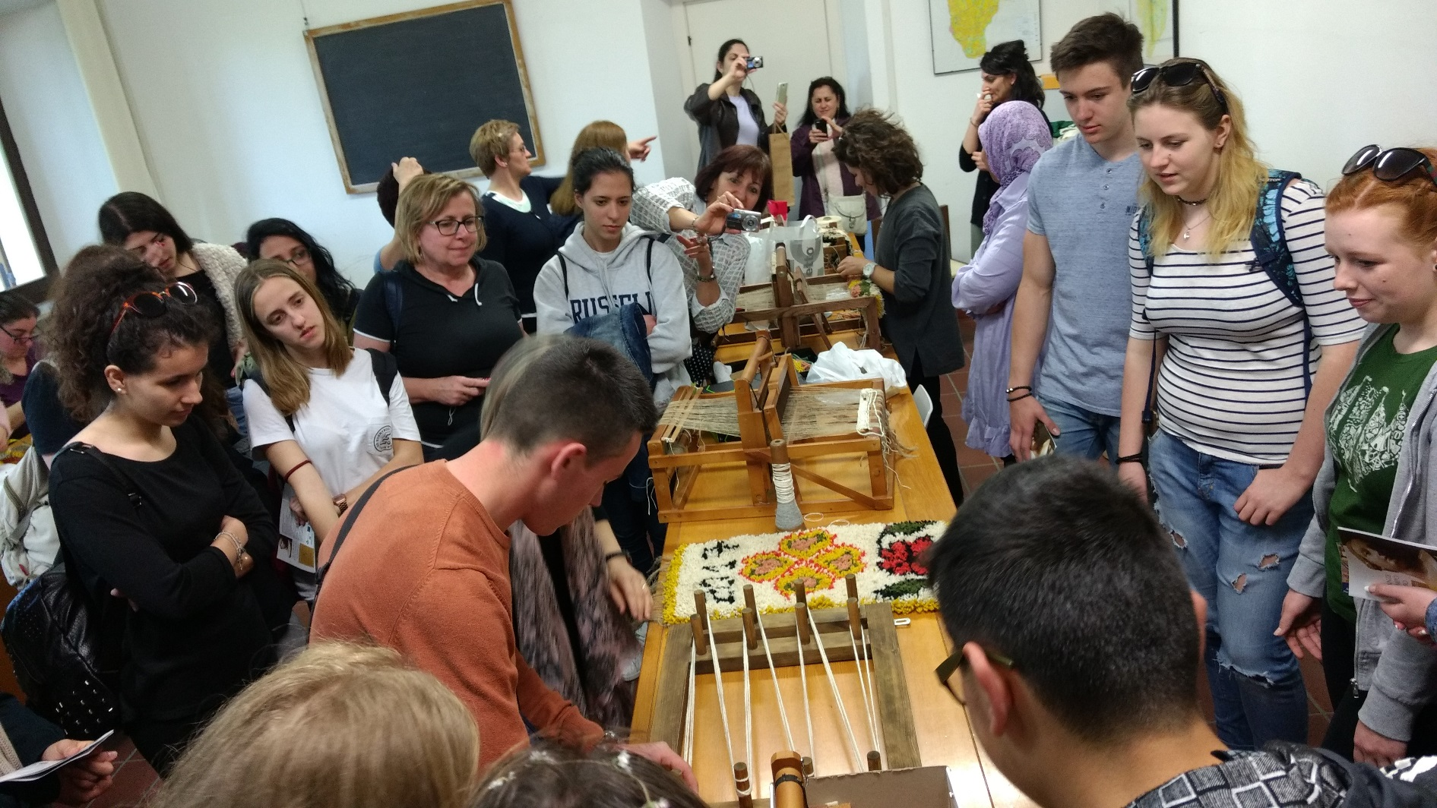
Visit to the museum
DAY 3
Very interesting…

Slide 10
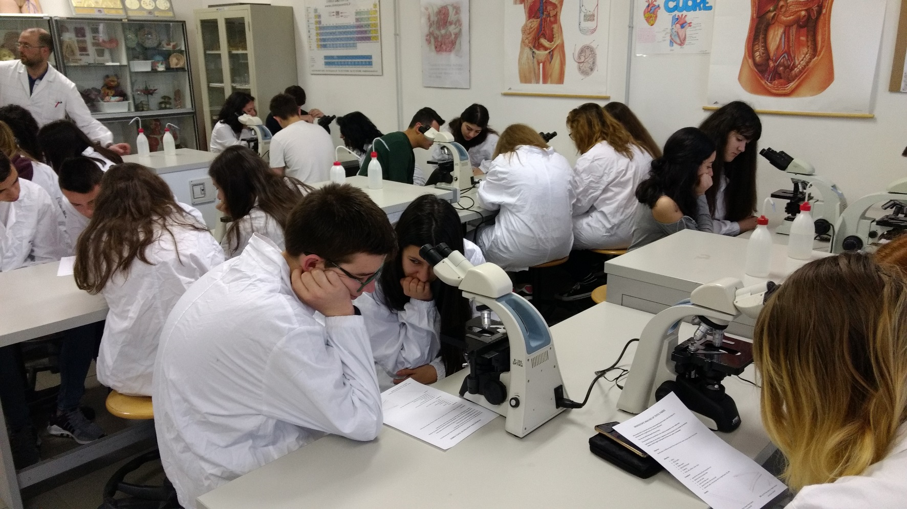
Practice with the microscopes
DAY 4
Discover fibres and differences between them

Slide 11
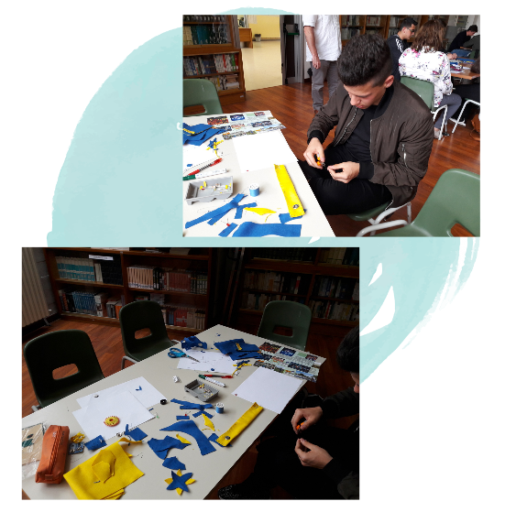
Sewn circuits
DAY 4
I have no idea what I’m doing
Work on our products with electric circuits

Slide 12
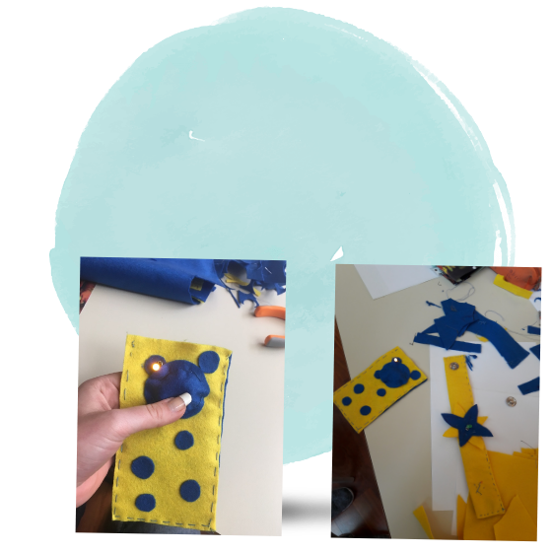
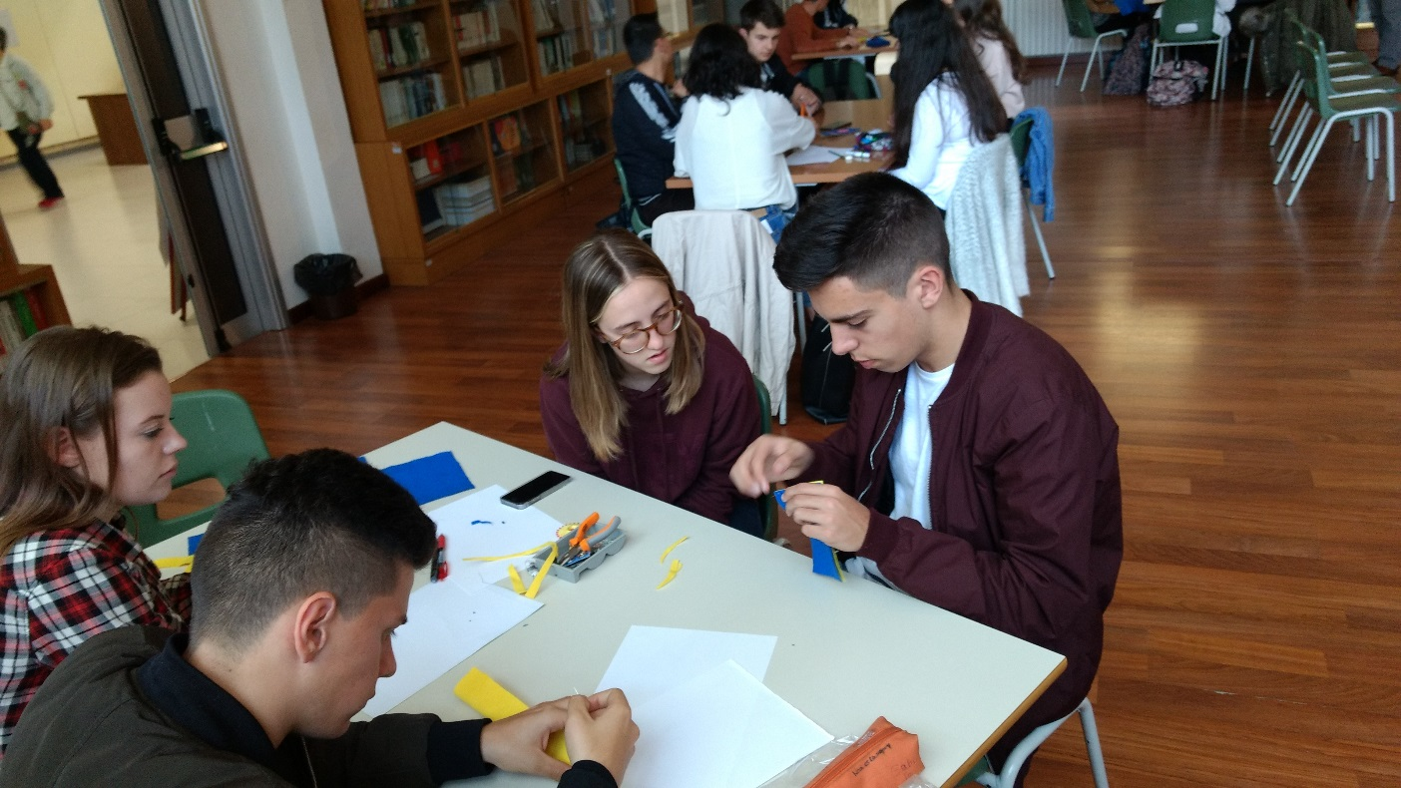
Final products
DAY 4

Slide 13
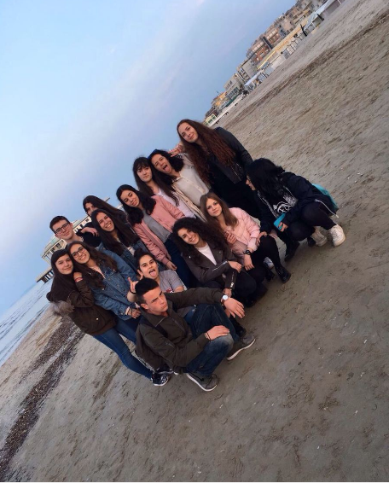
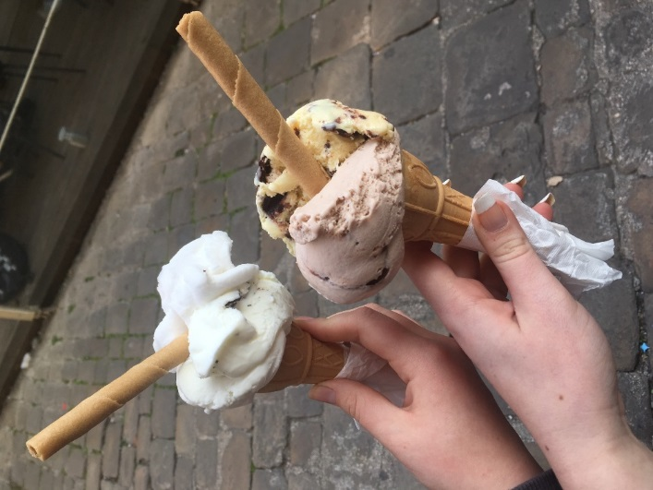
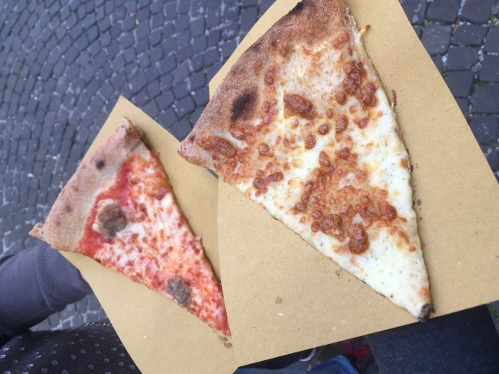
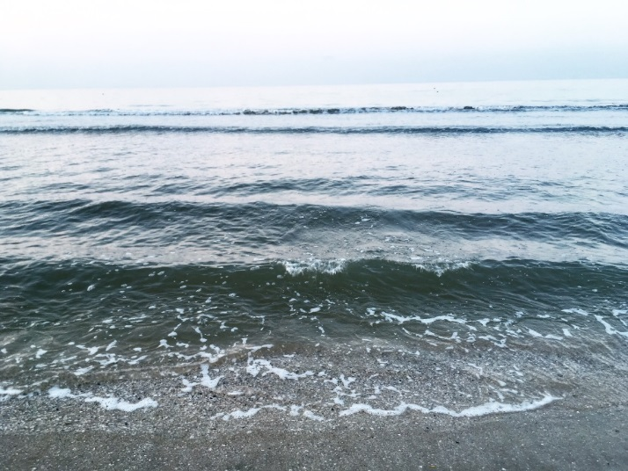
Senigallia
DAY 4
Visit beach
Go shopping
Have ice cream and pizza and fun :D

Slide 14
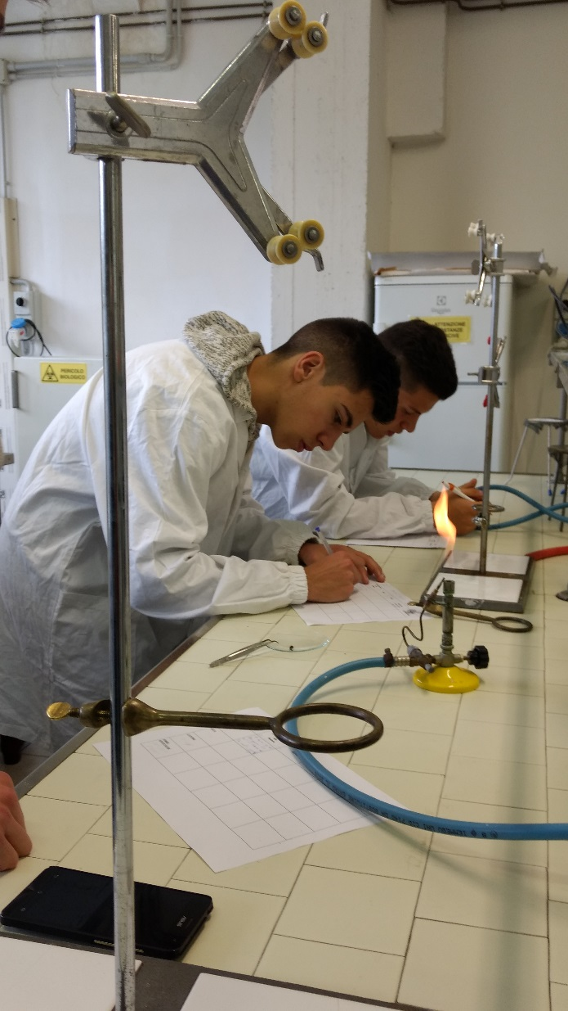
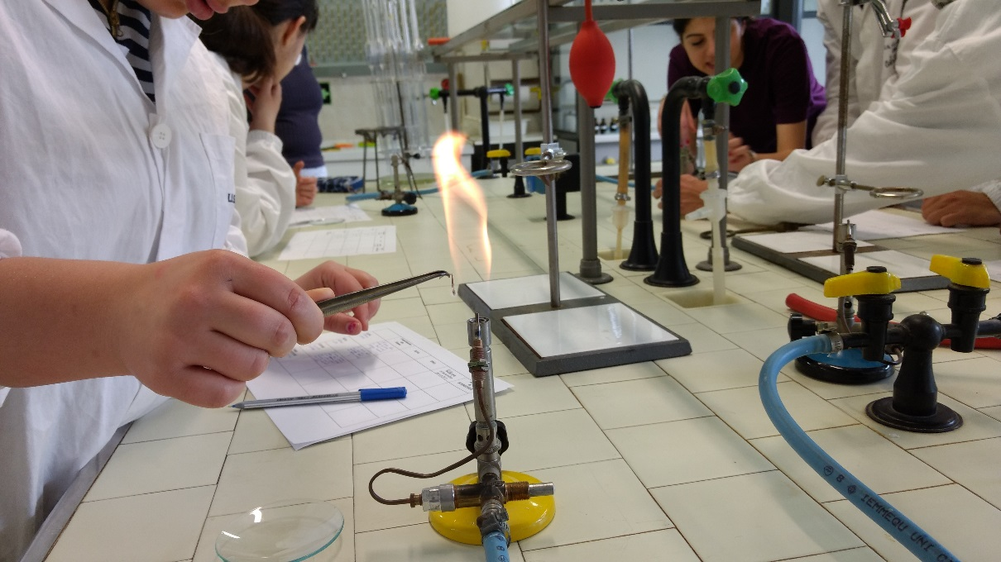
Organic chemistry lab
DAY 5
Burn fibres
Compare results
Discover behaviour of fibres in acids

Slide 15
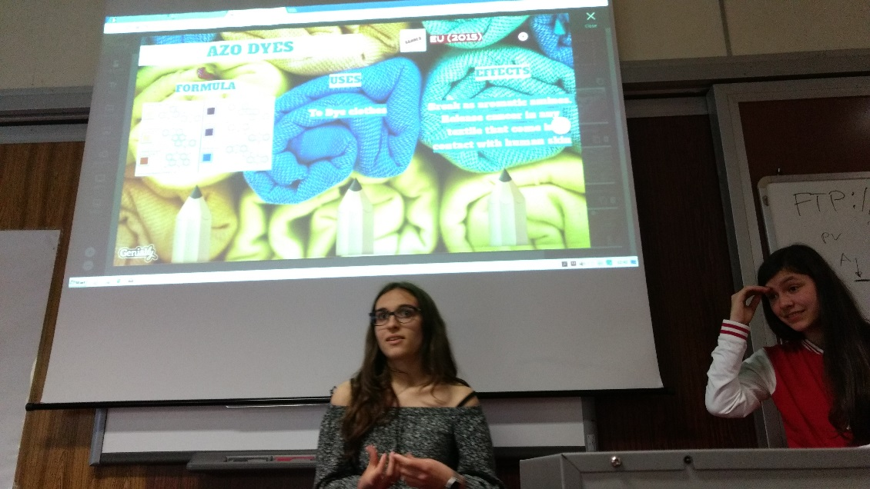
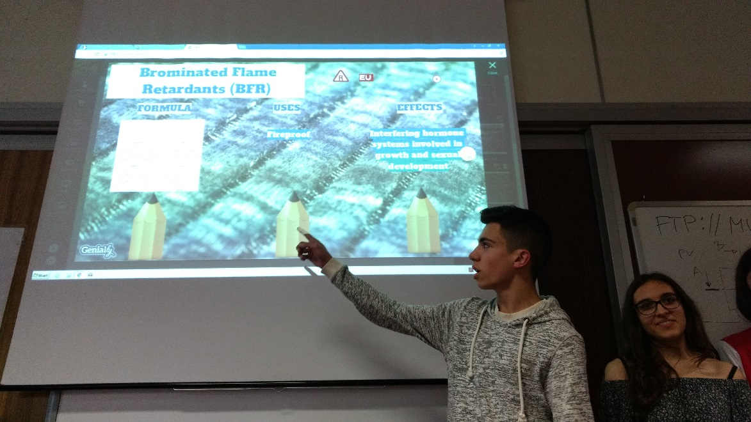
Presentations
DAY 5
One moment, please…
Work on presentation about one substance
What is she saying?

Slide 16
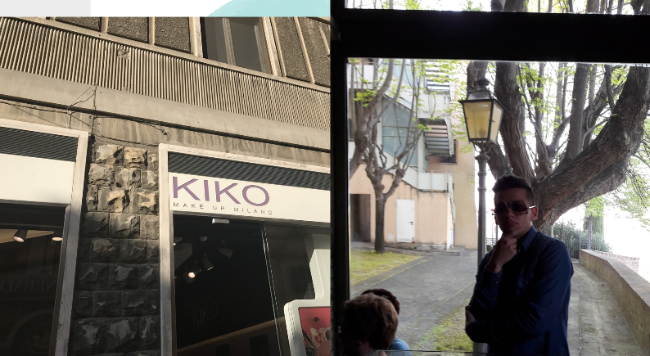
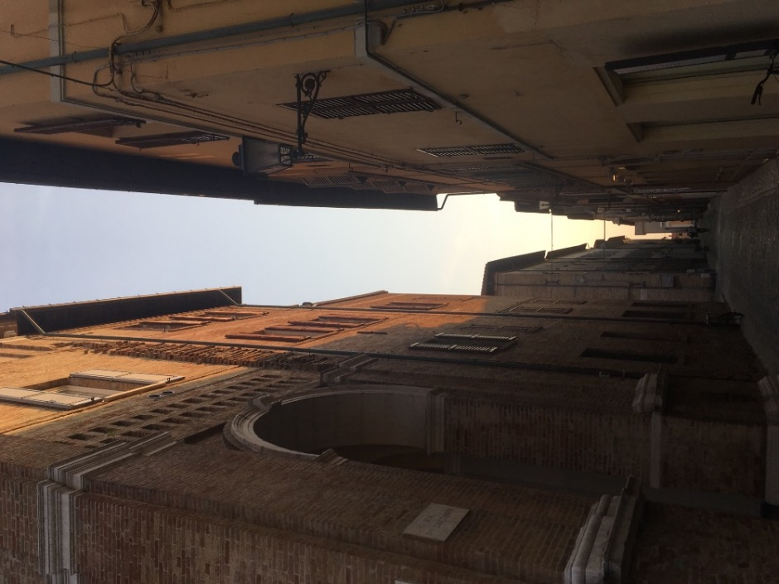
Ancona
DAY 5
Go shopping
Eat pizza

Slide 17
New words in Italian
Ciao, arrivederci, mangiare, prego, buona sera, buon giorno…

Slide 18
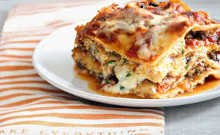
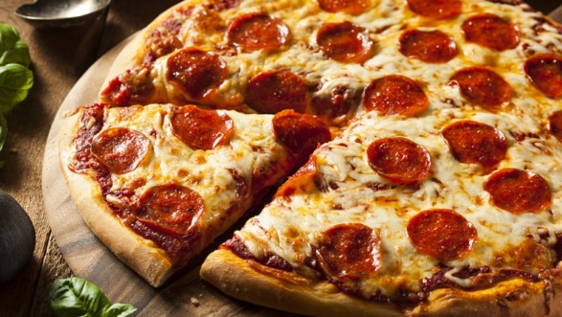
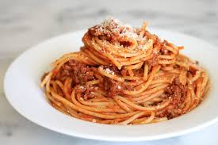
Typical food in Italy

Slide 19
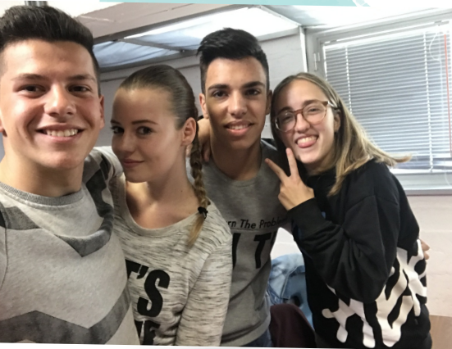
Made by the best group

Slide 20
THANK YOU FOR YOUR ATTENTION!

