Slide 1
USE OF RECYCLED MATERIALS IN TEXTILES
Made by:
Antonio Naumoski
Kristina Petrikova
Aurora Farinelli
Ana Marija Mitreska
Angela Jakimoska
Iria Ventoso

Slide 2
Recycling (processing of waste or obtaining secondary raw materials) is the processing of used materials for obtaining new products. This process prevents waste material loss, reduced consumption of new raw materials, reduces energy use, reduces air pollution and water. Recycling is an important component of modern waste reduction.

Slide 3
Many types of glass, paper, metal, plastic, textiles and electronics are recycled. Almost half of the waste we produce can be recycled. The recycling logo has three arrows that mark the three stages: collection, processing and reuse

Slide 4
Recycling
Recycling, changing unsuitable materials into new products.
How is it made?
In order to recycle it is need to separated the unsuitable materials one from another, instead, they should not be thrown away as waste that remains in nature and pollutes the environment in which people and the rest of the living world live.

Slide 5
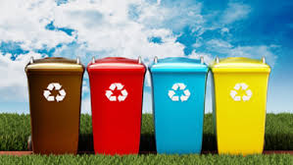
The next steps in recycling are the collecting separate materials and carrying them to the processing sites, where they are purified, and depending on the material, they follow different processing processes to obtain final raw materials ready for use in the creation of new products

Slide 6
Recycling of textiles
The most recyclable material is textile, mainly due to the simple donation of used clothing or its resale. Also in our country (Macedonia), the famous rugs, which the elderly wisely made from old pieces of clothing, are a great example of the recycling of textiles

Slide 7
COTTON Cotton recycling prevents unneeded wastage and can be a more sustainable alternative to disposal. Recycled cotton may come from older, previously used garments or by textile leftovers which are then spun into new yarns and fabrics. There are some notable limitations of recycled cotton, including separation of materials that are cotton/polyester mix. There may also be limits to durability in using recycled cotton.

Slide 8
PROCESS
Cotton can be recycled from pre-consumer (post-industrial) and post-consumer cotton waste. Pre-consumer waste comes from any excess material produced during the production of yarn, fabrics and textile products, e.g. selvage from weaving and fabric from factory cutting rooms. Post-consumer waste comes from discarded textile products, e.g. used apparel and home textiles.

Slide 9
During the recycling process, the cotton waste is first sorted by type and color and then processed through stripping machines that first breaks the yarns and fabric into smaller pieces before pulling them apart into fiber. The mix is carded several times in order to clean and mix the fibers before they are spun into new yarns.
The resulting staple fiber is of shorter length compared to the original fiber length, meaning it is more difficult to spin. Recycled cotton is therefore often blended with virgin cotton fibers to improve yarn strengths. Commonly, not more than 30% recycled cotton content is used in the finished yarn or fabric.

Slide 10
COTTON

Slide 11
Wool
The wool is natural
Wool is the textile fiber obtained from sheep and other animals, including cashmere and mohair from goats, qiviut wool from muskoxen, angora from rabbits, and other types of wool from camelids.
Wool has been used for blankets, horse rugs, saddle cloths, carpeting, insulation and upholstery.

Slide 12
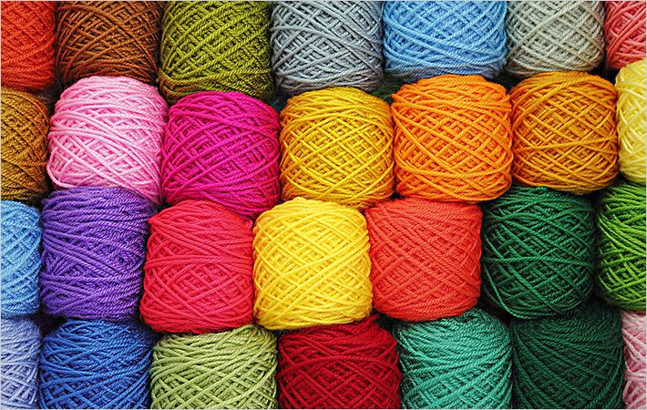
WOOL

Slide 13
Nylon
Nylon can be mixed.
Nylon is a generic designation for a family of synthetic polymers, based on aliphatic or semi-aromatic polyamides.
Nylon resins are widely used in the automobile industry especially in the engine compartment, nylon resins are used as a component of food packaging films where an oxygen barrier is needed.

Slide 14
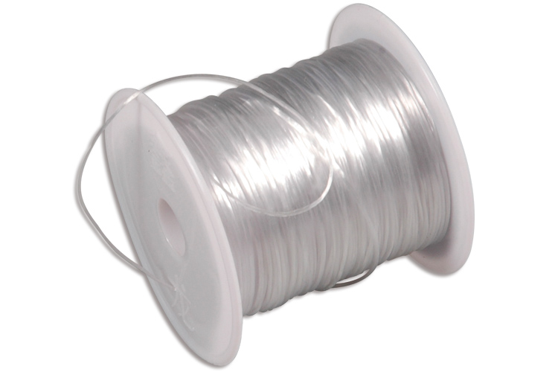
NYLON

Slide 15
Textiles and leather recycling
categories
Cotton Recycling
Wool Recycling
Burlap, Jute, and Sisal Recycling
Polyurethane Foam Recycling
Polyester and Polyester Fiber Recycling
Nylon and Nylon Fiber Recycling
Other Synthetic Fiber Recycling
Rags and Wipers
Used and Recycled Bags
Used Clothing
Leather Recycling
Textile Recycling Employment

