Slide 1
USE OF RECYCLED MATERIALS IN TEXTILES

Slide 3
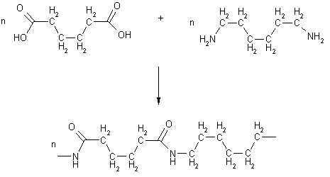
nylon
synthetic fibre
polymerisation: combination of two chemical compounds – nylon salt- heating device

Slide 4
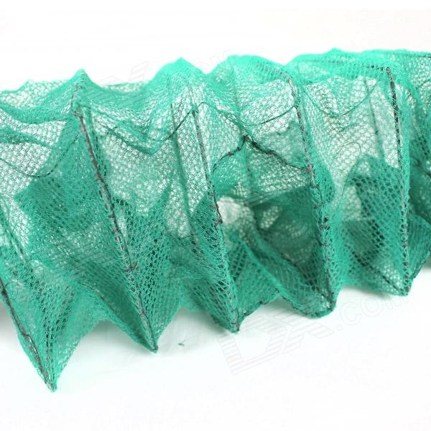
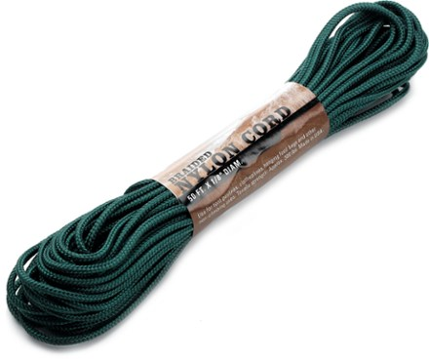
How is nylon used
fishing nets
ropes
cords

Slide 5
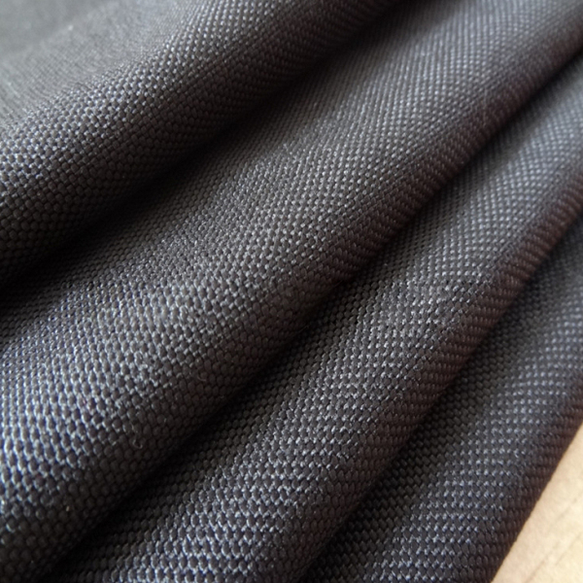
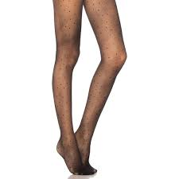
How is nylon used
fabrics in textile industry
elastic hosiery
machine parts

Slide 6
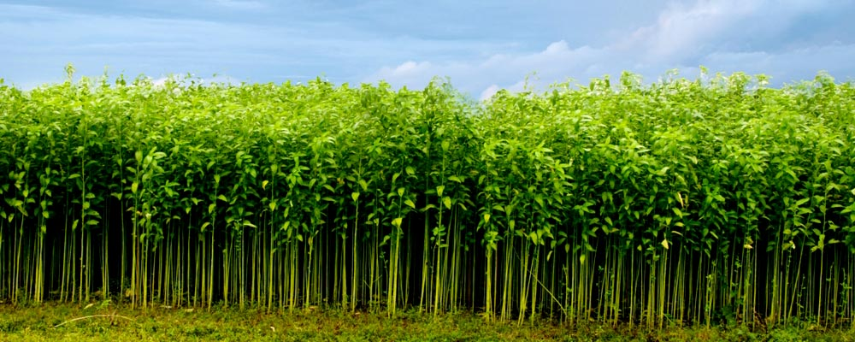
JUTE BURLAP
natural fibre
from the stems and skin of the Jute plant

Slide 7
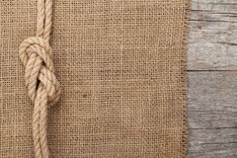
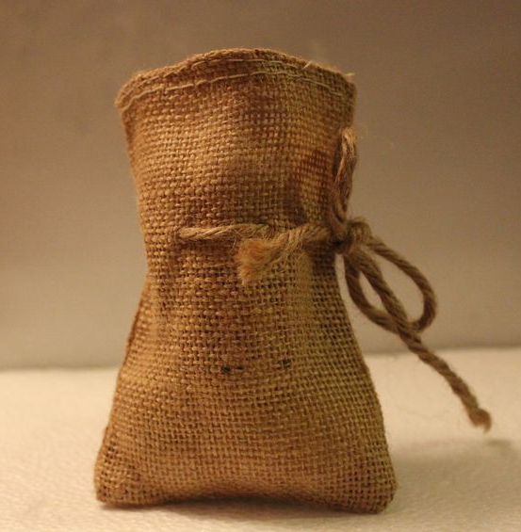
HOW IS jute BURLAP USED
ropes
nets
bags to ship goods – e. g. coffee beans

Slide 8
Waste material in numbers
72-75 million tonnes
of used fibre (2007)

Slide 9
Waste material in numbers
global fibre consumption has been increasing and even in developed countries it is still growing

Slide 10
Waste material in numbers
European Union consumers throw away
5.8 million tonnes
of textiles per year

Slide 11
Waste material in numbers
around
4.3 million tonnes
go to landfills or it is burnt in municipal waste incinerators

Slide 12
Waste material in numbers
only
1.5 million tonnes
are recycled mostly by charities and industrial enterprises

