Slide 1
ERASMUS PLUS+

Slide 2
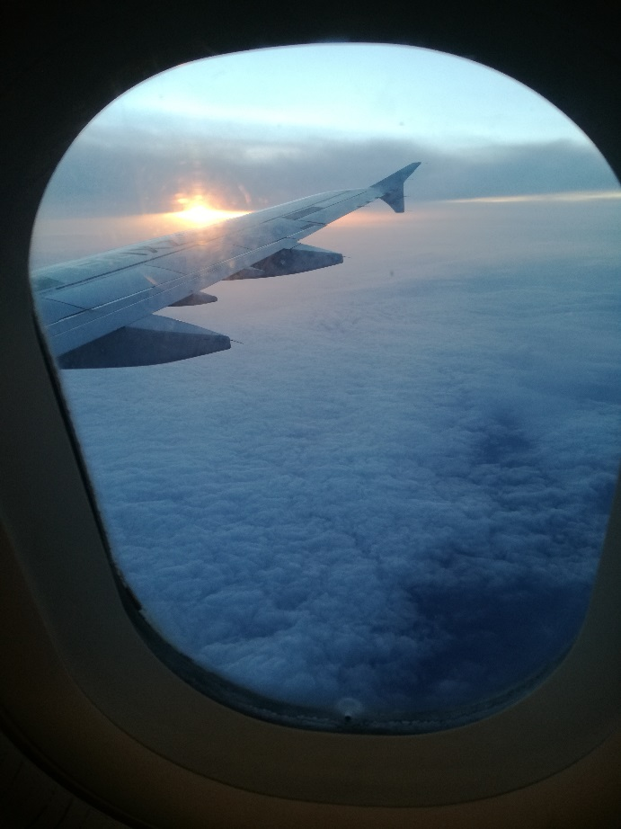
Travelling by plane..

Slide 3
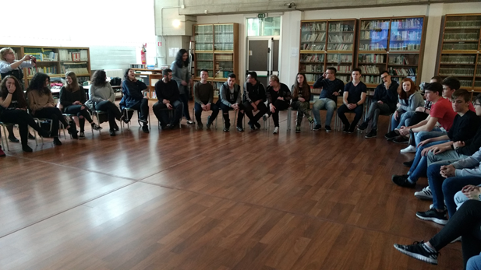
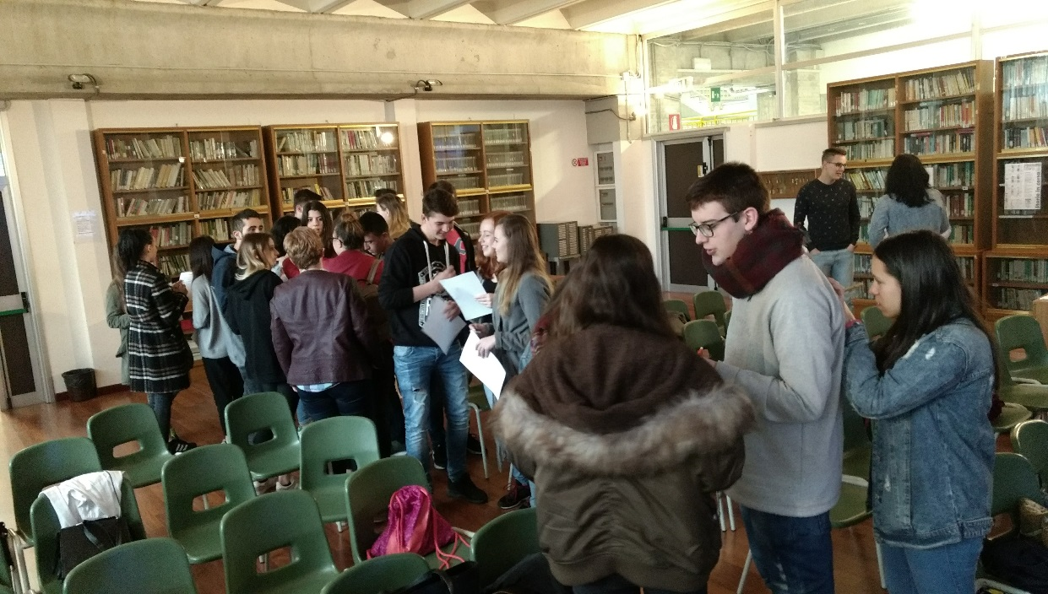
Ice breaking games

Slide 4
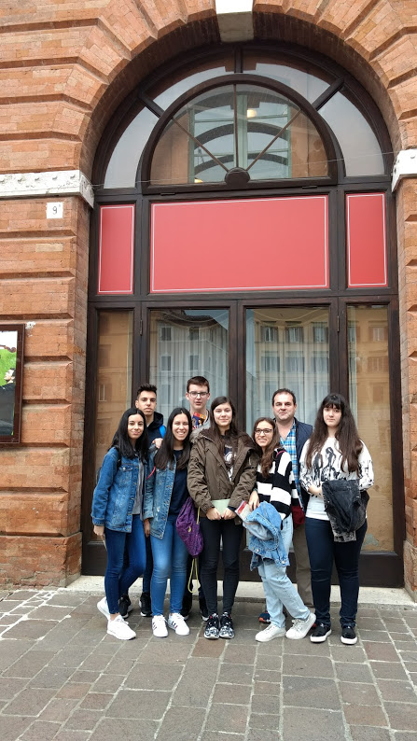
Visiting Jesi…

Slide 5
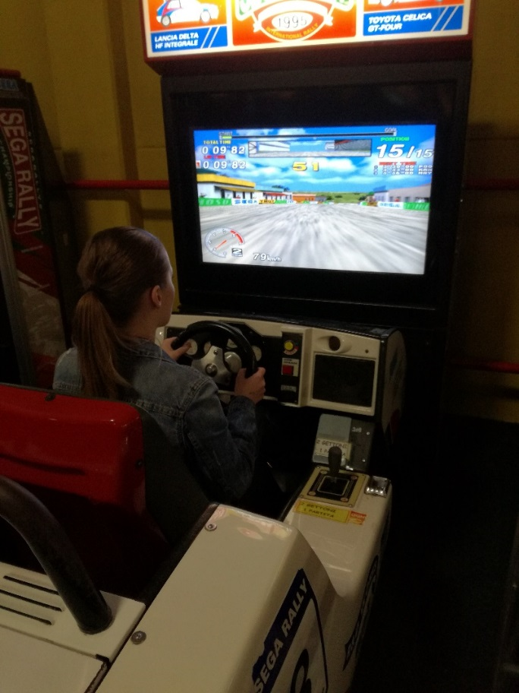
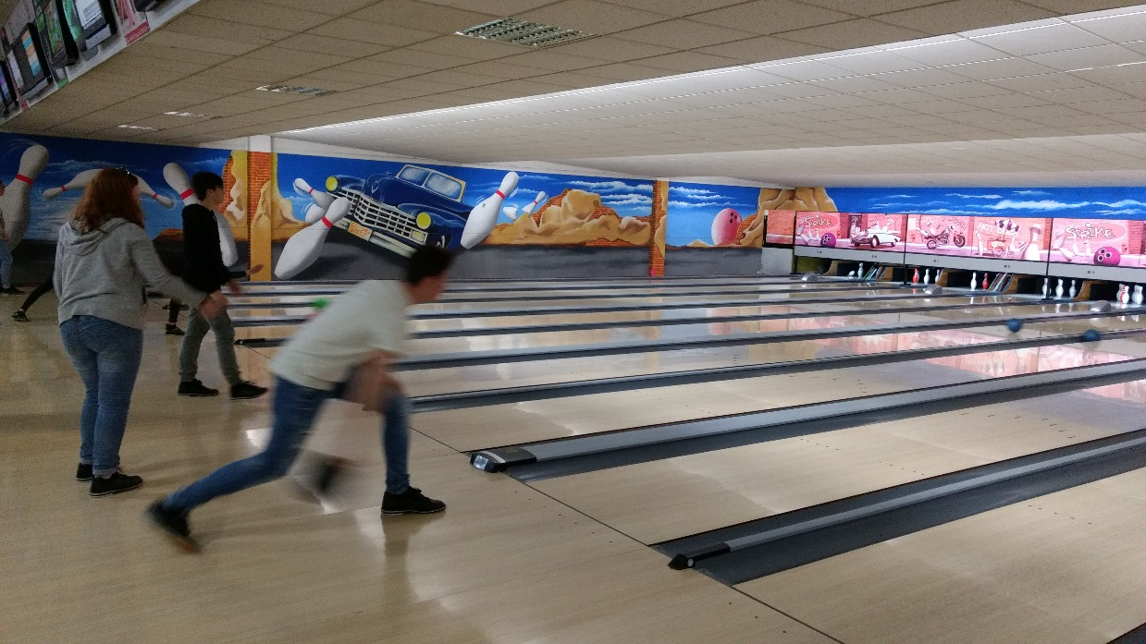
Having fun in Paradise..

Slide 6
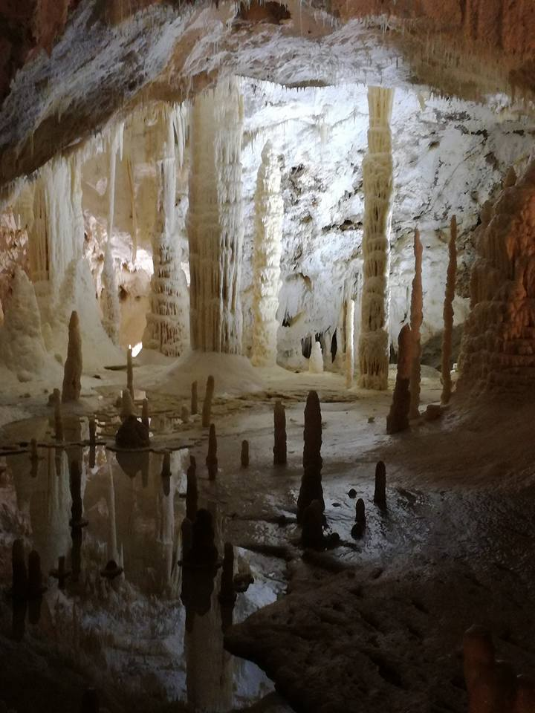
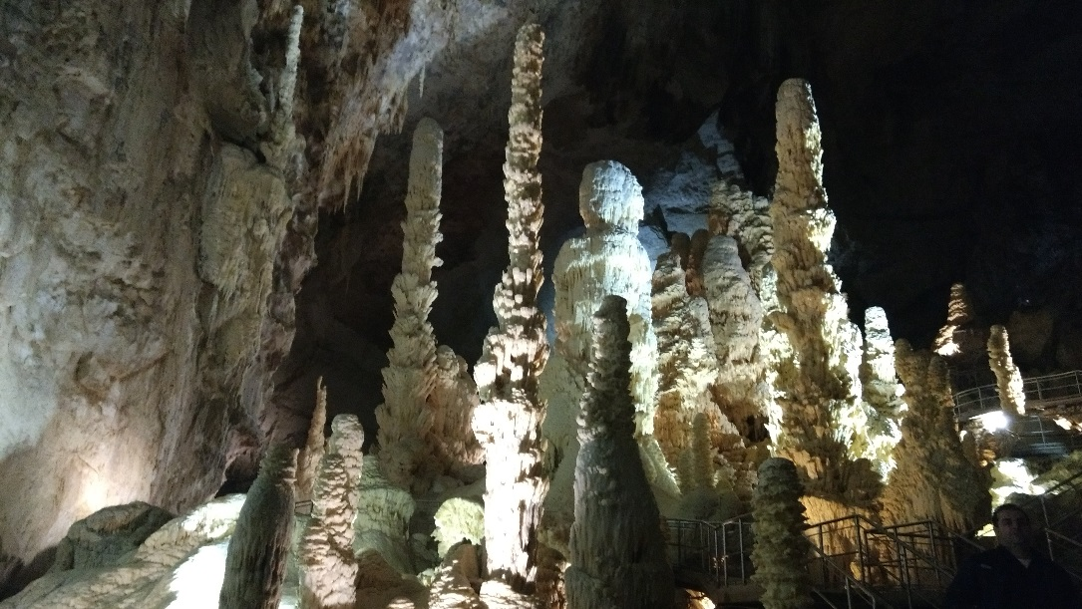
Visting Grotte di Frasassi…

Slide 7
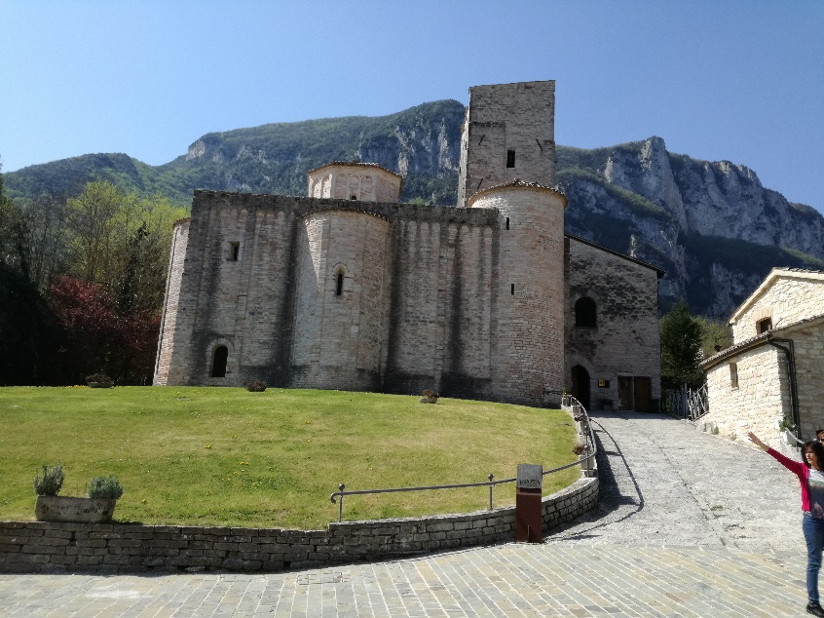
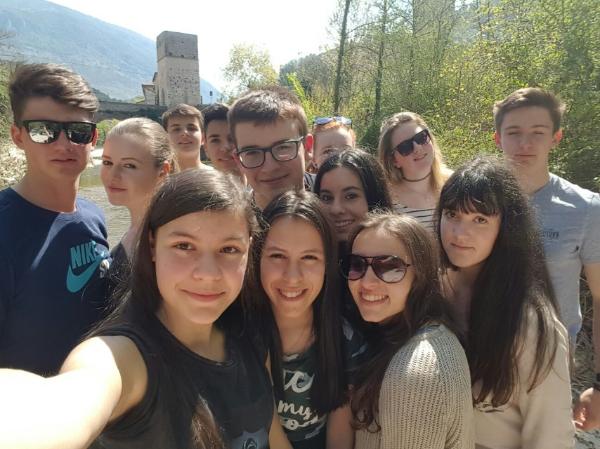
Visiting San Vittore..

Slide 8
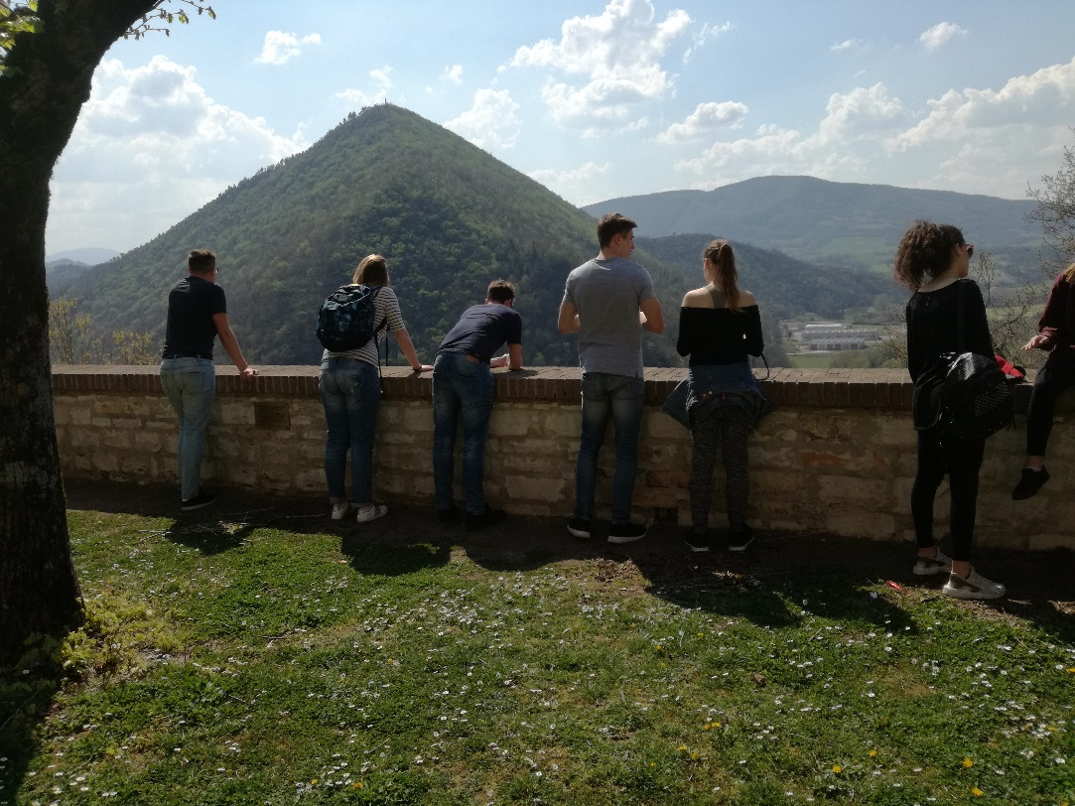
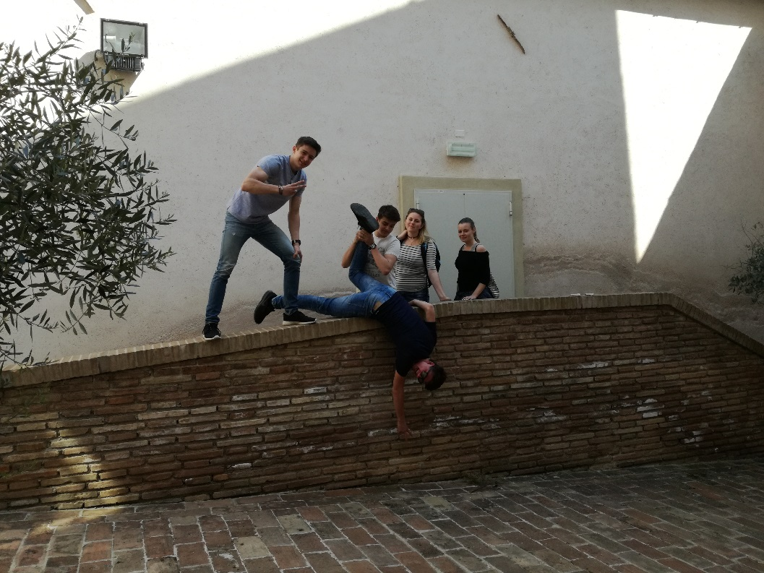
Visiting Genga..

Slide 9
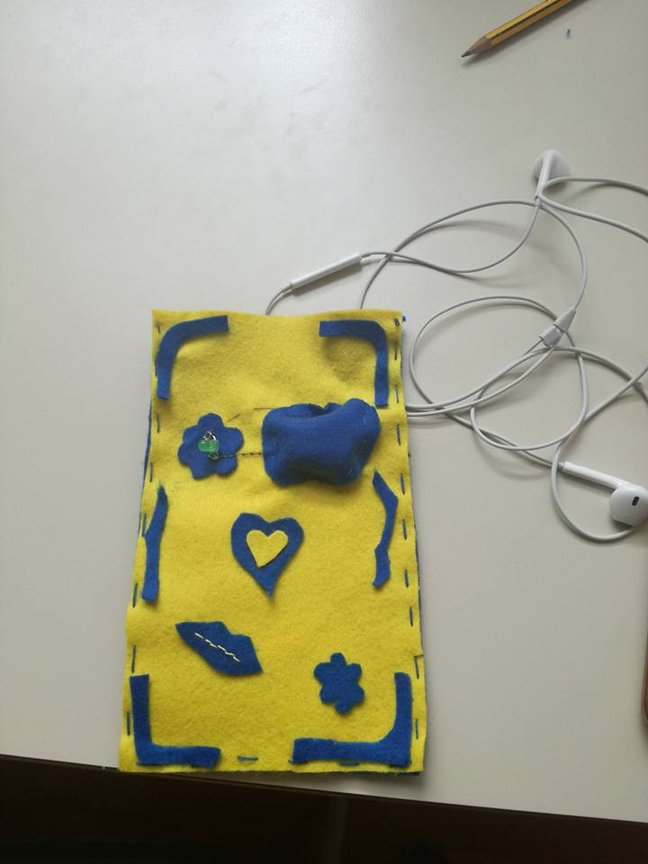
Sewn circuits..

Slide 10
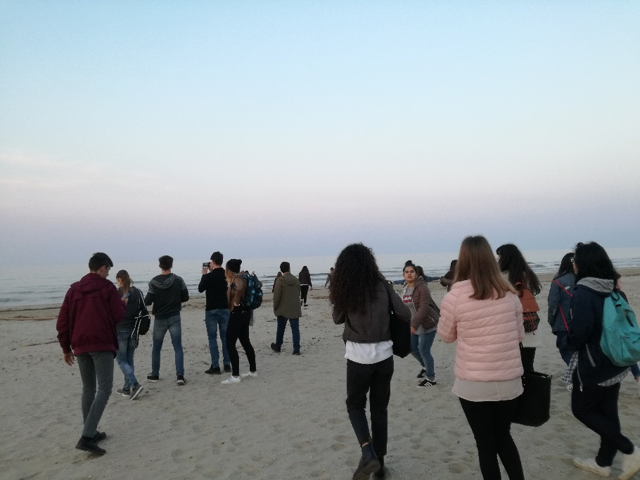
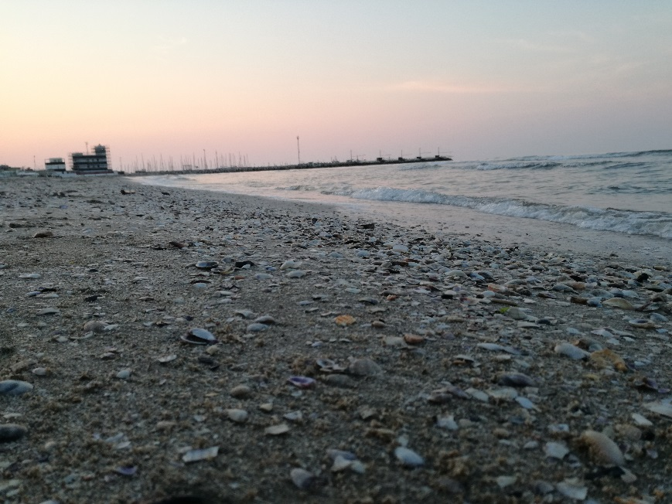
Visiting Senigallia…

Slide 11
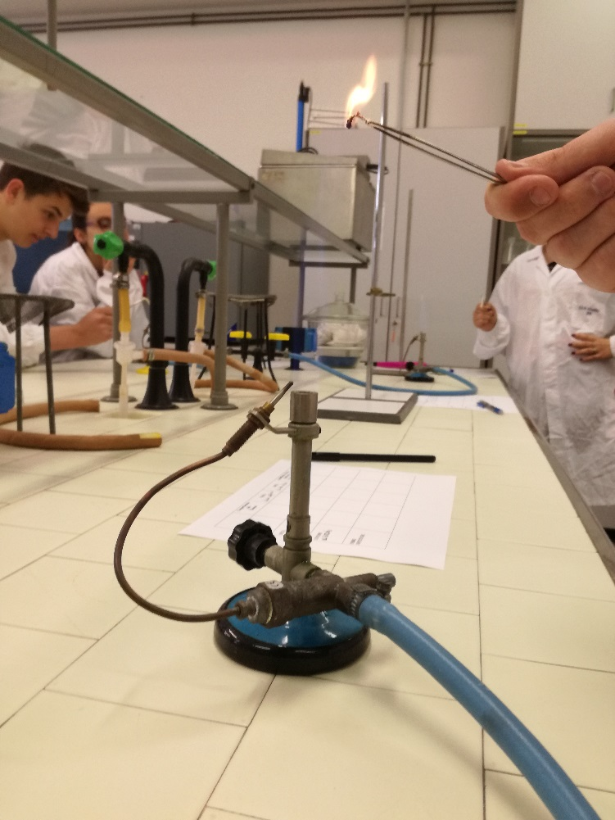
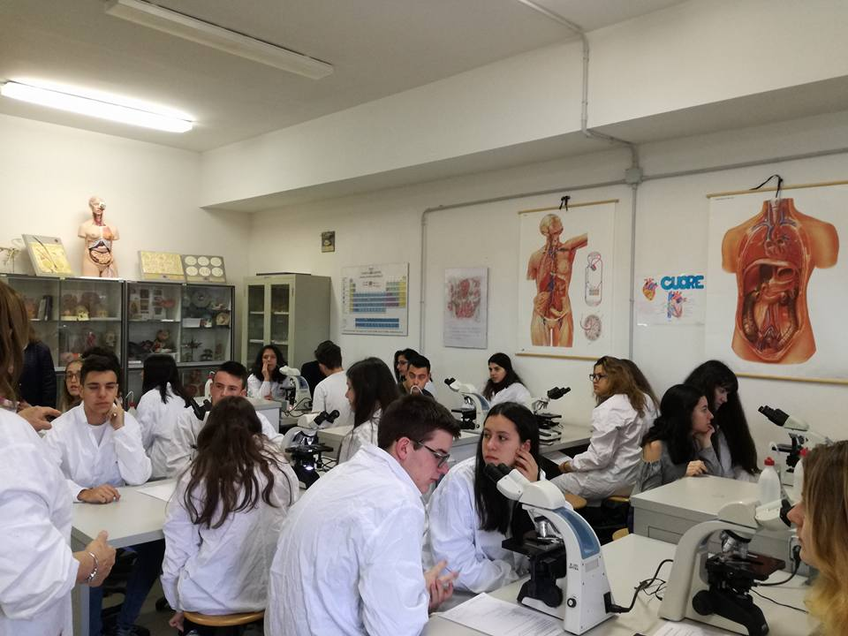
Lab work..

Slide 12
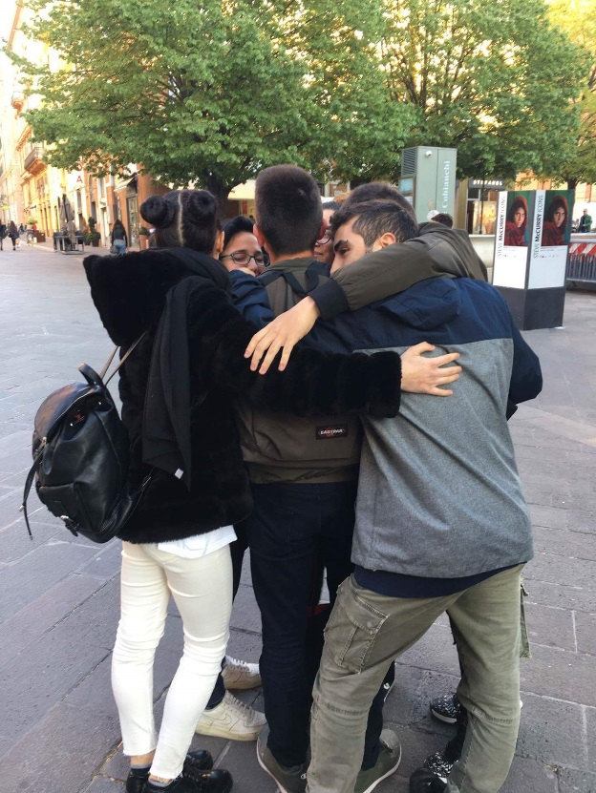
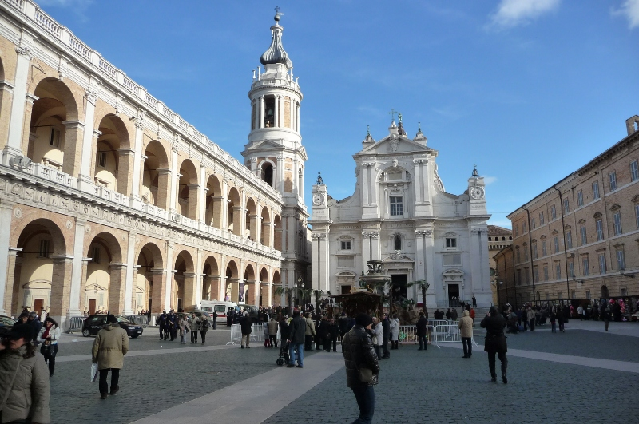
Visiting Ancona..

Slide 13
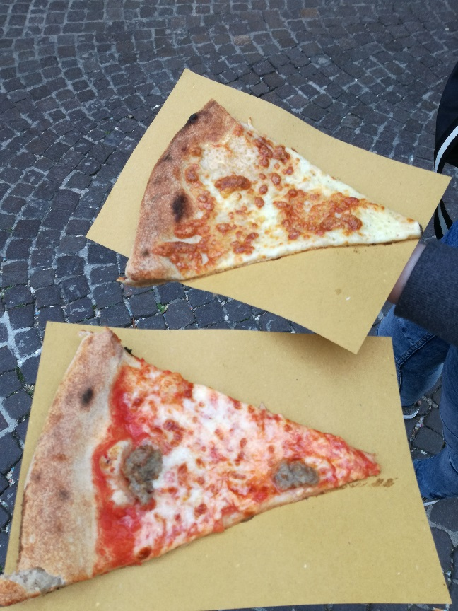
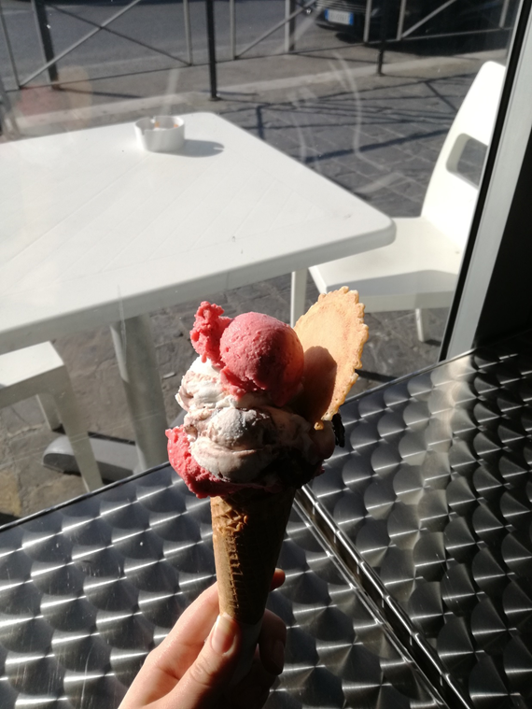
We love pizza… ..and ice cream too!!

Slide 14
A few expressions..
Italian
Ciao!
Come stai?
Sto bene.
Buongiorno
Buonanotte
Czech
Ahoj
Jak se máš?
Mám se dobře
Dobré ráno
Dobrou noc
Macedonian
Здраво
Kако си?
добро сум
добро утро
добра ноќ
Spanish
Hola
cómo estás?
Estoy bien.
Buenos días
Buenas noches

Slide 15
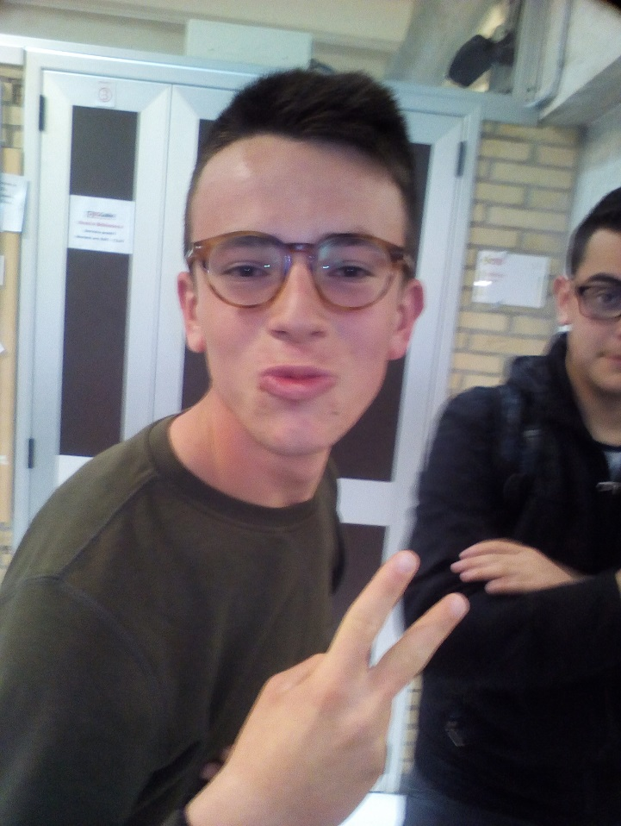
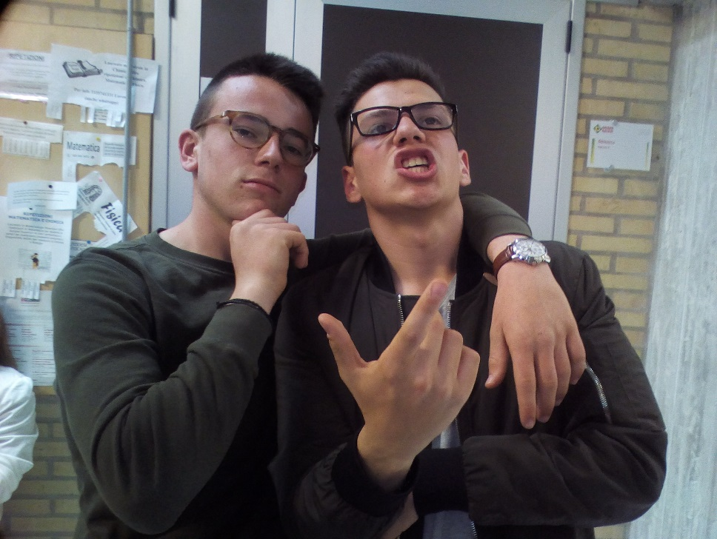
Funny photos…

Slide 16
Thank you for your attention!
Ljubica Dimkoska
Michela Albanese
Lenka Vávrová
Nerea Lamas

