Slide 1



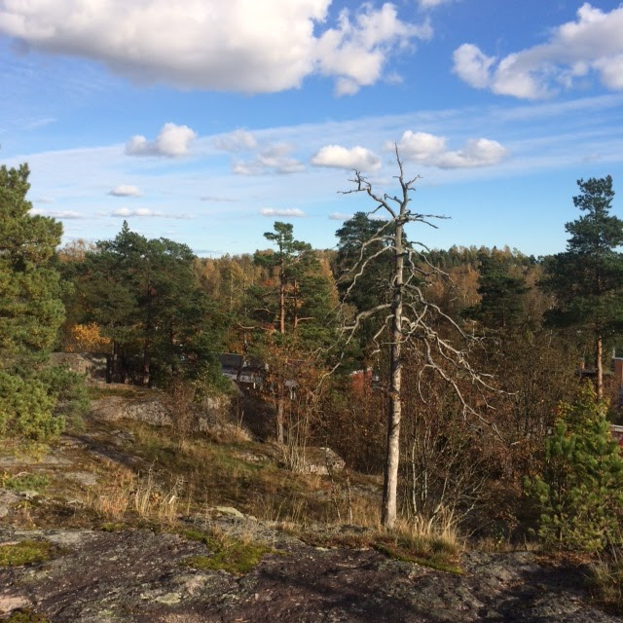
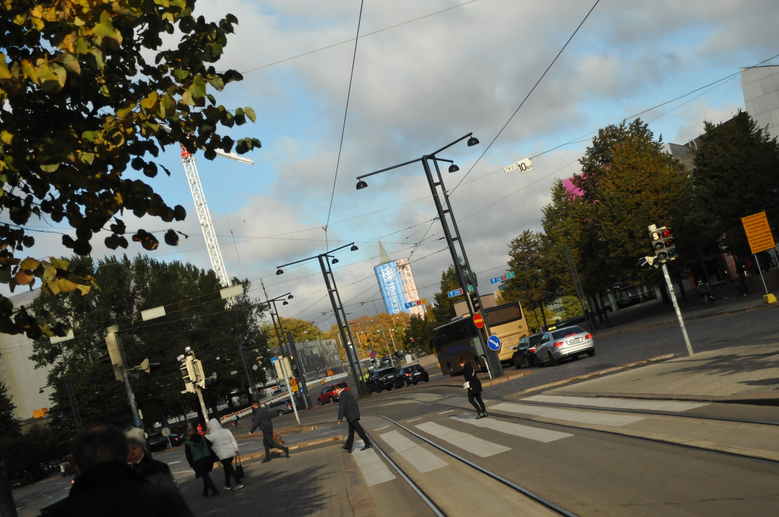
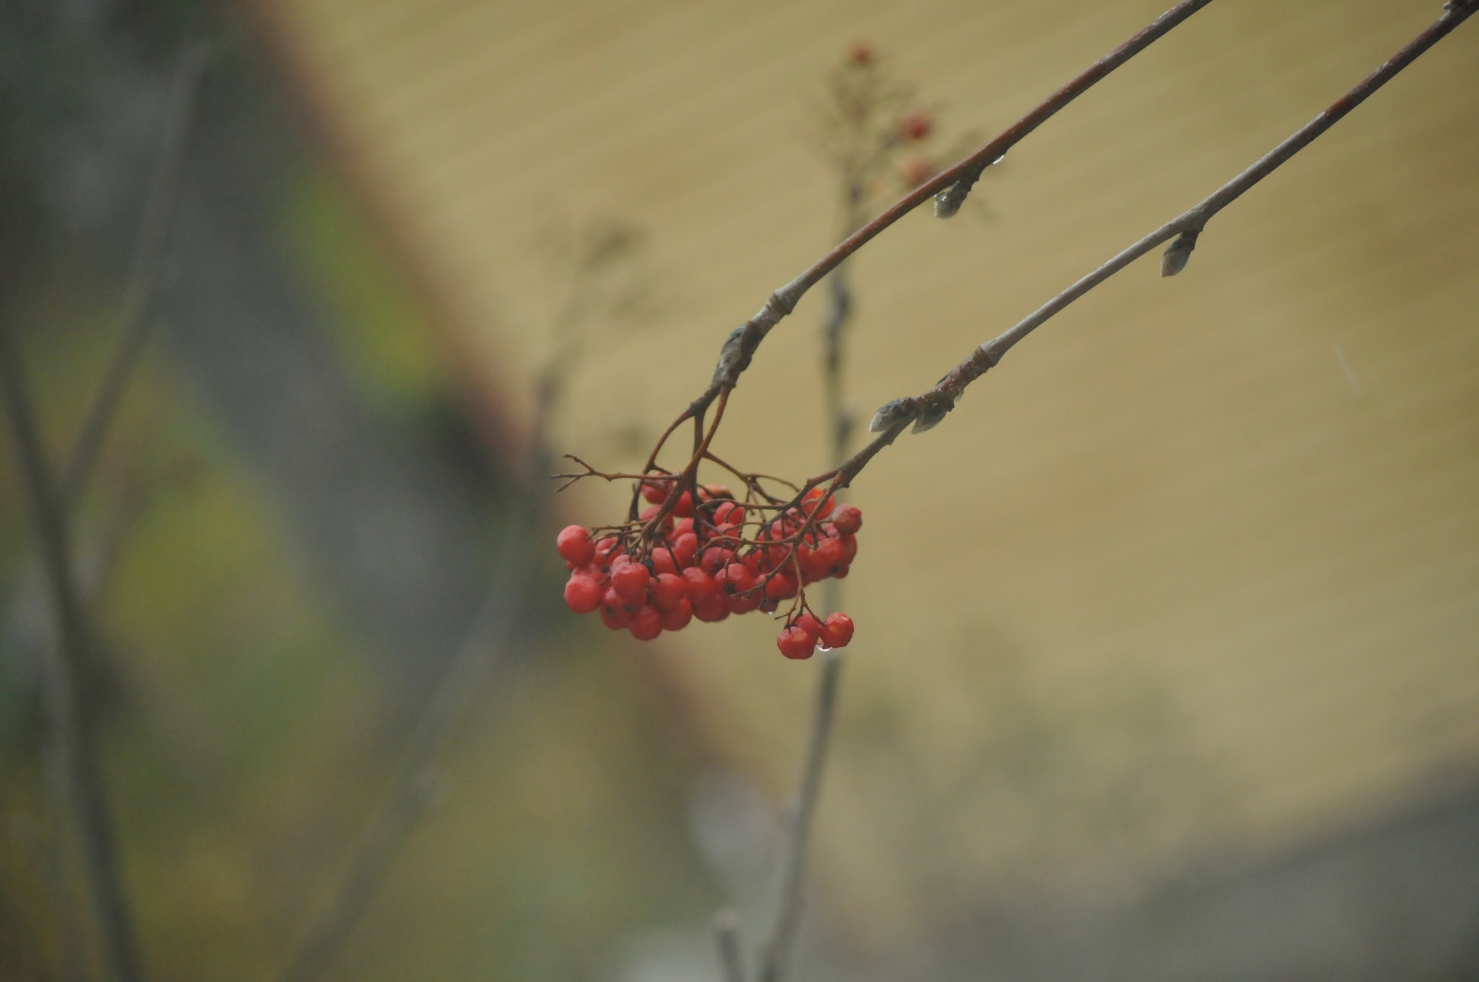
Greetings from Tomorrow
Calendar 2017

Slide 2
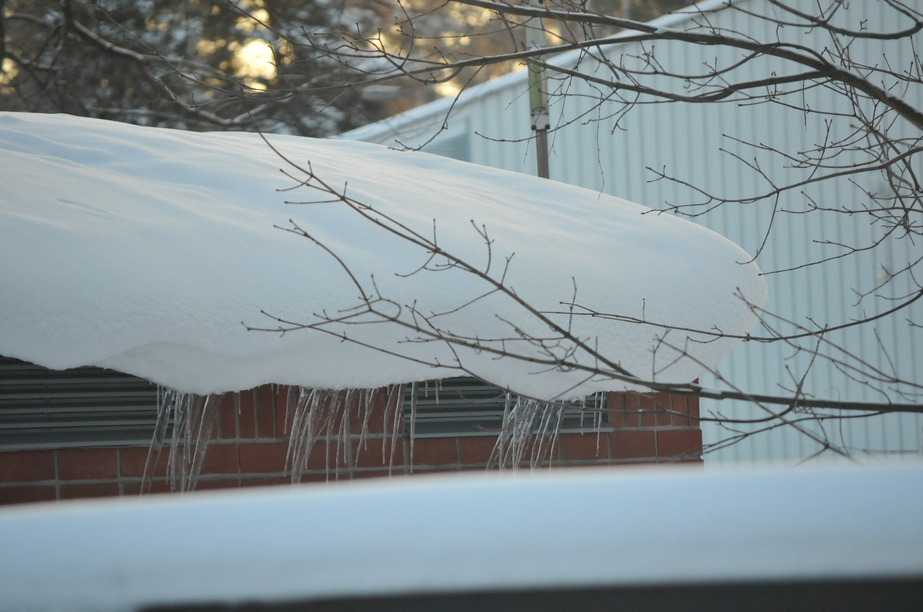

Slide 3
January
Monday | Tuesday | Wednesday | Thursday | Friday | Saturday | Sunday
 |  |  |  |  |  | 1 New Year's Day
2 | 3 | 4 | 5 | 6 | 7 | 8
9 | 10 | 11 | 12 | 13 | 14 | 15
16 | 17 | 18 | 19 | 20 | 21 | 22
23 | 24 | 25 | 26 | 27 | 28 | 29
30 | 31

Slide 5
February
Monday | Tuesday | Wednesday | Thursday | Friday | Saturday | Sunday
 |  | 1 | 2 | 3 | 4 France: spring holiday 4 - 19 Feb Romania: spring holiday 4 - 12 Feb | 5
6 | 7 | 8 | 9 | 10 | 11 | 12
13 | 14 | 15 | 16 | 17 | 18 | 19
20 Finland: winter holiday 20 - 26 Feb | 21 | 22 | 23 | 24 | 25 | 26
27 | 28

Slide 6


Slide 7
March
Monday | Tuesday | Wednesday | Thursday | Friday | Saturday | Sunday
 |  | 1 | 2 | 3 Bulgaria: Liberation day | 4 | 5
6 Exchange in Bulgaria 6 - 10 March | 7 | 8 | 9 | 10 | 11 | 12
13 | 14 | 15 | 16 | 17 | 18 | 19
20 | 21 | 22 | 23 | 24 | 25 | 26
27 | 28 | 29 | 30 | 31

Slide 8
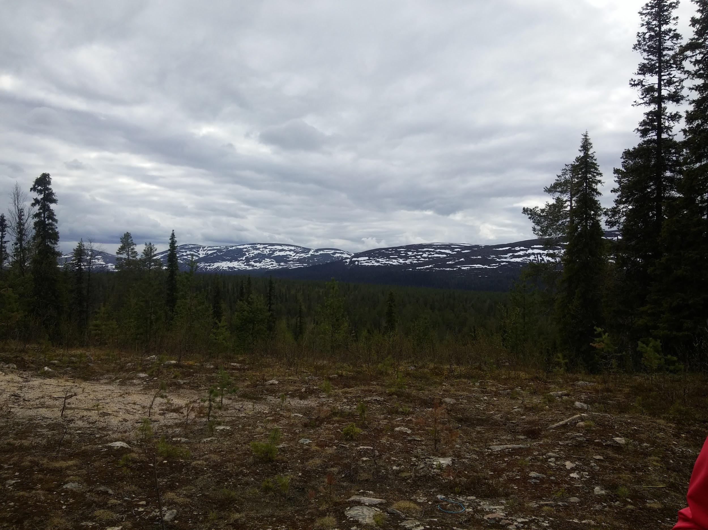

Slide 9
April
Monday | Tuesday | Wednesday | Thursday | Friday | Saturday | Sunday
 |  |  |  |  | 1 France: Easter holiday 1 - 17 April | 2
3 | 4 | 5 | 6 | 7 | 8 | 9
10 | 11 | 12 | 13 Italy: Easter holiday 13 - 18 April | 14 Good Friday Finland: Easter holiday 14 - 17 April | 15 | 16 Easter Sunday
17 Easter Monday | 18 Romania: holiday 18 - 30 April | 19 | 20 | 21 | 22 Earth Day | 23
24 Exchange in France 24 - 28 April | 25 Italy: Liberation Day | 26 | 27 | 28 | 29 | 30

Slide 10
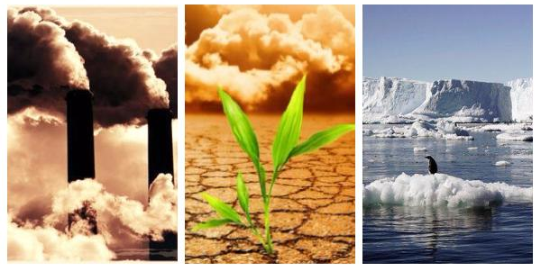

Slide 11
May
Monday | Tuesday | Wednesday | Thursday | Friday | Saturday | Sunday
1 May Day Labour day | 2 | 3 | 4 | 5 | 6 Bulgaria: St George day, Day of the Bulgarian army | 7
8 Armistice day 1945 (France) | 9 | 10 | 11 | 12 | 13 | 14
15 | 16 Transnational meeting in Italy | 17 | 18 | 19 | 20 | 21
22 | 23 | 24 Bulgaria: Day of Enlightenment and Culture | 25 Ascension Day | 26 | 27 | 28
29 | 30 | 31

Slide 12
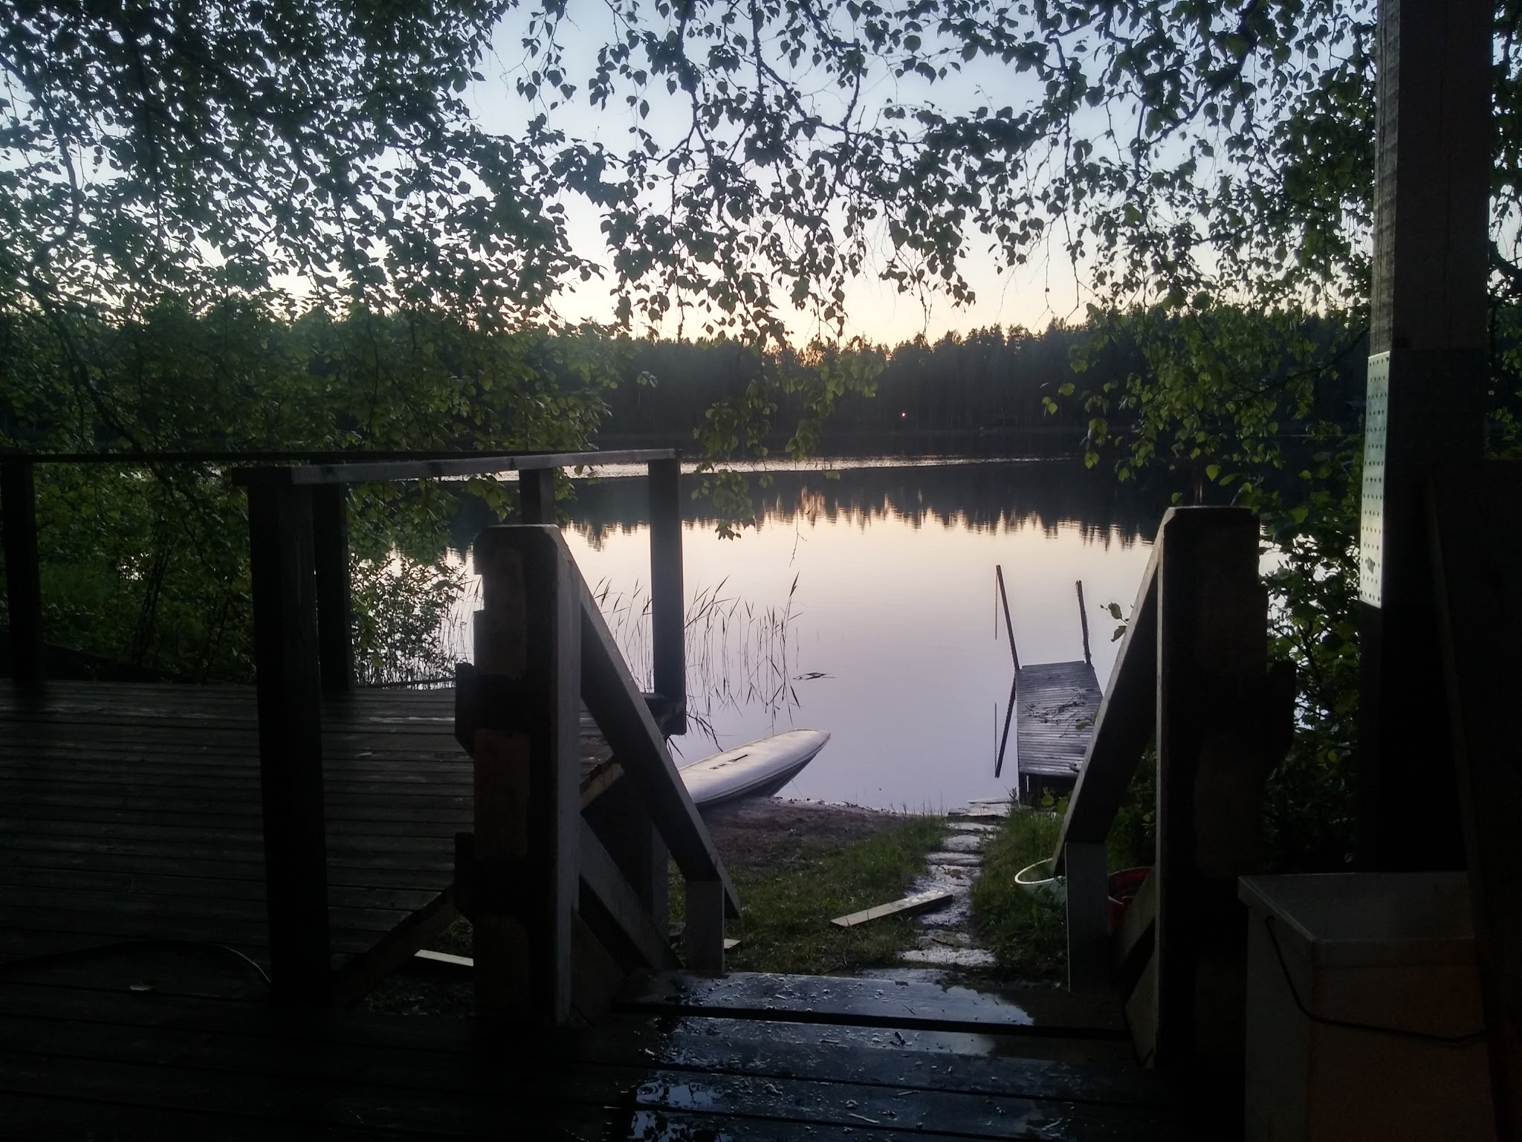

Slide 13
June
Monday | Tuesday | Wednesday | Thursday | Friday | Saturday | Sunday
 |  |  | 1 | 2 Italy: National Day | 3 | 4 Finland: Summer holiday 4 June - 9 August
5 France: Whit Monday | 6 | 7 | 8 | 9 | 10 | 11
12 Italy: national exams 12 - 30 June | 13 | 14 | 15 | 16 | 17 | 18
19 | 20 Romania: national exams 20 June - 15 July | 21 | 22 | 23 | 24 Finland: Midsummer Day | 25
26 | 27 | 28 | 29 | 30 Italy: summer holiday 30 June - 1 Sep

Slide 14


Slide 15
July
Monday | Tuesday | Wednesday | Thursday | Friday | Saturday | Sunday
 |  |  |  |  | 1 | 2
3 | 4 | 5 | 6 | 7 | 8 France: summer holiday 8 July - 3 Sep | 9
10 | 11 | 12 | 13 | 14 France: National Day | 15 Romania: summer holiday 15 July - 10 Sep | 16
17 | 18 | 19 | 20 | 21 | 22 | 23
24 | 25 | 26 | 27 | 28 | 29 | 30
31

Slide 16
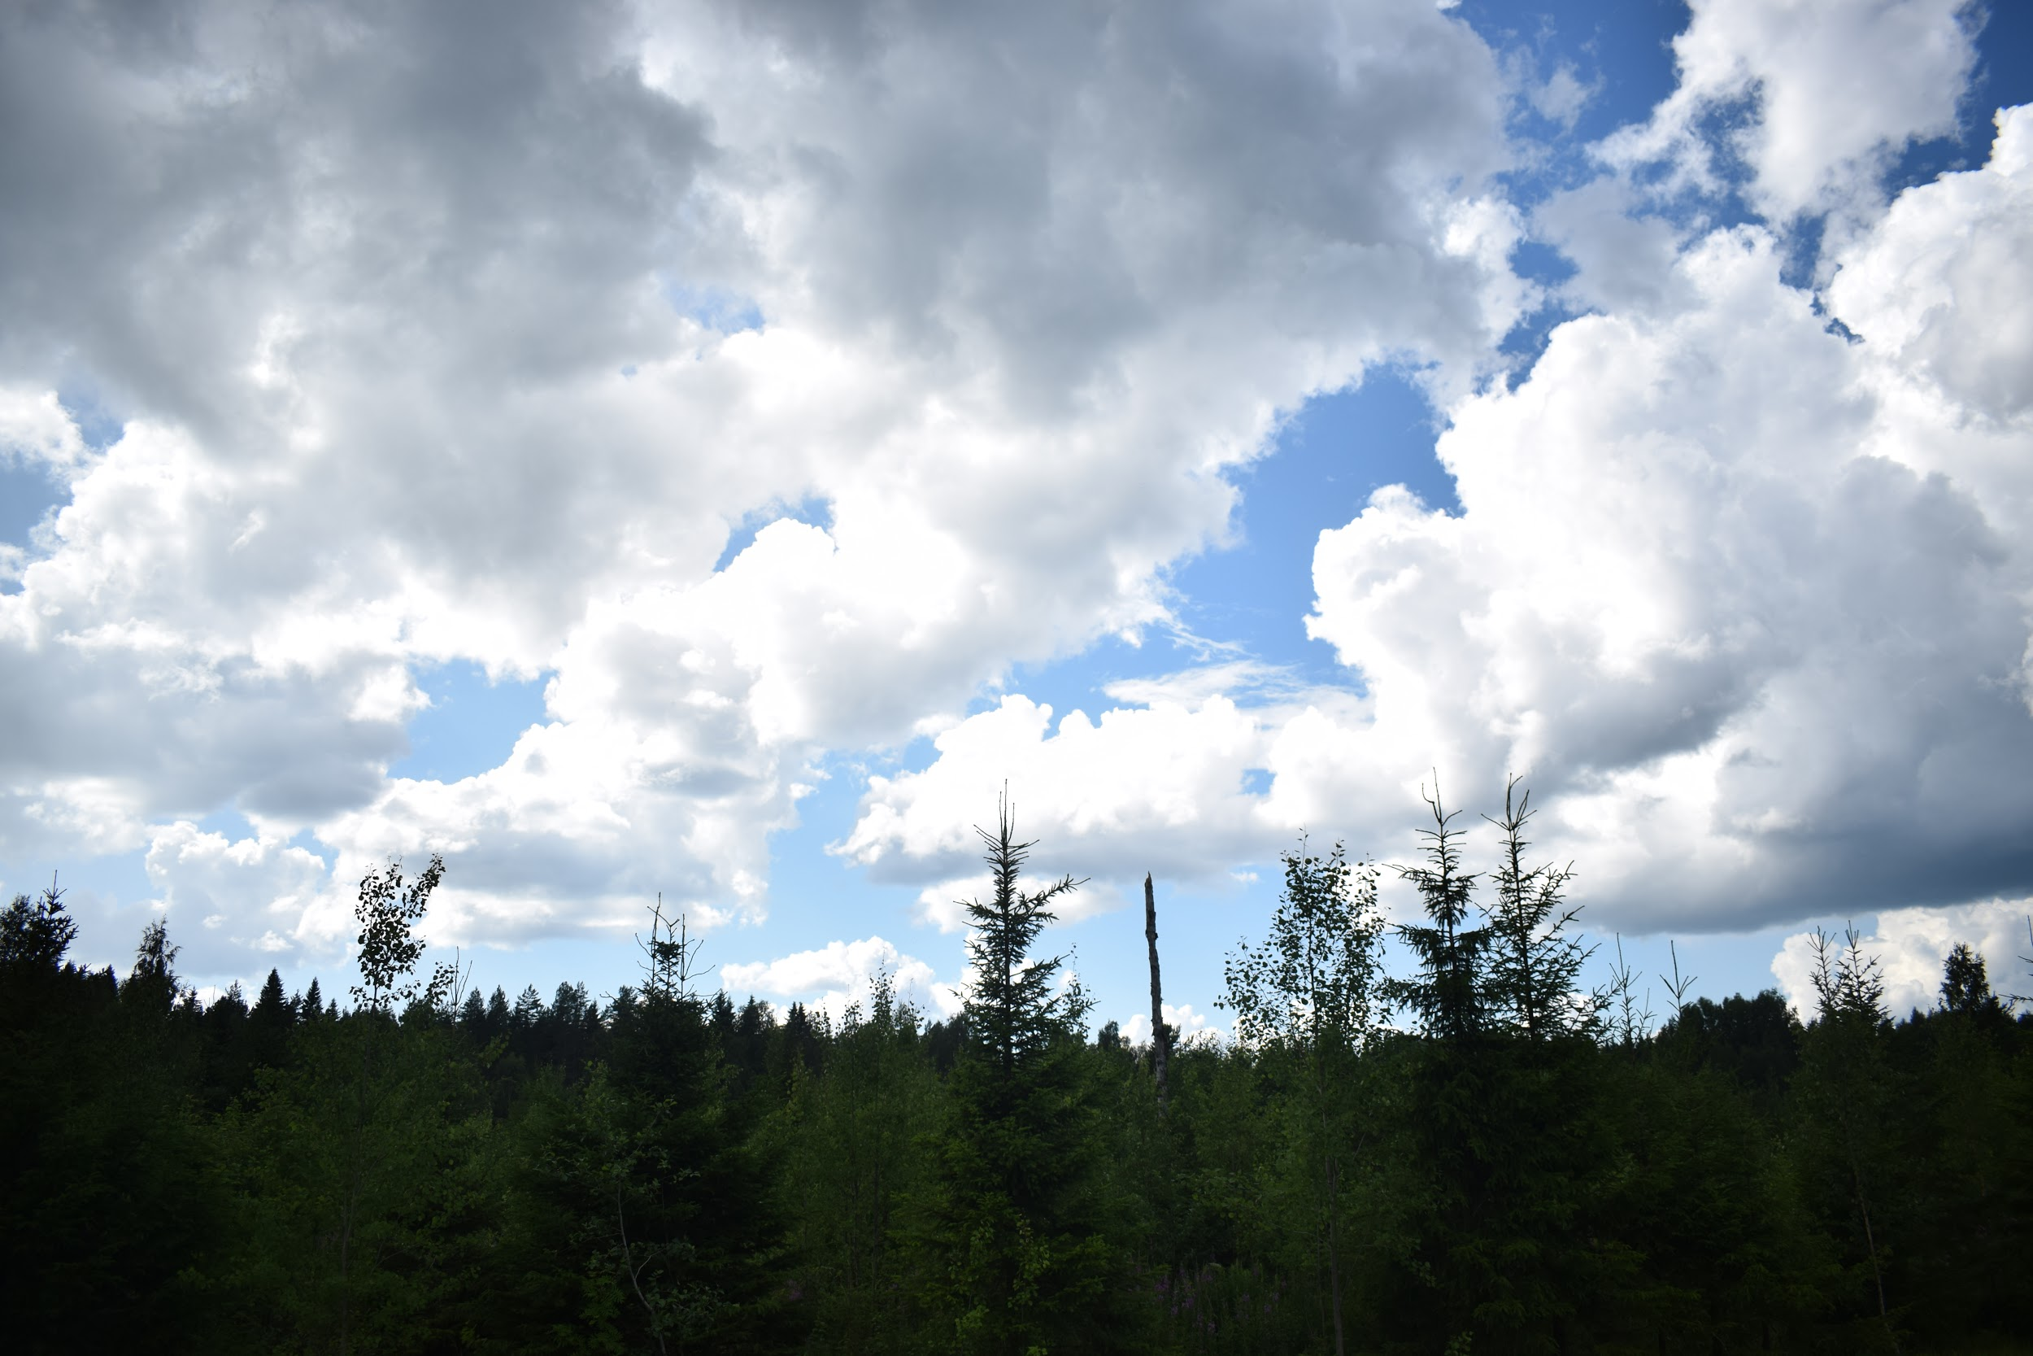

Slide 17
August
Monday | Tuesday | Wednesday | Thursday | Friday | Saturday | Sunday
 | 1 | 2 | 3 | 4 | 5 | 6
7 | 8 | 9 | 10 | 11 | 12 | 13
14 | 15 France: Assumption Day | 16 Italy: St Rocco patronal day | 17 | 18 | 19 | 20
21 | 22 | 23 | 24 | 25 | 26 | 27
28 | 29 | 30 | 31

Slide 18
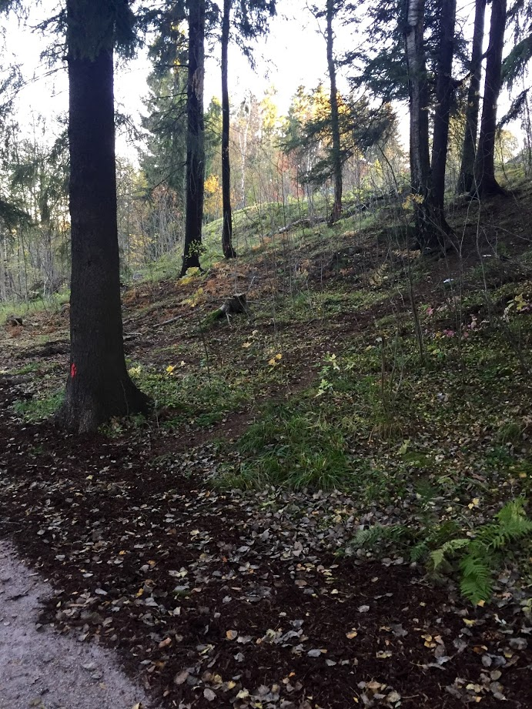
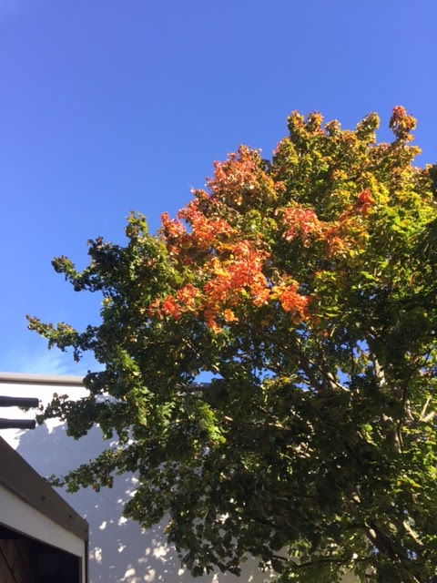


Slide 19
September
Monday | Tuesday | Wednesday | Thursday | Friday | Saturday | Sunday
 |  |  |  | 1 | 2 | 3
4 | 5 | 6 Bulgaria: Unification Day | 7 | 8 | 9 | 10
11 | 12 | 13 | 14 | 15 | 16 | 17
18 | 19 | 20 | 21 | 22 Bulgaria: Independence day | 23 | 24
25 | 26 | 27 | 28 | 29 Italy: St Michele Day in S.Angelo le Fratte | 30

Slide 20
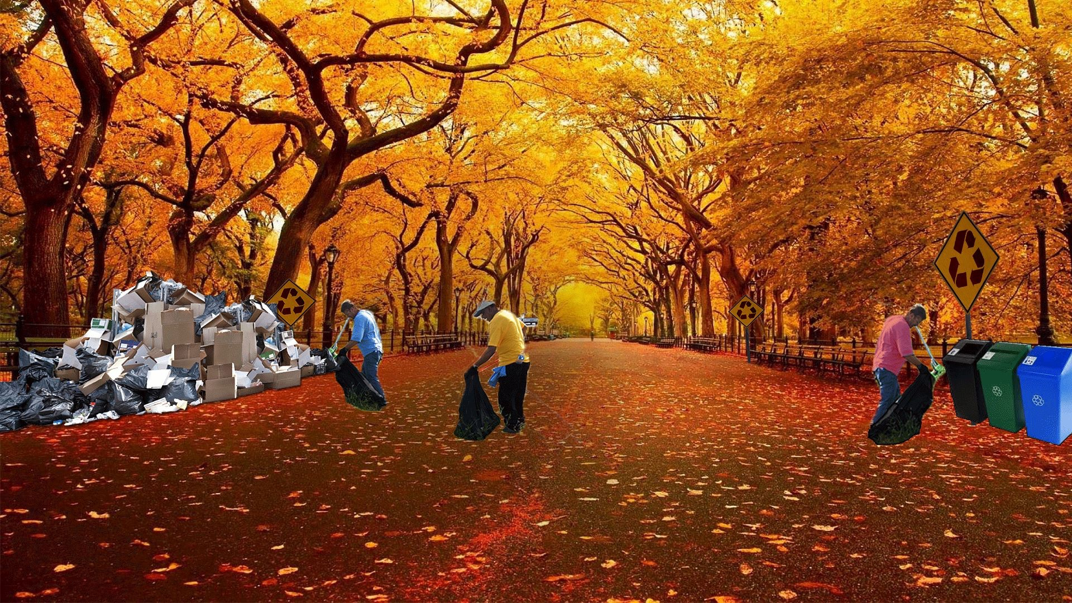

Slide 21
October
Monday | Tuesday | Wednesday | Thursday | Friday | Saturday | Sunday
 |  |  |  |  |  | 1
2 Exchange in Romania 2 - 6 Oct | 3 | 4 | 5 | 6 | 7 | 8
9 | 10 | 11 | 12 | 13 | 14 | 15
16 Finland: autumn holiday 16 - 22 Oct | 17 | 18 | 19 | 20 | 21 France: autumn holiday 21 Oct - 5 Nov | 22
23 | 24 | 25 | 26 | 27 | 28 | 29
30 | 31

Slide 22


Slide 23
November
Monday | Tuesday | Wednesday | Thursday | Friday | Saturday | Sunday
 |  | 1 All Saints Day | 2 | 3 | 4 | 5
6 | 7 | 8 | 9 | 10 | 11 France: Armistice Day 1918 | 12
13 | 14 | 15 | 16 | 17 | 18 | 19
20 | 21 | 22 | 23 | 24 | 25 | 26
27 | 28 | 29 | 30 Romania: St Andrei

Slide 24
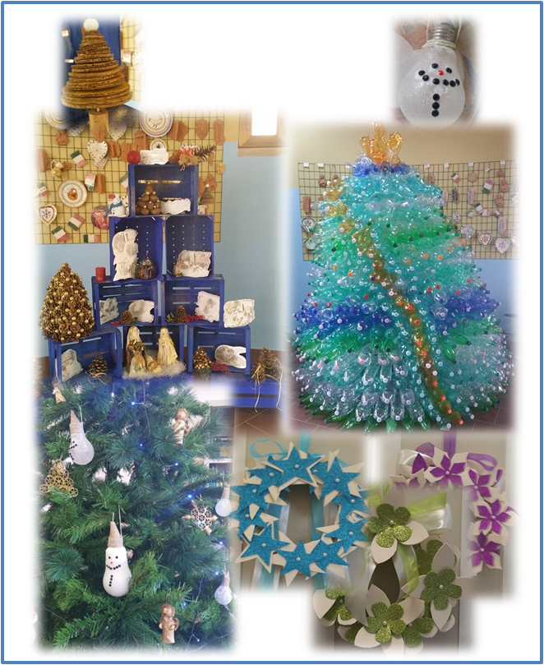

Slide 25
December
Monday | Tuesday | Wednesday | Thursday | Friday | Saturday | Sunday
 |  |  |  | 1 Romania: National Day | 2 | 3
4 | 5 | 6 Finland: Independence Day | 7 | 8 Italy: Immaculate Conception Day | 9 | 10
11 | 12 | 13 | 14 | 15 | 16 | 17
18 | 19 | 20 | 21 | 22 | 23 France: Christmas holiday 23 Dec - 7 Jan 2018 | 24 Christmas Eve
25 Christmas Day | 26 Boxing Day | 27 | 28 | 29 | 30 | 31

Slide 26

This project is co-funded by the European Union

