Slide 1
Learning Teaching Training Meeting
November 19th 2020

Slide 2
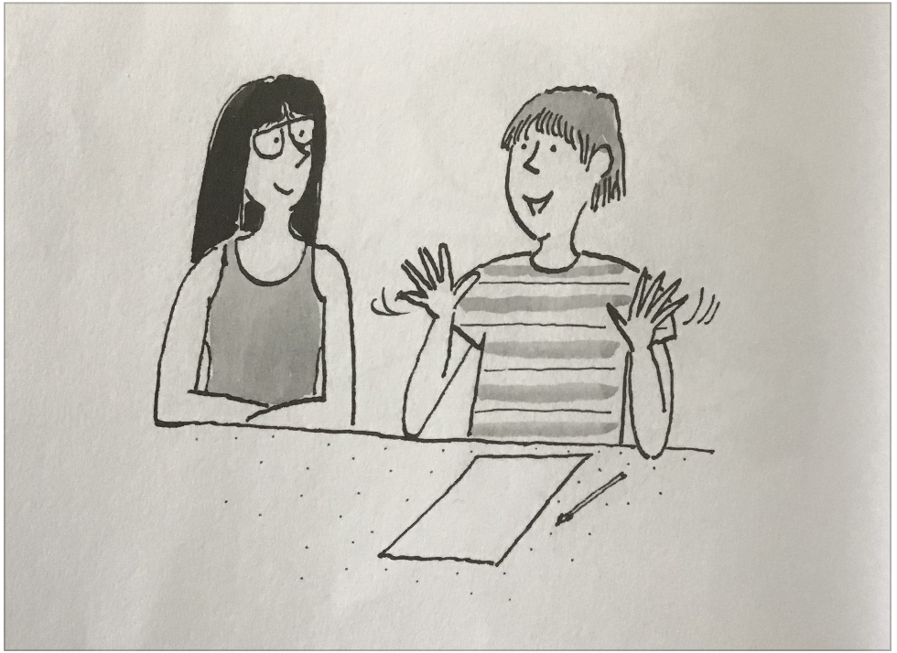
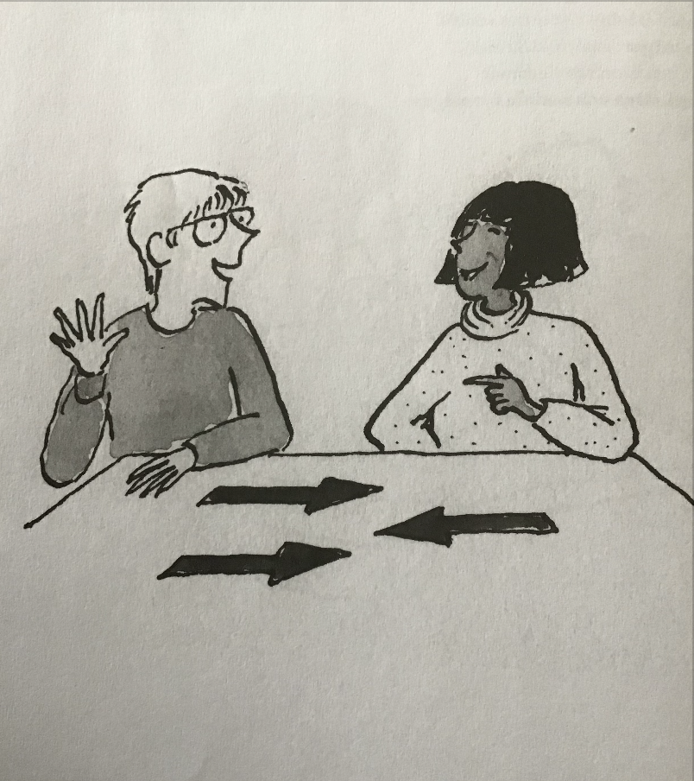
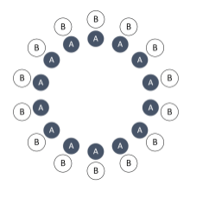
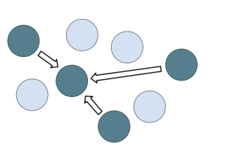
COOPERATIVE LEARNING

Slide 3
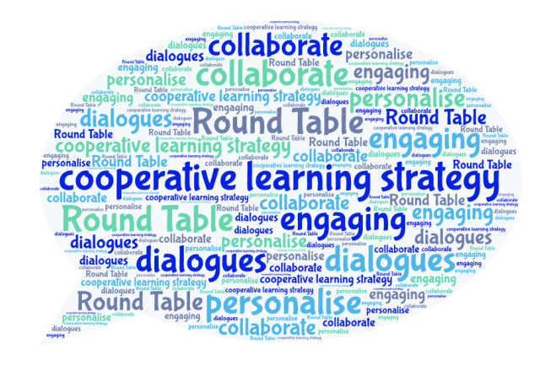
Thoughts from great thinkers...
Thoughts from great thinkers...​
John Dewey – believed that knowledge comes in community with others
Kurt Lewin – contributed with thoughts on group dynamics
Morton Deutsch – found out that groups that cooperate are more productive than individuals who compete
Lev Vygotsky – believed that learning is a social process that takes place during interaction with others
Notes:
J Dewey -
K Lewin – a German/American psychologist
M Deutsch – an American psychologist

Slide 4
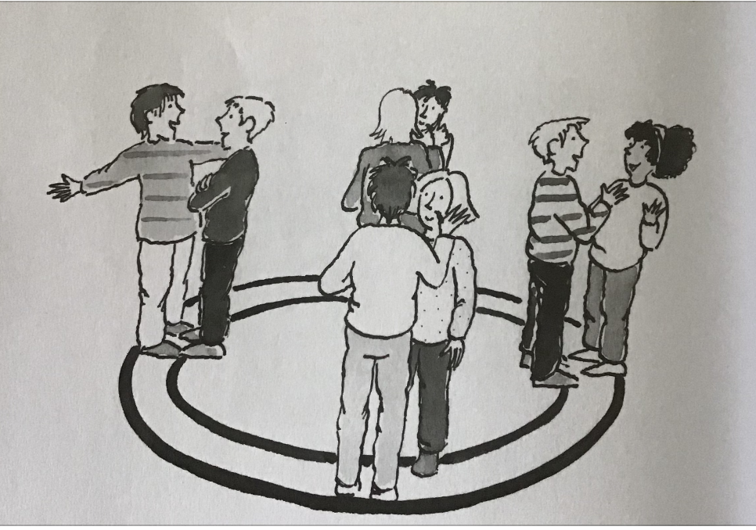
WHAT IS COOPERATIVE LEARNING?
“A teaching arrangement that refers to small, heterogeneous groups of students working together to achieve a common goal.
Students work together to learn and are responsible for the teammate‟s learning as well as their own.” (S Kagan 2010)

Slide 5
TRADITIONAL NORMS VS COOPERATIVE NORMS
Traditional norms | Cooperative norms
Just do your own work | Help others succeed
Mind your own business | Take responsibility for both yourself and your group
Don't care what others do | Take responsibility for the group's results, tell others and listen
Don't give others advise | Ask others what they think
Do not ask others for help | Ask others for help
Just the teacher is helping the students | Students help each other
Be quite! | Be active! Talk!

Slide 6
BASIC ELEMENTS OF COOPERATION
There are five basic elements that allow successful small-group learning.
The elements ensure that as many pupils as possible are active at the same time.
Positive Interdependence
Individual and group accountability
​
Simultaneous interaction
​
Face-to-Face Interaction
Group processing
Notes:
De 4 grundprinciperna:
Positivt ömsesidigt beroende
Eget ansvar
Lika delaktighet
Samtidig interaktion
Återkoppling

Slide 7
Positive Interdependence
Has two dimensions: one related to the word "positive" and the other related to the word "interdependence."
​
The word positive refers to a positive correlation of student outcomes; the word interdependence refers to situations in which students need the help of their classmates.
​
Having a positive correlation among outcomes puts students on the same side; they encourage and help each other. Interdependence goes a step further and makes the contribution of one necessary for the success of another, so students need each other to do well.
Notes:
Positivt ömsesidigt beroende

Slide 8
Individual and group accountability
The group is accountable for achieving its goals, and each member must be accountable for contributing a fair share of the work toward the group goal.
Notes:
Eget ansvar

Slide 9
Face-to-Face Interaction
Students promote each other's success by sharing resources.
They help, support, encourage, and praise each other's efforts to learn.
The environment encourages discussions and eye contact.
Notes:
Lika delaktighet

Slide 10
Simultaneous interaction
The more students talk with each other, the more they'll be engaged and the better they'll learn.
Notes:
Samtidig interaktion

Slide 11
Group processing
Group members analyze their own and the group's ability to work together.
​
Reflection and evaluation are important when students collaborate. In order for the groups to be able to reflect and evaluate their work efforts and the quality of the collaboration, clear and evaluable goals are required.

