Slide 1
STRESSES

Slide 2
Where are the stresses?
Do you want some ice-cream?
She’s doing her homework
Where do you come from?
How old are you?
What’s your name?

Slide 3
Where are the STRESSes?
DO you WANT some ICE-CREAM?
She’s DOing her HOMEwork
WHERE do you COME from?
HOW OLD are you?
WHAT’S your NAME?

Slide 4
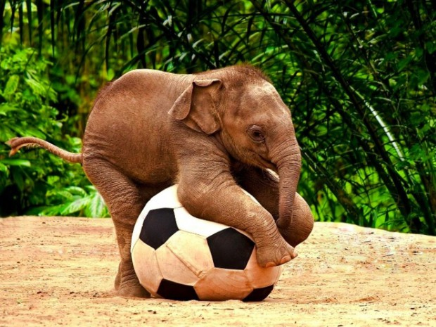
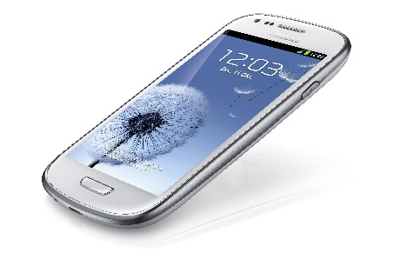
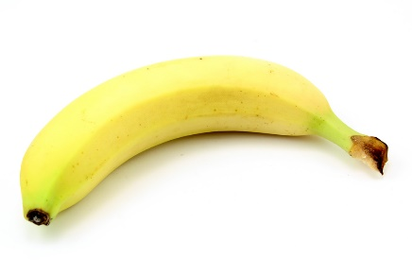
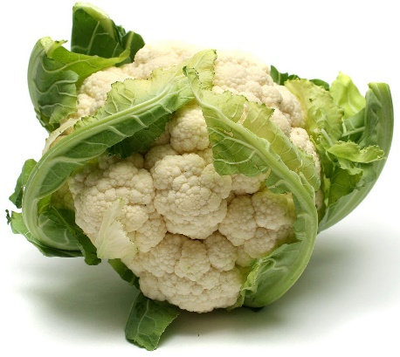
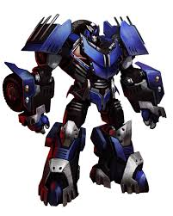
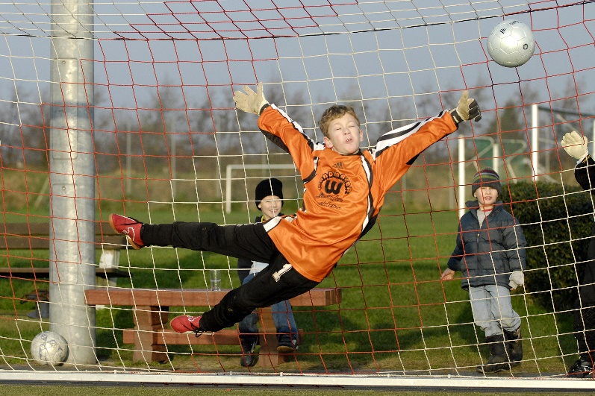
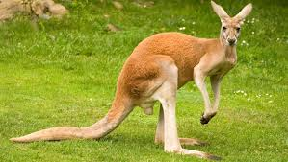
elephant
balloon
computer
banana
mobile
transformer
kangaroo
goalkeeper
cauliflower
empeefour (MP4)

Slide 5
ELephant
ballOON
comPUter
baNAna
MObile
transFORMer
kangaROO
GOALkeeper
CAULiFLOWer
empeeFOUR

