Slide 1
The writer, the ripper and the runner
Anne Rage Anca Couasnon
Structured Course Cyprus
10-14 September 2018
Alan Marsh

Slide 2
PLATEHEN
ELEPHANT

Slide 3
LOIAGLR
GORILLA

Slide 4
KNEYOM
MONKEY

Slide 5
AEECNMOLH
CHAMELEON

Slide 6
IPNECAEMZH
CHIMPANZEE

Slide 7
RAANCY
CANARY

Slide 8
RPTORA
PARROT

Slide 9
MUSIOQTO
MOSQUITO

Slide 10
YRNGFDAOL
DRAGONFLY

Slide 11
EKANSELTTAR
RATTLESNAKE

Slide 12
OGONKRAA
KANGAROO

Slide 13
IRORSEHNCO
RHINOCEROS

Slide 14
RNNUTOAAG
ORANGUTAN

Slide 15
LIPENAC
PELICAN

Slide 16
WORD STATUES Ready?

Slide 17
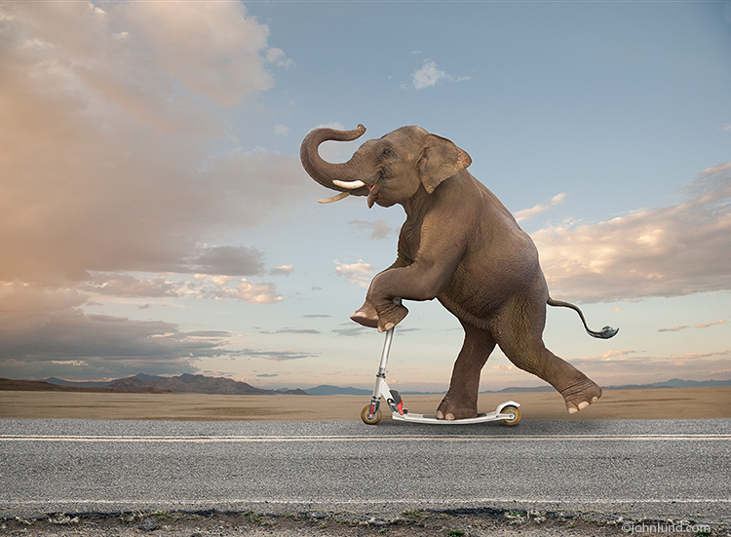

Slide 18
E-le-phant

Slide 20
go-RI-lla

Slide 22
MON-key

Slide 24
cha-ME-le-on

Slide 26
Chim-pan-ZEE

Slide 28
ca-NA-ry

Slide 30
PA-rrot

Slide 32
mos-QUI-to

Slide 34
DRA-gon-fly

Slide 36
RA-ttle-snake

Slide 38
kan-ga-ROO

Slide 40
rhi-NO-ce-ros

Slide 42
o-rang –u-TAN

Slide 44
PE-li-can

Slide 45
Lien vers notre espace Etwinning:
https://twinspace.etwinning.net/68515/home

Slide 46
Thank you very much!

