Slide 1
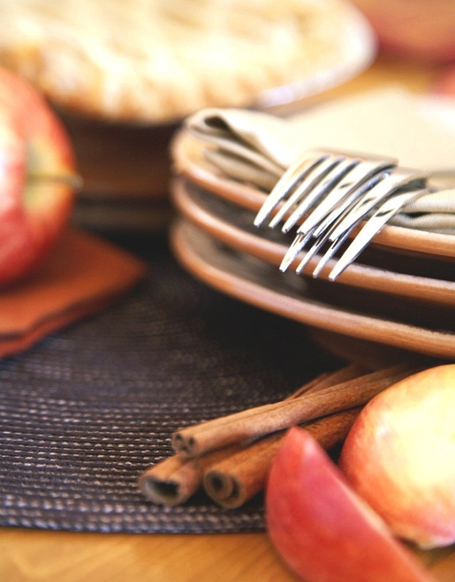
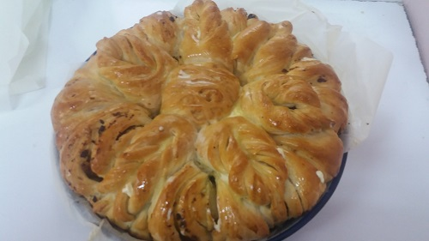
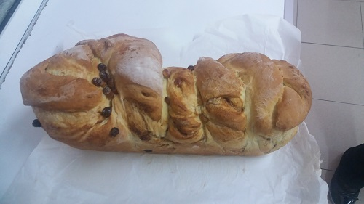
Next step of social life learning through English
Erasmus+
Notes:
ЗАБЕЛЕЖКА: За да заместите картина, просто я изберете и изтрийте. След това използвайте иконата за вмъкване на картина, за да я заместите с една от вашите собствени картини!

Slide 2
English lesson:
Cooking traditional Easter food
Bread wreath with cheese and sesame
Bulgarian Easter Bread (Kozunak)
Vocabulary

Slide 3
Bread wreath with cheese and sesame
Easter traditional food

Slide 4
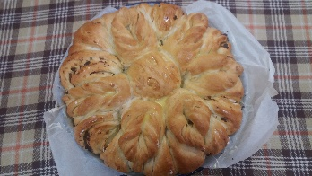
Bread wreath with cheese and sesame
Ingredients
Directions

Slide 5
Bread wreath with cheese and sesame
Ingredients:
For the dough:
500-550 g of flour (and extra for mixing)
1 egg
250 ml of fresh milk, warmed
2 tablespoons olive oil
1 teaspoon sugar
1 teaspoon salt
20 g fresh yeast (or 7 g dry
60 g butter, softened

Slide 6
Bread wreath with cheese and sesame
Ingredients:
For the stuffing:
100-120 g yellow cheese
For glaze:
1 egg, slightly broken
1 tablespoon Sesame seed
1 tablespoon Poppy seed

Slide 7
Bread wreath with cheese and sesame
Directions:
In the baker's container, mix the fresh milk, eggs, olive oil, salt and sugar, the yeast and activate the "Dough" program, letting the products mix for 4-5 minutes. We add the flour gradually - to a smooth and tight dough. We wait for the program to finish - and if we hurry, after the kernel signal, we transfer the dough covered with stretch foil into a preheated 45C or 40С fan with oven for 10-15 minutes or until the dough doubles its size.

Slide 8
Bread wreath with cheese and sesame
Directions:
Place over a plastic wrap on a sheet, roll in a tight roll and store in the refrigerator, freezing in advance for 2-3 minutes - for easier slicing or for 4-5 minutes - for easier grating.
Preheat the oven up to 45 ° C or 40 ° C with a fan. Cover a shallow tray with baking paper and leave aside. Pour the dough over the griddle and mix for a short time. Roll a rectangular crust 40 x 60 cm and a thickness of about 1/2 cm. Grate the cheese and at least the half of butter (grated)

Slide 9
Bread wreath with cheese and sesame
Directions:
Roll longitudinally into a tight roll, transfer to a baking sheet and turn on a wreath.
Using a sharp knife or scissors, cut into triangles - down and at regular intervals, the rounded roll. Cover with a cotton towel and let it heat in a warmer or preheated oven for up to 45 ° C or 40 ° C for 10-15 minutes or until the dough doubles its size.

Slide 10
Bread wreath with cheese and sesame
Directions:
Heat the oven at 180 ° C or 160 ° C with a fan.
Press each of the triangles in the middle with the handle of a wooden spoon to better open the layers of the roll.
Brush the wreath with the beaten egg and sprinkle with poppy and sesame seeds.
Bake in oven preheated to 180C or 160C with a fan for 25-30 minutes, or golden brown - stuck in the middle of the wreath to check is it ready - the stick should go out dry.

Slide 11
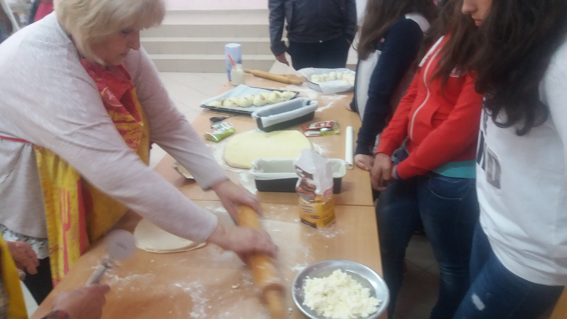
Bread wreath with cheese and sesame

Slide 12
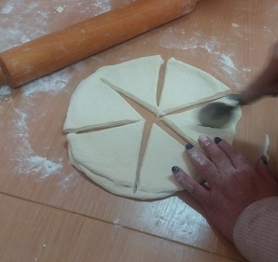
Bread wreath with cheese and sesame

Slide 13
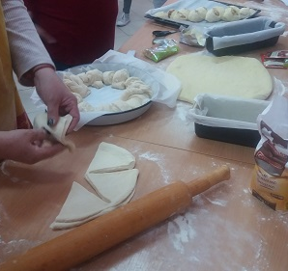
Bread wreath with cheese and sesame

Slide 14
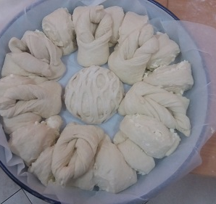
Bread wreath with cheese and sesame

Slide 15
Bulgarian Easter Bread (Kozunak)
Easter traditional food

Slide 16
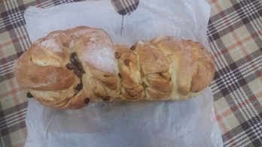
Bulgarian Easter Bread (Kozunak)
Ingredients
Directions

Slide 17
Bulgarian Easter Bread (Kozunak)
Ingredients:
3 eggs, beaten lightly
150 -200 g sugar
30 g (3/4 cube) fresh yeast (or 10 g dry yeast)
200 g sour cream
60 g butter, melted
40 ml vegetable oil
pinch salt
1/2 tablespoon Lemon juice

Slide 18
Bulgarian Easter Bread (Kozunak)
Ingredients:
1 tablespoon Pure vanilla extract
1 teaspoon rum emulsion (optional flavor, or 1 teaspoon of rum)
650 g sifted flour, plus extra if necessary. Fat for mixing and shaping
For the stuffing:
100 g of chopped walnuts (or optional nuts)
100 grams of raisins (or preferred dried fruit)

Slide 19
Bulgarian Easter Bread (Kozunak)
Ingredients:
For glaze:
1 egg, slightly broken
1 tablespoon Sesame seed
1 tablespoon Poppy seed

Slide 20
Bulgarian Easter Bread (Kozunak)
Directions:
In the bakery with activated "Dough" program, we add the products one after another: the lightly broken eggs, the fresh yeast, the sugar, the sour cream, the melted butter and olive oil, some salt, lemon juice, vanilla and rum emulsion, and leave for about 5 minutes.

Slide 21
Bulgarian Easter Bread (Kozunak)
Directions:
Mix well - or until the yeast dissolves completely. We begin to add the flour gradually, and after each addition we wait to take the mixture - until a soft dough is obtained, which separates itself from the walls of the container.

Slide 22
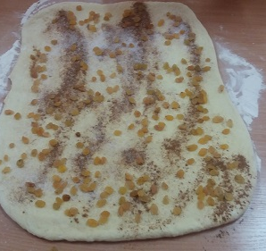
Bulgarian Easter Bread (Kozunak)

Slide 23
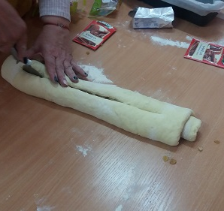
Bulgarian Easter Bread (Kozunak)

Slide 24
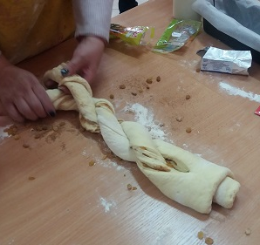
Bulgarian Easter Bread (Kozunak)

Slide 25
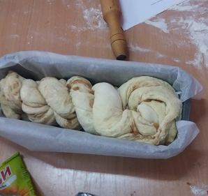
Bulgarian Easter Bread (Kozunak)

Slide 26

Vocabulary
Ingredient – n. /ɪnˈɡriː.di.ənt/a food that is used with other foods in the preparation of a particular dish. One of the parts of something successful
Dough – n./ dəʊ/ flour mixed with water and often yeast, fat, or sugar, so that it is ready for baking
Yeast – n. /jiːst/ a type of fungus that is used in making alcoholic drinks such as beer and wine, and for making bread swell and become light
Sesame seed –n. /ˈses.ə.mi ˌsiːd/ a seed of the sesame plant, whose seeds are added to food or are used to produce oil
Poppy seed – n. /ˈpɒp.i ˌsiːd/ / a seed of the plant with large, delicate flowers that are typically red and have small, black seeds
smooth – adj. /smuːð/ having a surface or consisting of a substance that is perfectly regular and has no holes, lumps, or areas that rise or fall suddenly
tight – adj. /taɪt/ (held or kept together) firmly or closely

Slide 27
Vocabulary
Preheat – v. /ˌpriːˈhiːt/ to heat an oven to a particular temperature before putting food in it
Oven – n. /ˈʌv.ən/ the part of a cooker with a door, used to bake or roast food
Slice –v. /slaɪs/ to cut something into thin, flat pieces
Grate – v. /ɡreɪt/ to rub food against a grater in order to cut it into a lot of small pieces
Pour – v. /pɔːr/ to make a substance flow from a container, especially into another container, by raising just one side of the container that the substance is in
Roll –v. /rəʊl/ to (cause something to) move somewhere by turning over and over or from side to si

Slide 28
Vocabulary
Brush – v. /brʌʃ/ make something smooth with a brush
Bake – v. /beɪk/ to cook inside an oven, without using added liquid or fat
Cover – v. /ˈkʌv.ər/ to put or spread something over something, or to lie on the surface of something
Sprinkle – v. /ˈsprɪŋ.kəl/to drop a few pieces or drops of something over a surface
Stuck – adj. /stʌk/ unable to move, or set in a particular position, place, or way of thinking:
Wreath- n. /riːθ/ an arrangement of flowers and leaves in a circular shape, used as a decoration or as a sign of respect and remembrance for a person who has died
sour cream – n. /ˌsaʊə ˈkriːm/cream made sour by adding special bacteria

Slide 29
Vocabulary
Melt – v. /melt/ to turn from something solid into something soft or liquid, or to cause something to do this
vegetable oil – n. /ˌvedʒ.tə.bəl ˈɔɪl/ cooking oil made from plants
Pure – adj. /pjʊər/not mixed with anything else
Vanilla –n. /vəˈnɪl.ə/ a substance made from the seeds of a tropical plant, used to give flavour to sweet foods
emulsion n. - /ɪˈmʌl.ʃən/a mixture that results when one liquid is added to another and is mixed with it but does not dissolve into it
Sift –v. /sɪft/ to put flour, sugar, etc. through a sieve (= wire net shaped like a bowl) to break up large pieces
Chop- v. /tʃɒp/ to cut something into pieces with an axe, knife, or other sharp instrument

Slide 30
Vocabulary
Stuffing – n. /ˈstʌf.ɪŋ/ material that is pushed inside something to make it firm
Raisin – n. /ˈreɪ.zən/ a dried black grape
Obtain – v. əbˈteɪn/ to get something, especially by asking for it, buying it, working for it, or producing it from something else
Separate – adj. /ˈsep.ər.ət/ existing or happening independently or in a different physical space

