Slide 1
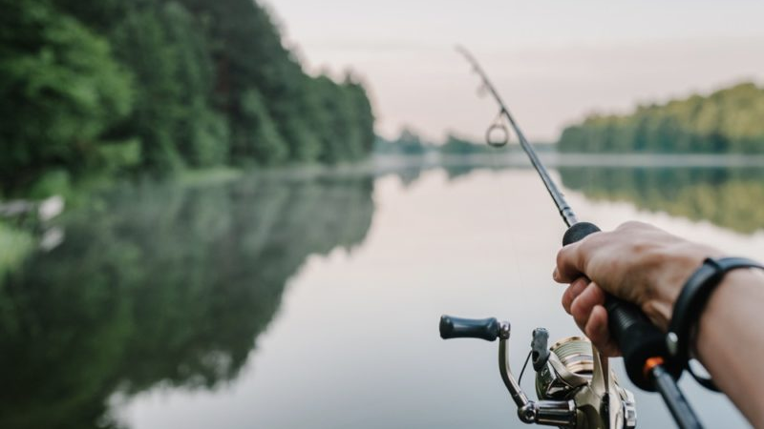
Fishing Gear and their Impacts

Slide 2
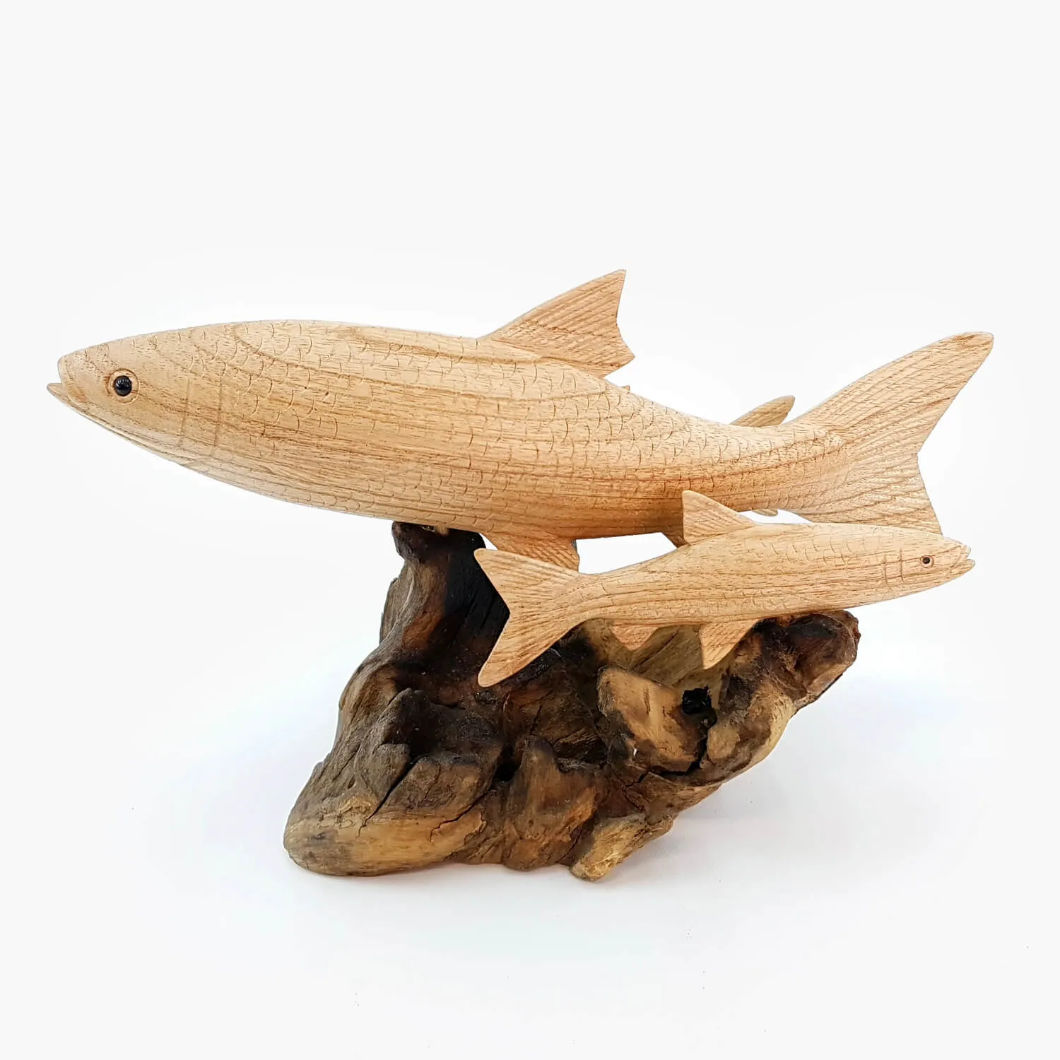
What is fishing?
fishing is an extraction of aquatic organisms from the environment where it develops for various purposes, food, or for industrial edible purposes, including the manufacture of feed for food in rearing and the production of substances.

Slide 3
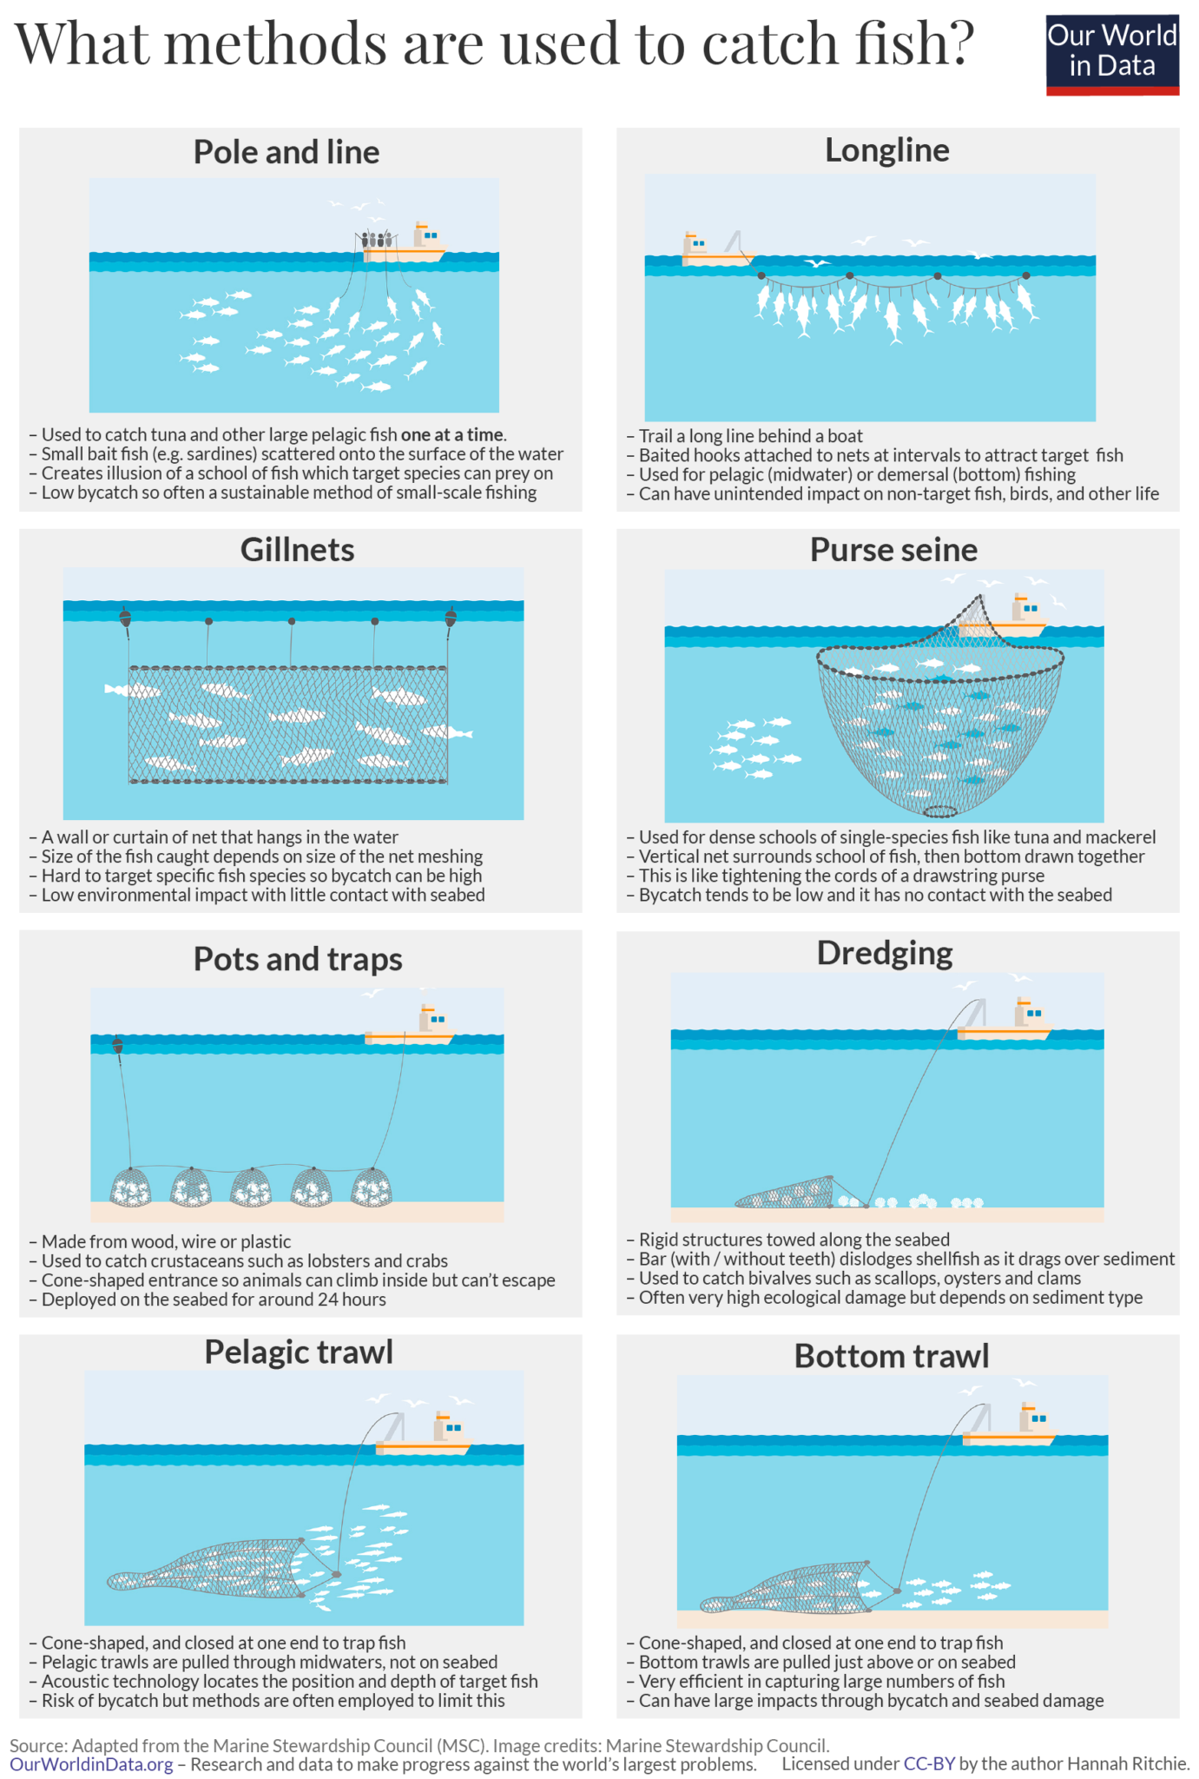
how do we fish?
Different types of fishing:
Common fishing gear in Europe

Slide 4
fishing gears

Slide 5
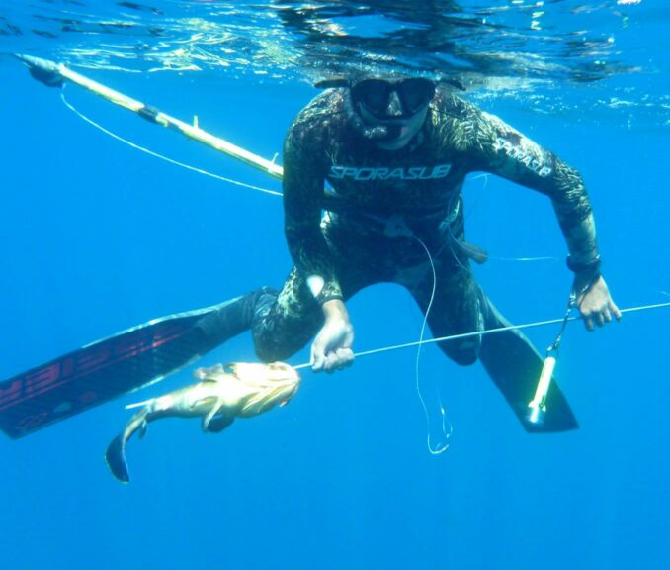
Wound fishing:
It is the type of fishing in which the fish is caught using a utensil, which could be: • By hand - a slingshot; • Throwing - a harpoon.

Slide 6
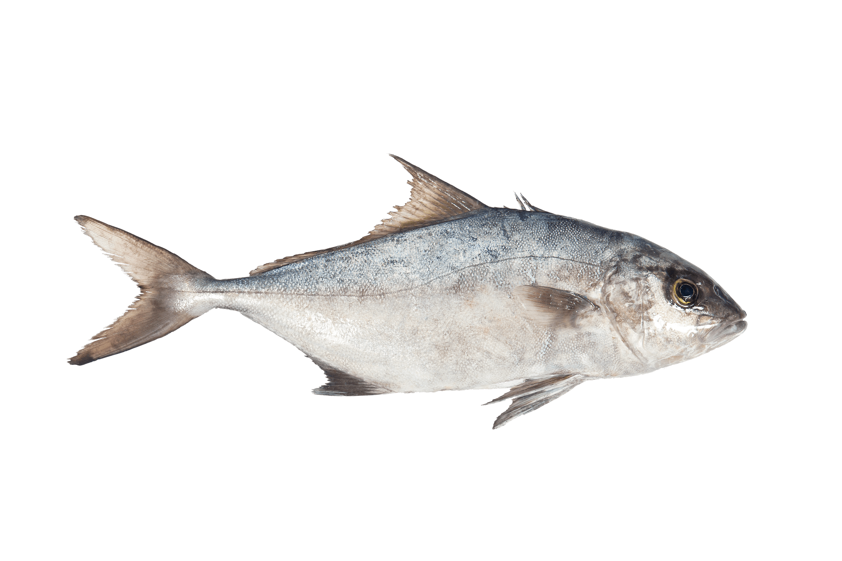
Stunt fishing:
Fish can become lethargic from several types of numbness:
Numbness by mechanical action; • Numbing by chemical action; • Electric shock numbness. With the dormant fish it becomes easy to catch it.

Slide 7
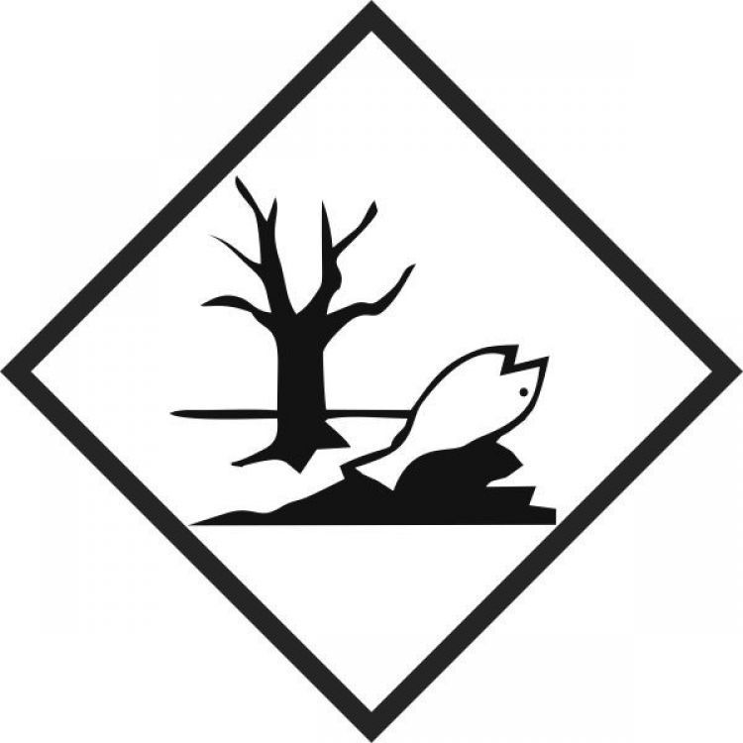
Consequences Of Stunt Fishing
A small change in temperature
A significant reduction in weight gain
A significant reduction in digestive enzyme activities

Slide 8
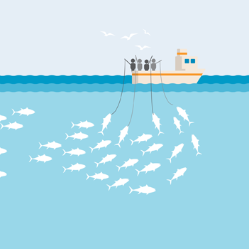
Line fishing:
This method allows for individual fishing. It is used for fishing tuna and other medium-sized fish species. It may or may not be done inside a vessel.

Slide 9
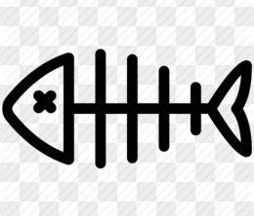
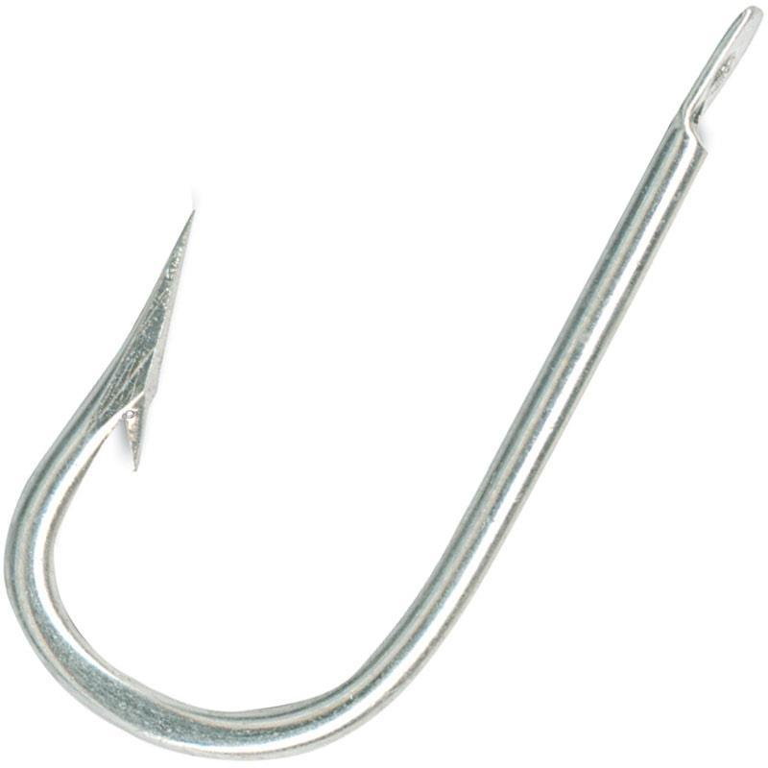
Consequences of Line Fishing
Is that it attracts and easily snags non-target marine life. A wide range of animals such as sea turtles, sharks, seals, seabirds, and marine mammals can get caught on hooks or entangled in fishing line

Slide 10
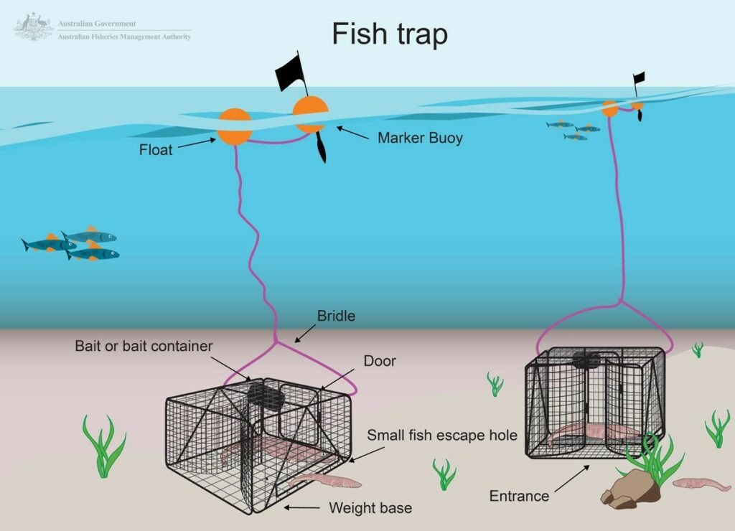
Fishing with traps:
This method consists of getting the fish into the trap using a bait. These are easy to get in, but difficult to get out, so that the fish is trapped inside.

Slide 11
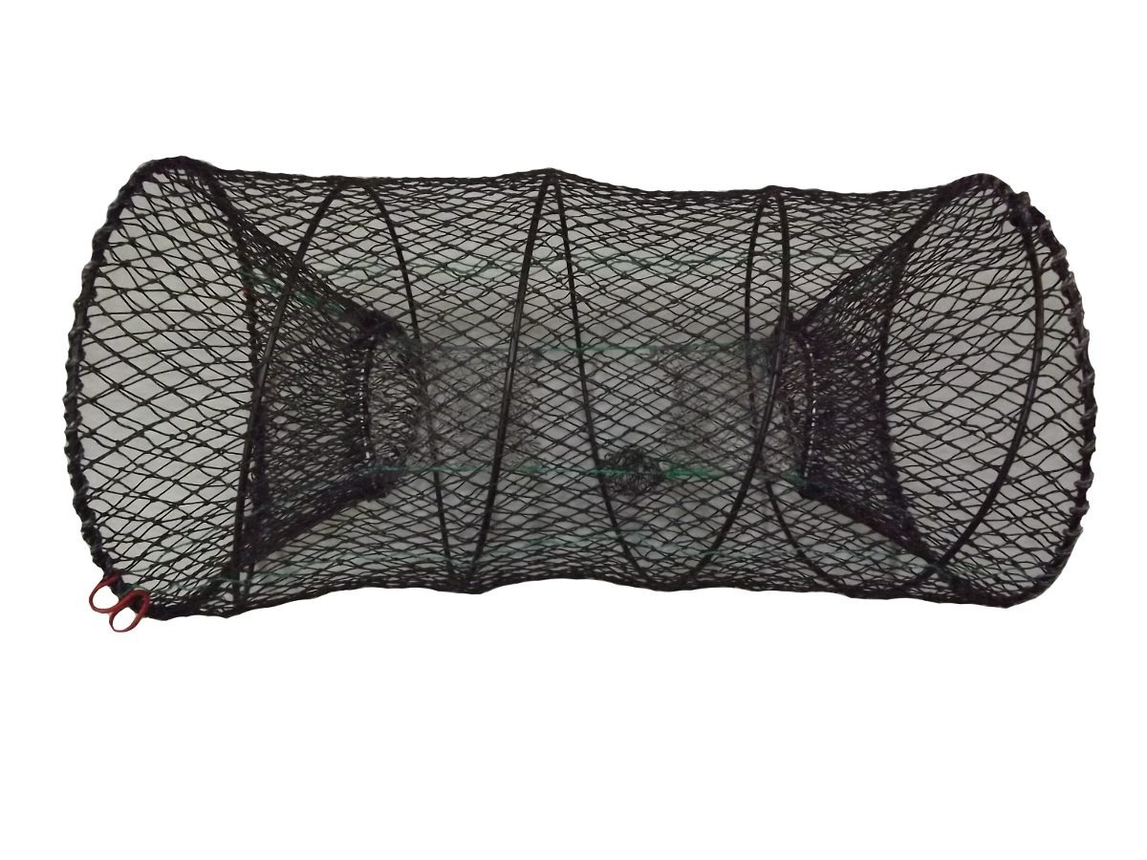
Consequences of Fishing with Traps
Trap fishing causes direct impacts on benthic habitats during setting and retrieval, including dragging along the seafloor, which can lead to the damage and destruction of habitat components such as corals, sponges, and other epifauna

Slide 12
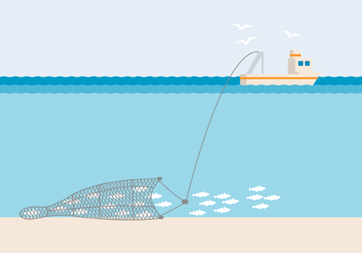
Trawl fishing:
There are several types of trawl fishing. It could be a more artisanal trawl with a hand dredger, or done industrially in trawl fishing vessels.

Slide 13
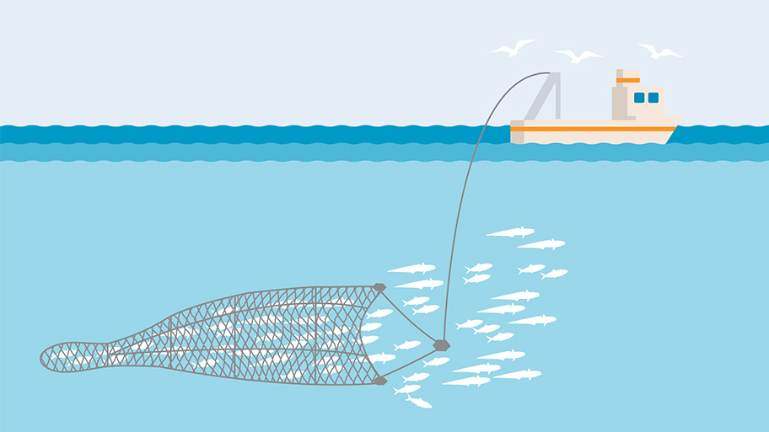
Consequences Of Trawl Fishing
In addition to directly killing many fish of marine species, research has shown that deep-sea trawling is extremely harmful to the seabed. It displaces sediment that destroys the habitat of organisms that live there, increases the opacity of water and makes it unsuitable for many species, and releases pollutants and carbon deposited under the ocean floor.

Slide 14
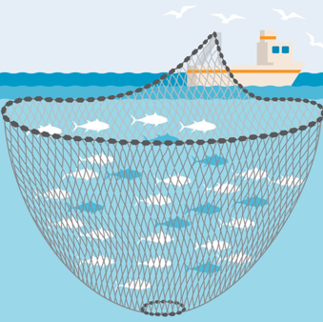
Fishing by encircling art of siege:
In this method, the vessel makes a 360º turn around the shoal to envelop it in the siege. This way the fish will be in the center of the trawl and can be caught.

Slide 15
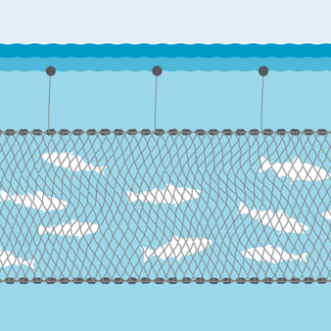
Fishing by gillnetting:
In this type of fishing, the net is left suspended, in a place where it is known that there is a certain type of fish that we intend to catch. When passing through the net, the fish becomes entangled, that is, trapped in its meshes, due to its own movement against the net.

Slide 16
Consequences of Fishing by Gillneting
Gillnet bycatch negatively affects a wide range of species including turtles, marine mammals, sharks and seabirds. For some of these species like turtles, gillnets are considered the main threat to their survival. Lost gillnets can also be highly detrimental.

Slide 17
Resultados da tradução
Work done by

