Slide 1
Sustainable Fish Cookbook
Be Conscious and Responsible as a Consumer

Slide 2
Sustainable
and
Responsible
Choices

Slide 3
Introduction
Portugal has a long tradition linked to the sea. Our flavors and our dishes are filled with aromas of sea air with a high consumption of fish.. Data from the Food and Agriculture Organization of the United Nations (FAO,2008) point to Portugal as one of the Mediterranean countries where fish consumption has a high importance in the diet of the population and the Mediterranean lifestyle. Portugal is the largest consumer of fish per inhabitant in the EU and the third in the world..
Fish consumption in Portugal (55.6 kg/percapita/year) is more than double the average consumption in the EU-27. In the EU the annual consumption is on average 17 kilos. (FAO, 23/05/2021)..

Slide 4
Introduction
According to the pyramid of the Mediterranean diet, fish is on the level of food that should be consumed weekly. This food pattern suggests the consumption of two or more fish/fish per week (Real, Helena, et.al; 2016)
The consumption of fish brings a great health benefit given its nutritional richness, namely the presence of omega-3 fatty acids. In addition, they are a balanced source of protein of high biological value and high digestibility, providing in significant quantities the essential amino acids for the good maintenance of the body, of enhancing lysine levels (necessary for infant growth), (Bandarra, Narcisa; 2021).
Or

Slide 5
Make a Difference
BUY CERTIFIED FISH
Labels on products of marine origin shall provide information on species, the source of fishing and any information on the sustainability of the product. Once a fisherman obtains certification, his product can only bear the MSC brand when all actors in the supply chain are certified according to the MSC – Chain of Responsibility framework. Products with the MSC seal are guaranteed to come from sustainable fishing.

Slide 6
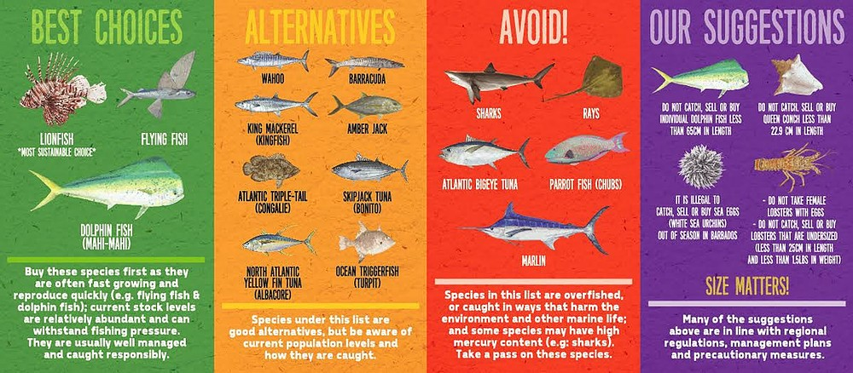
Sustainable Choices

Slide 7
Index
Olhão
Agrupamento de Escolas Dr. Alberto Iria

Slide 8
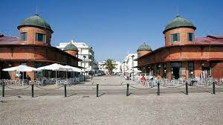
Olhão
Algarve

Slide 9
-Popular Olhanense Saying
Olhão-City of Restoration
“Tá o Mar fêto dum cão,
Nã há choque nem bergão!”

Slide 10
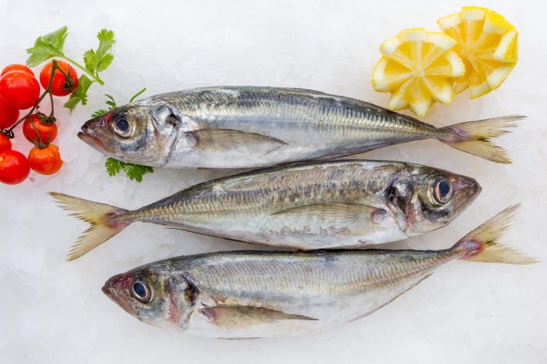
Starters
"Temaki" with Mackerel
Horse mackerel in two textures with red onion puree
Horse mackerel fillet with tomato seaweed on filo pastry tulips
Eggs Stuffed with Pâté of Sea Delights

Slide 11
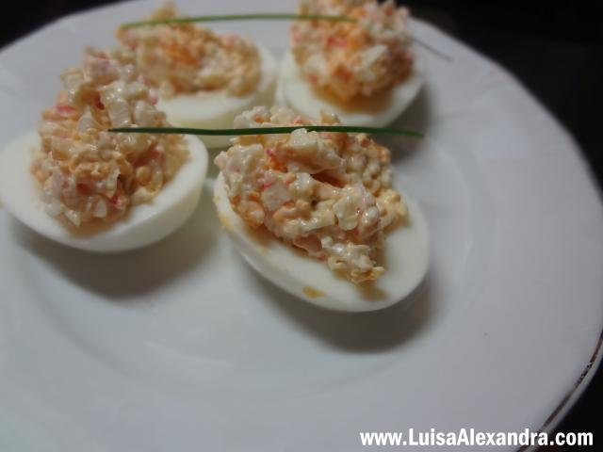
Eggs Stuffed with Pâté of Sea Delights
Ingredients:
two eggs
Delights of the Sea - four
Pickles
Mayonnaise, a spoonful [of soup] [or the amount needed to get the creaminess to taste]
Fresh Chive

Slide 12
Preparation
Bake the eggs for approximately 15 minutes after cooking remove the eggs and peel them in half, removing the cooked yolks that are reserving.
grind the pickles and
Add the delights of the sea by repeating the operation.
Add the mayonnaise and boiled yolks and wrap in the
With the aid of a small spoon, I filled the egg whites cooked with the preparation.
It decorates with fresh chives.

Slide 13
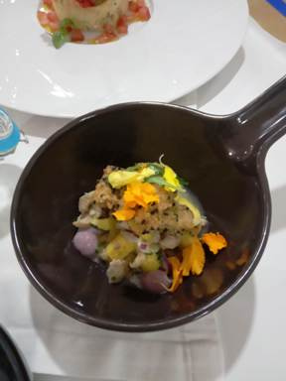
Horse mackerel in two textures with red onion puree
100 ml of olive oil
2 eggs
Salt
pepper
chives
Watercress leaves "baby" .
Powdered Ginger
sugar
Butter
Ingredients:
5 fresh horse mackerel
100 g of breadcrumbs
300 g of white sesame
500 ml of oil
1 lime
1 orange
300 g red onion
100 g of "shimiji" or "shiitake" mushrooms

Slide 14
Preparation
Clean the horse mackerel and carefully remove the fillets. Cut 4 fillets in half. Season with salt, pepper and a little lime juice and let it marinate for a while. Dip in egg and then in breadcrumbs with sesame. Fry in plenty of oil.
Cut the remaining fish into small cubes. Chop an onion and a little chives and mix with the fish. Add a little lime and orange juice and zest to taste. Season with salt, pepper and a little powdered ginger. Reserve.

Slide 15
Preparation
Cut the remaining onion into small pieces. In a pan, add the butter and sugar and let it melt. Add the onion and add a little water. Let it cook and season with salt. Pass everything to "mix" until obtaining a puree.
Saute the mushrooms in oil and season with salt.
Season the watercress leaves with olive oil, salt and lime juice.
Place a little puree in the center of the plate. On top, place the marinated horse mackerel on a plate with the help of a ring and overlap the breaded fillets. Garnish with the sautéed mushrooms and watercress leaves.

Slide 16
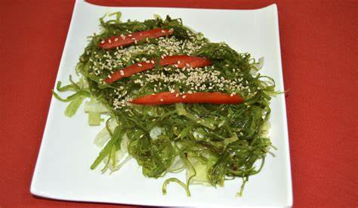
Horse mackerel fillet with tomato seaweed on filo pastry tulips
Ingredients:
2 sheets of filo pastry
Melted butter q.b.
800 g of fresh horse mackerel
1 onion
1 clove of garlic
Olive oil q.b.
100 g of peeled tomato
Pennyroyal
Algae

Slide 17
Preparation
Brush the sheets of filo pastry and glue one on top of the other, cut into squares and bake in the oven until golden.
Clean the horse mackerel, removing all the scales and guts.
Cut into slices and season with a little salt.
Chop the onion and garlic and sauté in oil, add the crushed peeled tomato and then the horse mackerel.
Add the pennyroyal and seaweed, let it cook, adjust the seasoning and serve inside the filo pastry tulips.

Slide 18
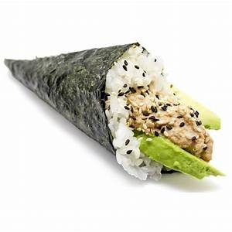
Temaki with Mackerel
fine salt
black pepper
Olive oil
Lemon and lime juice
Ingredients:
2 fresh horse mackerel
30 g chopped red onion
50 g red pepper
50 g of mango
50 g peeled tomatoes, cut into cubes
10 g of chopped "cornichons"
chopped chives

Slide 19
Preparation
Wash and open the peppers. Remove the seeds and cut into fine brunesa.
Arrange the mango and cut into small cubes.
Morning, eviscerate and descale the fish. Remove the fish fillets and cut into cubes of the same thickness. Reserve.
Season the horse mackerel with a lemon and lime vinaigrette (olive oil, lemon and lime juice, fine salt and pepper) and add the remaining ingredients.

Slide 20
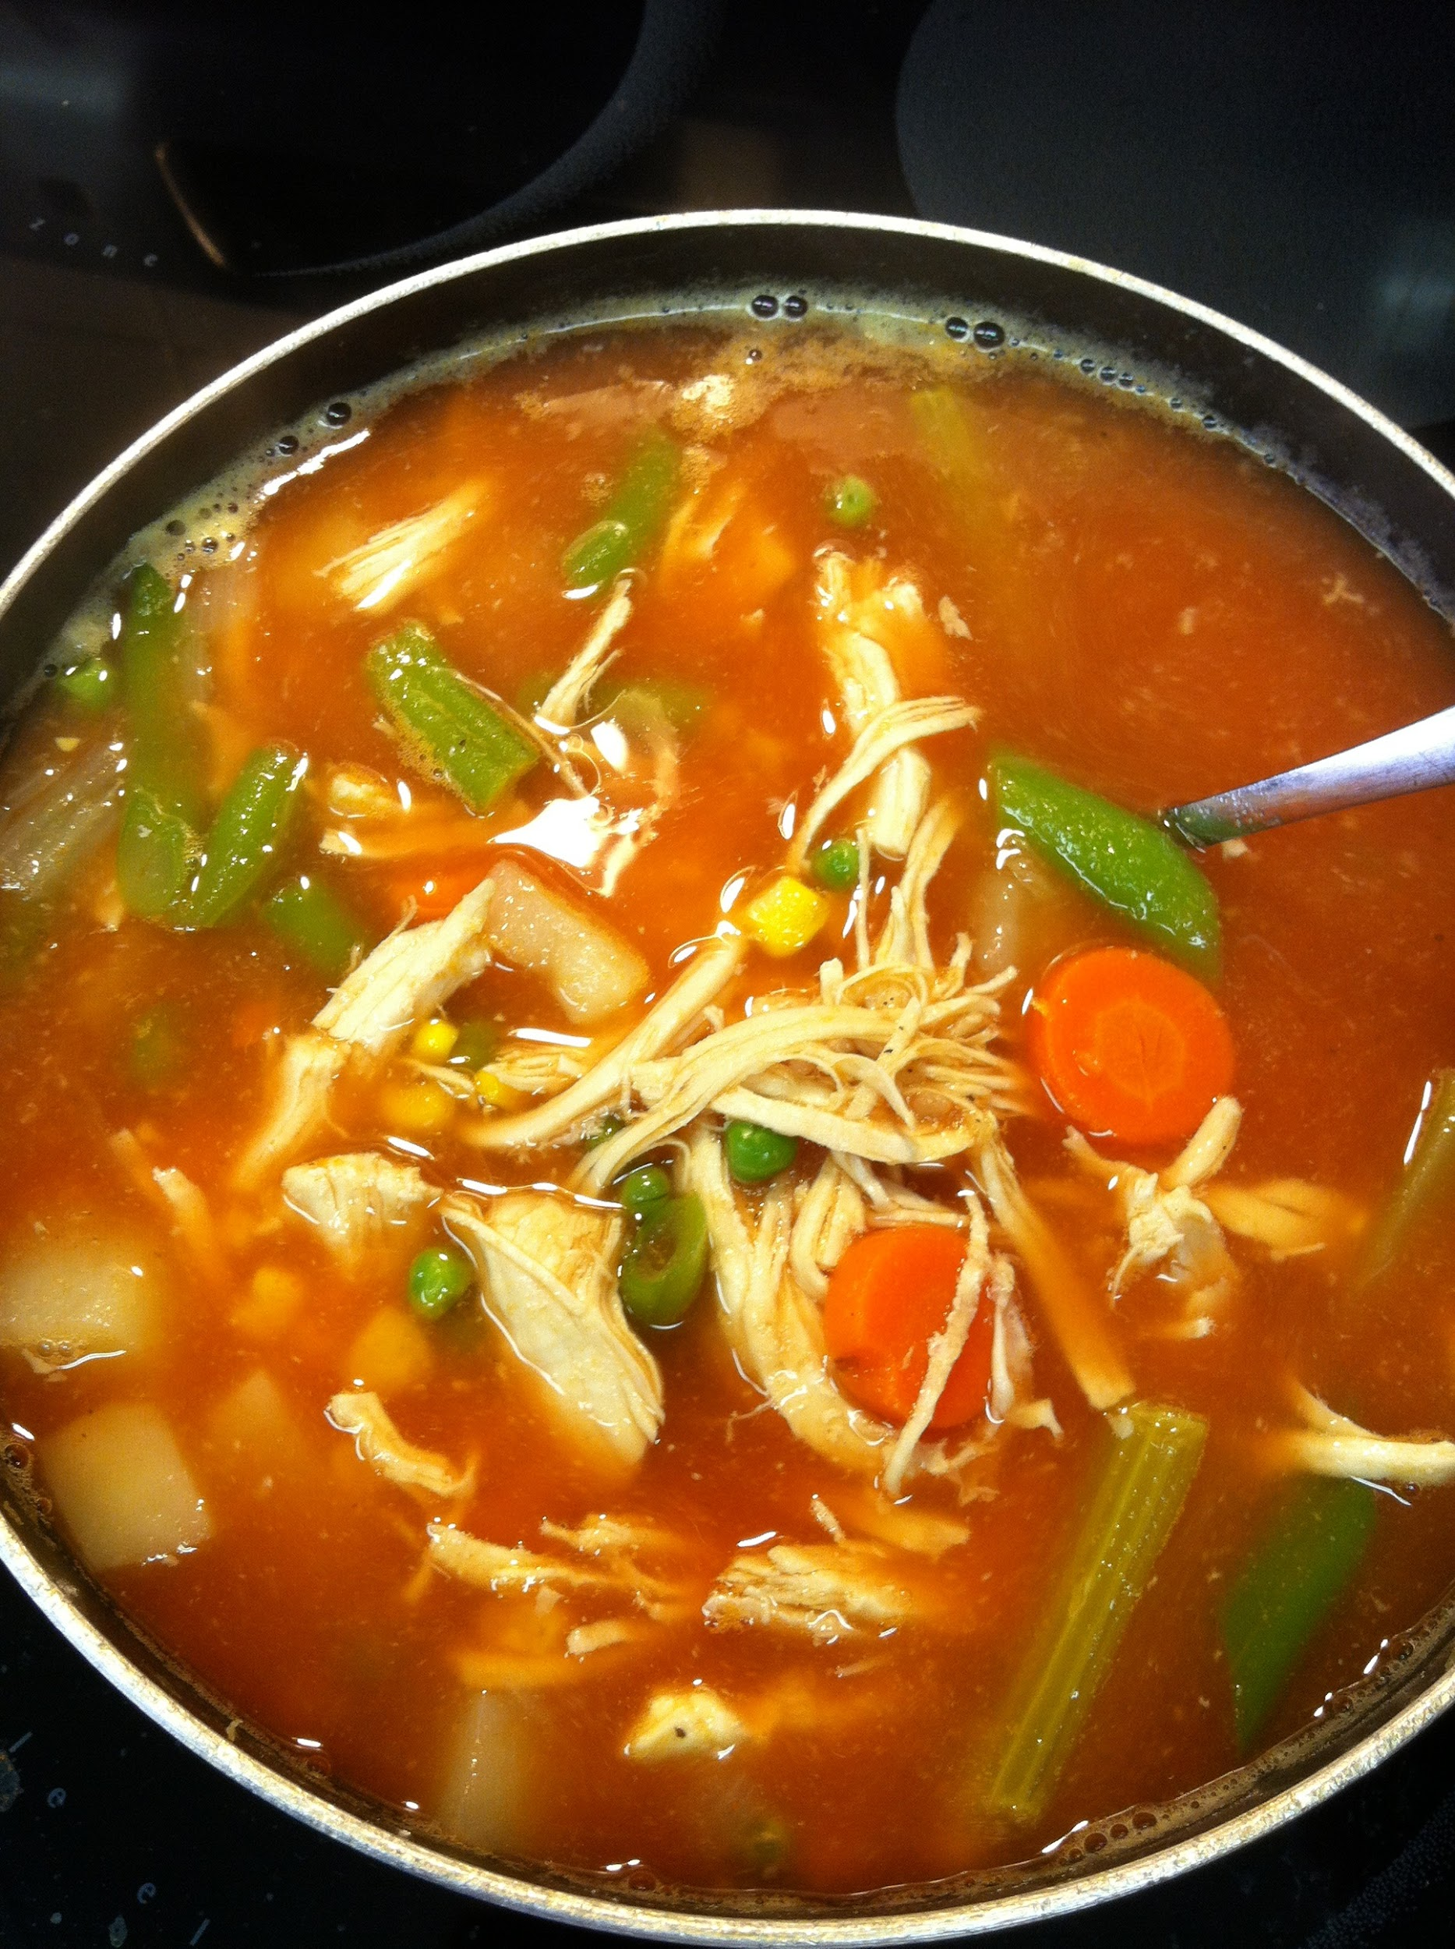
Soups:
Cold Tuna Soup
Fish soup
Homemade bread soups with cod and poejo (Querença)

Slide 21
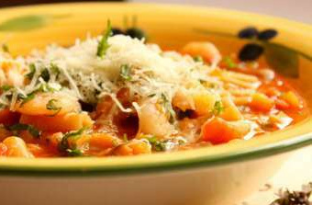
fish soup
Ingredientes:
2 fillets of monkfish or other fish, boneless
1.2 L of water
salt
½ c. chilli tea powder
freshly ground black pepper
1 Knorr fish broth
1 chopped onion
2 garlic cloves, minced
4 c. of oil soup
1 c. chili tea
1 small can of chopped tomato
2 carrots, cut into cubes
100 g of pasta to taste
100 g of cooked prawns, skinless
1 bunch coriander, chopped
50 g Parmesan cheese, shredded

Slide 22
Preparation
Cook the fish in water together with a fish stock and a little salt. Remove the fish with a slotted spoon and reserve the broth.
Saute onion and garlic in oil. Add the pepper, piri-piri and tomato. Add the carrots and sprinkle with the broth from the fish cooking, cook for 10 minutes, bring to a boil and add the pasta.
Cook for another 10 minutes, add the prawns and the shredded fish. Adjust seasonings and serve sprinkled with coriander and Parmesan cheese.

Slide 23
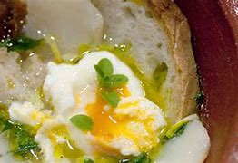
Homemade bread soups with cod and poejo (Querença)
Ingredientes:
800g cod
1 onion
2 cloves garlic
1 ripe tomato
1 bay leaf
400g homemade bread
Olive oil Pennyroyal
White wine Salt
Pepper 4 eggs

Slide 24
Preparation
After soaking and soaking, place the cod to marinate in olive oil and chopped pennyroyal.
In a pan, sauté, in olive oil, the onion and the chopped garlic with a bay leaf.
Add the diced tomato, without the seeds and skin.
Let it refine a little and refresh with white wine.
Season with salt and pepper and place the cod in the pan.
Let it cook on low heat.
Cut the bread into thin slices and place in a bowl.
After the cod is cooked, adjust the seasonings.
Place the mixture on top of the bread and decorate with pennyroyal leaves.

Slide 25
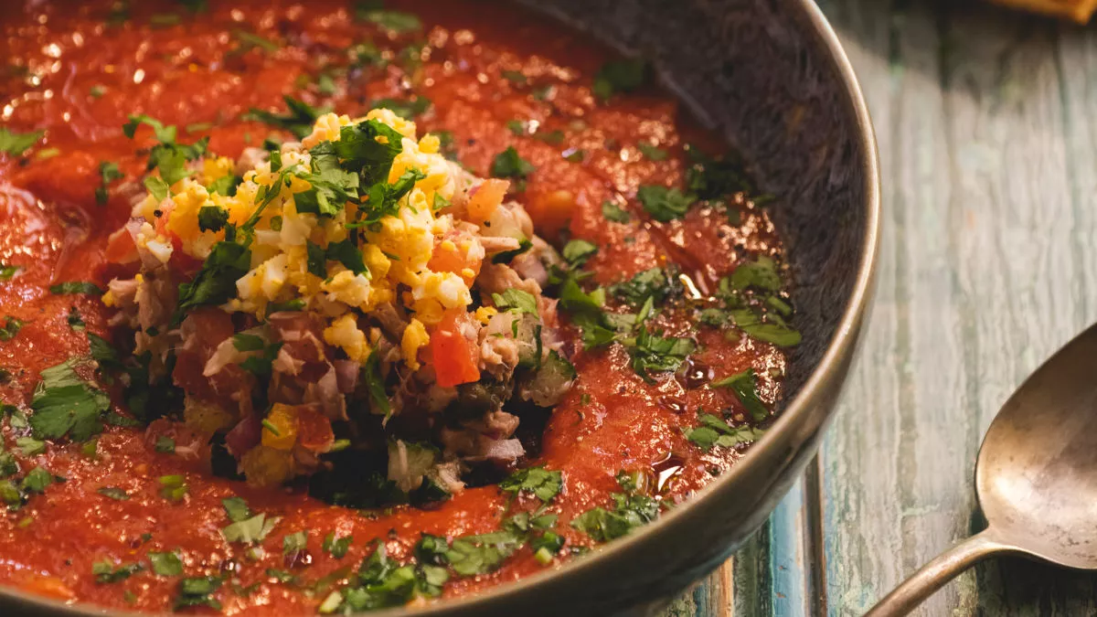
Cold tuna soup
Ingredients:
400g Ripe Tomato, coarsely chopped (with skin and seeds)
100ml tomato pulp
2 shallots, peeled and cut into quarters
½ cucumber, peeled and pitted, cut into pieces
¼ cucumber, peeled, seeded and chopped
1 Roasted Red Pepper without skin (purchase)
1 or 2 cloves of Garlic
100g of black-eyed peas
50ml of Cider Vinegar
50ml of Olive Oil
Salt q.b.
Pepper q.b.
150g natural tuna (drained weight) - can - crushed with a fork
30 capers
½ yellow pepper, chopped
1 chopped seedless tomato
1 chopped red onion
chopped parsley q.b.
2 hard-boiled eggs, chopped to finish
4 slices of “Rio Maior” type bread without crust
300ml olive oil for frying the bread
1 crushed chilli

Slide 26
Preparation
In a blender, place 400g of coarsely chopped ripe tomato, 100ml of tomato pulp, 2 shallots cut into quarters, ½ cucumber, peeled and seeded, cut into pieces, 1 roasted red pepper, skinless, 1 clove of garlic, 50ml cider vinegar, 50ml olive oil, chopped parsley, salt and pepper q.b. Blend everything at maximum speed until you obtain a homogeneous cream. Reserve (in the fridge).
Place in a large bowl 150g of natural tuna (canned, drained and crushed with a fork), 30 capers, ¼ unpeeled cucumber, seeded and chopped, ½ chopped yellow pepper, 1 chopped seedless tomato, 1 chopped red onion, 100g of black-eyed peas and chopped parsley to taste. Reserve the preparation in the fridge.
In a frying pan, heat 300ml of oil with 1 crushed chilli and fry 4 slices of bread. Remove the bread and place on kitchen paper to absorb excess oil.
In an individual bowl, place 1 slice of bread at the bottom and place ¼ of the chopped mixture on top. Pour the cream around.
Serve cold and sprinkle with the chopped egg.

Slide 27
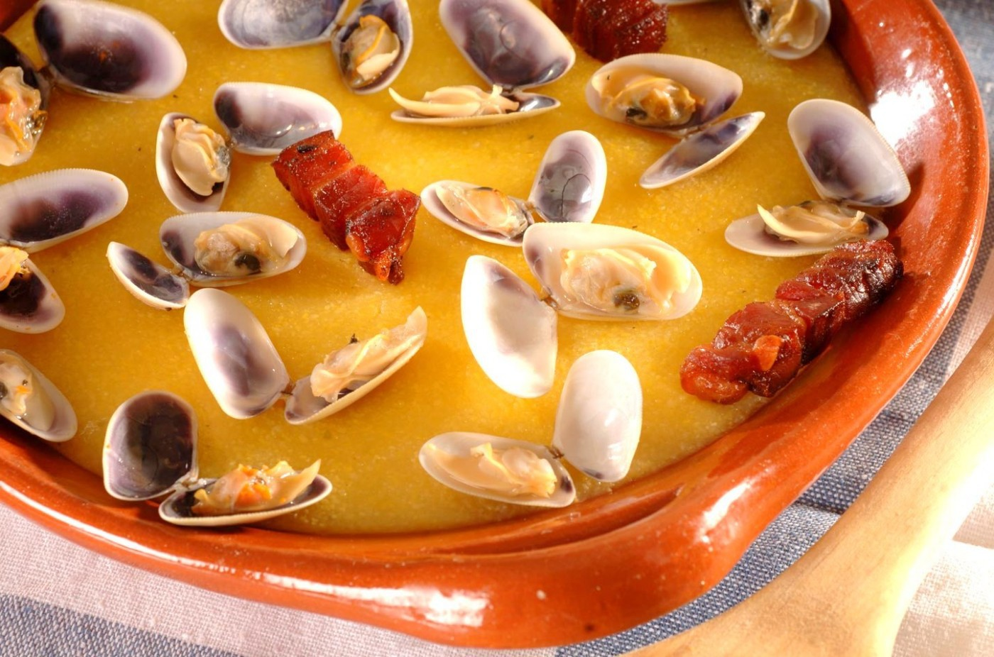
Main Courses:
Xarém with cockles
Black Mouth Catshark Olhão Style
Skate with Garlic

Slide 28
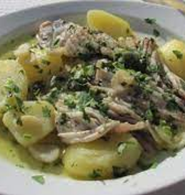
Skate with Garlic
Ingredientes:
400g of Skate
5 garlic cloves
3 olive oil spoons
1 vinegar spoon
4 Potatoes
Salt (thick)

Slide 29
Preparation
The Skate should be thoroughly washed under running water and should be salted for 2 hours. In a pan with boiling water, the streak and potatoes (already salted) are introduced and the potatoes are baked (approximately 5 minutes).
In a bowl we have the garlics very well crushed, olive oil, vinegar, 3 tablespoons of water to bake the streak.
Once cooked, the water flows from the ray and potatoes, joins the previous preparation and goes back to the fire about five minutes. It is served right after the confection.

Slide 30
Litão fish in the fashion of Olhão!
Ingredients
•half a dozen litão
•400 g of potatoes
•3-4 onions
•garlic
•2 green and red peppers
•4 ripe tomatoes
•0,5 dl olive oil•bay leaf
•white pepper
•1 glass of white wine
•Salt

Slide 31
Preparation
The day before and after skinning, cut the littão into pieces and soak in salted water. On the day of cooking, cover the bottom of the pan with oil, then sliced ​​onion, sliced garlic, bay leaf and white pepper. On top of this, add the litão, the sliced potatoes and another layer of onion, pepper cut into squares, tomatoes without skins or seeds, garlic, bay leaf and pepper (repeat the layers as often as necessary) .
Drizzle with olive oil, add white wine, water and salt and place on the fire to cook slowly..

Slide 32
Xarém with cockles
Ingredientes:
1 kg of cockles
200 g cornflour
8 strips of smoked bacon
2 slices of bread cut to squares
2 liters of water
olive oil
Onion
Coriander
salt

Slide 33
Preparation
In a bowl wash the Cockles, in cold water, so that they release the impurities they may have. Cover with sea water, or optionally with fresh water with plenty of salt and leave to stay about 4 to 5 hours.
In a pan, place the olive oil and chopped onion to brown; the indicated water is added; spreads the flour slowly and stirs at the same time. It boils for 15 minutes, stirring constantly.
Fry the bacon strips and bread squares in olive oil, remove from the frying pan and reserve. In the same frying pan, the cletins are opened. Add the Cockles bacon, fried bread and chopped coriander to the shawl, rectify the salt and serve.

Slide 34
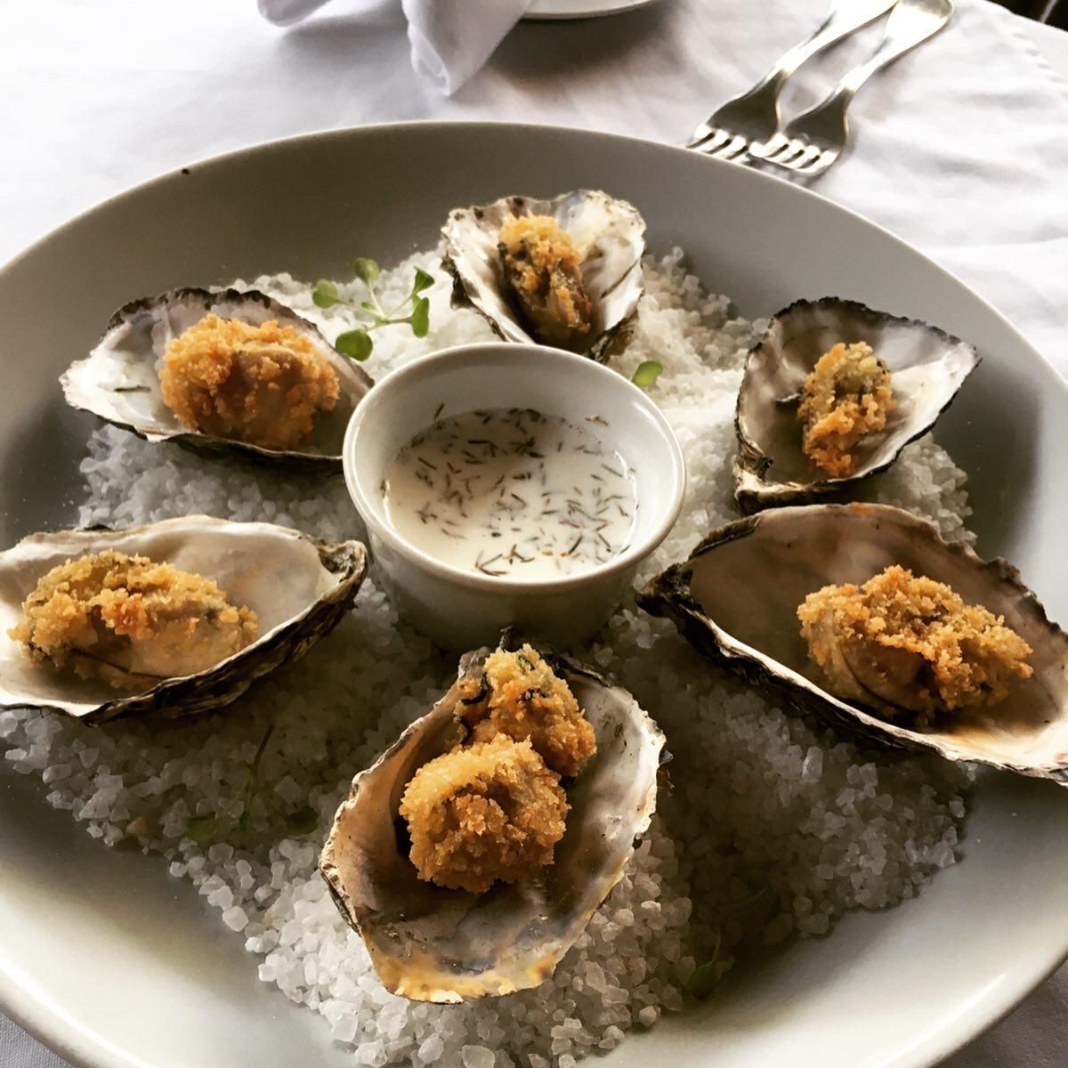
Oyster cream with smoked horse mackerel broth
Ingredientes:
4 horse mackerel
12 oysters
olive oil
6 large potatoes, cut into rounds
2 sliced onions
croutons
Chives

Slide 35
Preparation
Fillet the horse mackerel and reserve the bones, after washing them well.
Take the pimples to smoke with bay leaf and salt.
After they are smoked, place them in a pan, covering them with water and putting them on the fire for about 20 minutes.
Open the oysters, reserve their liquid, after straining through a strainer.
In olive oil, make a pull with the potatoes, onion and celery.
Cover them with the horse mackerel broth.
After everything is cooked, mash it with the magic wand.
Add the oyster broth to the cream, stir everything and serve the same over the oysters.
Sprinkle everything with chives and croutons and serve immediately.

Slide 36
Be Sustainable!
Be Seafishient!!!
You have a Sea of Choices
A Book made with Love for our Biodiversity

