Slide 2
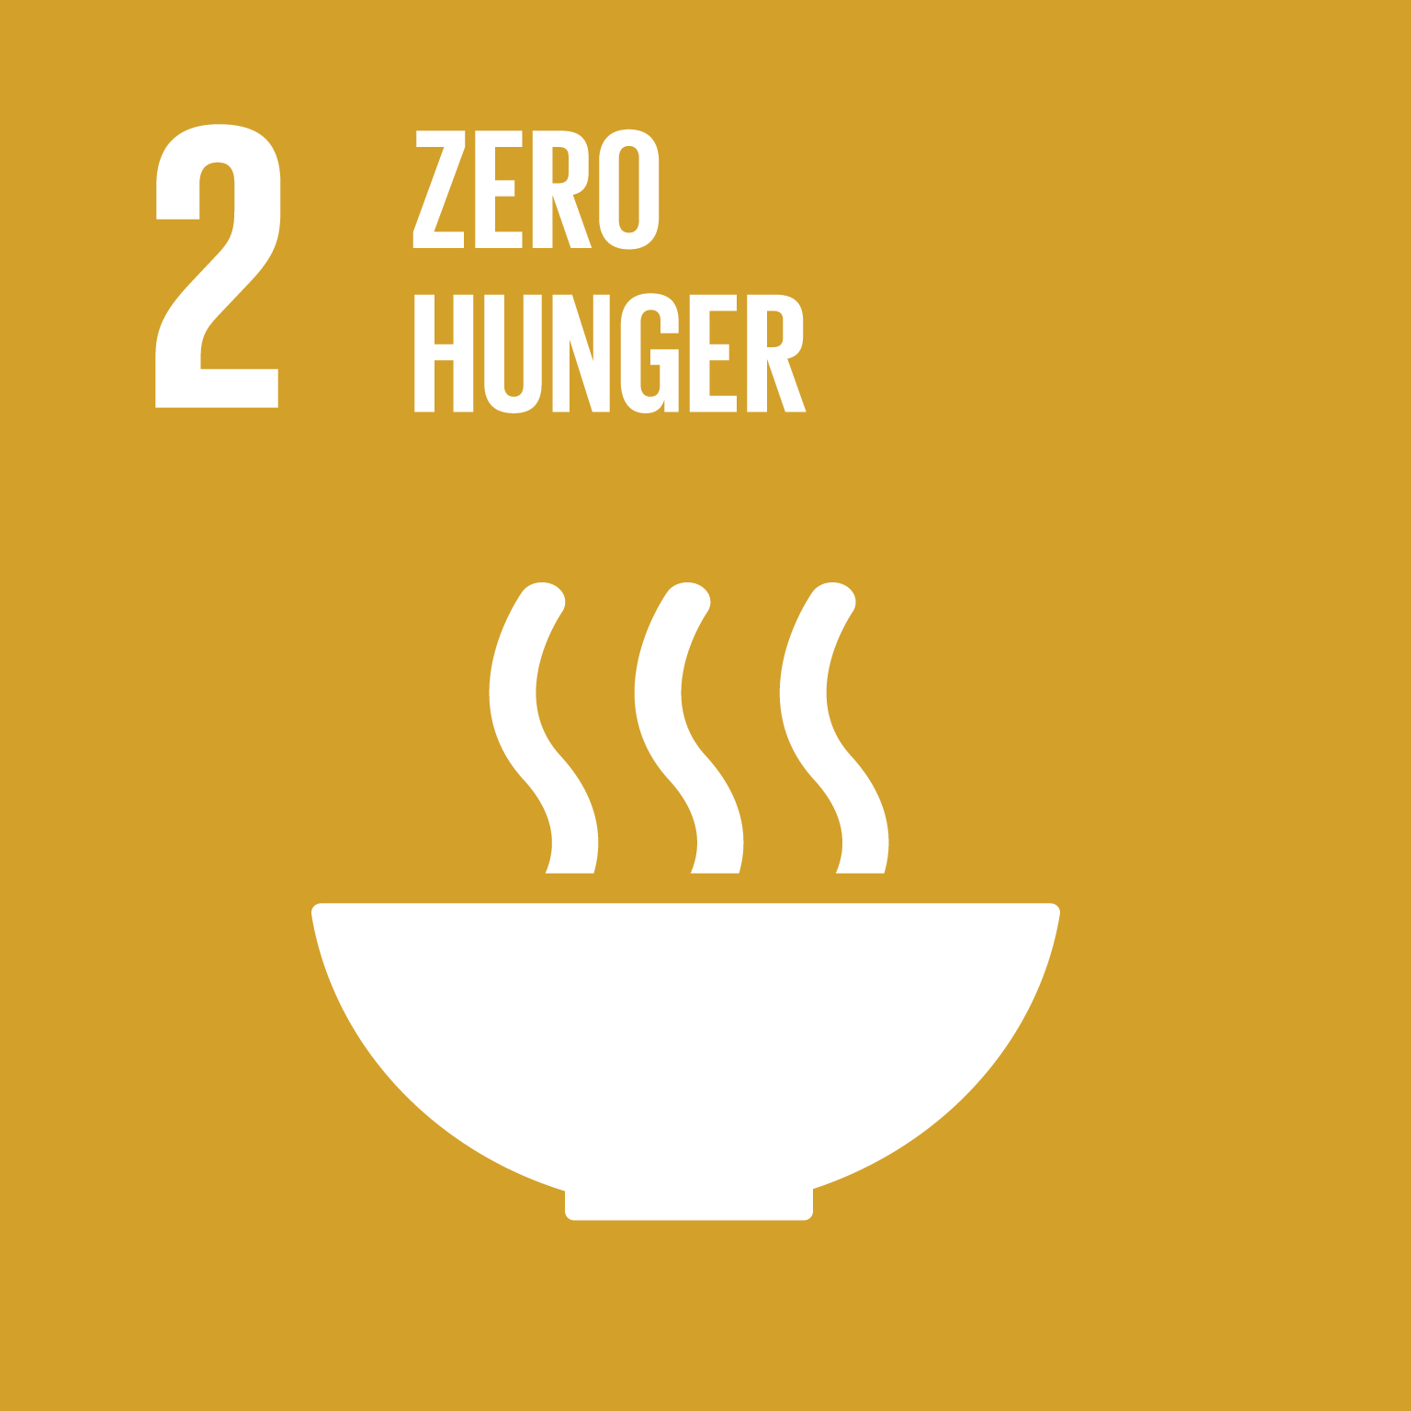
Zero Hunger
End hunger, achieve food security and improved nutrition and promote sustainable agriculture
The world is not on track to achieve Zero Hunger by 2030. If recent trends continue, the number of people affected by hunger would surpass 840 million by 2030.
Current estimates are that nearly 690 million people are hungry, or 8.9 percent of the world population – up by 10 million people in one year and by nearly 60 million in five years.
Current estimates are that nearly 690 million people are hungry, or 8.9 percent of the world population – up by 10 million people in one year and by nearly 60 million in five years.
The UN has defined 8 Targets and 13 Indicators for SDG 2

Slide 3
Quality Health
3.1 By 2030, reduce the global maternal mortality rate to less than 70 deaths per 100,000 live births
3.2 By 2030, end preventable deaths of newborns and children under 5 years old, with all countries aiming to reduce neonatal mortality to at least 12 per 1,000 live births and under-5 mortality to at least minus 25 per 1,000 live births
3.3 By 2030, end epidemics of AIDS, tuberculosis, ignored tropical diseases, combat hepatitis, water-altered diseases, and other communicable diseases

Slide 4
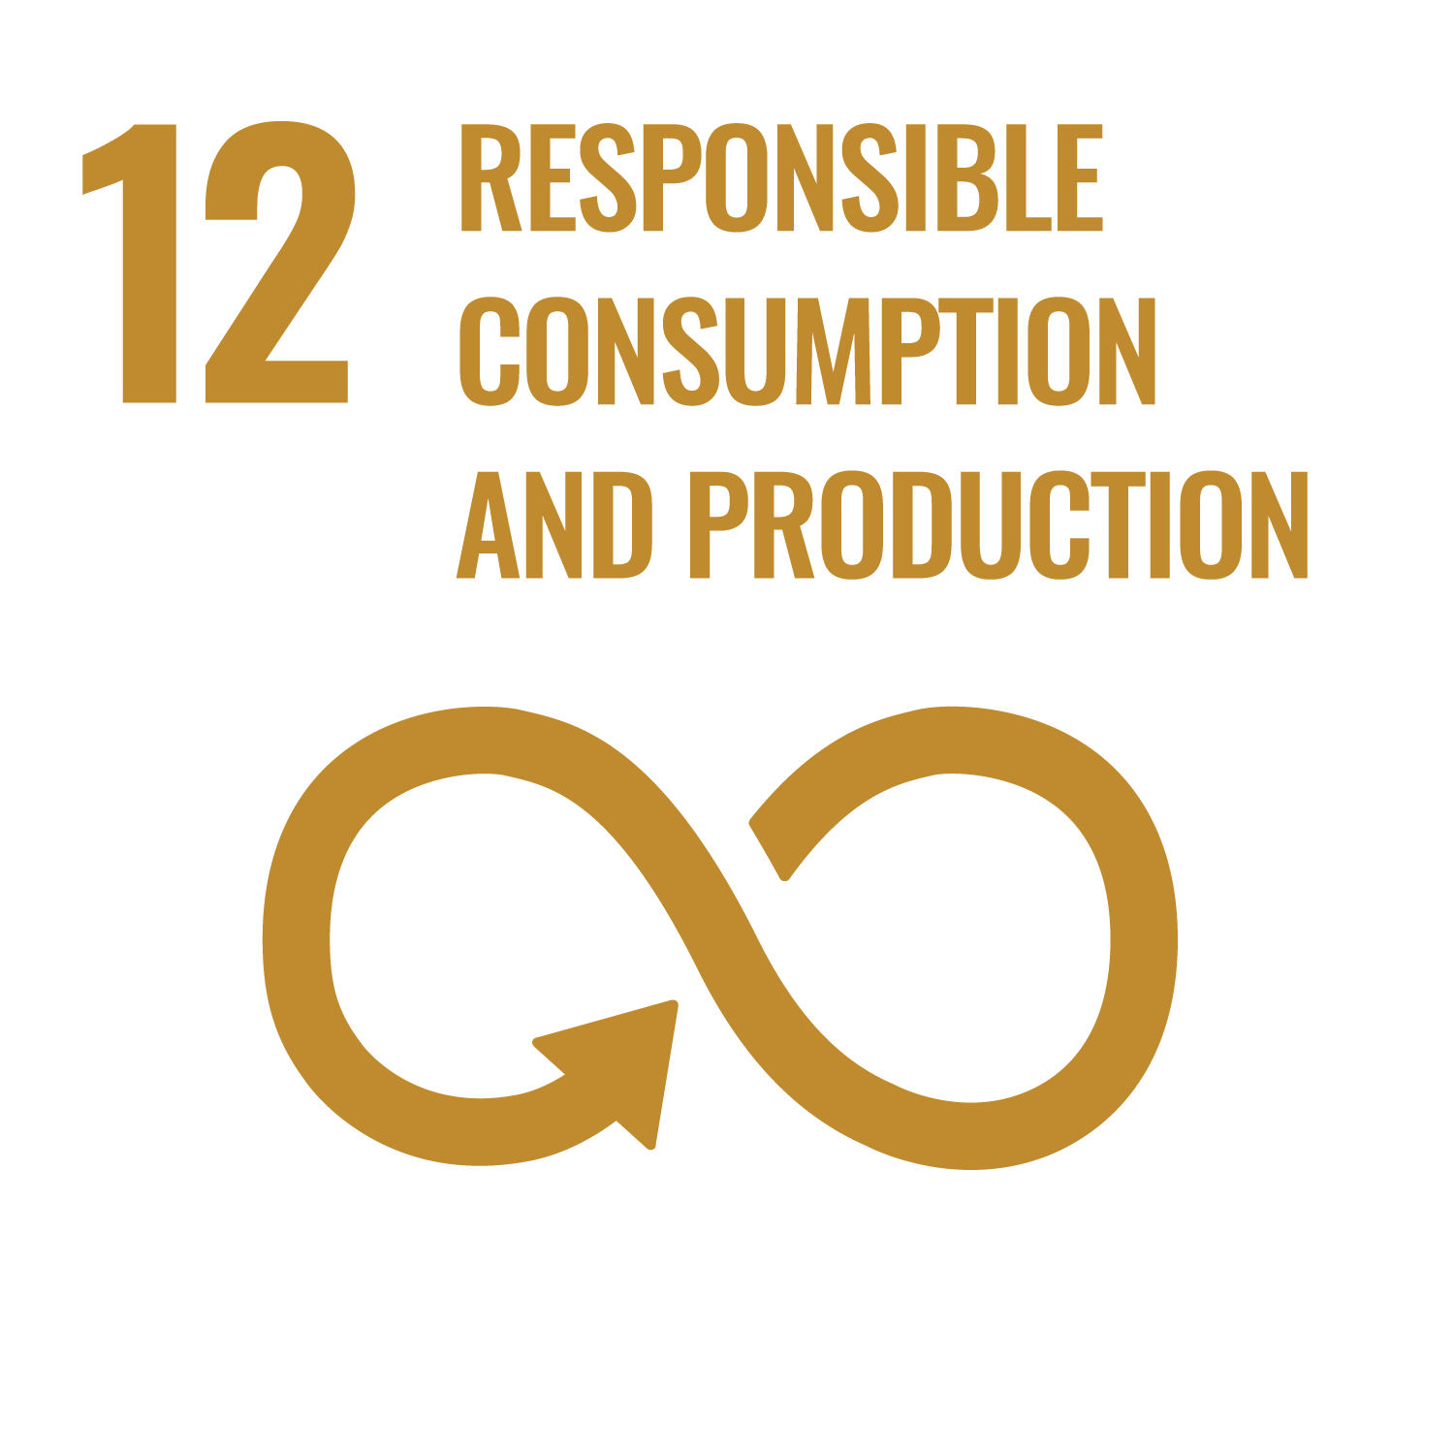
The Sustainable Development Goal 12 deals with "responsible consumption and production" .
Sustainable consumption and production is about promoting resource and energy efficiency, sustainable infrastructure, and providing access to basic services, green and decent jobs and a better quality of life for all. Its implementation helps to achieve overall development plans, reduce future economic, environmental and social costs, strengthen economic competitiveness and reduce poverty.
Transforming Our World: the 2030 Agenda for Sustainable
Development. It is one of the 17 Sustainable Development
Goals established by the United Nations in 2015.

Slide 5
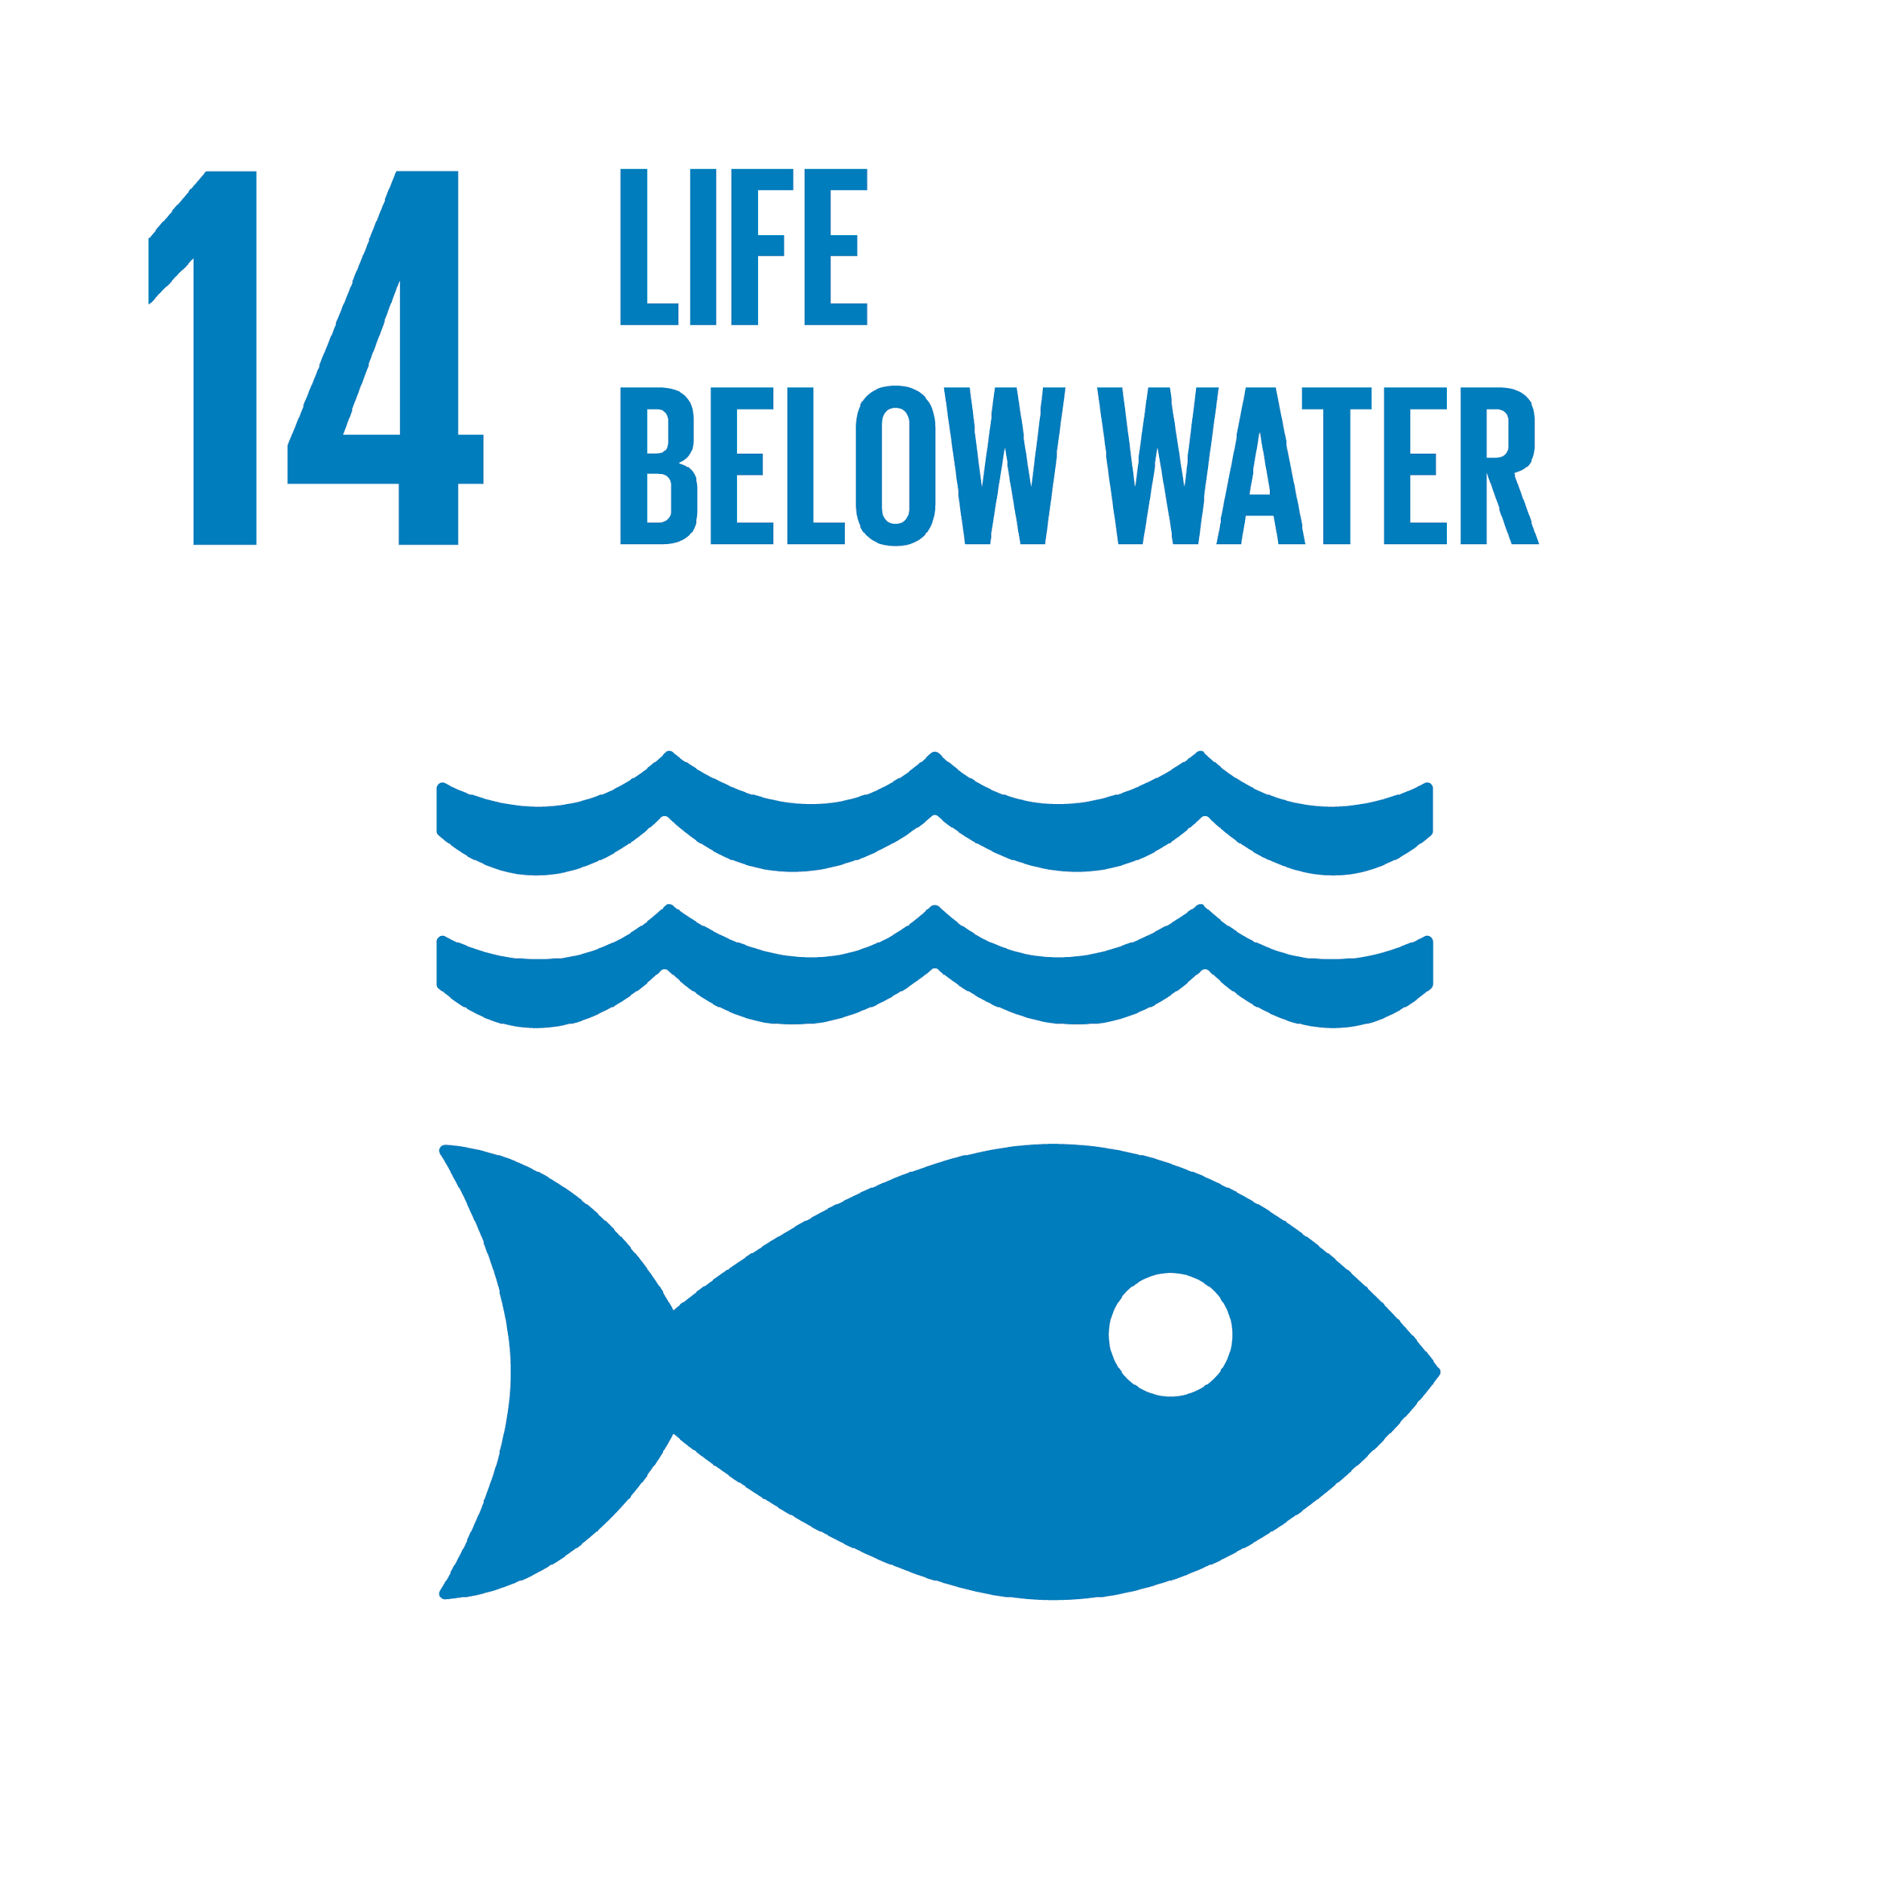
Sustainable Development Goal 14 is about "Life under water". One of the 17 Sustainable Development Goals established by the United Nations in 2015, the official word is: "Conserve and sustainably use the oceans, seas and marine resources for sustainable development"

Slide 6
The UN has defined 10 Targets and 10 Indicators for SDG 14:
Reduce Marine Pollution
Protect and Restore Ecosystems
Reduce Ocean Acidification
Sustainable Fishing
Conserve Coastal and Marine Areas
End Subsidies contributing to Overfishing
Increase the Economic benefits from Sustainable use of marine resources
Increase Scientific Knowledge research and Technology for Ocean Health
Support small scale fishers
Implement and EnforceInternational Sea Law

