Slide 1
Aquaculture
Problem or solution?

Slide 2
What is Aquaculture?
Aquaculture is the science that studies cultivation techniques, not only for fish, but also for crustaceans, algae and other organisms that live in aquatic environments. They can be used for studies or for human use.
Even frogs, turtles and alligators can be raised for human food!
In Portugal, aquaculture is a primary and a recent activity. The weight of
national aquaculture compared to the supply of fish to the Portuguese market
is still very low.

Slide 3
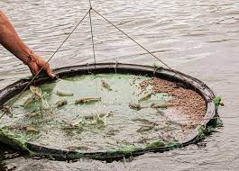
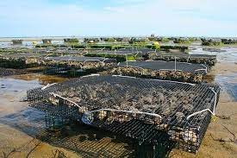
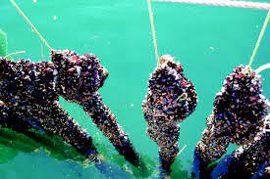
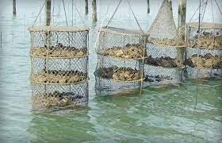
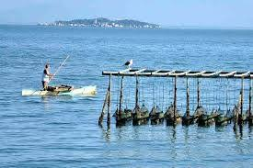
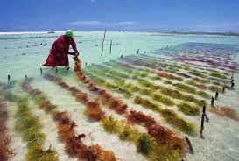
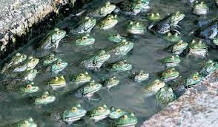
Here´s some types of Aquaculture
Pisciculture: fish farming in fresh
water, brackish water or marine water
Shrimp farming: shrimp and lobster farming
Mariculture: aquaculture in salt water
Malacoculture: raising molluscs (snails,
cuttlefish, squid and octopus)
Mytiliculture: mussel farming
Pectiniculture: scallop farming
Algiculture: algae cultivation
Raniculture: raising frogs

Slide 4
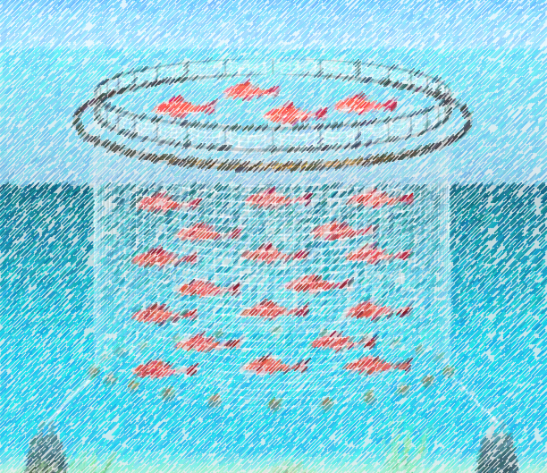
Sustainable Aquaculture
https://youtu.be/fu5wvD9iDyU

Slide 5
Yes or No?
Advantages
Disadvantages
Aquaculture has many advantages! For example…
Protects the environment and recovers areas with ecological interest
Increased employment and development opportunities in rural and coastal areas
Try to solve problems of over exploration of species, caused by the industrial fishing
It makes possible to correct some deficiencies in the supply of fish and other species
Face the fish needs of a population residing in a country where fresh fish is reduced
The catches will be more stable, with a better quality and in a good quantity
However…
There´s many bureaucratic difficulties
Fish are fed by diets that endanger the nutritional quality of these food products and, consequently, the human health
Fish live with no space ‘cause the amount of fish in captivity is bigger than the capacity of the tank where they live. In some cases, the fish may eat each other's feces:(
The water get more polluted because a lot of water is spent to maintain the ideal hygiene conditions for fish, and it isn’t Sustainable...

Slide 6
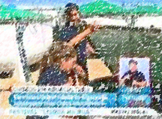
Aquaculture in Ria Formosa
https://youtu.be/Hdu58mSC67M

Slide 7
So is it a solution or a problem?
So we can conclude that.... it's all opinions. It is true that Aquaculture has
very good principles, and many people consider it the future of fishing,
but everything has impacts. So we won't say it's a solution or a problem
because Aquaculture can be perfected over time and become the main
method of farming fish and other marine species.

Slide 8
THANK YOU!!

