Slide 1
CONSERVATIVE INDUSTRY IN PORTUGAL
Work done by: Cátia Santos n3
Carlota Marcelino n2 9C

Slide 2
THE ORIGINS
Nicolas Apert discovered in 1804 the principle of conservation by heat in hermetically sealed containers.
The foundations of the canning industry were laid.
The abundance of fish and its quality, the length of the
coast and the traditional inclination towards the fishing gear, allied to the simplicity of the technique, created among us unique conditions
the establishment of the canning industry.
In 1938 there were 152 canning factories in Portugal that produced around 34,000 tons of canned fish.

Slide 3
TODAY
There are currently 20 factories in operation that produce 58,500 tons of canned fish.
It is a traditional sector of our economy with more than
150 years.
It transforms above all the sardine of the species “Sardina
Pilchardus (Walbaum)”, tuna in its various species
and mackerel, also in its various species.

Slide 4
THE SARDINE
The “sardine” resource is the most used by the industry
Portuguese canning company and on which, although not exclusively, almost all the factories located in mainland Portugal depend.
It is the most abundant resource on the Portuguese coast, representing
more than 40% of the total catches of the national fleet.
The canning industry currently absorbs between 40% and 50% of sardine catches from the siege fleet.
Sardines are captured essentially by the national siege fleet and along the Portuguese coast, and the industry canning and siege fleet are interdependent.

Slide 5
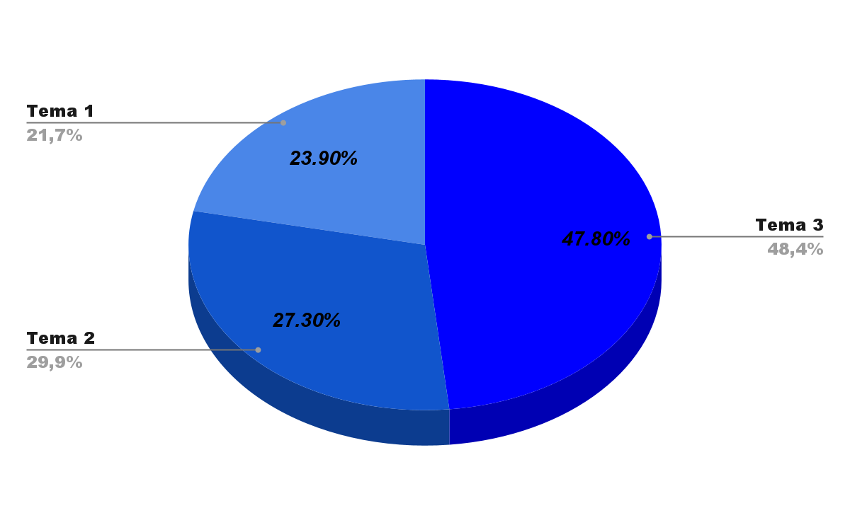
Production of Canned Fish
in Portugal
In Portugal they produce
if 58 500 tons of
canned fish: sardines 28 000 t, mackerel
16,000 t, tuna 14,000 t
and 500 t of other
species.
Tema 1: Tuna fish
Tema 2: Mackerel
Tema 3: Sardine

Slide 6
THE EXPORT
Around 60% of our preserves are destined for the markets
which characterizes this industry as an exporting sector for a long time.
The main export destinations for canned fish
Portuguese are: France, Italy, England, Benelux, Sweden, USA, Brazil, Canada, Israel, Japan, etc.
Portuguese fish to many other countries, although in smaller quantities and to the most remote places. (former Peruvian jungle).
A curiosity (?) : Portuguese canned fish are not exported
to Spain, while Spanish canned fish invade the Portuguese market, namely canned tuna, under the
own brands of large distribution.

Slide 7
TRADE BALANCE
The sector's turnover amounts to around 250 million euros.
In the fish processing sector, the canning industry is
the only one with a positive contribution to the trade balance of fishery products and the one with the greatest vocation for the use of national raw materials.

Slide 8
SARDINE CERTIFICATION
PORTUGUESE
The proper and responsible use of resources and, therefore, the preservation of biodiversity, constitutes the fundamental foundation for the construction of a future based on the economic and social stability of the sector of
fisheries in general.
This concern is present both in the canning industry
Portuguese, or in the national siege fleet
ANICP and ANOPCERCO, promoted a certification process for Portuguese sardines through the MSC‐Marine Stewarship Council, which has already been concluded and, therefore, wants our sardine canning factories
and our siege fleet are now certified and the frozen food industry is now also in the process of being certified.
The Portuguese sardine is, in fact, the only species certified in the entire Iberian Peninsula.

Slide 9
The Social Dimension of Industry
canned
The canning industry has always assumed a remarkable
social, regional and local relevance.
There are communities that have in the canning industry the
their main and even only source of subsistence.
It is a labor intensive industry.
It mainly uses female labor.
It indirectly contributes to part of the employment in the fleet
of the siege and in other sectors located either upstream,
either downstream.

Slide 10
MAIN CONSTRAINTS
The irregular supply of sardines due to the high prices that
this raw material reaches at certain times of the year.
Competition in the international markets for low-quality canned
prices from countries with cheap labor (“social dumping”), as is the case in North Africa, in canned
sardines and the Far East (Thailand, Philippines, etc.)
canned tuna.
The foreseeable abolition or reduction of the customs duties of the
Common Customs Tariff in the case of canned tuna
from the Far East..
The competition of canned “sardines” from Peru and Chile of the species “sardinops sagax sagax” and “strangomera bentinky”.

Slide 11
Challenges
Living with the globalization of markets:
Competition in the domestic and international market for
low quality and cheaper products.
The 21 more species of “sardines” in addition to “sardines”
pilchardus (walbaum) which is ours, recognized by the
Codex Alimentarius and that at any time
may invade markets.

Slide 12
Opportunities
It is an easily accommodated food product.
and manufacturing, of great durability, natural, without dyes or preservatives, made with deep knowledge and long tradition;
Product intended for the domestic market is for the export.
Good for the health and at an affordable price;
The use of Atlantic sardines of the species “sardina pilchardus (Walbaum)”;
The fact that Portuguese sardines are certified.
The flooding of the EU and the consequent increase in the number of
potential consumers.

Slide 13
INNOVATION
MSC – certification
Packaging – packaging with a renewed image (eg.
gourmet packaging);
More environmentally friendly packaging;
Easier-to-use packaging (flexible aluminum and
easy opening)

Slide 14
INNOVATION (cont.)
Innovation in the target and niches to be reached – ex. children and
Gourmet;
Innovation in the concept, always following the good
nutrition and low caloric value and no preservatives;
Innovation in recipes – use of new species of
fish as well as new ingredients;
Innovation in nutritional assessment studies
supported by scientific articles.

Slide 15
CONSUMER INFORMATION
We think that the development of the industry canned food will undergo campaigns institutional promotional information, valuing this high quality product and value food, because in this matter there is a great consumer ignorance.
And it is not by chance that the ANCP is today in Lisbon at an event promoted by the Fundação de Cardiology, integrated in the Month of the Heart.

Slide 16
END
ANCP
MAY 2010
HISTORY OF THE OLHANENSE CONSERVATIVE INDUSTRY
http://www2.cm-olhao.pt/listar-artigos/3043-historia-da-industria-

