Slide 1
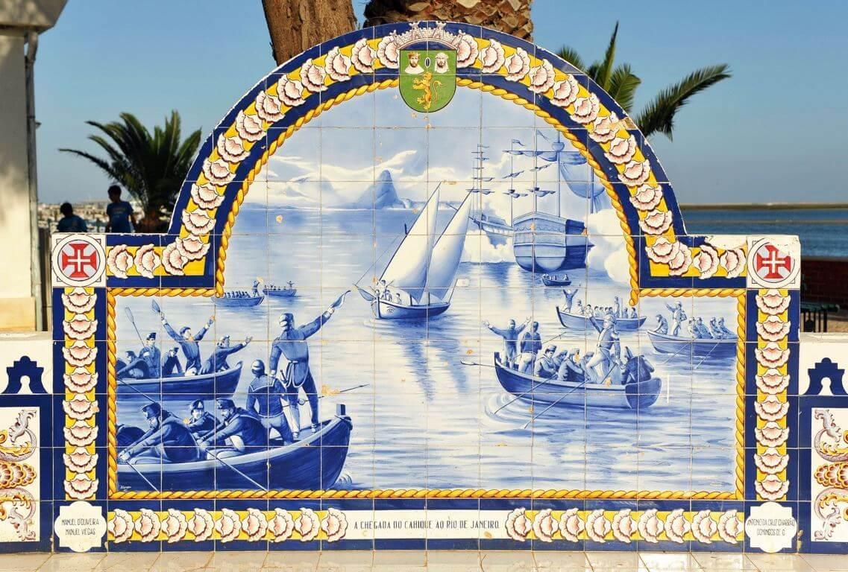
Historical Fishing Traditions of Olhão and its connection to the sea

Slide 2
Historical context
The history of Olhão does not date back as long ago as the history of most towns in the Algarve. The simple fishermen’s huts were replaced by stone buildings in the 18th century. The fishing of tuna and sardines was the main activity of this town. An important fish canning industry developed in Olhão during the second half of the 19th century. Both activities led to the development of the town until the 1960´s, when the decline of the fish canning industry led to the town’s decline. This was due to the reduction in the consumption of sardines and to the competition from developing countries.

Slide 3
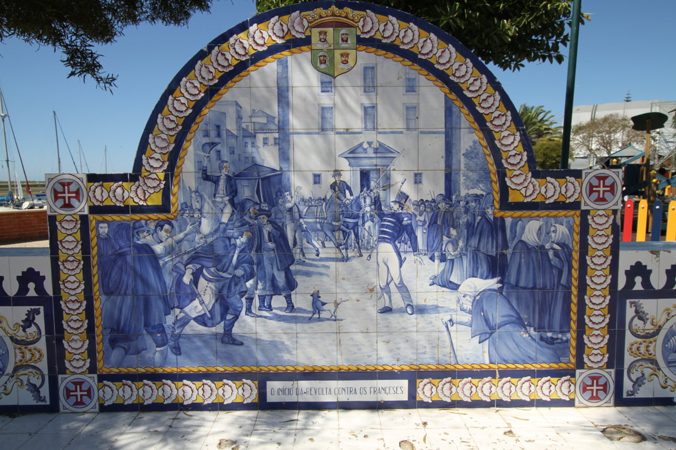
The most important historical fact about Olhão is that, in 1808, during the Napoleonic occupation of Portugal, it was in Olhão that a rebellion started against the French occupation. This succeeded in expelling the Napoleonic armies from the Algarve. You can see this in the tiles of the picture below.

Slide 4
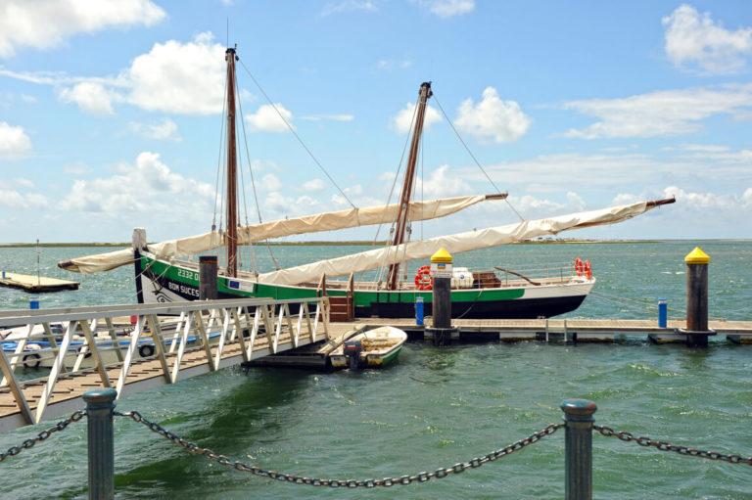
Caravela Bom Sucesso
As the royal family lived in exile in Brazil, a crew of 17 brave fishermen sailed (without navigational aids) a small fishing boat to Brazil. They traveled there to deliver the news to the royal family, that the French troops had left Portugal. In Olhão you can still find an exact replica of the original sailing boat, called Bom Sucesso.

Slide 5
Nowadays, the town is recovering and becoming a prosperous place, due to fishing, clam production, the shellfish trade, industry and services. In recent years, the tourism industry in Olhão is developing.

Slide 6
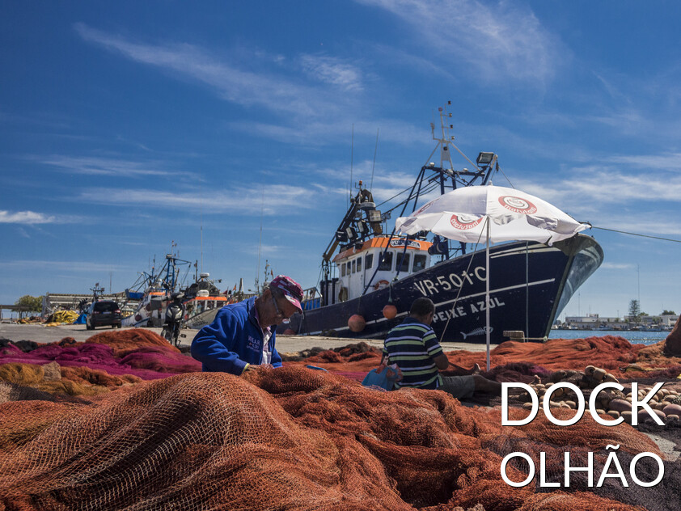
The fishing tradition in Olhão
The traditions of Olhão are very visible. Fishing continues to be one of the main livelihoods of the local population. In the West zone of the city of Olhão there is a fishing port. Is located near the industrial zone, which is still very linked to the fish processing

