Slide 1
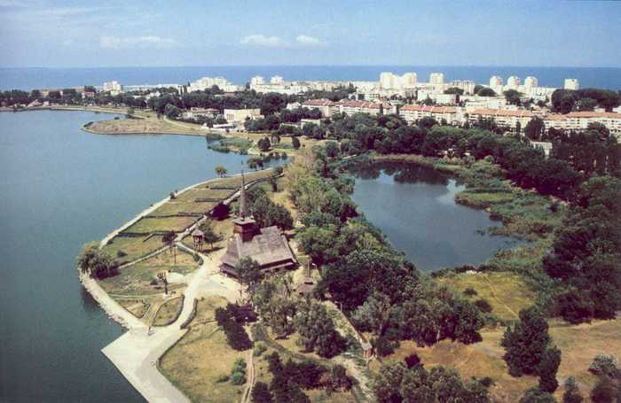
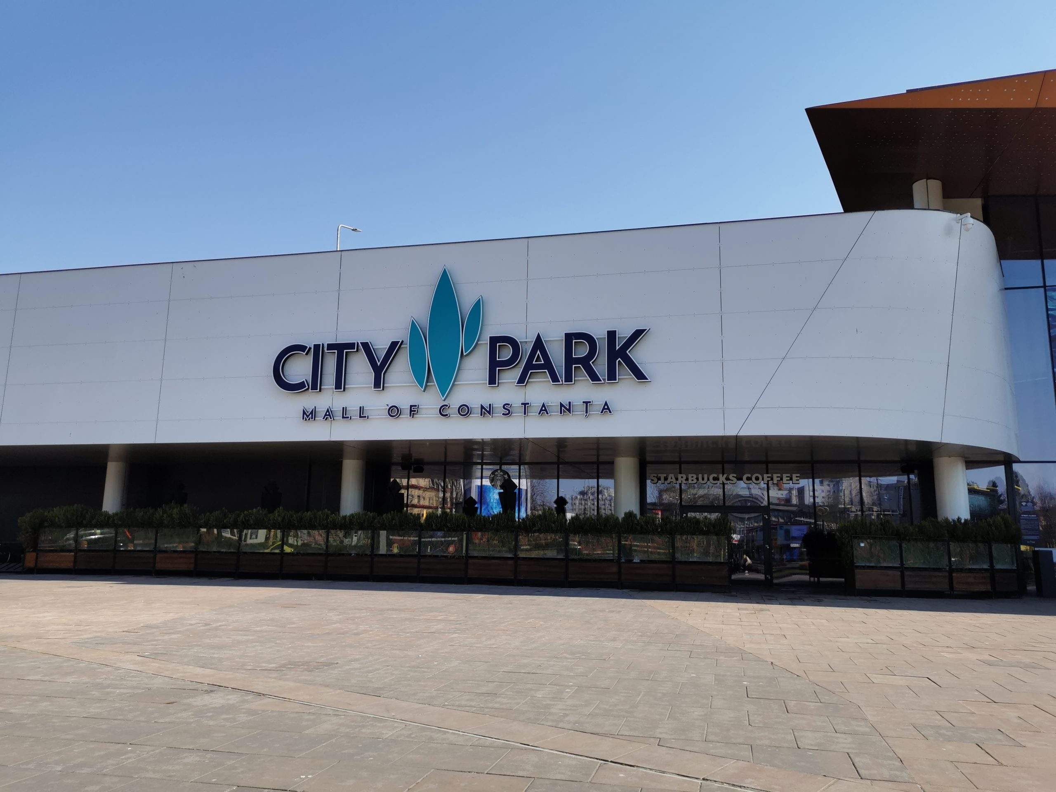
Constanta
By Bako Paula-Aylin

Slide 2
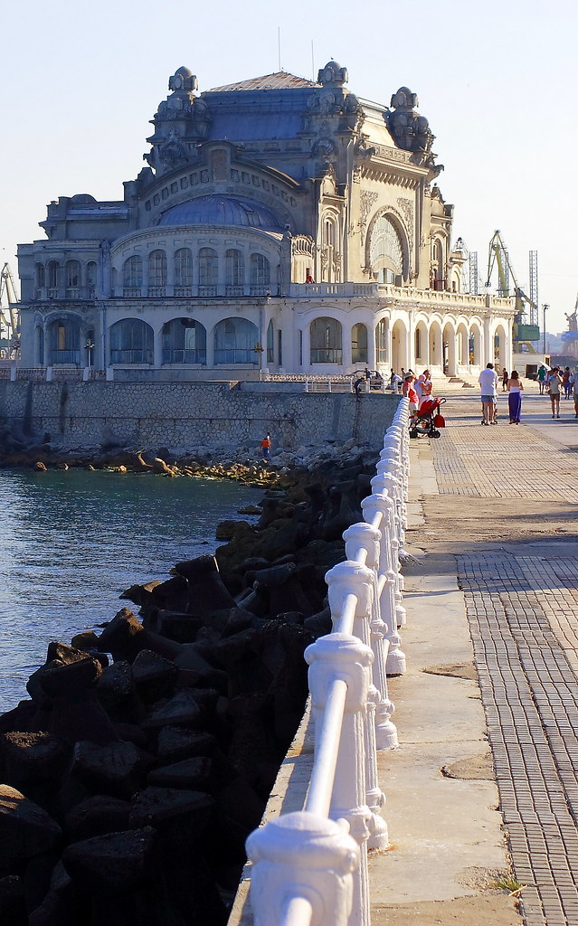
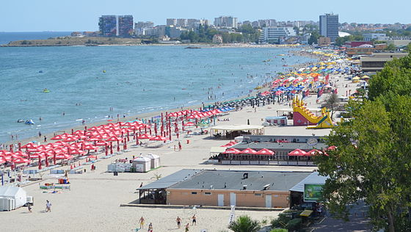
Our City-Constanta
Constanta is a city in south-east Romania. It is on the Black Sea’s coast. This city also used to be a Greek colony named “Tomis”. It’s a very popular place to visit in the summer, because our city has beaches. Constanta is also home to the largest port on the Black Sea.
There are also a lot of things to visit! The Constanta Casino, the Mamaia Beach, the malls named ViVo! and City Park, Tabacariei Park are a few things you can visit here.
At the beach you can sometimes see fish, crabs and jellyfish. Fish usually swim away from people at the beach and they are tiny. There are also dolphins here, but they are very hard to find at the beach. In Constanta we also have seagulls, you see them a lot outside.
Well-known beaches in Constanta: Modern, Mamaia, Trei Papuci. The cities/towns near Constanta also have: Navodari, Eforie Sud, Eforie Nord, Tuzla (it is wild and you can also find sea glass here), Corbu, Vama Veche (which is near the Romania-Bulgaria border).

Slide 3
