Slide 1
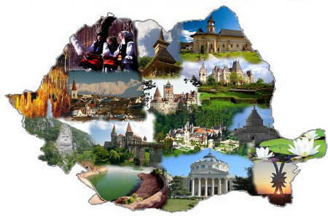
My country- ROMANIA
Made by:Anton Matei
5th grade A
School Nr 29 Mihai Viteazul Constanta

Slide 2
Where is Romania?
Romania is a state located in southeastern Central Europe, on the lower Danube, north of the Balkan Peninsula and on the northwestern shore of the Black Sea. On its territory is located almost the entire surface of the Danube Delta and the southern and central part of the Carpathian Mountains. It borders Bulgaria to the south, Serbia to the southwest, Hungary to the northwest, Ukraine to the north and east, the Republic of Moldova to the east, and the Black Sea coast to the southeast.

Slide 3
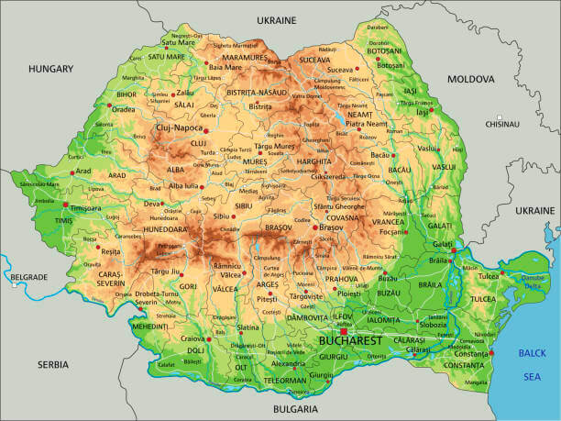
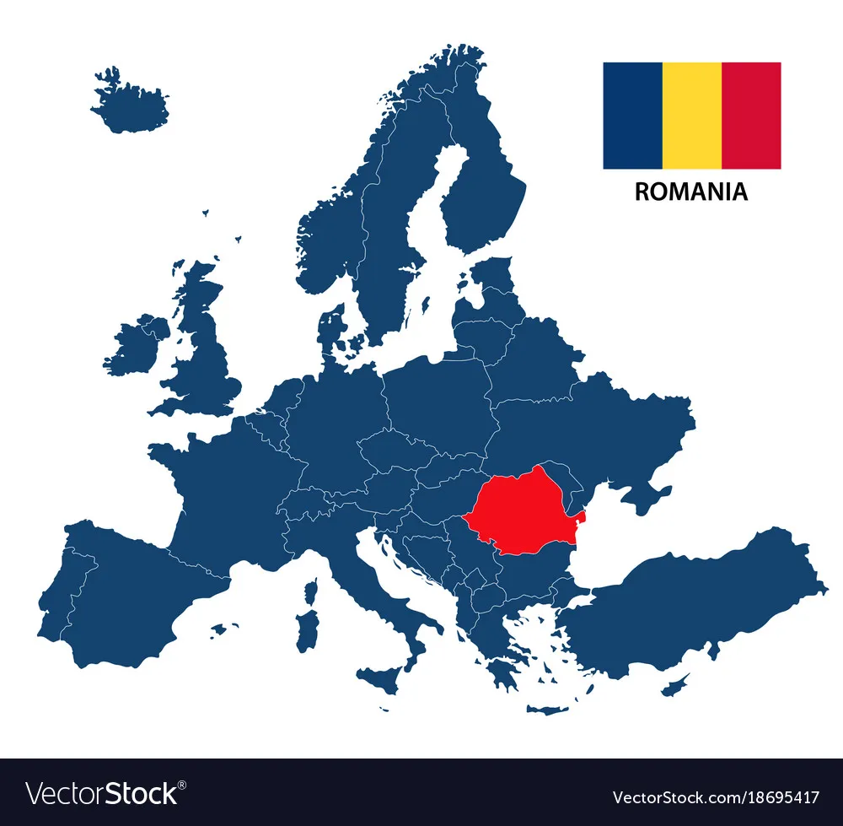
ROMANIA IN EUROPE

Slide 4
What can I visit in Romania?
Our country has all forms of relief and many waters. It is crossed by the Danube River which flows into the Black Sea, forming a unique delta in Europe.
In Romania you can visit several places (cities). You can visit Constanta, Bucharest, Sibiu, Sinaia, etc.
You can go to the mountains in winter and ski or in summer you can go to the Black Sea and swim.
Or you want to visit some historical monuments such as: Bran Castle,The Casino, Peles Castle, etc.

Slide 5
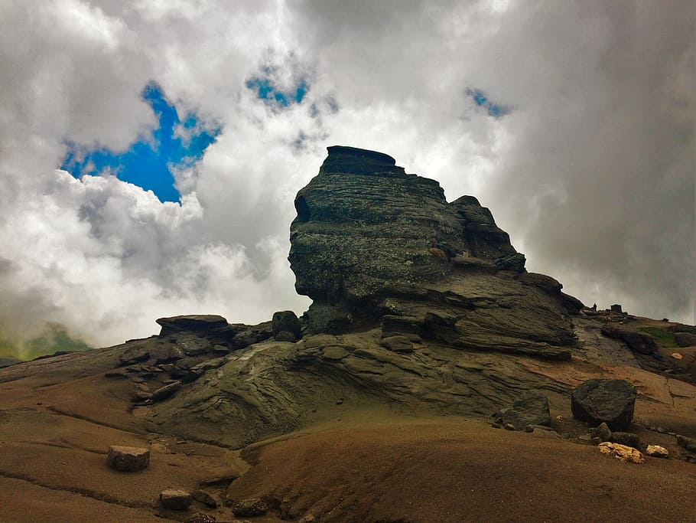
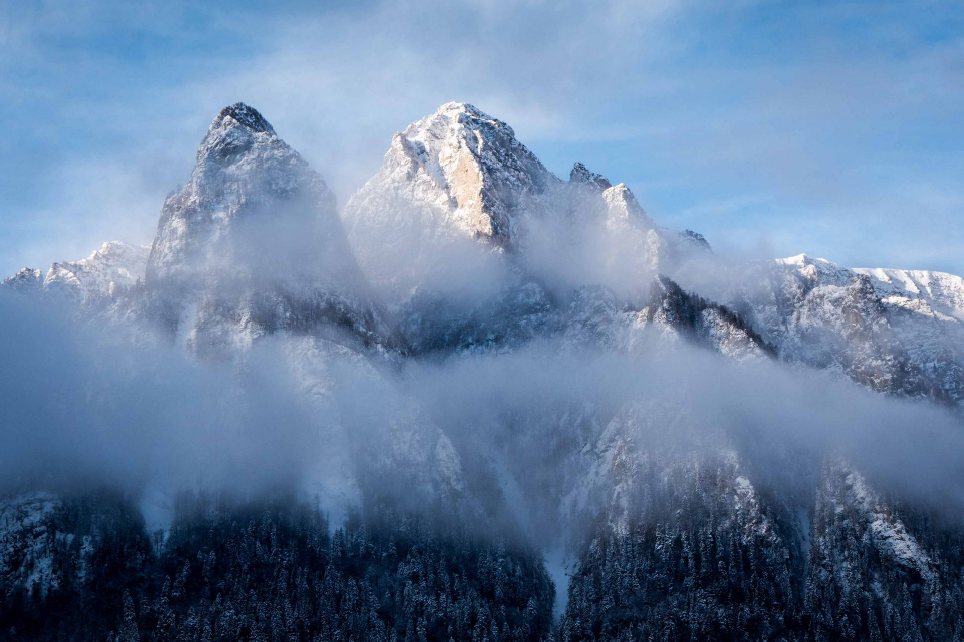
OUR MOUNTAINS- THE CARPATHIANS

Slide 6
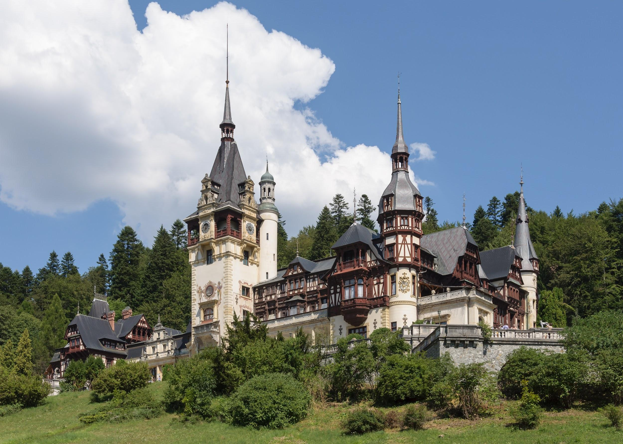
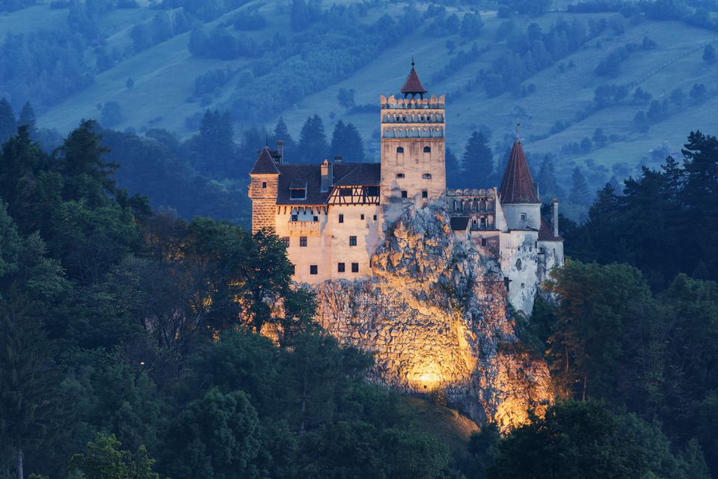
CASTLES IN ROMANIA PELEȘ AND BRAN (Dracula’s Castle)

Slide 7
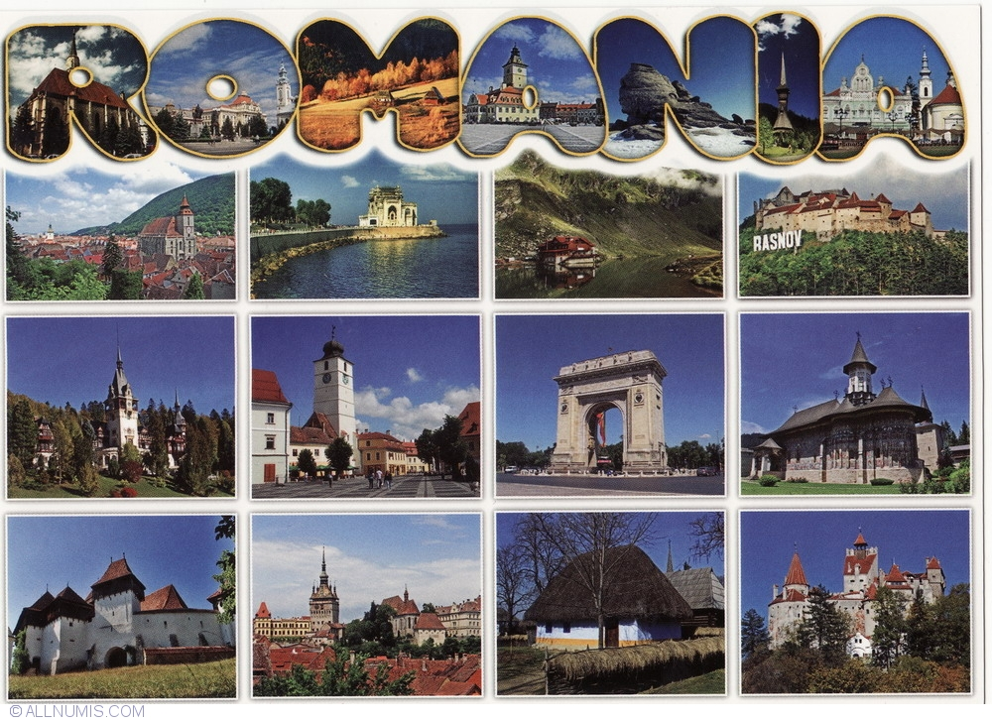
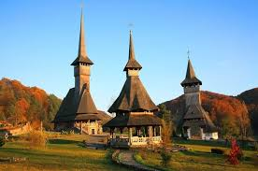
Old and beautiful monasteries
A history full of battles and heroes

Slide 8
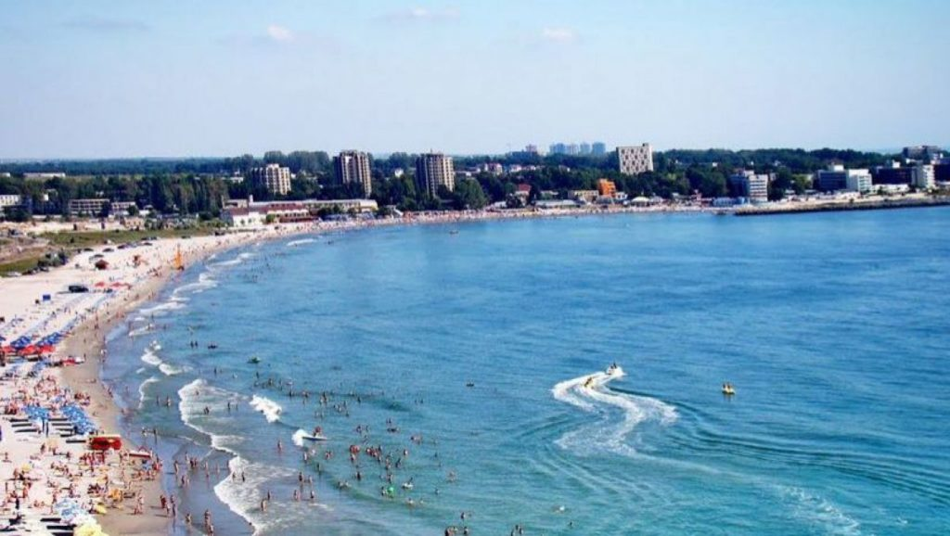
THE BLACK SEA
The Black Sea is a marginal sea lying between Europe and Asia
The Black Sea is bordered by Bulgaria, Georgia, Romania, Russia, Turkey, and Ukraine.
My city, Constanta, is located near the Black Sea.

Slide 9
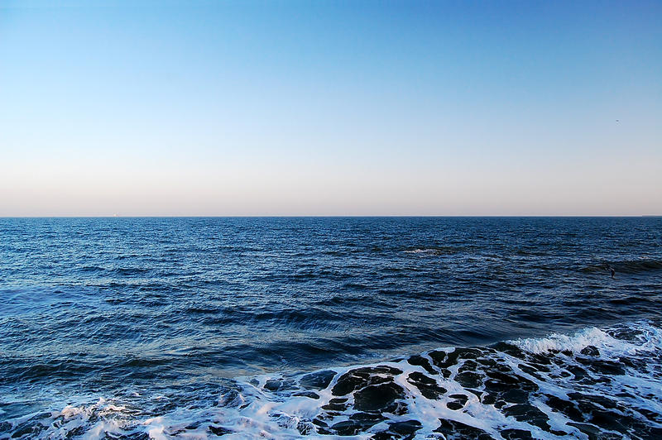
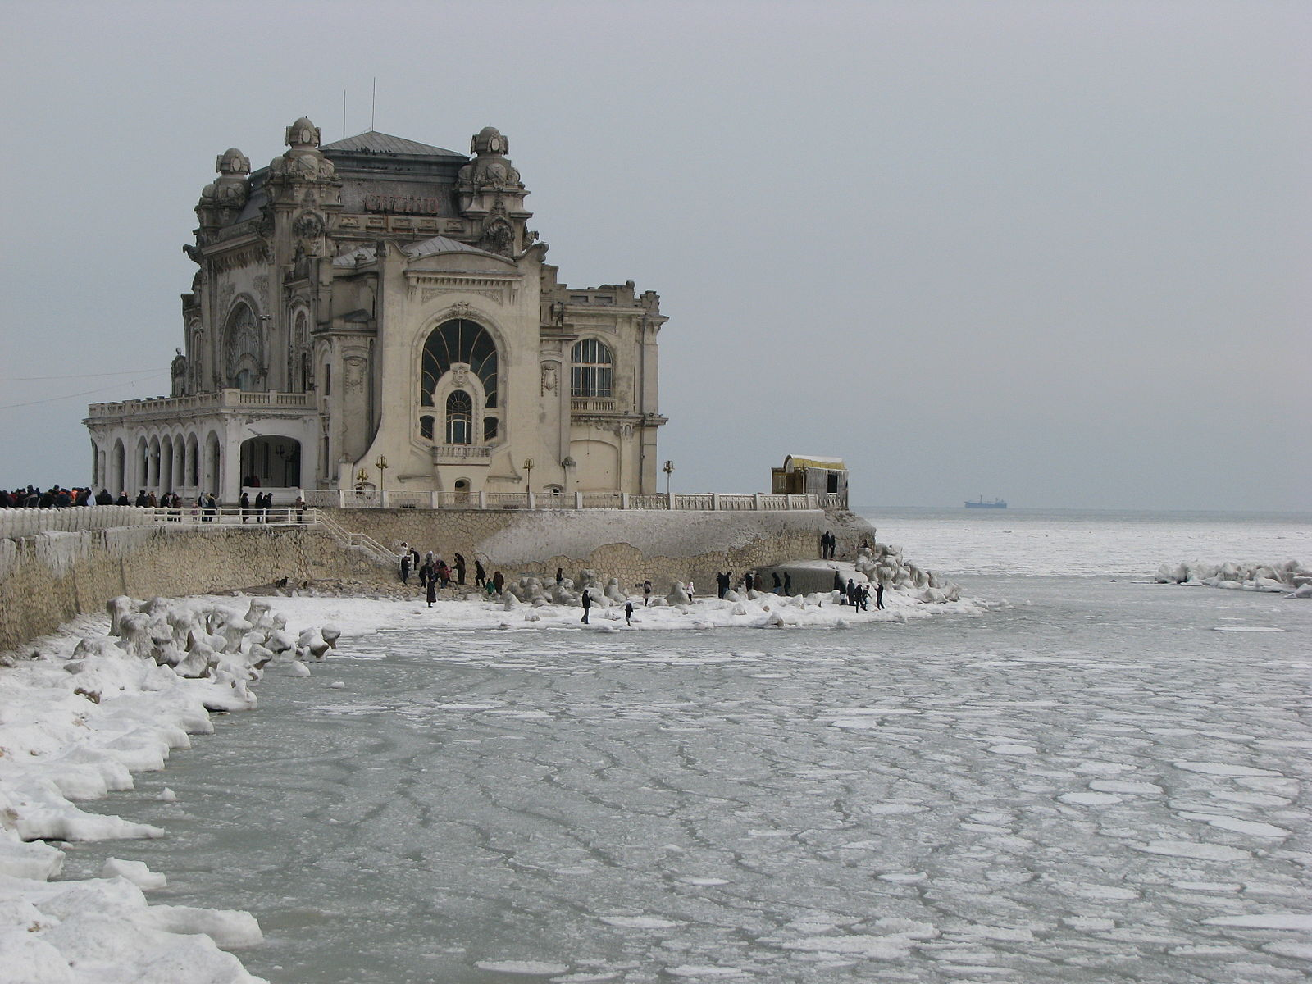
THE BLACK SEA and The CASINO from Constanta

Slide 10
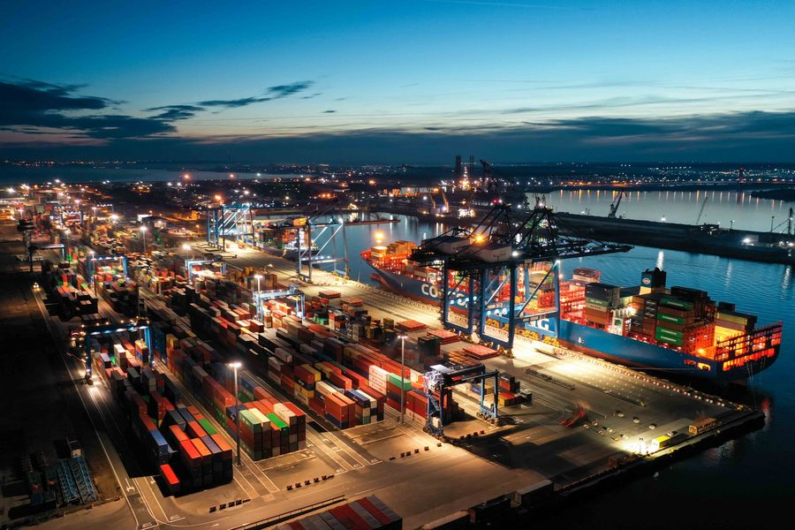
CONSTANTA HARBOUR

Slide 11
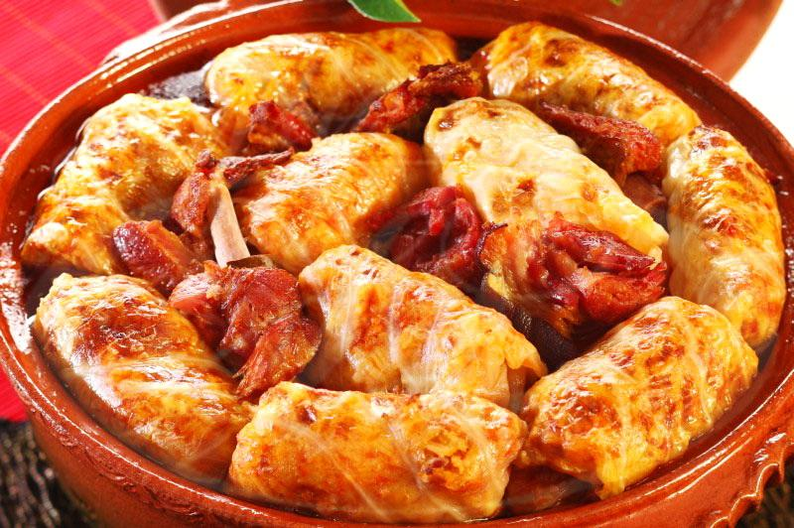
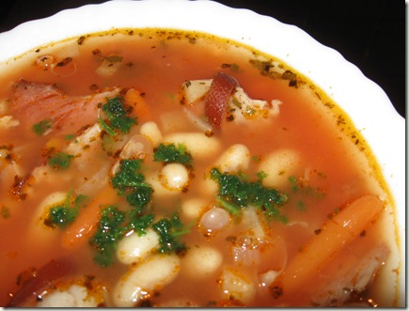
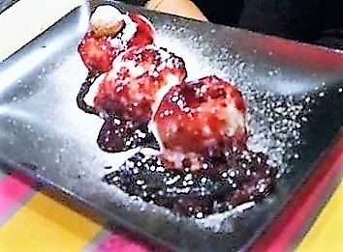
What do we eat in Romania?
In Romania we have several traditional Romanian dishes such as: sarmale, smoked sausages, pork alms (a Romanian tradition), bean soup with ciolan, papanasi with cheese and cherry jam, etc.

Slide 12
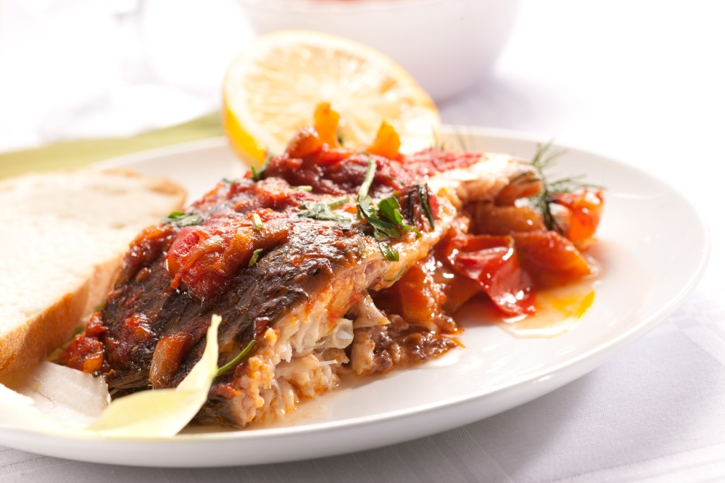
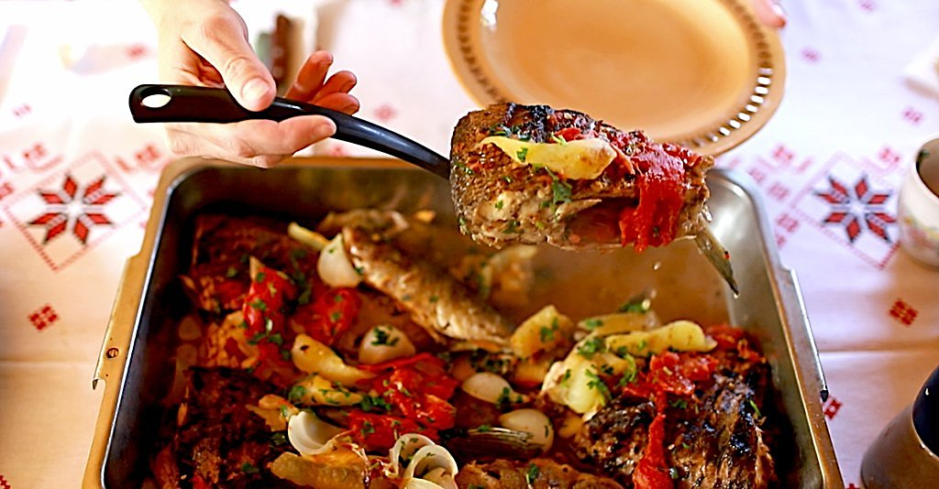
DOBROGEA (our area) IS FAMOUS FOR ITS FISH DISHES.
YOU SHOULD DEFINITELY TRY SARAMURA, FISH SOUP, GRILLES FISH WITH ONION AND PAPRIKA AND MANY OTHERS.

Slide 13
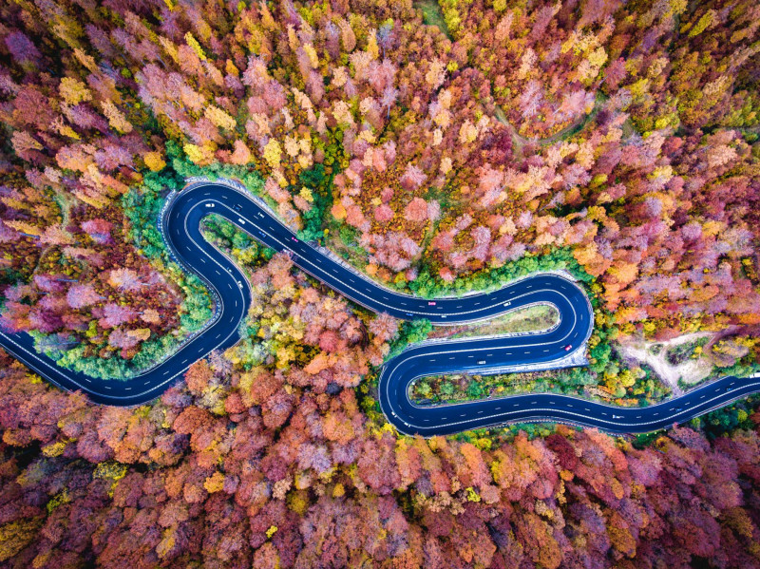
One of the most beautiful autumn image
Chosed by National Geographic
Constanta Harbour – a big one in Europe!

Slide 14
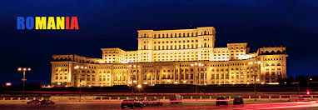
The Parliament – The biggest building from EU
https://repatriot.ro/romania-imagini-de-vis-selectie/
Thank you for your time!

