Slide 1
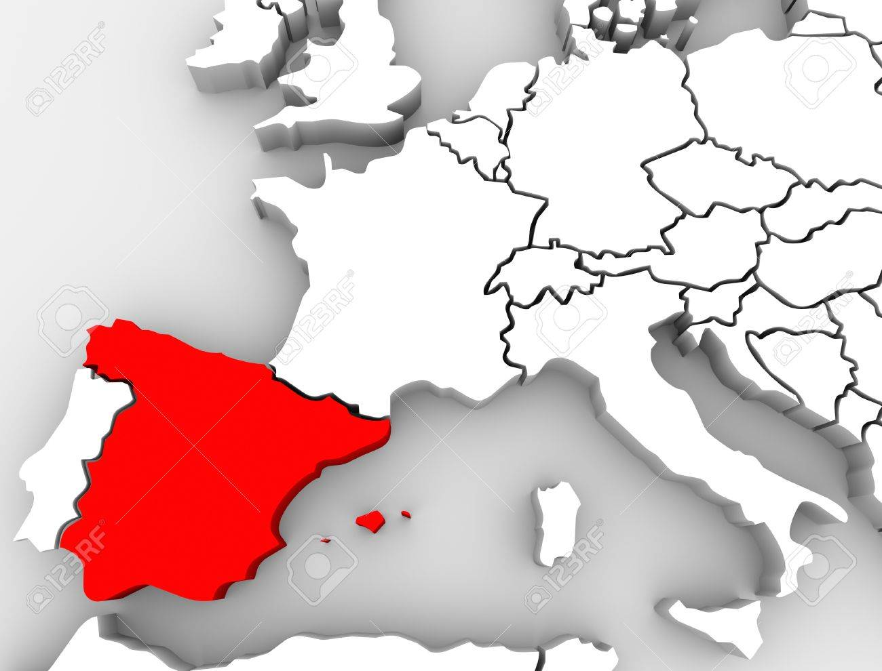
SPAIN

Slide 2
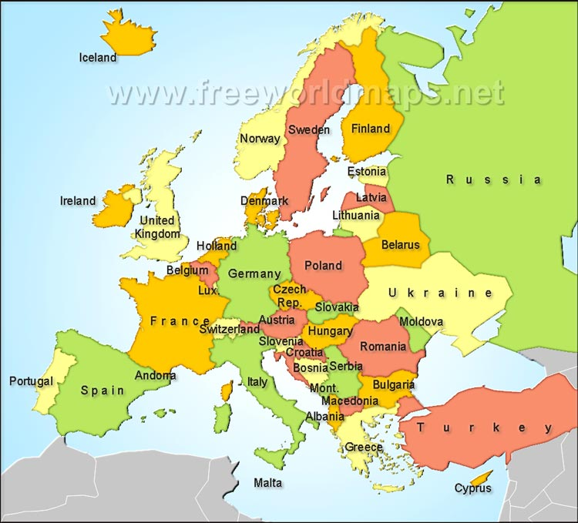
POLAND
Katowice

Slide 3
SPAIN
Area: 505,990 square km
Population: 46,7 milion people
European Union member since 1986

Slide 4
Spanish Cultural heritage

Slide 5
our school is in Cordoba, south of spain

Slide 6
The Main Cities

Slide 7
BARCELONA

Slide 8
MADRID, CAPITAL OF SPAIN

Slide 9
Famous SPANISH PEOPLE

Slide 10
SPANISH SINGERS – ROSALIA AND ENRIQUE IGLESIAS

Slide 11
SPANISH TENNIS PLAYER – RAFA NADAL

Slide 12
OUR SCHOOL

Slide 13
FLAMENCO

Slide 14
Thank you and I HOPE TO see you in SPAIN

