Slide 1
PRIMARY SCHOOL ALOJZA GRADNIKA DOBROVO
E- Twinning
Manca Miljavec
Dobrovo, maj 2018

Slide 2
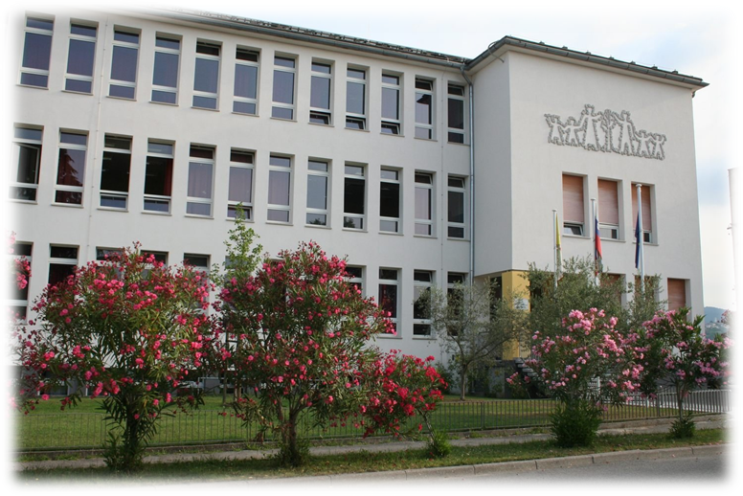
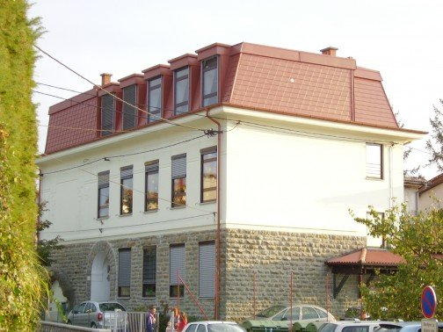
ABOUT OUR SCHOOL
Official name: Primary school Alojza Gradnika Dobrovo
Previous name: Primary school Dobrovo
It‘s in Dobrovo; Trg 25, maja 9 – Square 25. maja 9
It‘s a central school in Goriška brda, a kindergarden and it has a
affiliate school in Kojsko, which is over 100 years old
Classes are from 1st to 9th and it has about 412 students

Slide 3
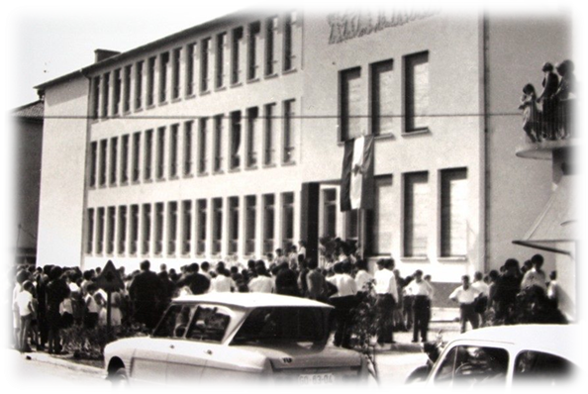
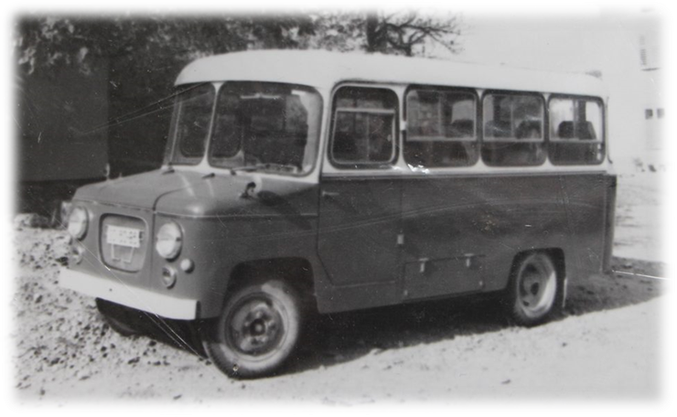
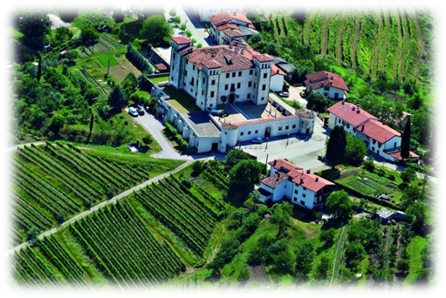
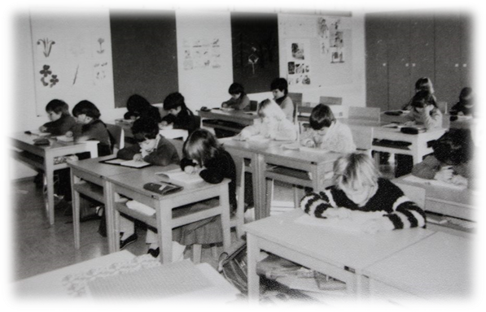
HISTORY
It was build in 1966, butuntil then the school was in Dobrovo Castle
The first headmaster was Mr. Peter Žigon

Slide 4
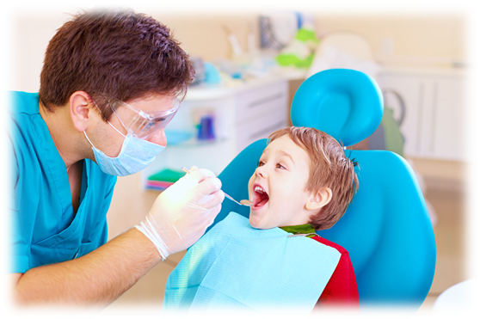
ROOMS IN SCHOOL
Our school has:
2 gyms
About 22 classroms
Kitchen
Canteen
Dentist’s
Library
Computer classroom
Secretary
Accounting
Psychologist
Social worker

Slide 5
SUBJECTS
COMPULSORY ELECTIVE SUBJECTS
Biology
History
Slovene lanquage
Maths
Psyhics
Geography
Art
Ethics
Music
English
Chemistry
Technique
OPTIONAL SUBJECTS
For example:
Italian lanquage
PE
Multimedia
Chemical experiments
Astronomy

Slide 6
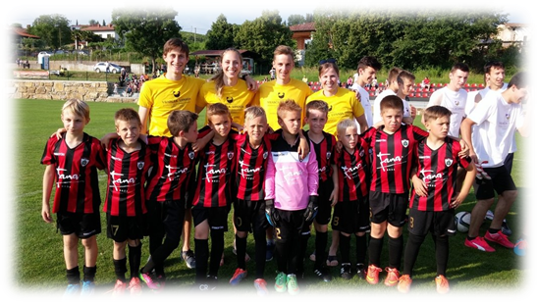
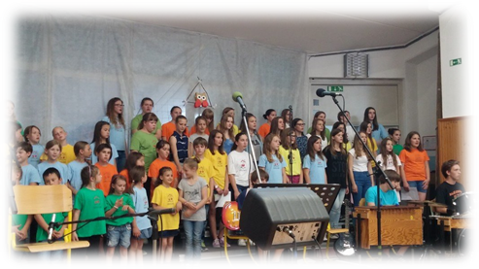
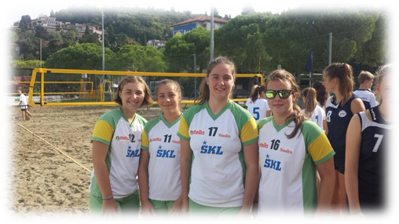
AFTER SCHOOL ACTIVITIES
We have a lot of options to spend our free time.
For example:
Choir
Dance
Gymnastisc
Football
Volleyball
Art
Extra classes of a subject, so they prepare for a knowledge competitions.

Slide 7
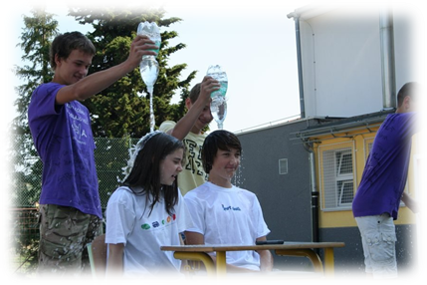
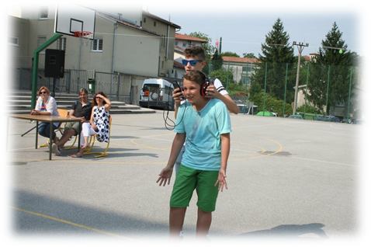
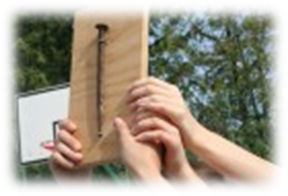
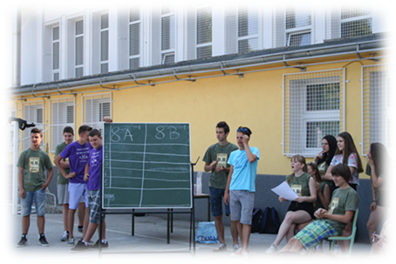
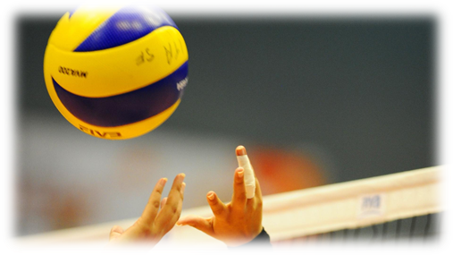
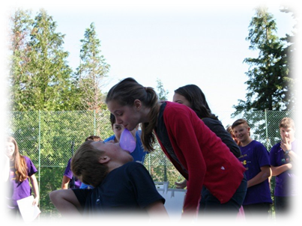
TRADITIONS
Every year 9th graders pass the key to 8th graders, but they have to do funny tasks to get it
The class who wins has the chance to prepare this traditional event for the next generation
The class who loses gets a nail

Slide 8
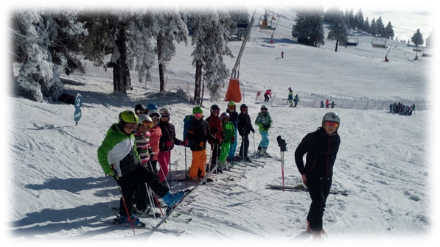
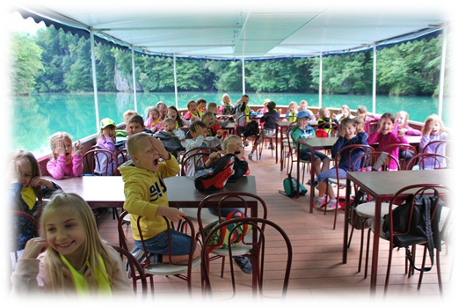
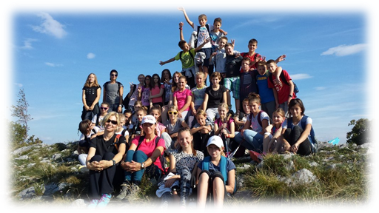
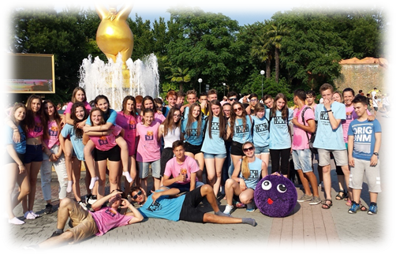
SCHOOL TRIPS
In a school year we go on a lot of fun trips.
We see different castles, caves, citties, waters … etc.
We also go on hikes and longer walks.
From 3rd to 8 th grade we go on a longer school trip, which takes 5 days.
For example we go on sea side, near the mountains… etc.
We do different activities and it’s basicly a different way of class outdoors.
In the last grade we go on our final trip, usually to Gardaland

Slide 9
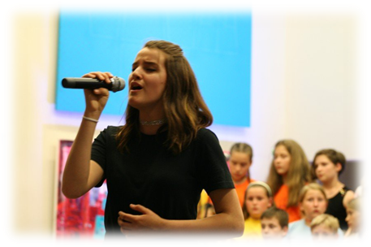
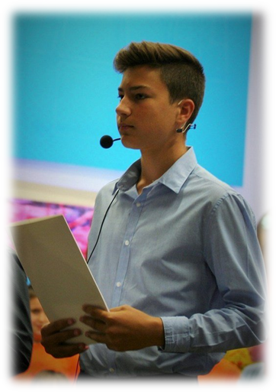
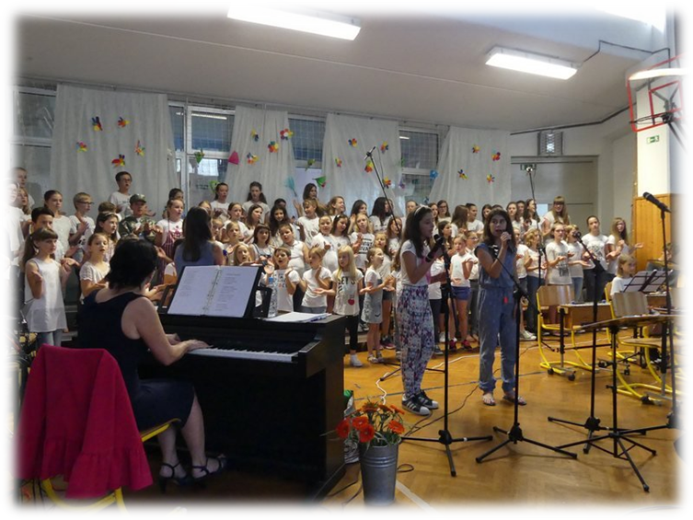
CELEBRATIONS FOR DIFFERENT OCCASIONS
For every occasion for example:
Before Christmas holiday, Summer and Spring break we prepare an event where choir and some solo performers performe.

Slide 10
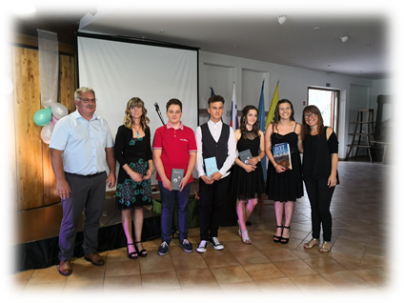
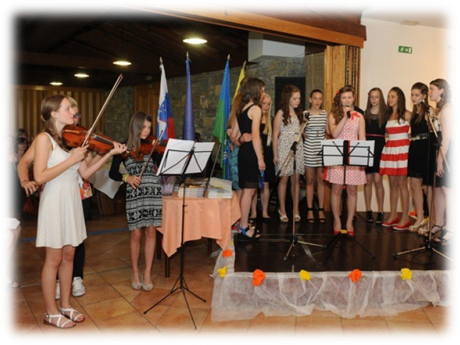
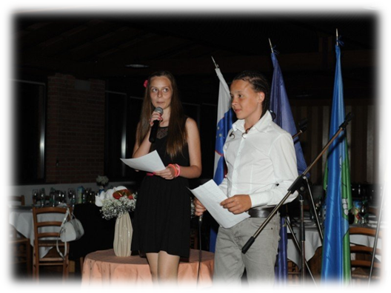
GOODBYE FROM THE 9 GRADERS
9 graders prepare a goodbye celebration. They invite their parents, sisters, brothes and guys ask a girl to be their „date“ for this evening.
People sing, dance, have dinner, give awards for different things and finish primary school as well as say goodbye.
9 graders also make a short film and customized T- shirts with their signiture.

Slide 11
SOURCESS AND LITERATURE
https://www.google.si/search?rlz=1C1GGRV_enSI751SI751&biw=1920&bih=1067&tbm=isch&sa=1&ei=tDEpW5uPBoqPsAGTt7rQDQ&q=dobrovo+castle+school&oq=dobrovo+castle+school&gs_l=img.3...79657.81138.0.81399.7.7.0.0.0.0.135.847.0j7.7.0....0...1c.1.64.img..0.0.0....0.AkbuoIzB7m8
https://www.google.si/search?rlz=1C1GGRV_enSI751SI751&biw=1920&bih=1067&tbm=isch&sa=1&ei=VTwpW8ePLqSPmwXA64_wBA&q=o%C5%A1+alojza+gradnika+dobrovo+predaja+klju%C4%8Da&oq=o%C5%A1+alojza+gradnika+dobrovo+predaja+klju%C4%8Da&gs_l=img.3...7337.12439.0.12784.15.15.0.0.0.0.544.2240.0j13j5-1.14.0....0...1c.1.64.img..1.0.0....0.yBj0co5Ke3g#imgrc=_
http://www.os-dobrovo.si/

