Slide 1
BRDA
Elena Plesničar, Meta Konjedic, Mineja Podgornik Pulec
8.B

Slide 2
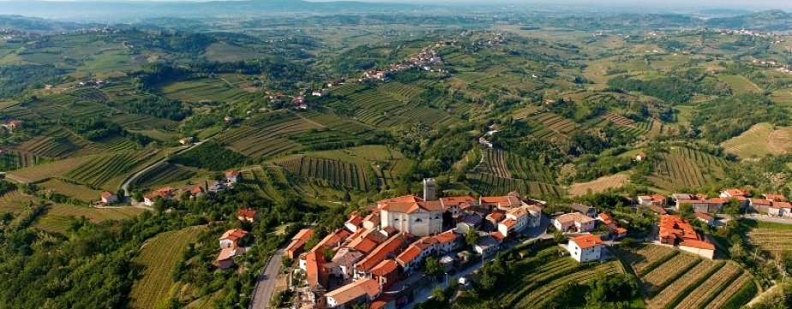
Characteristics
Area: 72km²
Population: 5,575
Language: slovenian
45 villages

Slide 3
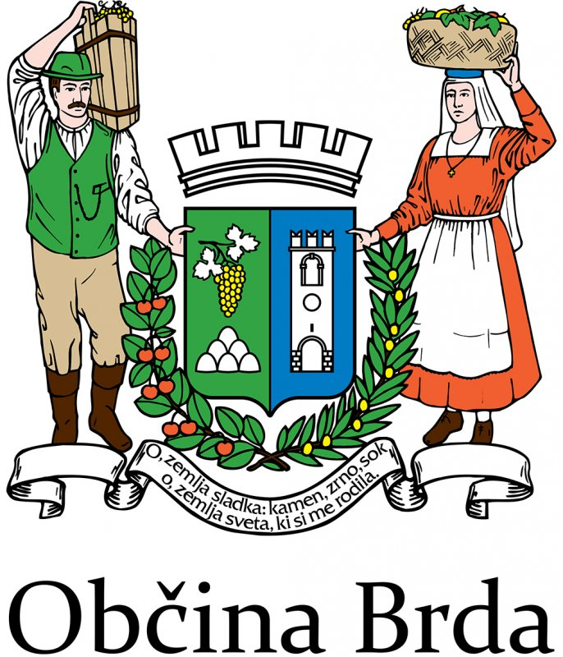
Goriška Brda coat-of-arms

Slide 4
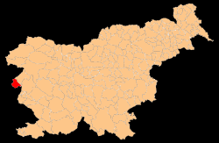
Position
Western Slovenia
Primorska
Western from river Soča
Bounded by Sabotin and Korada hill
Near Nova Gorica and Solkan
Border within Italy and Slovenia

Slide 5
Climate
Mediterranean climate
Winter: min -10
Summer: max +35
Few of precipitation

Slide 6
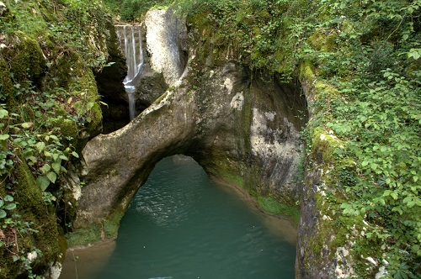
Natural attractions
Krčnik (natural stone bridge)
Sabotin (peace park)
Kožbanjšček valley (Kotline pools)
Korada (Korada hill)

Slide 7
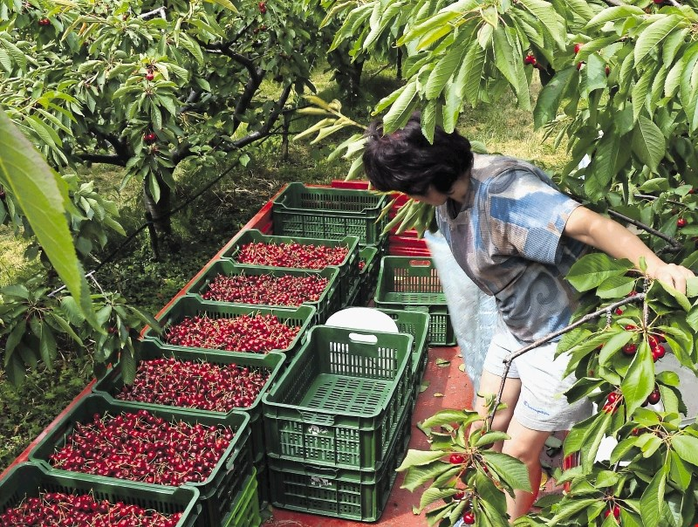
Economy
Tourism
Agritourismm
Apartments, hotels
Viticulture
Fruit farming (cherries, apricot, peach,
nectarine
Koline (livestock production )
Olive oil industry

Slide 8
Viticulture
Vineyards covers 18000 hectars
Brda‘s white wines:
    Rebula
    Tokaj
    Pinot
    Sivi pinot
    Chardonnay
    Sauvignon
    Rdeči merlot
    Cabernet
Wine cellar at Dobrovo (1957)
Wine growers (Simčič, Ščurek, Movia, Medot…)

Slide 9
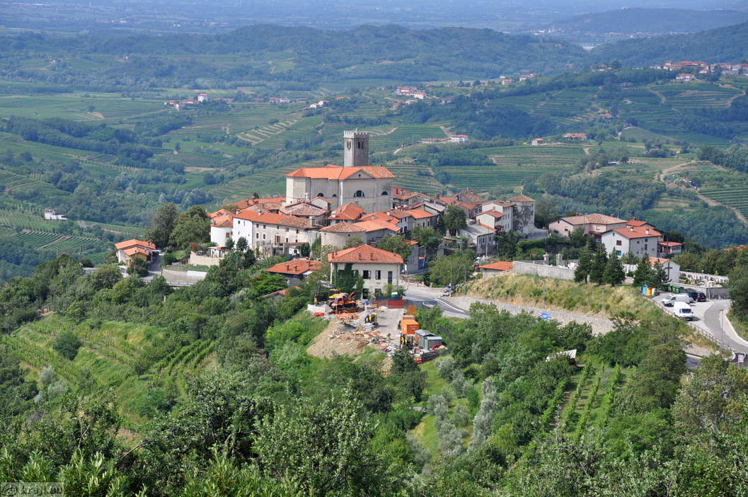
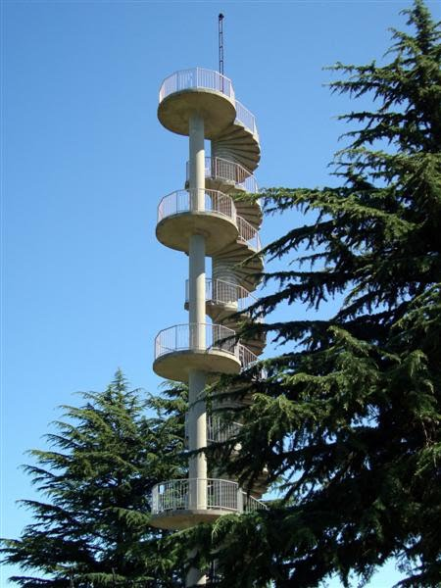
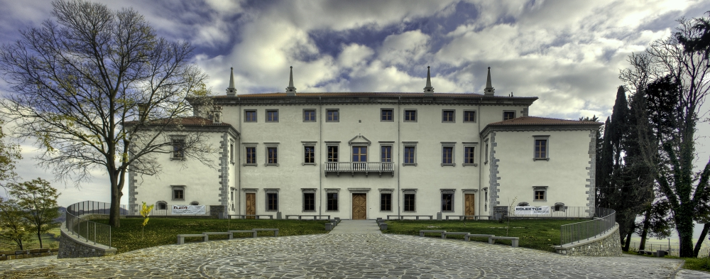
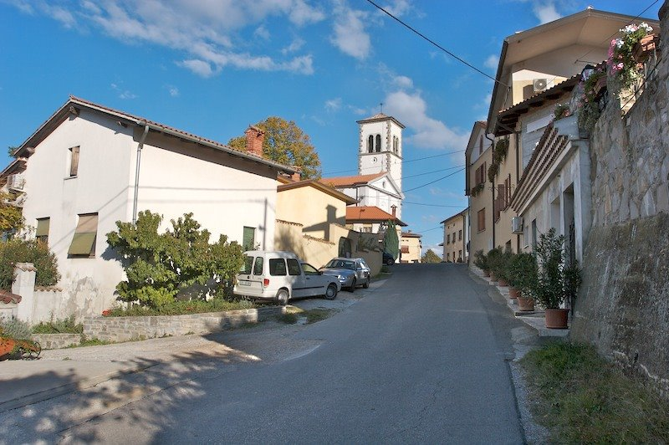
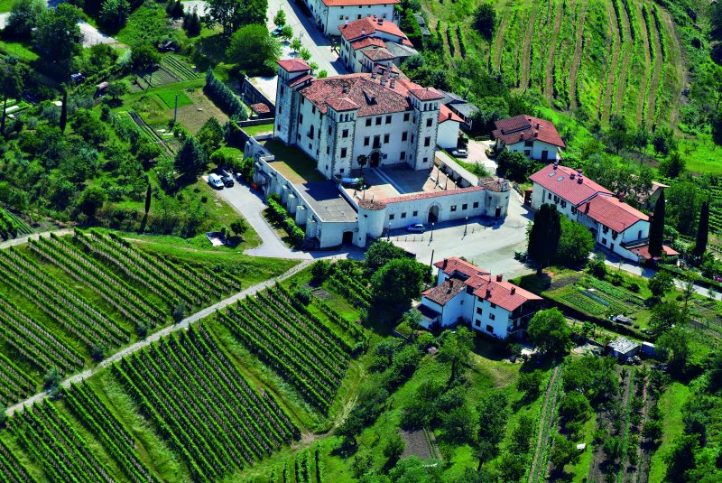
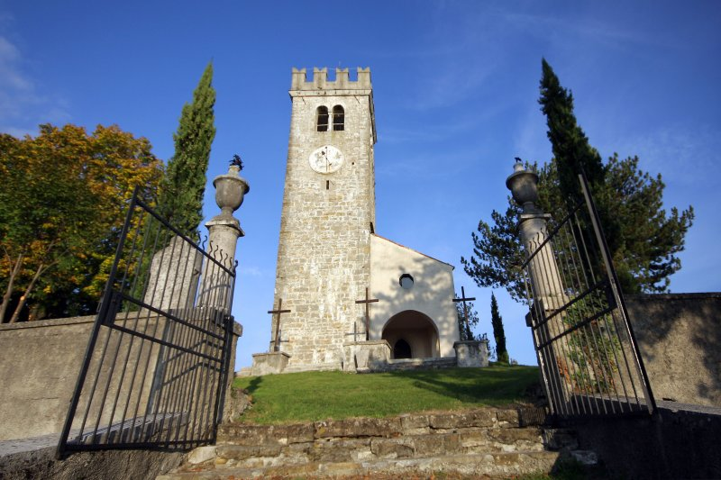
ATRACTIONS

Slide 10
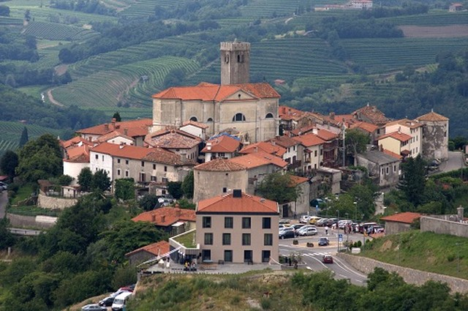
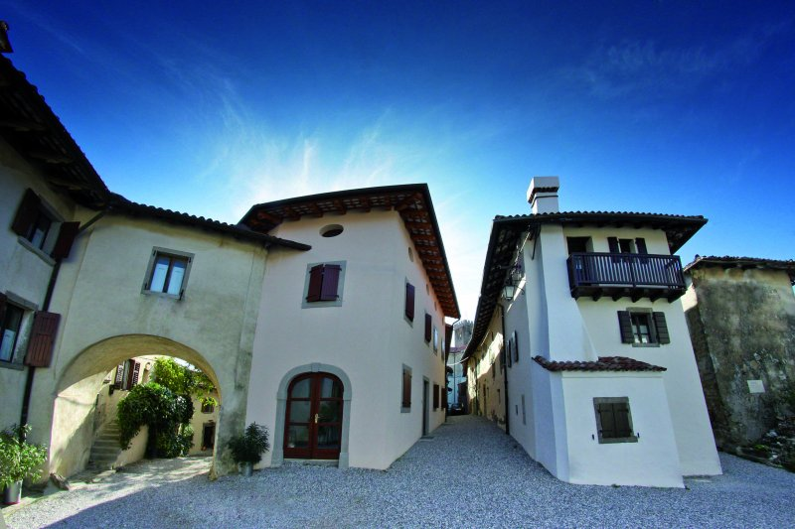
Šmartno (cultural monument)
Cultural monument:
    Gostilna Turn
    Hiša Marica
    Nona Luisa
    Briška hiša
architecture biser, culture monument, unique
All details
strategic defence point (13 stol. – 18 stol.)
Church of sv. Martin
Church bell from 1857 with motive holy three kings
Hotel San Martin

Slide 11
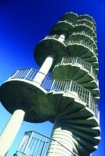
Gonjače (view tower)
Manuscripts
View tower:
    23m
    144 stairs
    1961
    Brda, Julians and Karnians Alps, Dolomite, Furlanijo,
    Trieste bay, Kras, Vipava‘s valley in Trnov‘s forest
    Arhitect: Marko Šlajmer

Slide 12
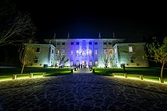
Villa Vipolže (Renaissance manor house)
Villa Vipolže:
    lovski dvorec goriških grofov
    Later were owners aristocrats
    17 stol. Processed into renaissance villa
Gredič
the only preserved water mil
fossil numulitins

Slide 13
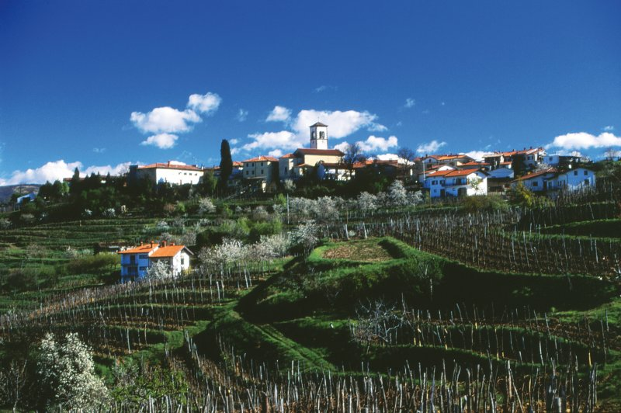
Medana
birth house of Alojz Gradnik
Ludvik Zorzut
MMMart painting colonies

Slide 14
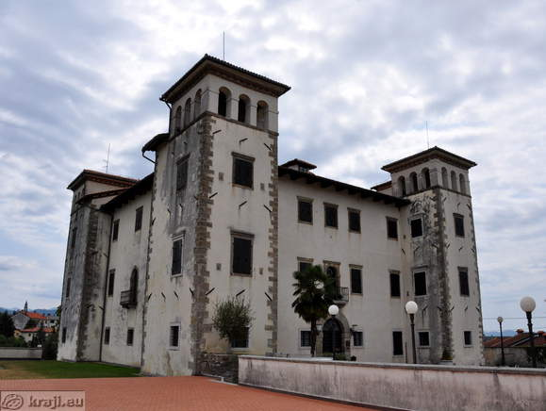
Dobrovo
The capital of Brda
400 inhabitants
Castle Dobrovo (Zoran Mušič, accolade hall,
castle courtyard, familly Baguer)
Cherry fastival ( Brda‘s wedding , bycle maratton „heoroes of vineyards“, parade…)

Slide 15
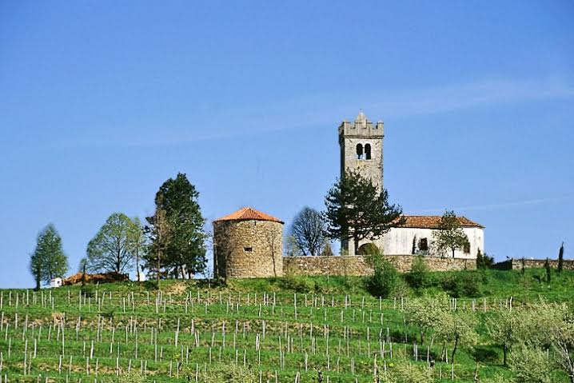
Kojsko (gothic church of the Holy Cross)
Wayside village situated at the top of the hill
In the past the village was the cultural and
economic centre of East Brd
There used to be a portal, which
was closed in the evening. At night, the
village was protected by guards
The settlement is first mentioned in 1086.

Slide 16
Thank you for your attention!

