Slide 1
11 november: St Martin‘s day
NOT A WORK FREE DAY
THE DAY WHEN MUST TURNS INTO WINE
CELEBRATIONS ALL OVER SLOVENIA

Slide 2
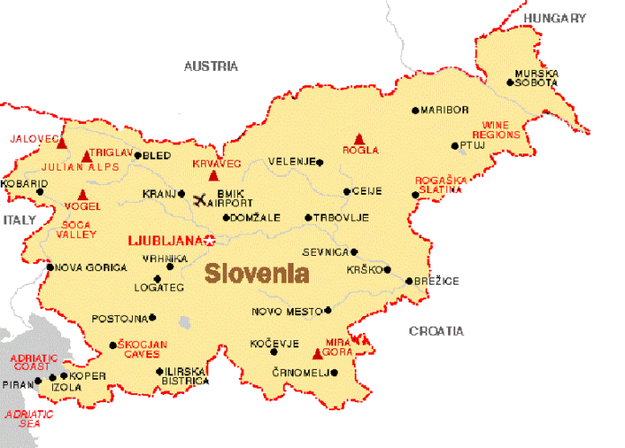
location
the feast of St Martin‘s is celebrated all over Slovenia:
People from all over the world come to celebrate in Maribor, where the oldest wine in the world still grows gives grapes (440 years)
The Vipava Valley: wine tasting, singing and dancing groups preformances
In Ljubljana, they organise the so called wine road across the city.
In the Karst they organize walking tours on the wine road with stops at local wineries

Slide 3
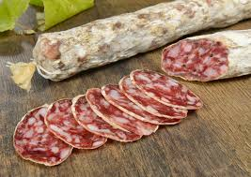
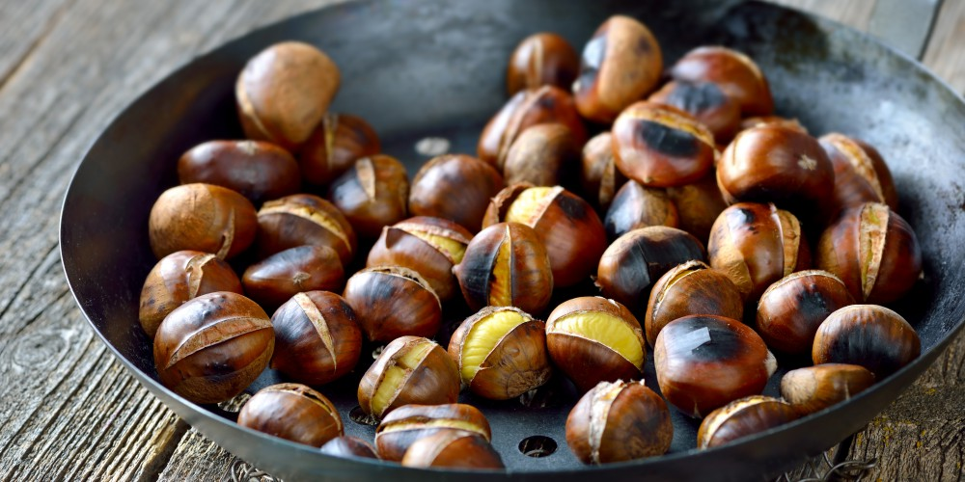
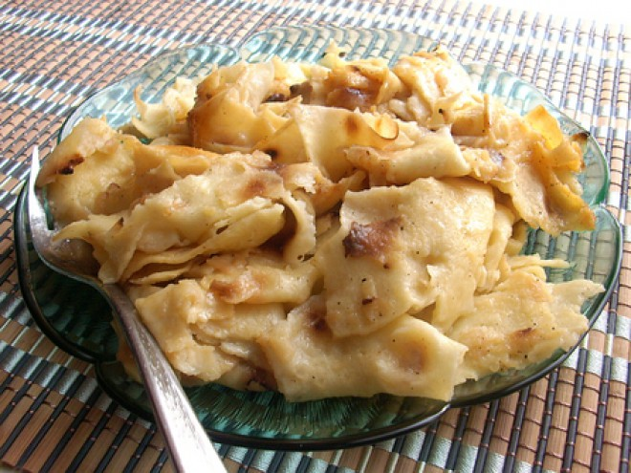
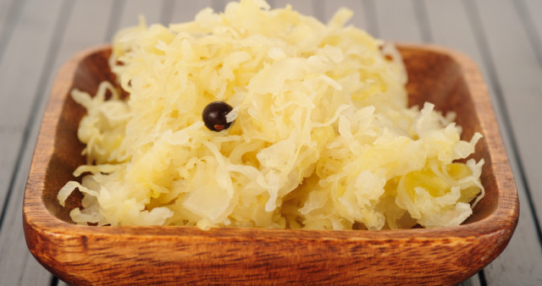
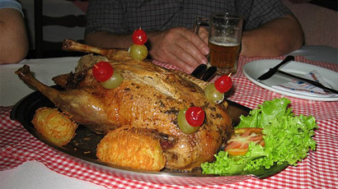
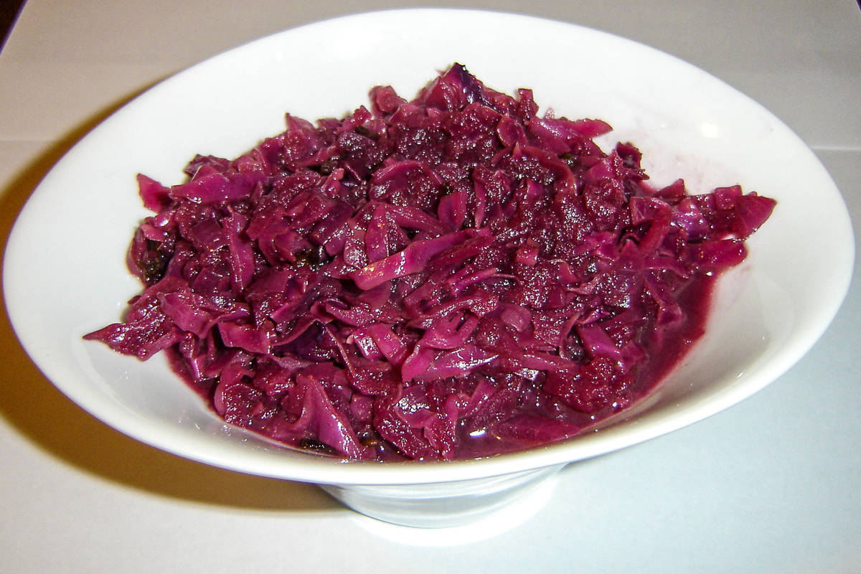
Food
mlinci Slovenian pasta tatters made from thin dried dough
chestnuts
home made salami
stuffed duck or goose
sauerkrauts- in Primorska;
red cabbage in other parts

