Slide 1
San martins day IN BRDA today

Slide 2
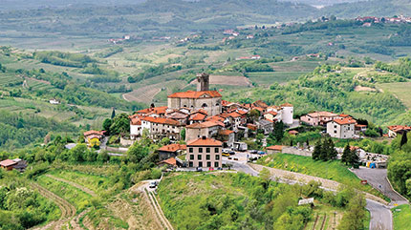
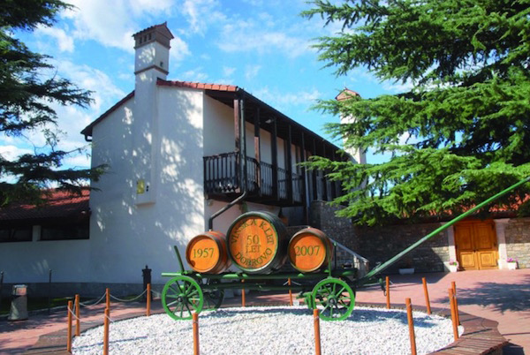
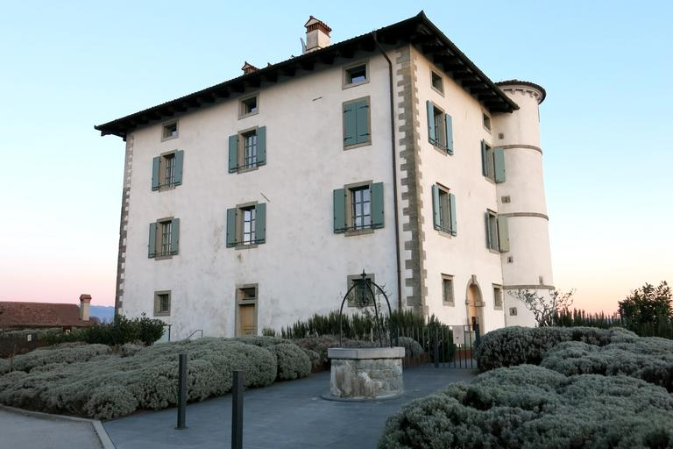
Location
San Martin‘s Day takes place in different locations like Šmartno, Wine Cellar Dobrovo, picnic park Čelo and in Gredič.
The celebration in Šmartno attracts crowds from different parts of Slovenia and Italy.
PIC 1 Šmartno
PIC 2 Wine Cellar Dobrovo
PIC 3 Gredič

Slide 3
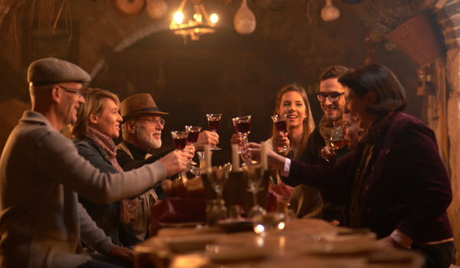
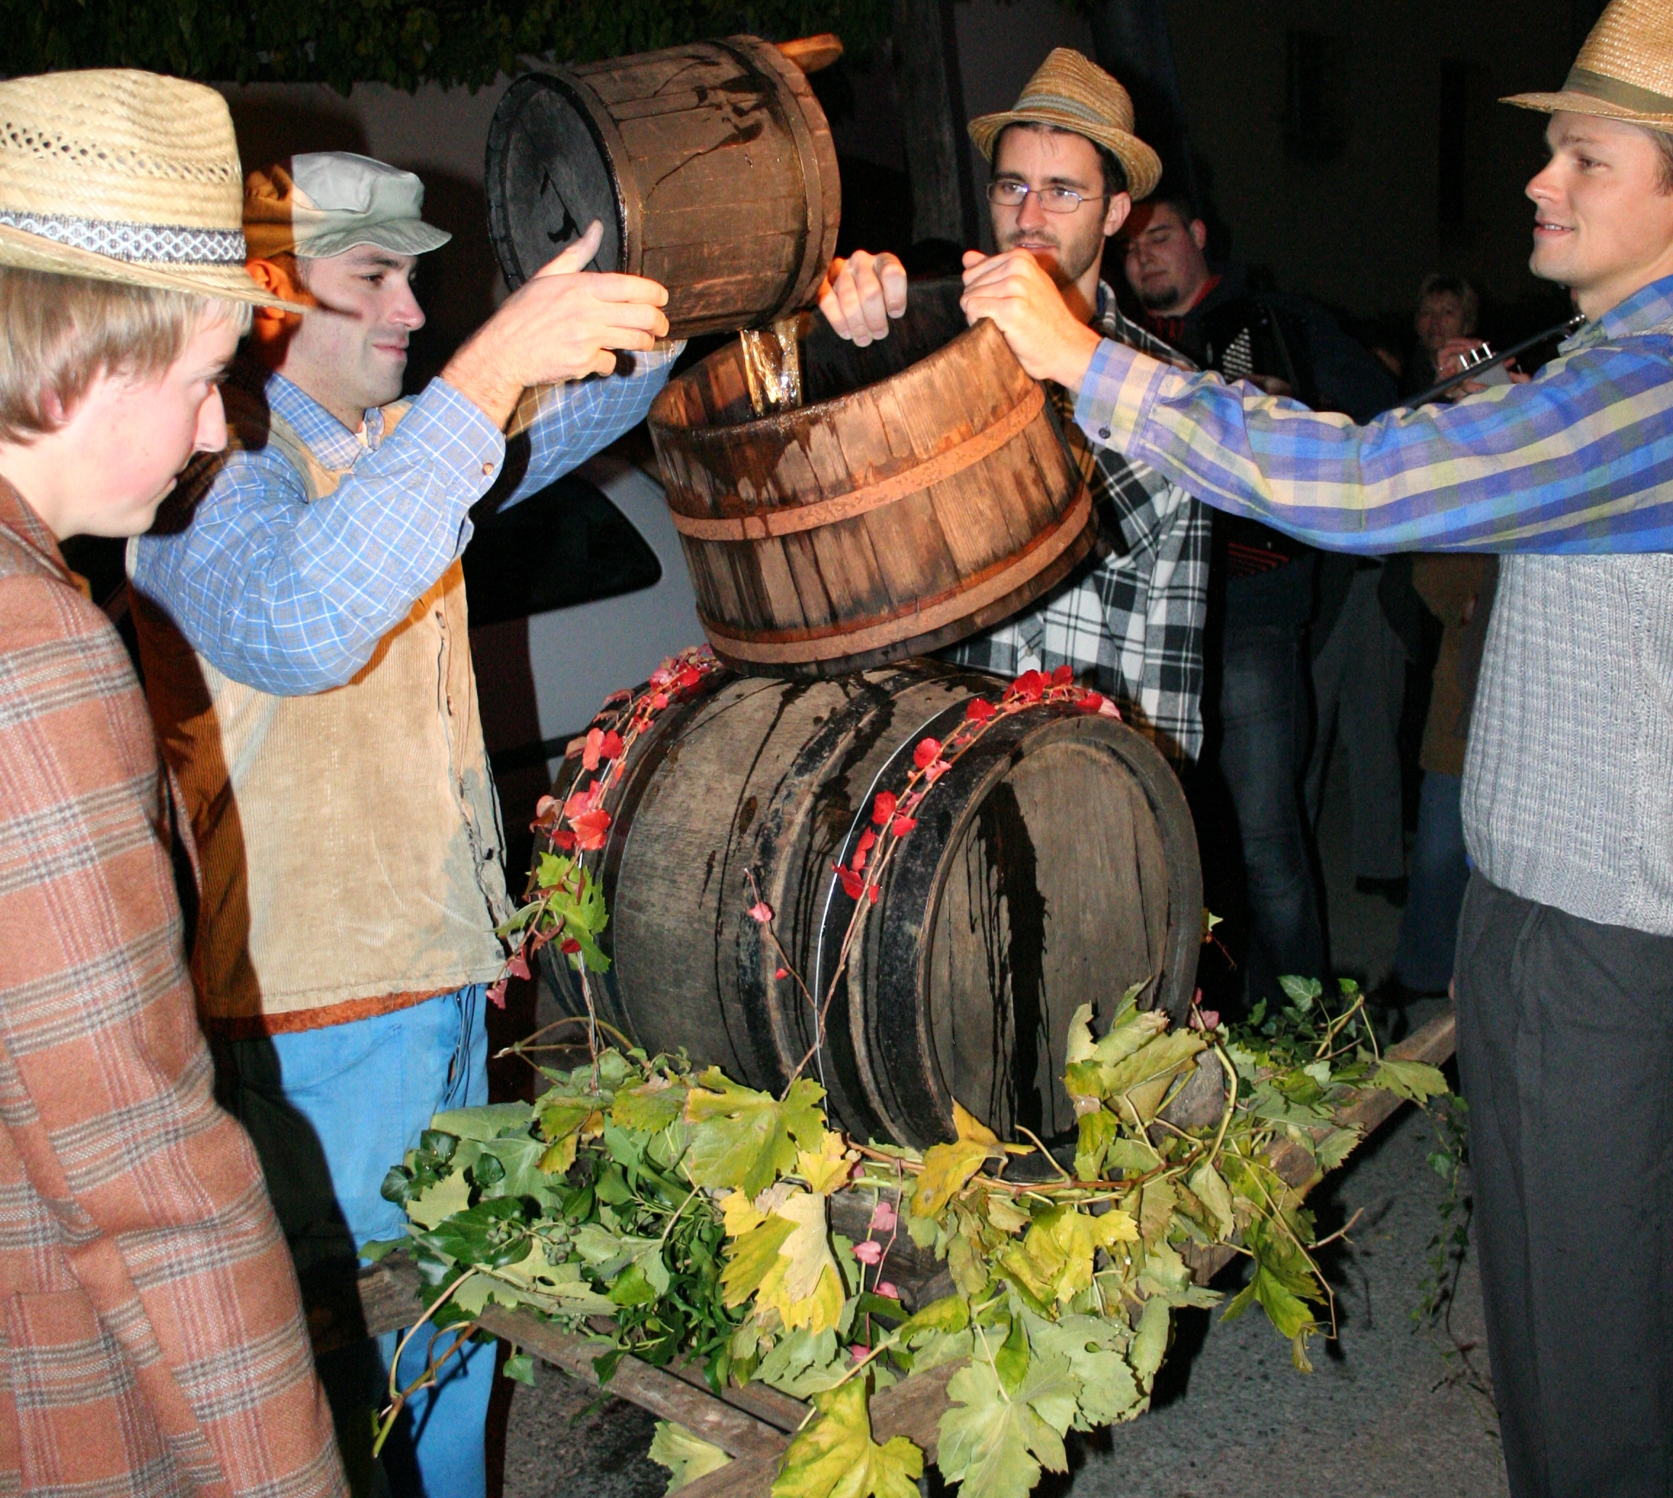
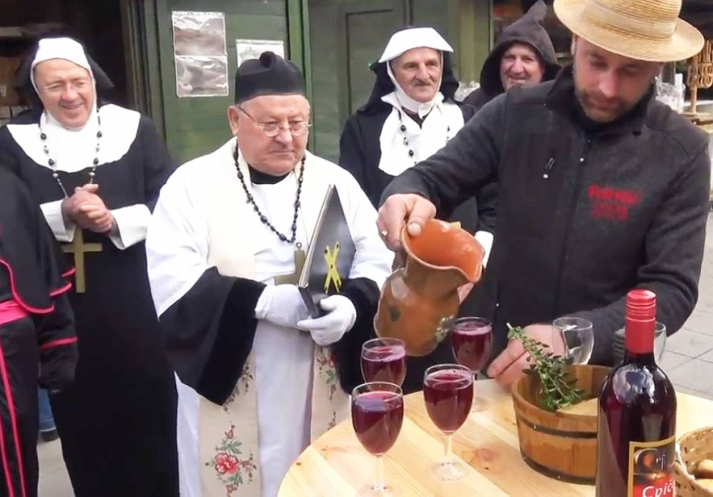
CUSTOMS
On St Martins Day the priest blesses the new wine.
After the blessing, there are different events where people taste the new wine, eat local food and hang out with friends.
Nowdays, St Martins Day is an occasion where winemakers present their wines.
Video: St Martin‘s Day in Šmartno
PIC 4
PIC 5
PIC 6

Slide 4
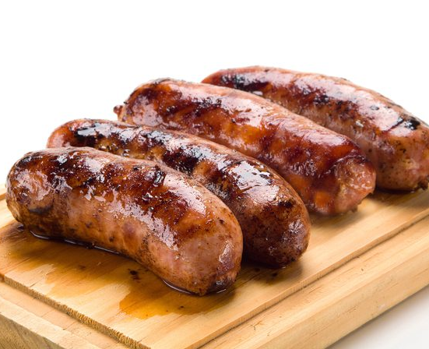
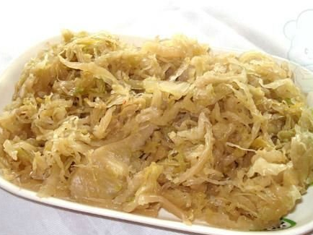
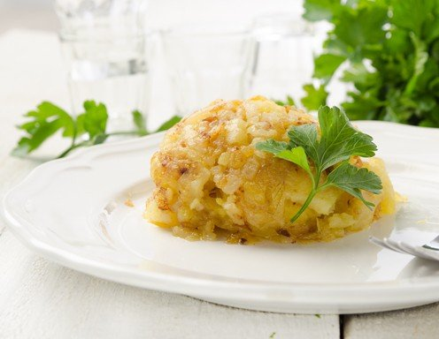
food
Today, people usually eat sausages, cabbage, turnip and „tenstan krompir“ local word for fried mashed potato made with onion and crackles
Prosciutto and salami are always a must
PIC 7
PIC 8
PIC 9

Slide 5
SOURCES
PIC 1- https://www.google.si/search?rlz=1C1PRFI_enSI813SI813&biw=1280&bih=913&tbm=isch&sa=1&ei=V5v-W9HcO4OzkwXcwqegBA&q=GREDI%C4%8C&oq=GREDI%C4%8C&gs_l=img.3..35i39j0l3j0i5i30j0i30l2j0i5i30l3.3991.5679..6126...0.0..0.147.787.0j6......1....1..gws-wiz-img.......0i67j0i10.UuWFyE62Dqs#imgrc=QdbdHRhdzrhLLM:
PIC 2-https://www.google.si/search?q=vinska+klet+dobrovo&rlz=1C1PRFI_enSI813SI813&source=lnms&tbm=isch&sa=X&ved=0ahUKEwi3v_HIm_feAhWBKewKHeE0B0IQ_AUIDigB&biw=1280&bih=913#imgrc=8C6u4iB_IMlfeM:
PIC 3-https://www.google.si/search?q=SMARTNO&rlz=1C1PRFI_enSI813SI813&source=lnms&tbm=isch&sa=X&ved=0ahUKEwiP172jm_feAhXDPOwKHexxCYcQ_AUIDigB&biw=1280&bih=913#imgrc=lUxmGH3KSfLGbM:
PIC 4-https://www.google.si/search?rlz=1C1PRFI_enSI813SI813&biw=1280&bih=913&tbm=isch&sa=1&ei=5pT-W7yBBZHMwQLrp5ww&q=st+martin%27s+day+in+brda&oq=st+martin%27s+day+in+brda&gs_l=img.3...3059.5281..5961...0.0..0.100.604.7j1......1....1..gws-wiz-img.......0i19.Hx7VDEBs24g#imgrc=qdhGTxmai8p8xM:
PIC 5-https://www.google.si/search?rlz=1C1PRFI_enSI813SI813&biw=1280&bih=913&tbm=isch&sa=1&ei=5pT-W7yBBZHMwQLrp5ww&q=st+martin%27s+day+in+brda&oq=st+martin%27s+day+in+brda&gs_l=img.3...3059.5281..5961...0.0..0.100.604.7j
PIC 6-https://www.google.si/search?rlz=1C1PRFI_enSI813SI813&biw=1280&bih=913&tbm=isch&sa=1&ei=5pT-W7yBBZHMwQLrp5ww&q=st+martin%27s+day+in+brda&oq=st+martin%27s+day+in+brda&gs_l=img.3...3059.5281..5961...0.0..0.100.604.7j1......1....1..gws-wiz-img.......0i19.Hx7VDEBs24g#imgrc=zf0Uqj1WIrjHuM:
PIC 7-https://www.google.si/search?rlz=1C1PRFI_enSI813SI813&biw=1280&bih=913&tbm=isch&sa=1&ei=7JT-W5qmOtClwQLH8pP4DA&q=SAUSSAGES&oq=SAUSSAGES&gs_l=img.3..0i10i24.235504.238591..240876...0.0..1.100.726.8j1......2....1..gws-wiz-img.....0..0j35i39j0i67j0i30j0i19j0i10i19j0i5i30i19j0i30i19.YrGGQx66Rxk#imgrc=5QbCY9ytGQbjzM:
PIC 8-https://www.google.si/search?rlz=1C1PRFI_enSI813SI813&biw=1280&bih=913&tbm=isch&sa=1&ei=cZf-W4zQEsSzkwW1hLqwDA&q=sour+cabbage&oq=sour+cabbage&gs_l=img.3..0j0i30l6j0i5i30l3.6731.15019..15305...0.0..0.188.1687.0j12......2....1..gws-wiz-img.....0..35i39j0i67j0i10i30.fhje9hh8iXk#imgrc=DFMXY5U37R1iGM:
PIC 9 - https://images.ichkoche.at/data/image/variations/496x384/3/gestampfte-bratkartoffeln-img-23879.jpg

