Slide 1
Mining tools from Silesia region
Crest of Silesia

Slide 2
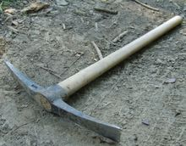
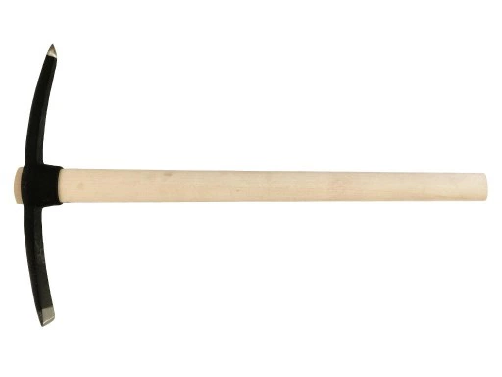
Pickaxe- was used to crush larger rock crumbs and pre-crush hard ground.

Slide 3
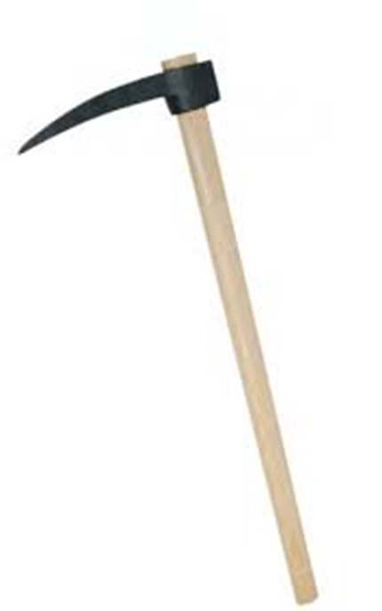
Pickaxe (another type)- used in the same way but the stick was longer.

Slide 4
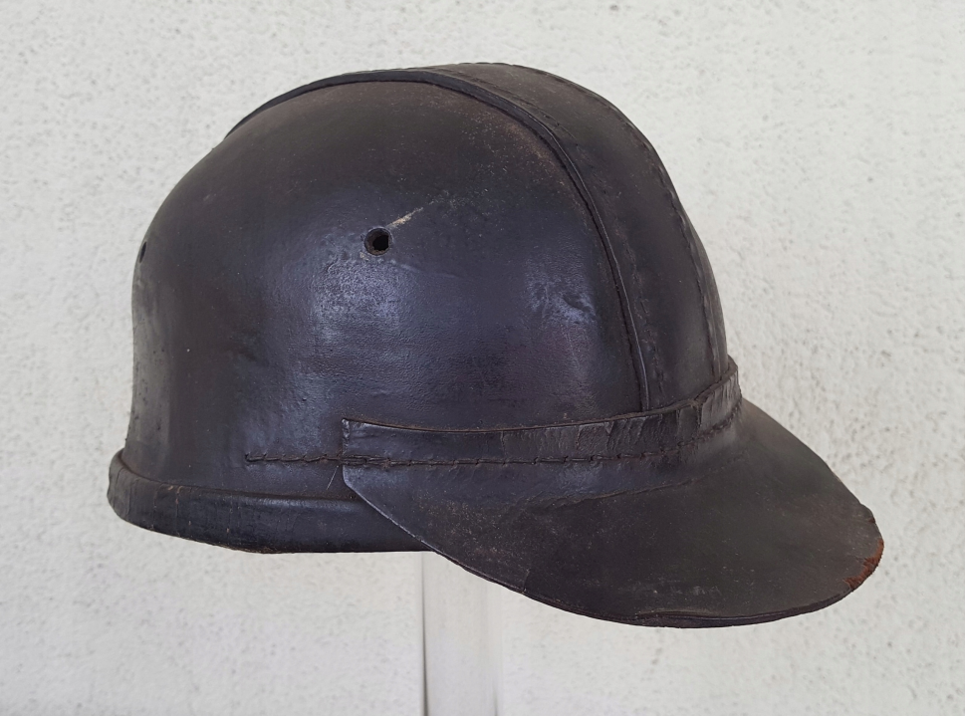
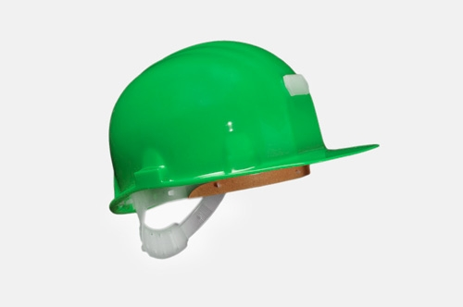
Mining helmet- used to protect miners’ heads. There were few colours of helmets and they were worn by different types of miners e.g. normal miners had brown helmets but, newly hired red.

Slide 5
,,Iron’’
One of the oldest mining tools used to crush rocks.

Slide 6
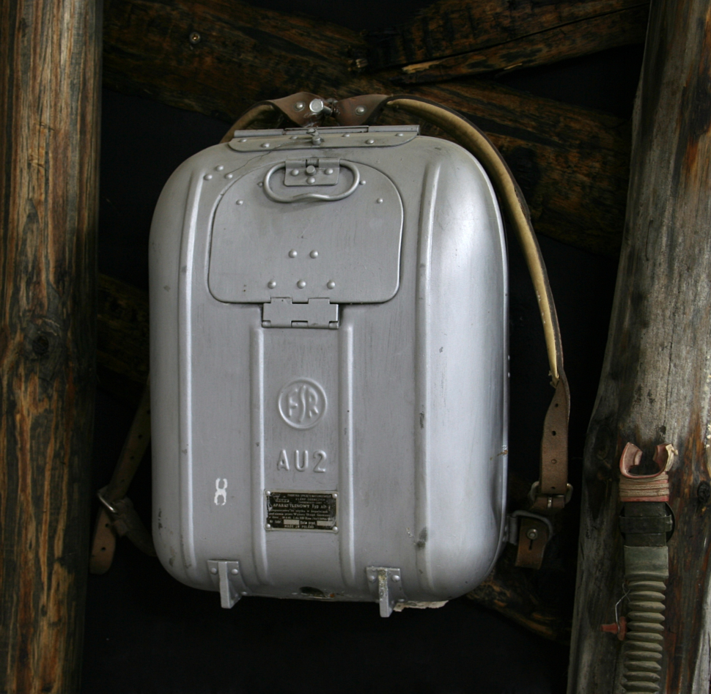
Absorber (escape device) a portable oxygen source for providing breathable air when the surrounding atmosphere lacks oxygen or is contaminated with toxic gases, e.g. carbon monoxide. Quite similar to oxygen mask.

Slide 7
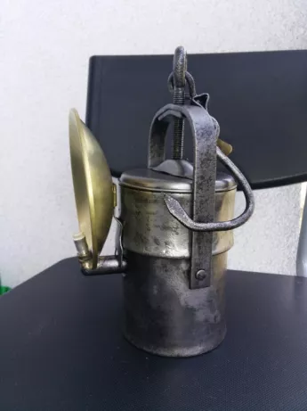
Mining lamp- used to illuminate the way for miners. It could be filled with paraffin oil or just had a candle inside.

Slide 8
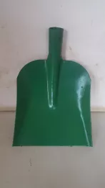
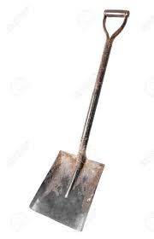
Shovel- simple and primitive device used to dig or to move ground or rocks from place to place.

Slide 9
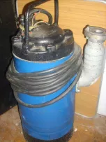
Water pump- device used in mining when there was a flood in a mine. Used to pump out the water.

Slide 10
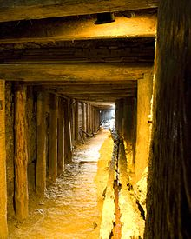
Kaszt- wood bales put in a special way to protect the mining corridors from collapsing. In case of collapsing wood produced sounds and miners knew that they had to run away

Slide 11
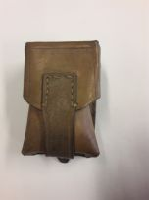
Mining pouch- pouch used for keeping small or valuable things in one place. Miners also used to keep explosives in it.

