Slide 1
St. martin‘s day in BRDA IN the past
St. Martin´s Day was very important for Brda‘s farmers as the farmers supported their families with viniculture and fruit farming
On St Martin‘s day, when the must was ready, farmers could finally have a rest.
St Martin‘s Day was always celebrated on a Saturday

Slide 2
Where DID they celebrate st. martin‘s day?
Celebrations took place in every village‘s largest farmer‘s wine cellar
The farmers invited their fellow villagers and the people who helped with the grape picking.

Slide 3
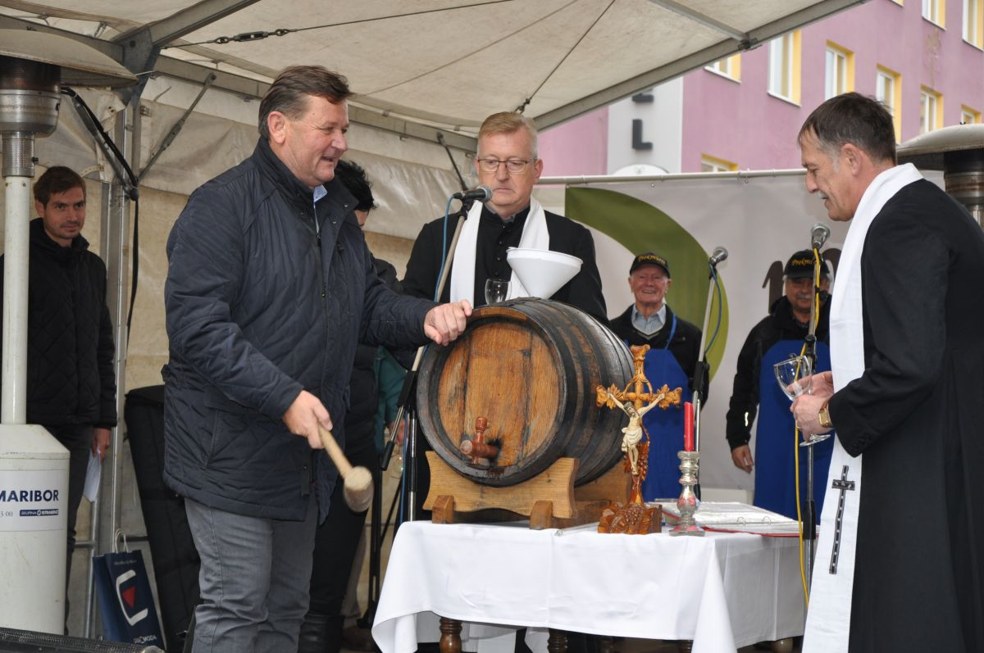
CUSTOMS
The landowner was in charge of the celebration. His wife took care of the food.
While the housewife was preparing dinner, the priest made the so called blessing of the wine.
If there was a priest in the village, he was invited to the farmer‘s cellar to bless the wine.
The farmer hammered a pipe into the wine barrel to taste the wine. The first to taste were the priest and the farmer.
Pic 1

Slide 4
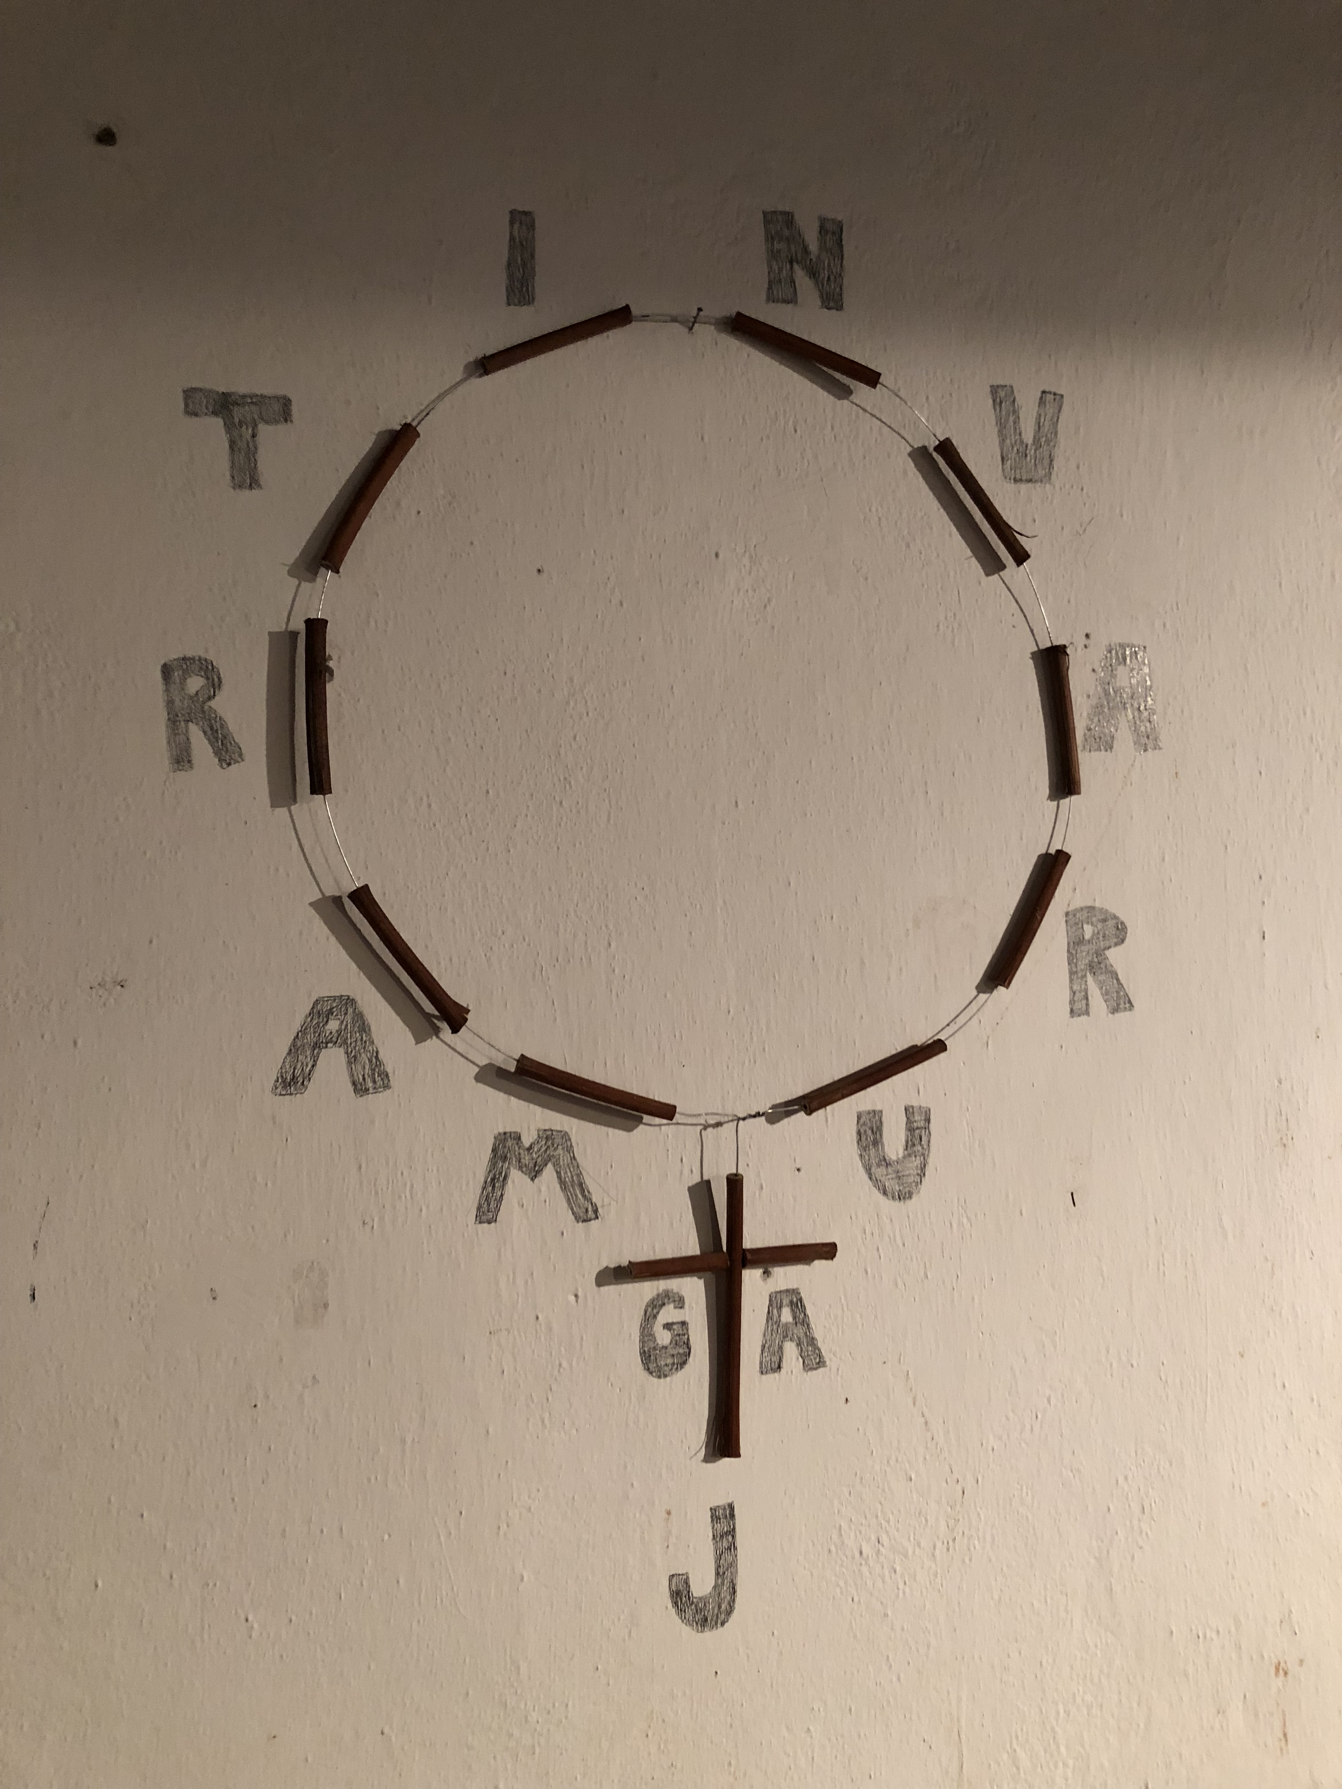
„tercent“ – St Martin‘s rosary
Made of 13 wooden pieces and wire
There is a circle on the top and a cross on the bottom
A custom preserved up to WW1
Made by the farmer
The rosary was first put on the cellar‘s wall.
On St Martin‘s Day the farmer put it on the barrel.
It was believed it would protect the wine.
Made of exactly 13 pieces of vine wood because each piece stands for a letter of the sentence „Martin, varuj ga!“ (Martin look after it!)
Pic 2

Slide 5
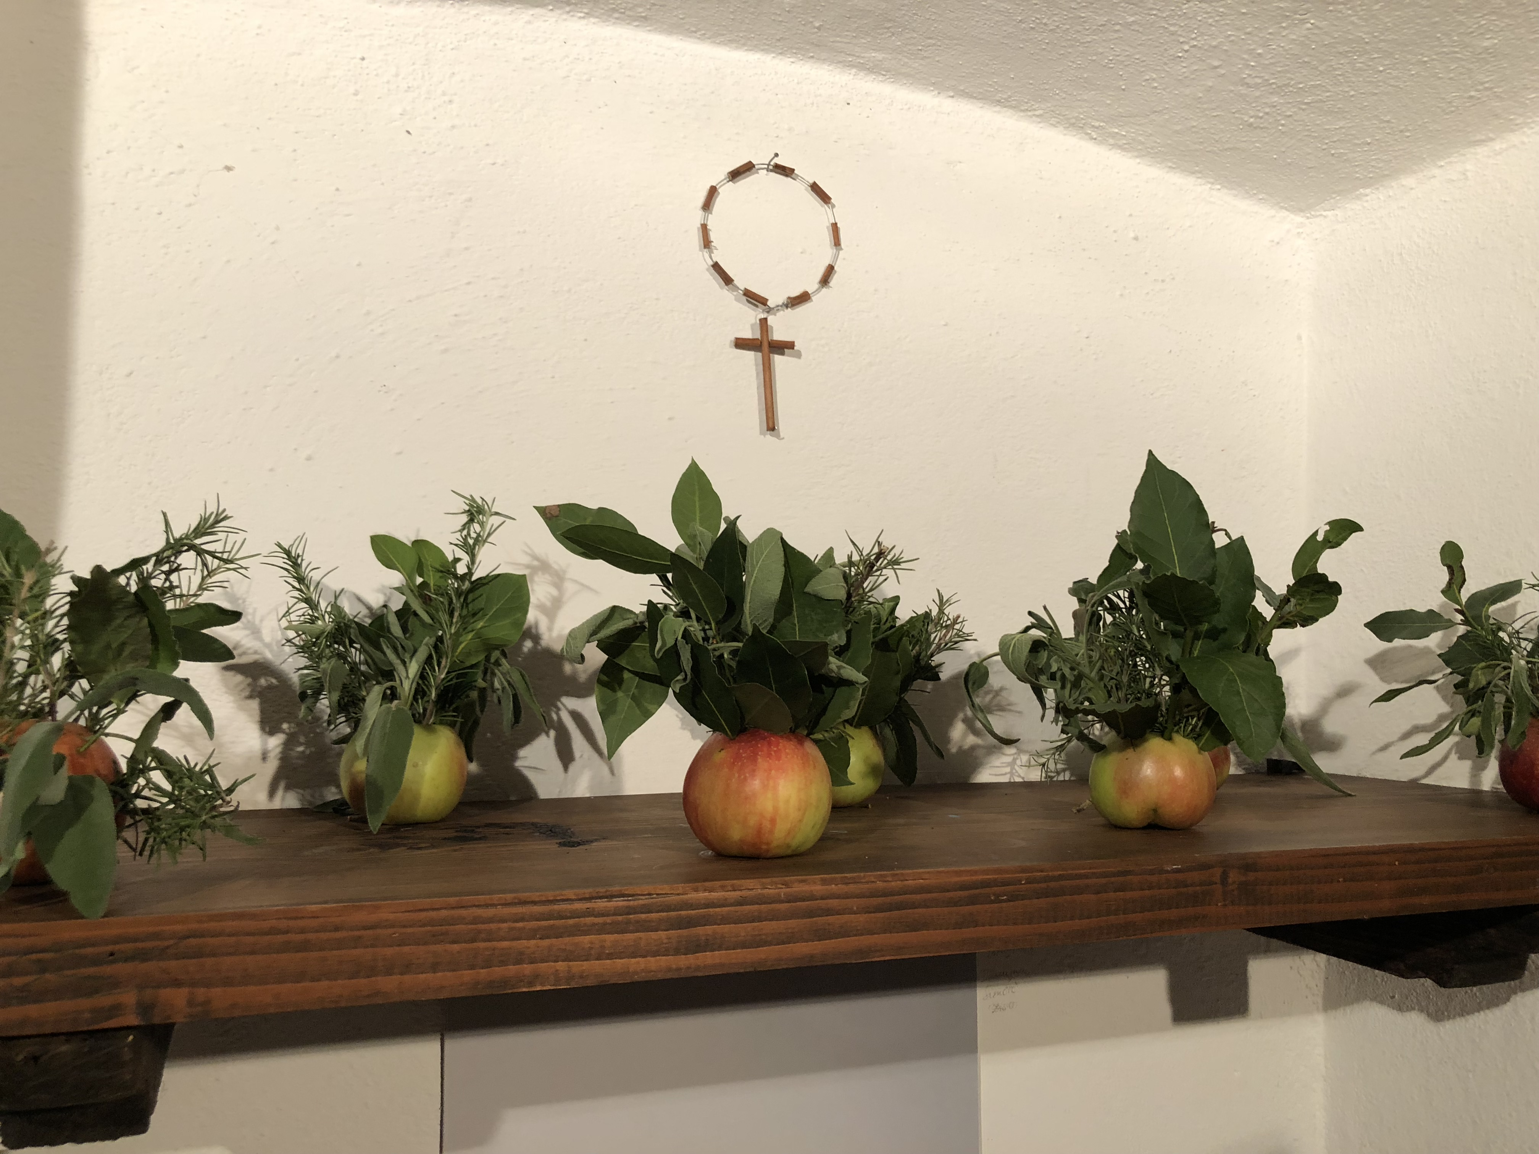
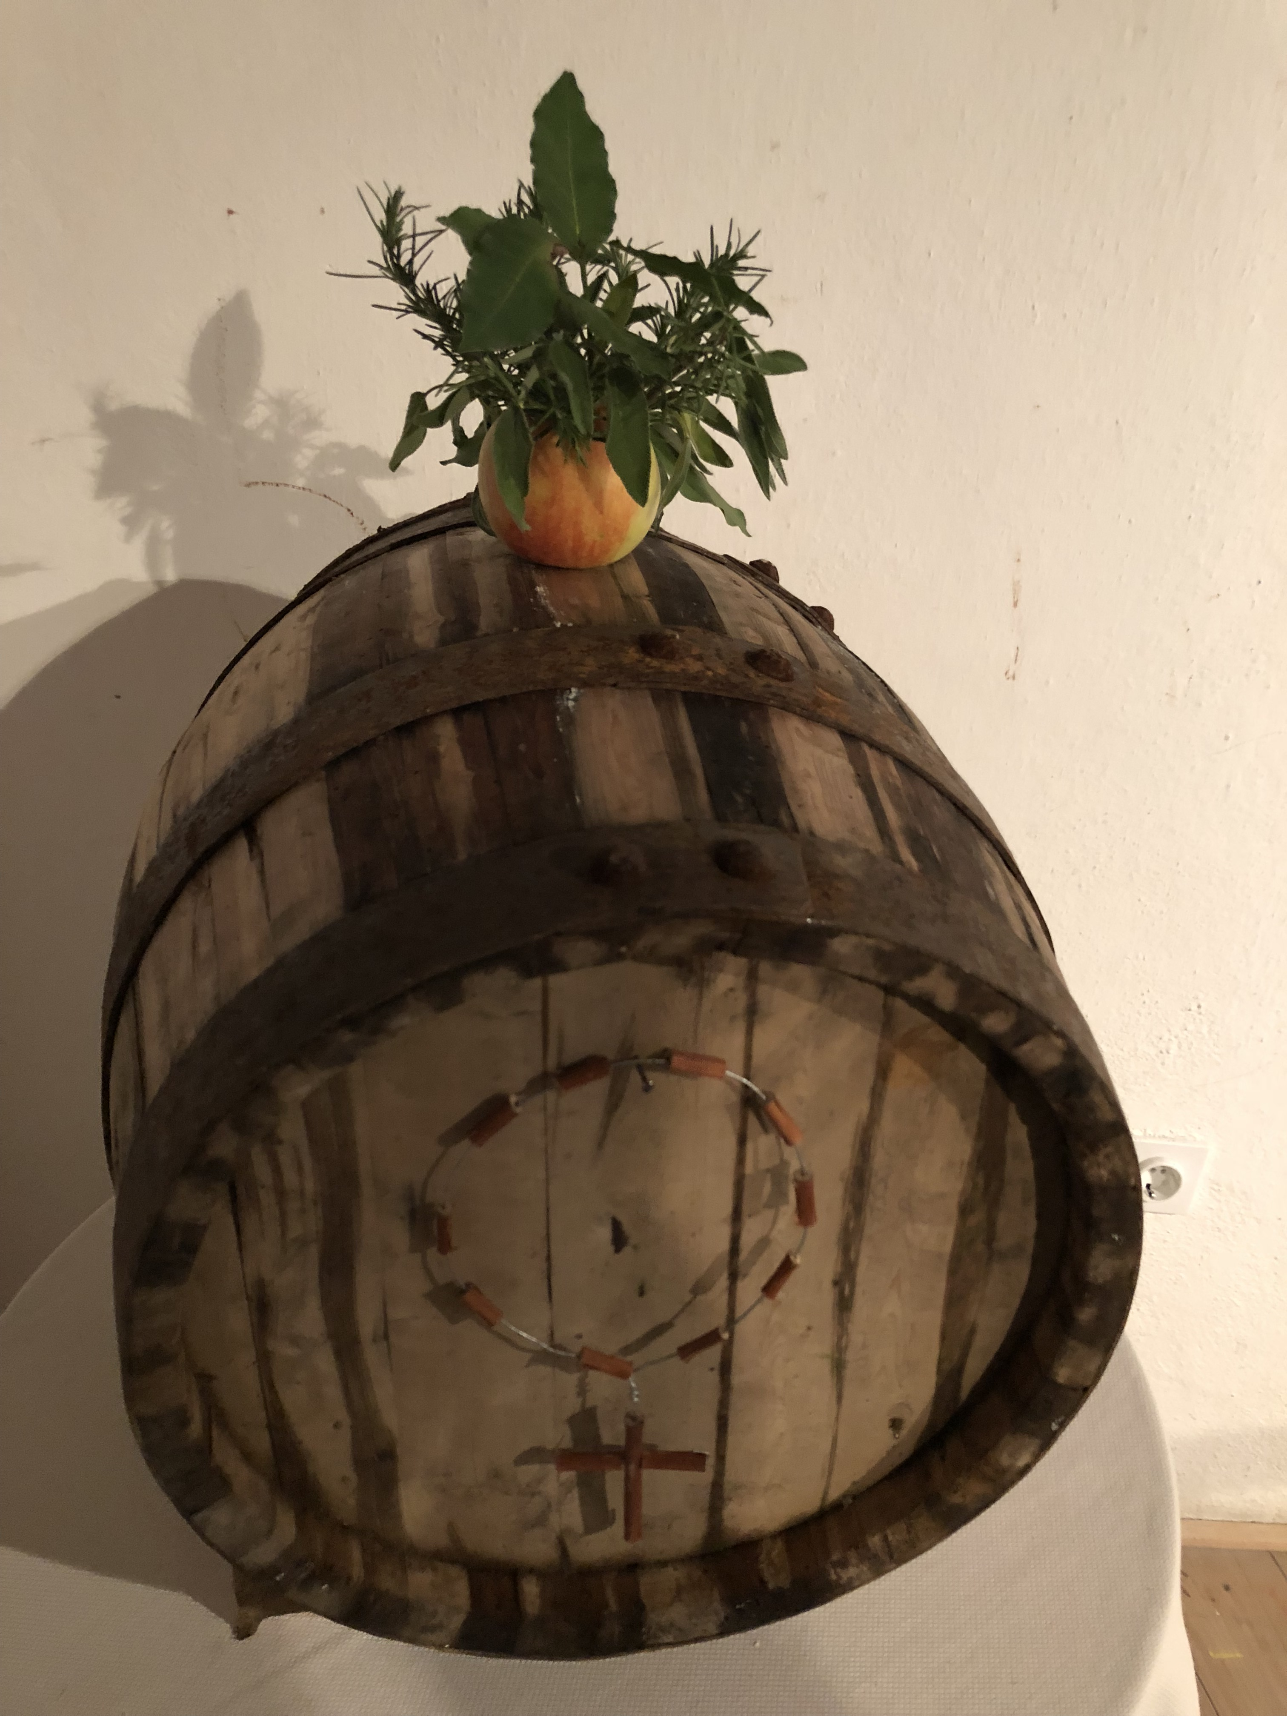
„MARTINC“
It is an apple with herbs, which was placed on a wine barrel to protect the wine from getting sour
Made by the housewife after the grape picking
The apple was checked by the housewife on St Martin‘s Day.
A healthy apple meant good wine, while a rotten apple predicted bad wine.
Pic 3
Pic 4

Slide 6
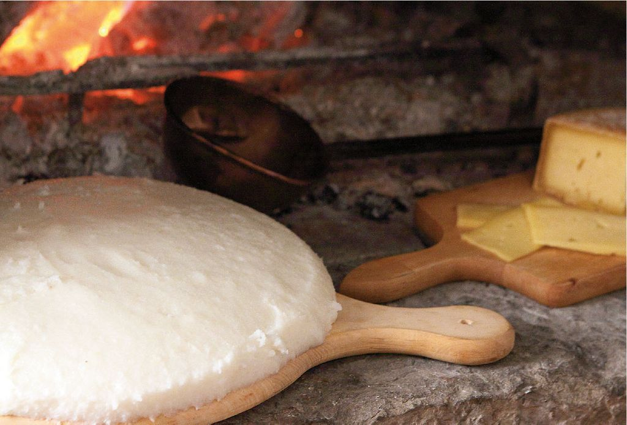
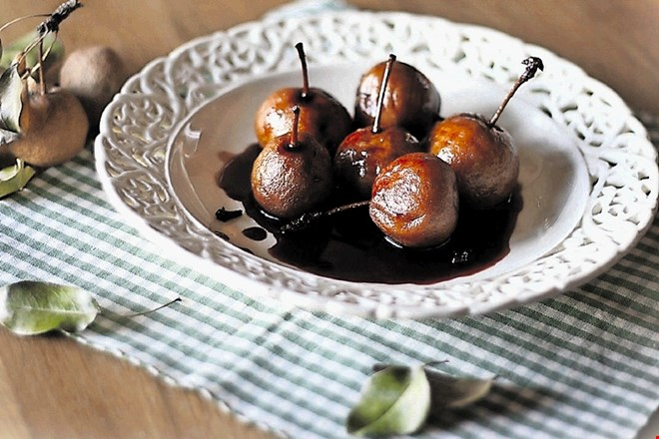
Traditional food
The housewife took care of the feast, which consisted of white „ polenta“ , turkey, chicken or rabbit.
They invited the locals to have some cold cuts like prosciutto or salami with some bread.
They also had sausages cooked in wine and prosciutto fried on butter with some wine and vinegar
For dessert they had cooked pears called „pituralke“ soaked in wine, baked in the oven and sprinkled with sugar.
white polenta
pituralke
Pic 5
Pic 6

Slide 7
Sources:
Oral source:
Mrs Darinka Sirk
Literature:
Ivánov venec : briške šege in navade. [Darinka Sirk; Janez Bogataj; Marija Stanonik; Franco Juri; Andrej Colja; Janez Pukšič; et al]
Pictures:
Pic1 https://encrypted-tbn0.gstatic.com/images?q=tbn:ANd9GcTspNzWFLm79JM53cObtHroX9mI9UBibqbxlZMLeWTdcjPWx2an
Pics 2,3,4 Author: Tanja Slapernik Tominec
Pic 5 https://www.delo.si/images/slike/picture/20101105/o_5_1024.jpg
Pic 6 https://www.dnevnik.si/i/as/2016/12/13/982978.jpg

