Slide 1
Terrasson-Lavilledieu
une ville française
a french town

Slide 2
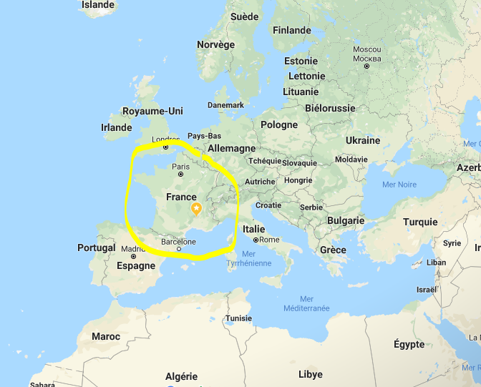
France is at the west of Europe.

Slide 3
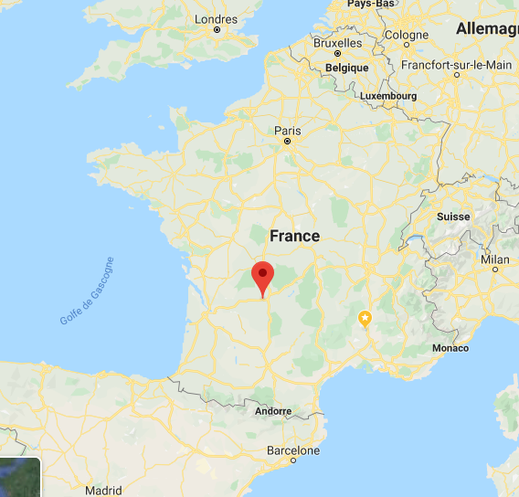
Terrasson-Lavilledieu is in the South West of France.

Slide 4
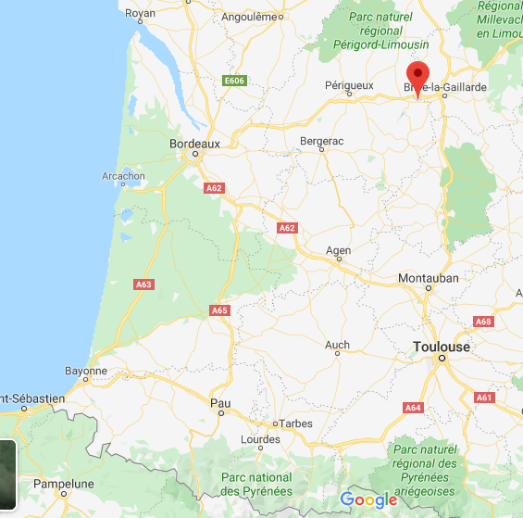
Terrasson-Lavilledieu is next to Brive-la-Gaillarde (20 km)
Bordeaux and Toulouse are 2 big towns,
at 2 hours by car.

Slide 5
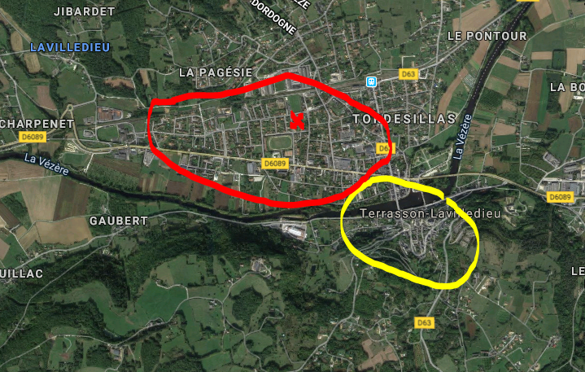
Terrasson-Lavilledieu
6 500 inhabitants ; a river « la Vézère »
the old town is in yellow and the new town in red. The elementary school is on the red cross.

Slide 6
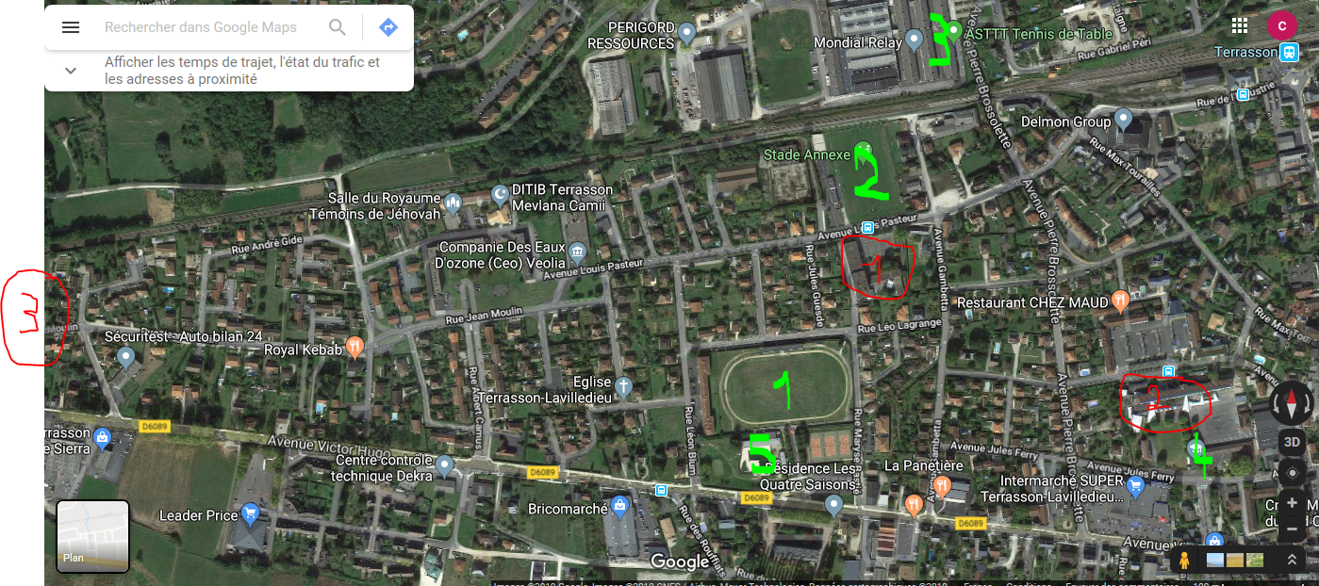
In red :
the elementary school 3) the high school
2) the middle school
In green :
1)rugby field 4) the gym
2) football field 5)the swimming pool
3) table tennis room

Slide 7
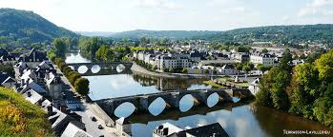
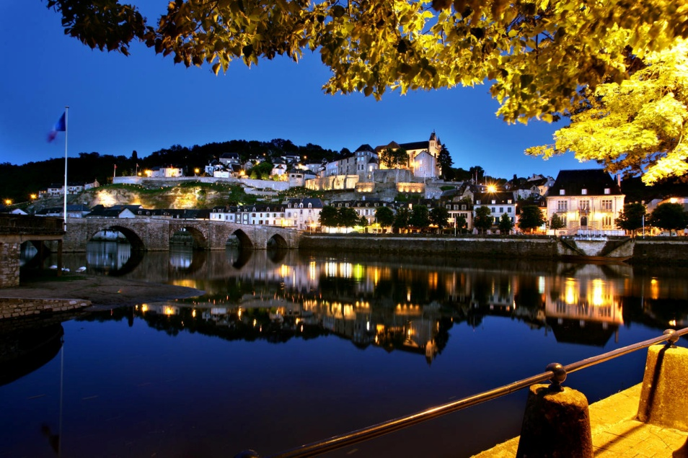
pictures about Terrasson-Lavilledieu
the town see view
from the old town
the old town by night

Slide 8
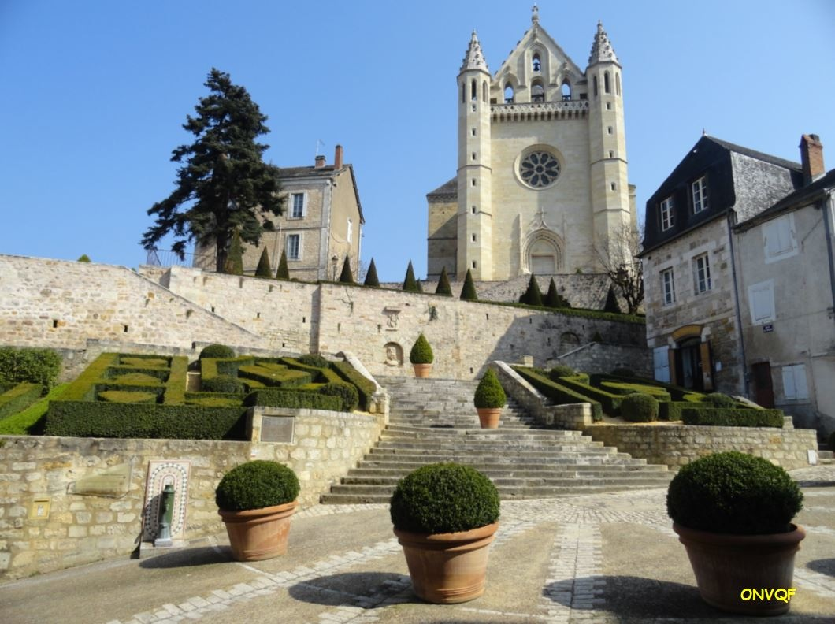
the abbey Saint Sour in the old town

Slide 9
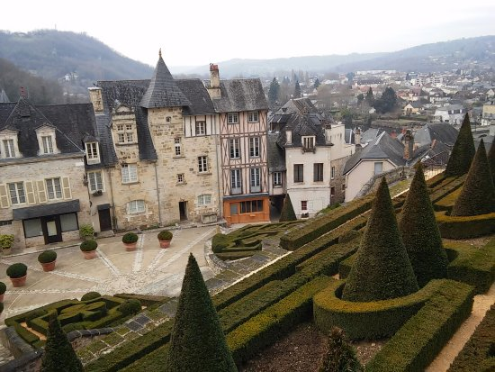
the view from the abbey

Slide 10
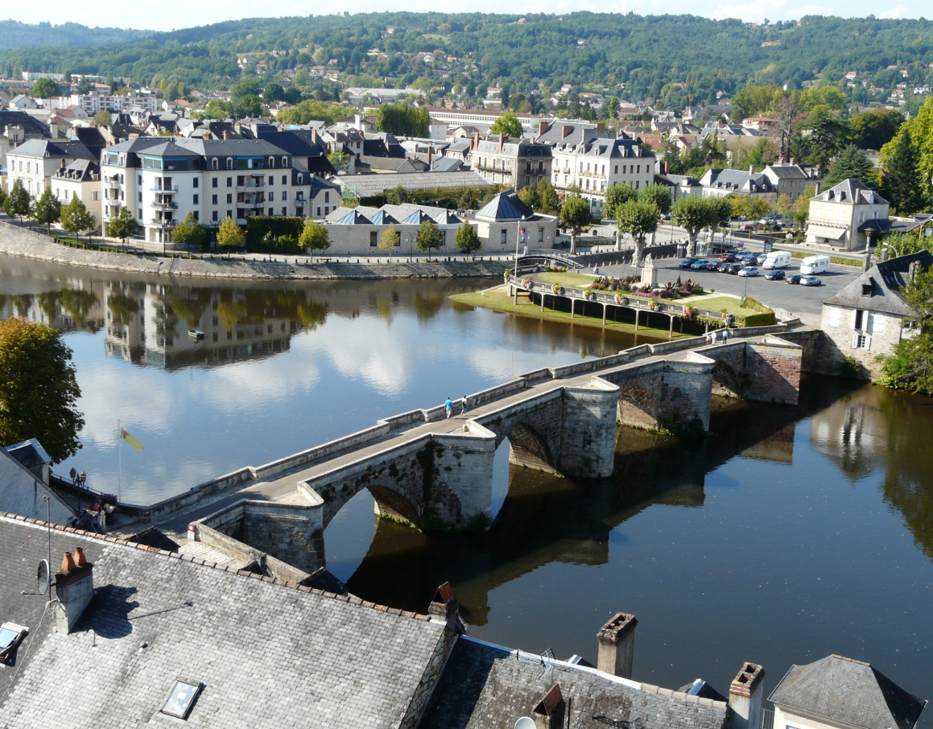
the old bridge (12è)

Slide 11
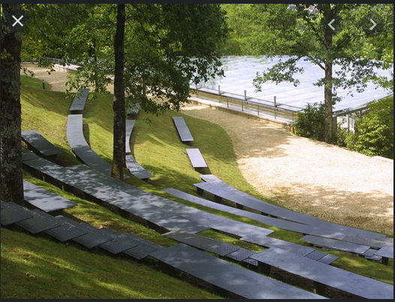
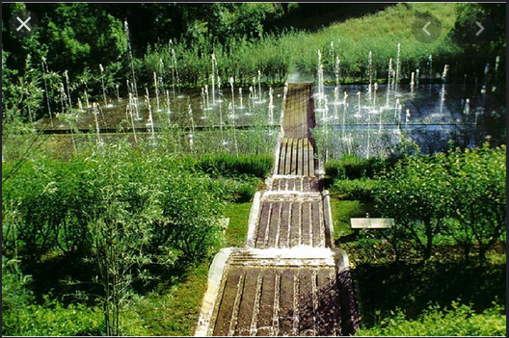
the gardens of the imagianire

Slide 12
You can make a boat ride on the Vézère

Slide 13
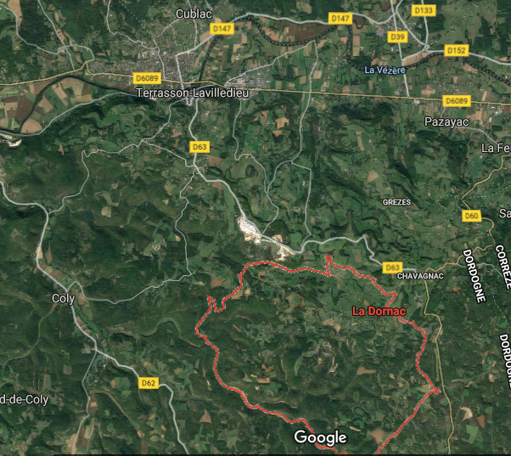
All over Terrrasson, there many little villages, as mine Ladornac

Slide 14
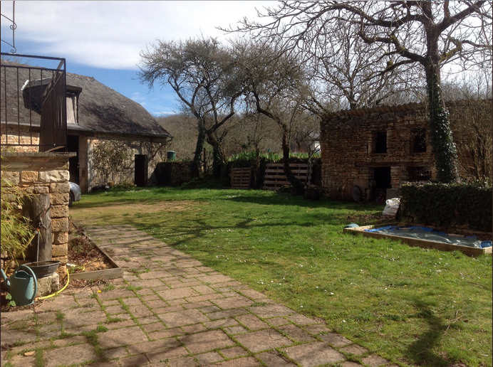
an old typical house (old farm)
stone walls, slate roofs (and tiles), courtyard with small buildings and barn

