Slide 1
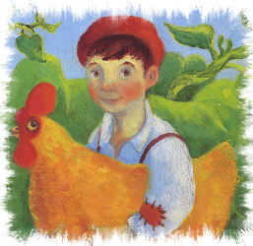
Jack and the Beanstalk
Story retold by Bev Evans

Slide 2
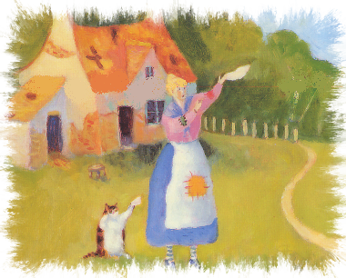
One day, Jack’s mother sent him out to sell the family cow.
The cow was very old and she was going to be very difficult to sell!
Once upon a time there was a little boy called Jack who lived in a little cottage with his mother.
They were very poor and very hungry.

Slide 3
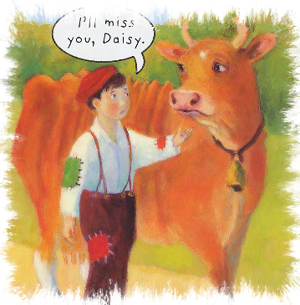
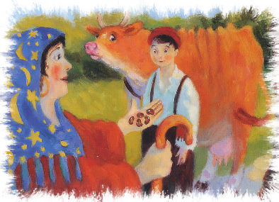
While Jack was walking back home an old woman said she would buy the cow for five beans.
Jack and the cow walked for miles and miles but no one wanted to buy the cow.

Slide 4
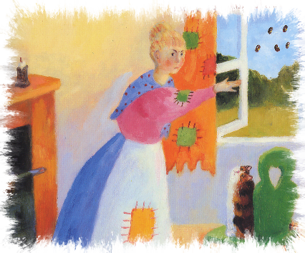
The old woman said the beans had magic powers
Jack thought the beans would be better than nothing so he agreed to hand over the cow.
But, when he got home, Jack’s mother was not happy!
She sent Jack straight to bed and threw the five beans out of the window.

Slide 5
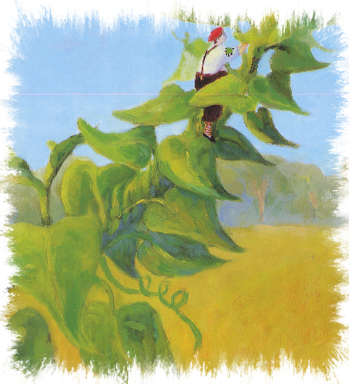
The next morning, when Jack woke up, he could not believe his eyes!
A huge beanstalk had grown overnight.
Jack decided to climb up it to see where it went.
The beanstalk went up and up and up into the sky!

Slide 6
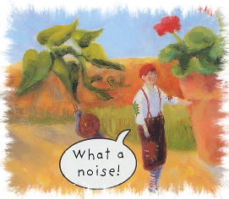
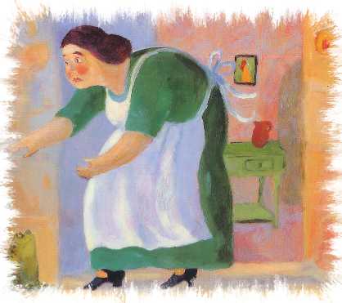
He walked up to the door of a huge castle.
The noise was getting much louder and Jack could see the biggest lady he had ever seen!
When Jack reached the top of the beanstalk he could hear a loud noise!

Slide 7
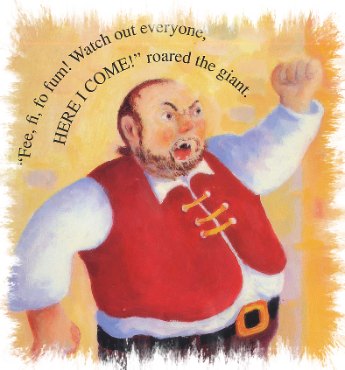
The lady was a giant’s wife.
Jack crept into the castle.
Now he could see where the noise was coming from!
A huge giant was stomping around the castle shouting……
“FEE, FI, FO, FUM! Watch out everyone – HERE I COME!”

Slide 8
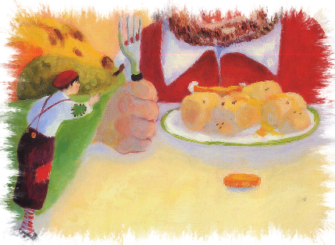
The giant was hungry and wanted his dinner.
Jack watched quietly.
When the giant finished eating he started to count all his gold.
Jack had never seen so much money!
Eventually, the giant got so tired he fell asleep at the table.

Slide 9
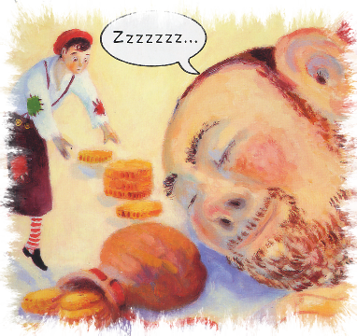
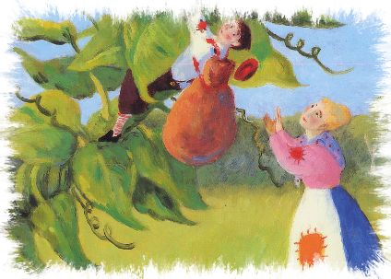
Jack crept out of the castle, and back down the beanstalk, carrying the giant’s gold.
Jack tiptoed carefully across the table and collected the giant’s gold.

Slide 10
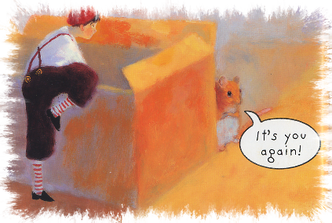
Jack knew the giant had many more treasures.
He climbed back up the beanstalk to see what else he could find.
Jack sneaked through the door and hid silently.
He could hear the giant’s stomping and again he heard the giant shout……

Slide 11
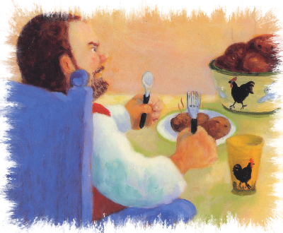
The giant sat down at the table to eat.
“FEE, FI, FO, FUM! Watch out everyone – HERE I COME!”
When he finished eating he asked his wife to bring him his magic hen.

Slide 12
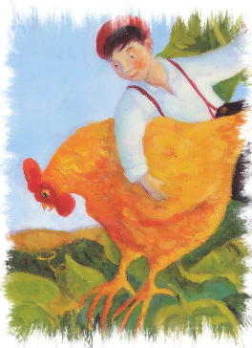
The hen could lay golden eggs!
Jack could not believe his eyes!
As soon as the giant was asleep again Jack crept up and took the magic hen!
Quietly, Jack ran out of the castle and down the beanstalk with the hen under his arm.

Slide 13
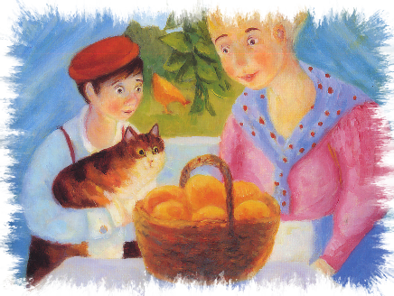
Jack and his mother now had enough money and were not hungry any more.
But, after a while had past, Jack decided to visit the giant's castle one more time.
As he tiptoed into the castle Jack could hear a familiar sound!
“FEE, FI, FO, FUM! Watch out everyone – HERE I COME!”

Slide 14
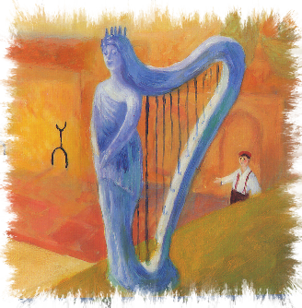
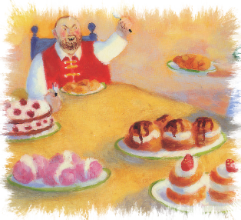
The giant seemed angrier than ever!
He sat down for his supper while Jack watched from his hiding place.
After his meal the giant asked his wife to bring him his magic harp.
The harp could sing beautiful songs. Jack thought it was wonderful.

Slide 15
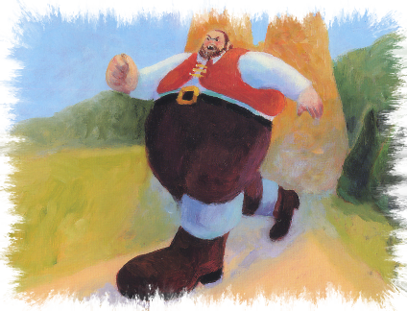
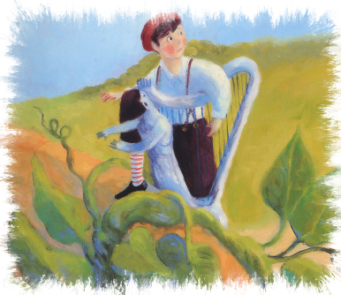
As soon as the giant was asleep, Jack grabbed the harp and ran out of the castle.
But the harp was frightened and started singing again.
Soon the giant was awake and chasing after Jack!
“FEE, FI, FO, FUM! Watch out everyone – HERE I COME!”

Slide 16
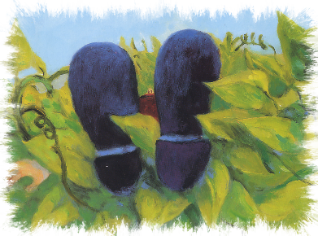
Jack rushed down the beanstalk and ran to the cottage get an axe.
He chopped and he chopped and he chopped.
Eventually, the beanstalk came crashing down to the ground.
The giant’s body lay silently on the ground.

Slide 17
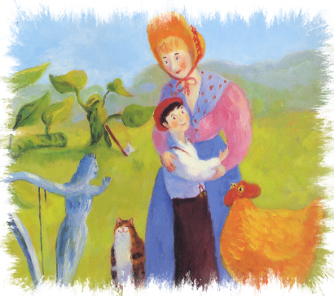
His beanstalk adventures were over and Jack and his mother could live happily ever after in their little cottage.
Jack ran to his mother.

Slide 18
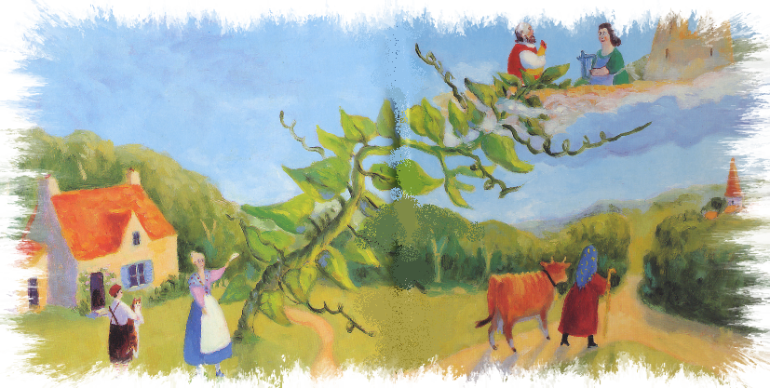
The End
Story retold by Bev Evans www.communication4all.co.uk
Images © Ruth Rivers available from Getty Images

