Slide 1
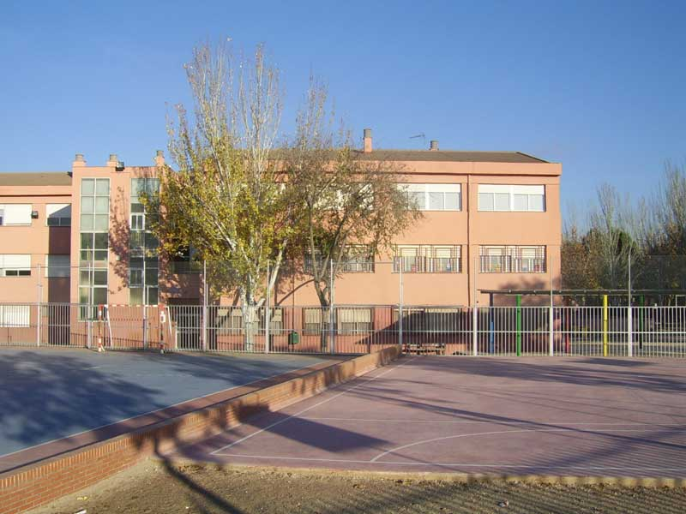


LET´S MEET TO KNOW EACH OTHER THROUGH OUR GREAT CULTURES
Comenius Partnership
CEIP LA ESCUELA
RIVAS VACIAMADRID
ESPAÑA
2013-2015

Slide 2

Ceip la escuela
Comenius Partnership 2013-2015
Code: 2013-1-TR1-COM06-48302

Slide 3
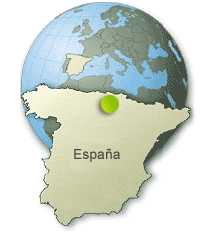

Slide 4
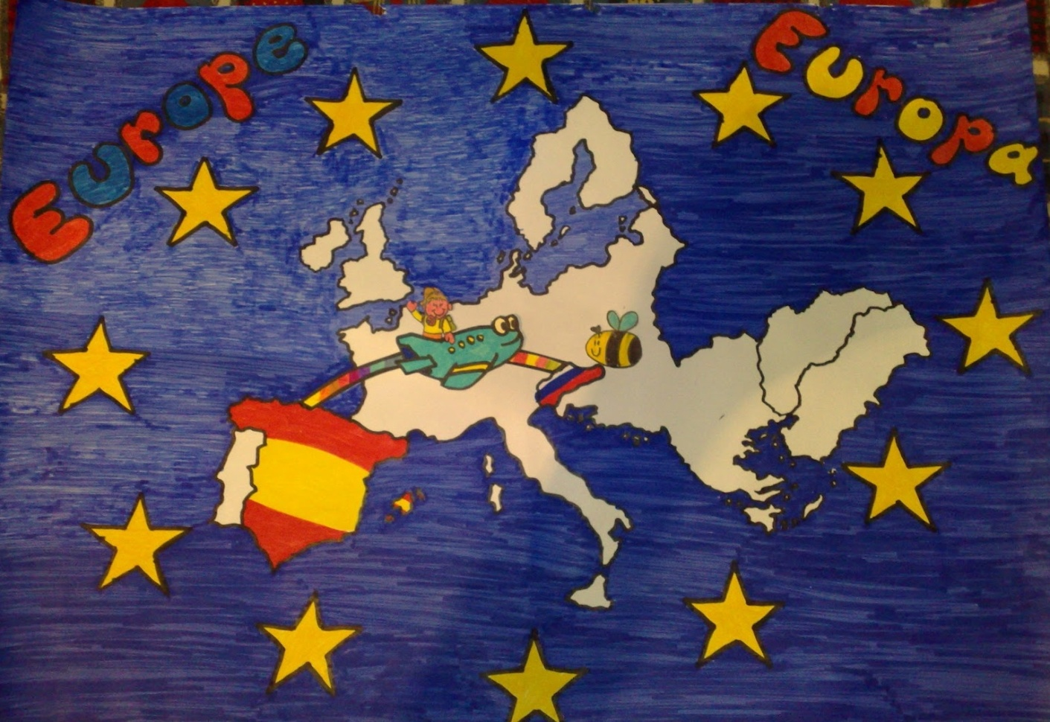
Spain is a transcontinental country located in the southwest of Europe and north of Africa.
Spain has two archipelagos: the Canary Islands and the Balearic Islands, and two autonomous cities (Ceuta and Melilla) located in North Africa.

Slide 5
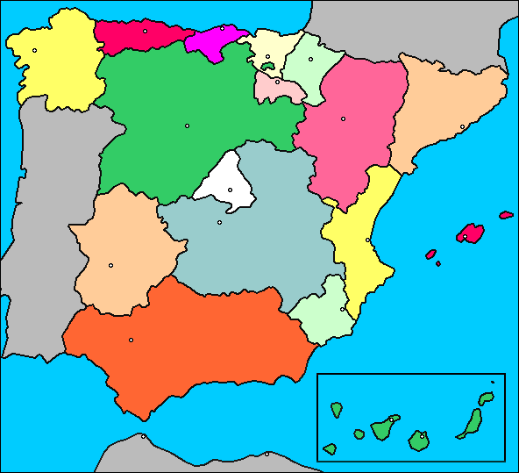
spain
Borders Portugal, Andorra and France. South to Morocco.
It is composed of 17 autonomous communities and two autonomous cities.

Slide 6


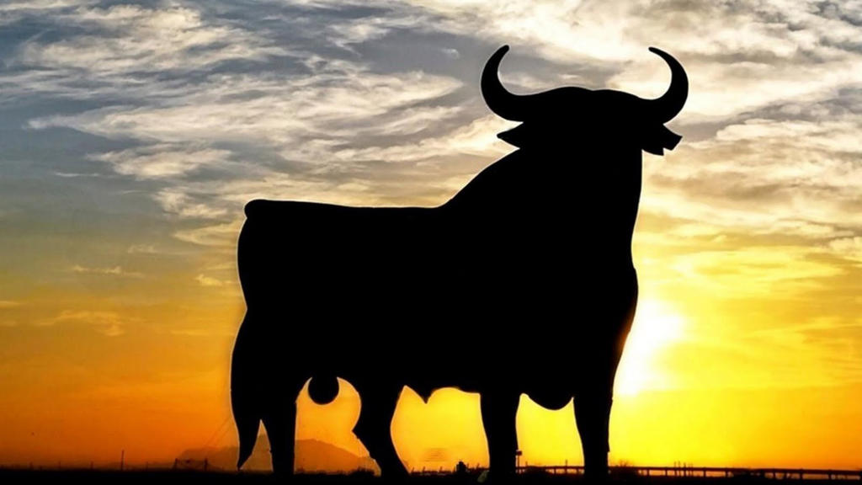
Shield, banner and cultural symbol

Slide 7
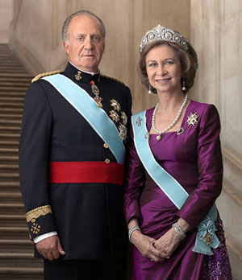
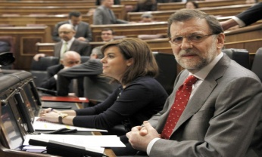
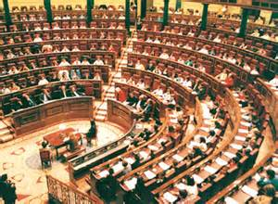
spain
46.700.000 citizens.
Parliamentary monarchy.

Slide 8

spain
The president is Mr. Mariano Rajoy.

Slide 9
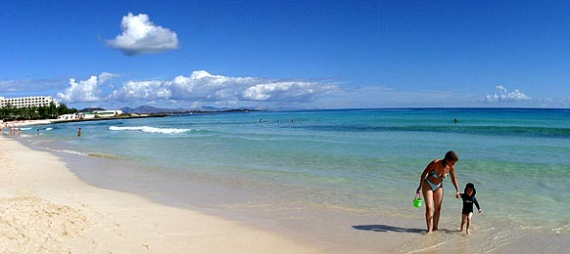
Spain landmarks: Canary Islands

Slide 10
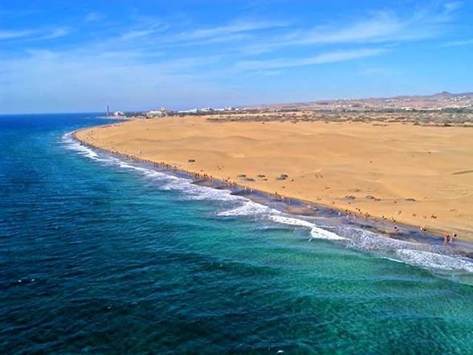
landmarks

Slide 11
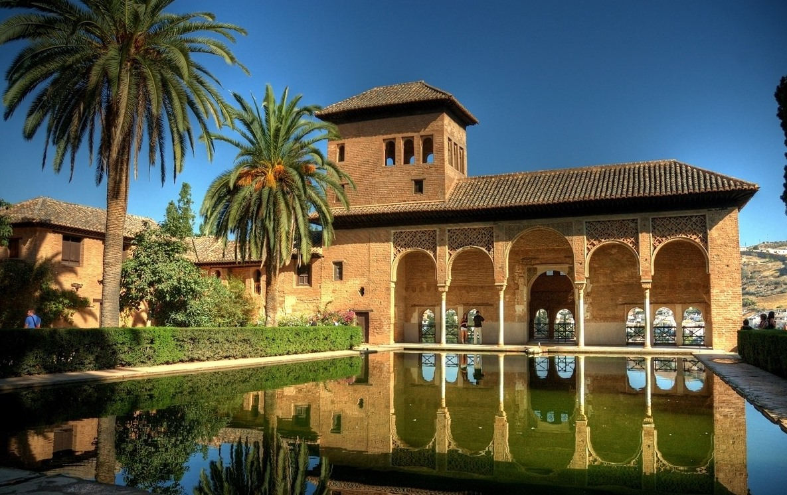
Spain landmarks: granada

Slide 12
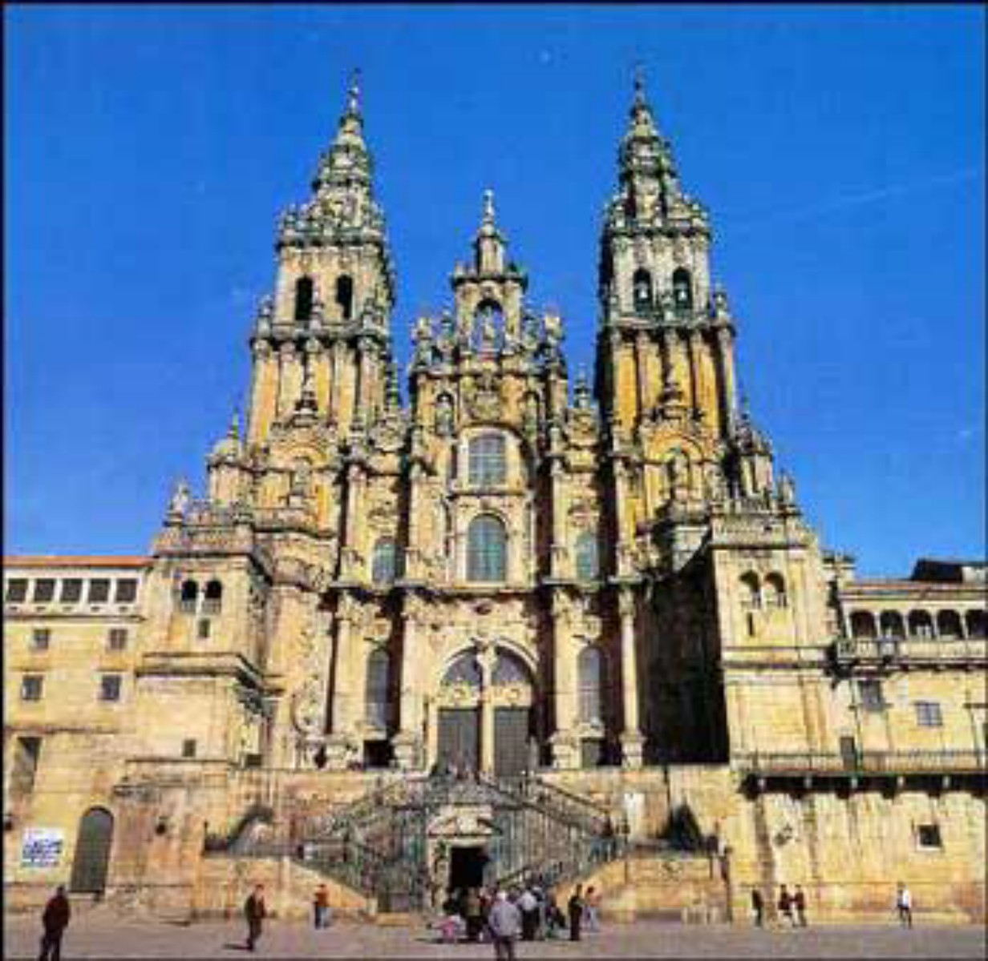
Spain landmarks: santiago

Slide 13
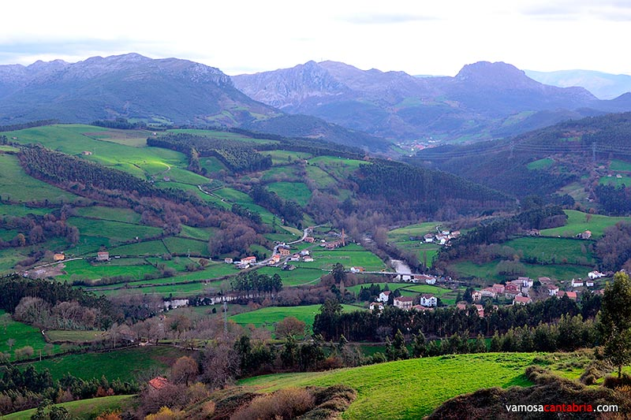
Spain landmarks: cantabria

Slide 14
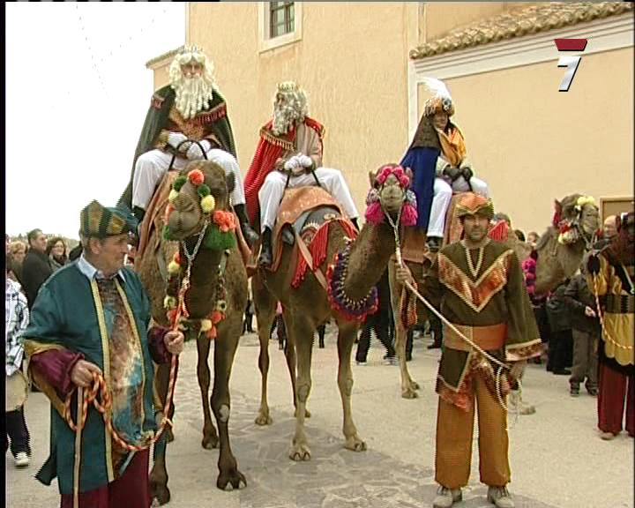
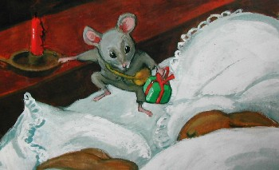
Traditional characters for children

Slide 15
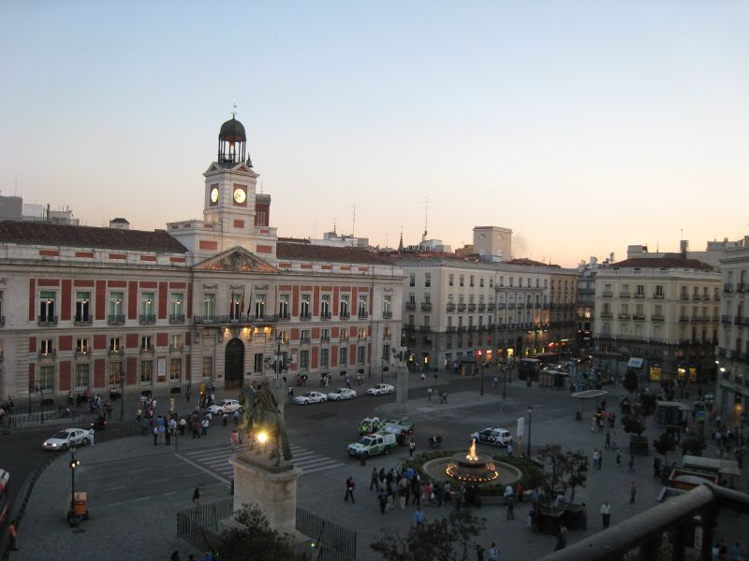
madrid
Is the capital of Spain
It has 3.200.000 inhabitants
Located in the center of the country

Slide 16
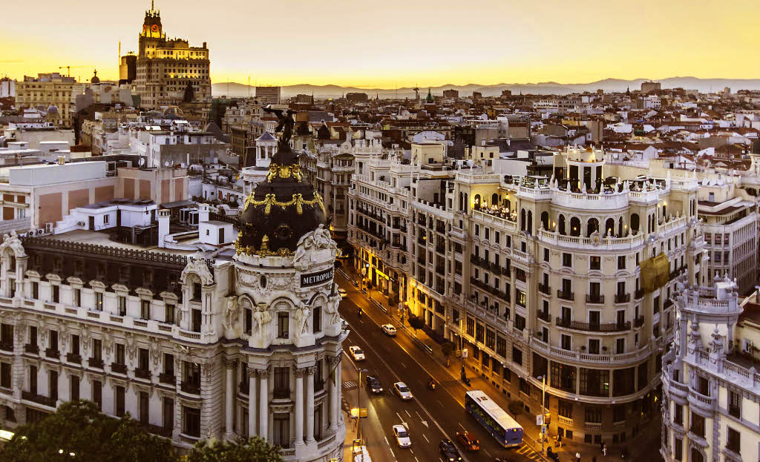

Slide 17
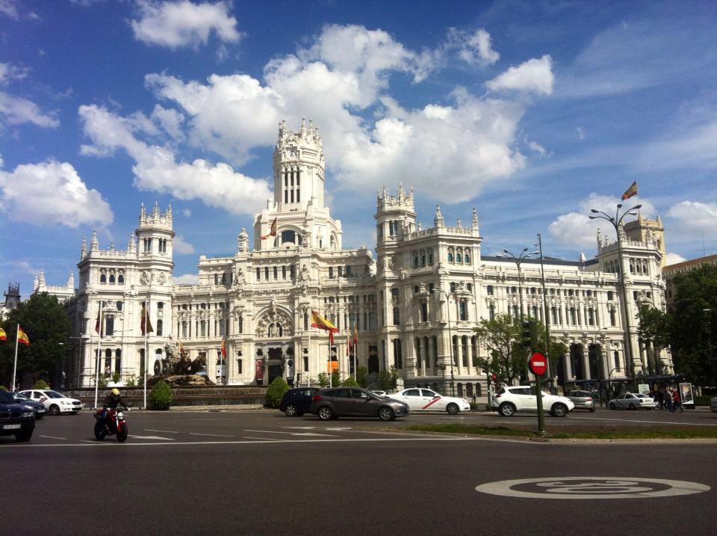
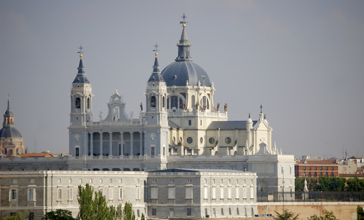
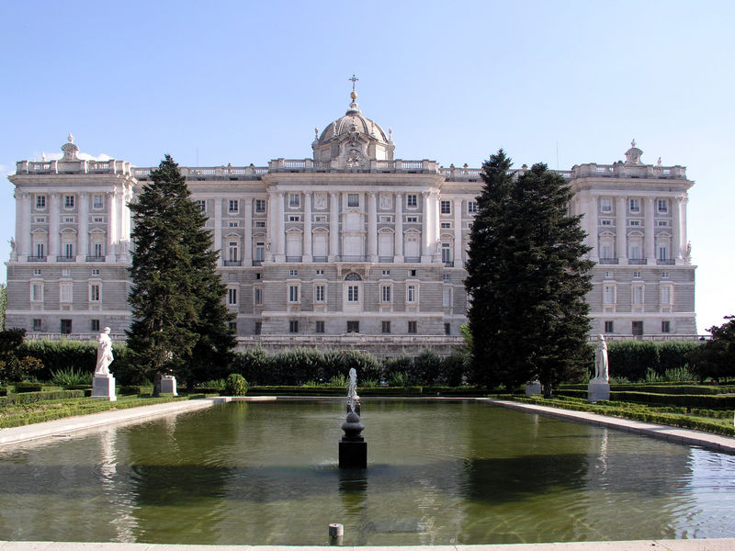
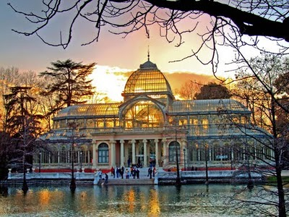
Important Buildings

Slide 18
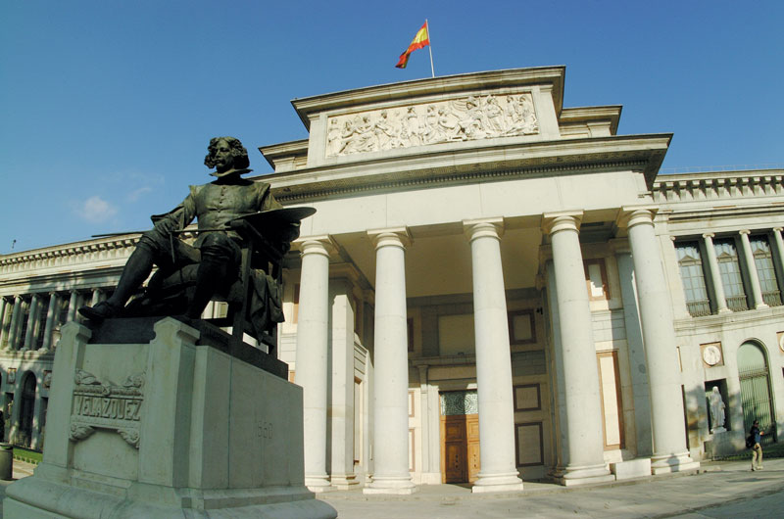
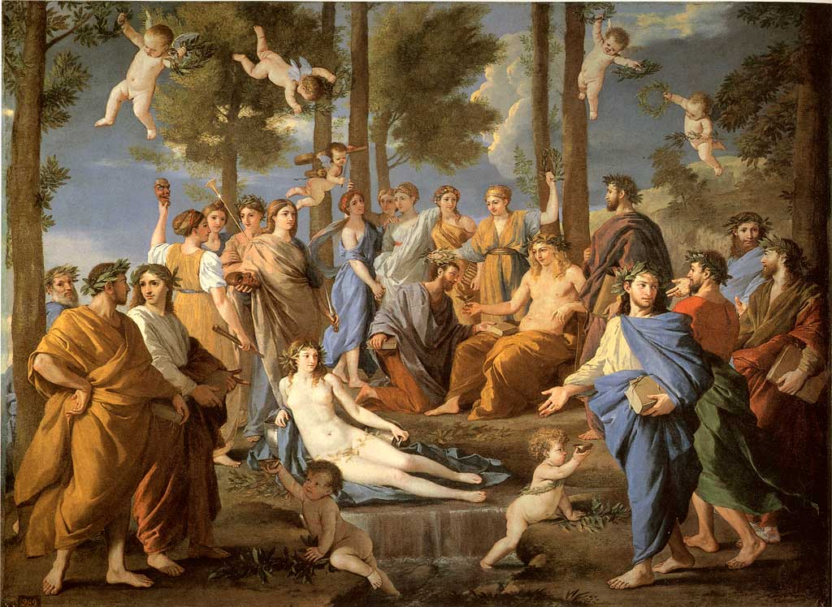
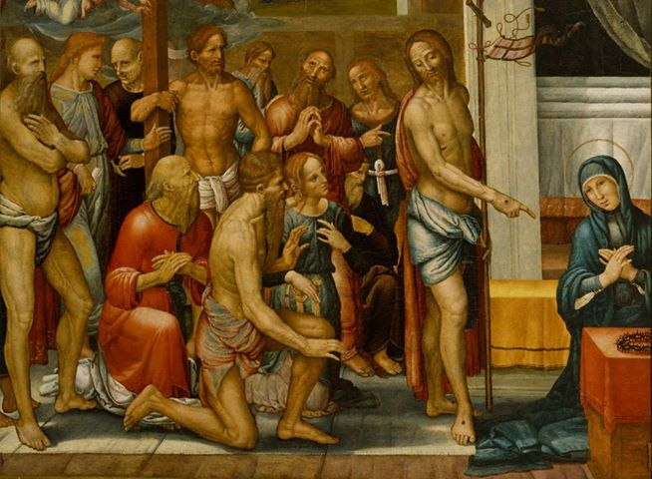
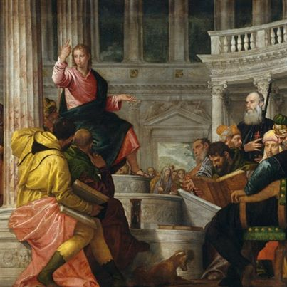
The prado museum

Slide 19
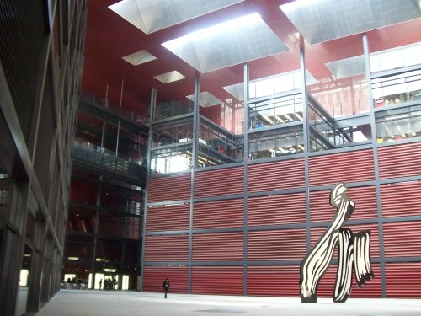
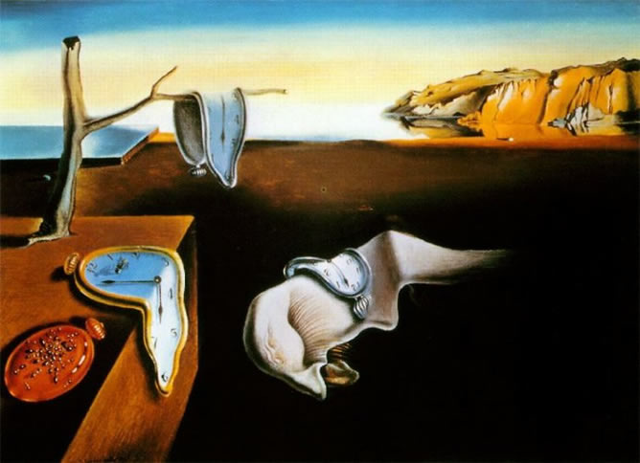
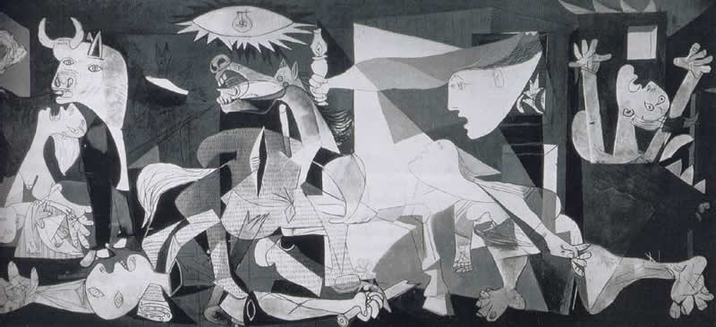
The reina sofia museum

Slide 20
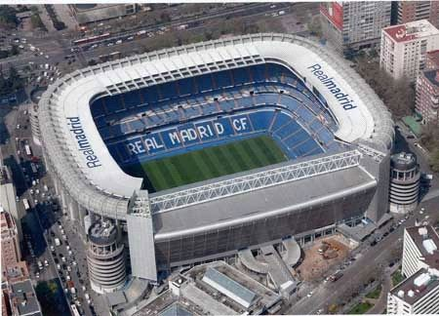
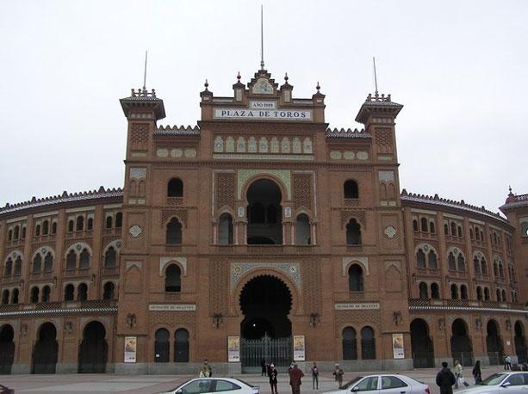
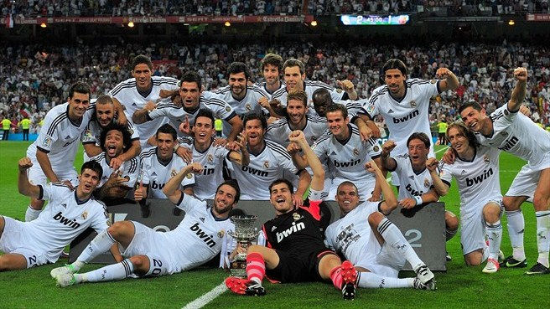
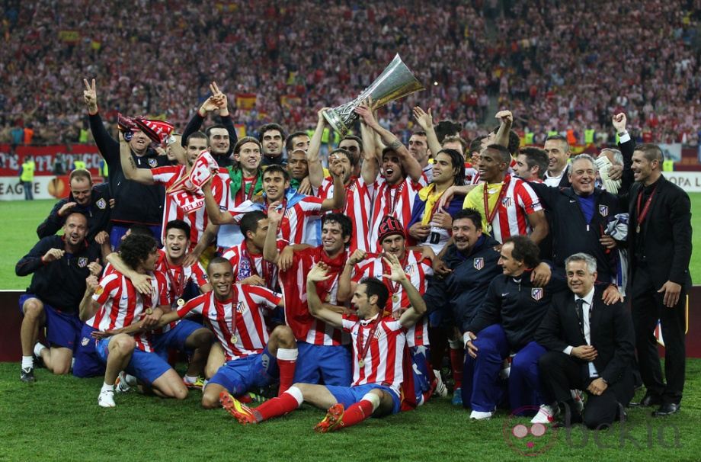
Sport culture

Slide 21
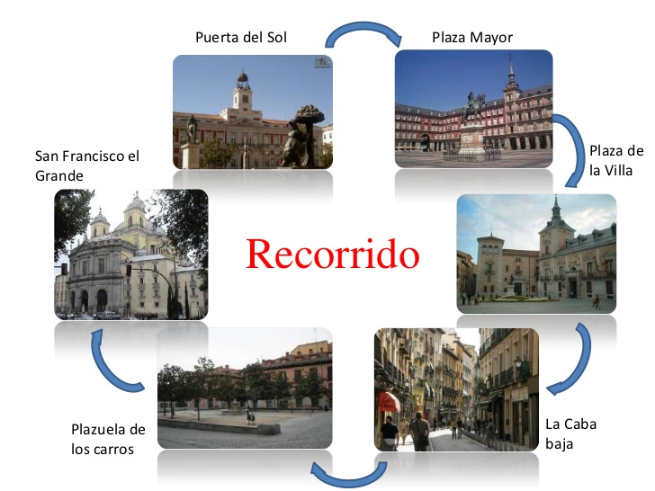
Madrid landmarks.

Slide 22
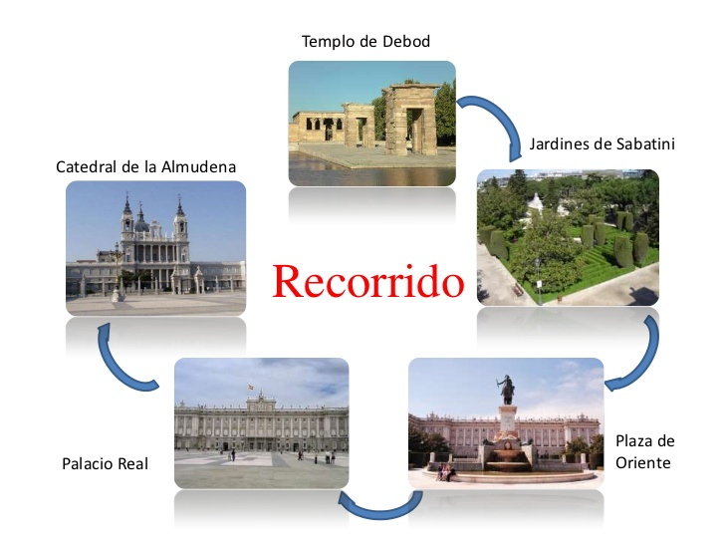
Madrid landmarks

Slide 23
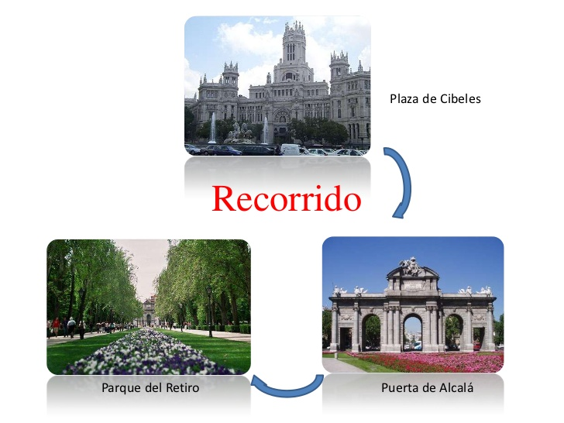
Madrid landmarks

Slide 24
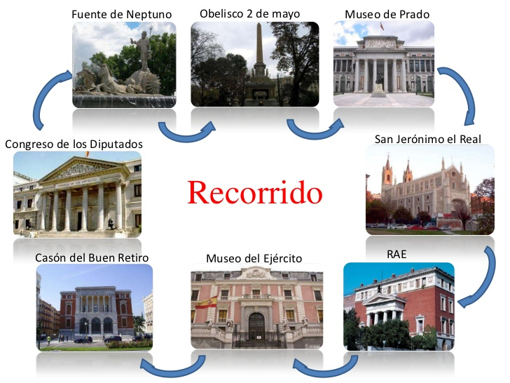
Madrid landmarks

Slide 25
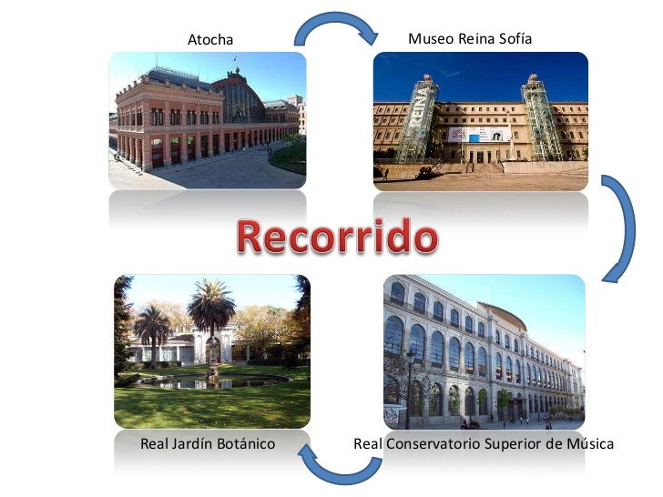
Madrid landmarks

Slide 26
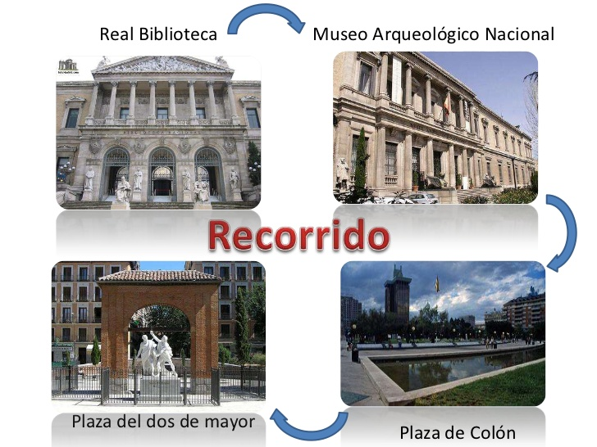
Madrid landmarks

Slide 27
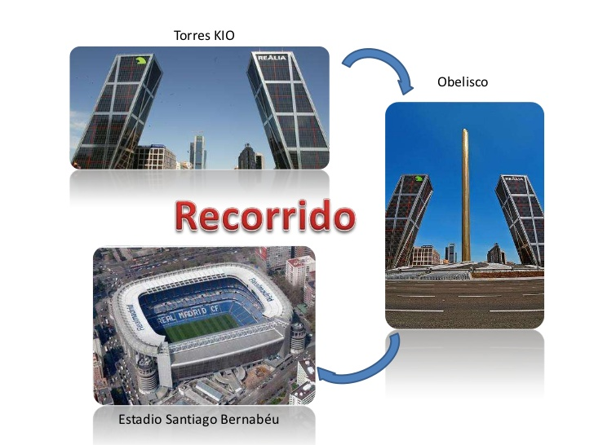
Madrid landmarks

Slide 28
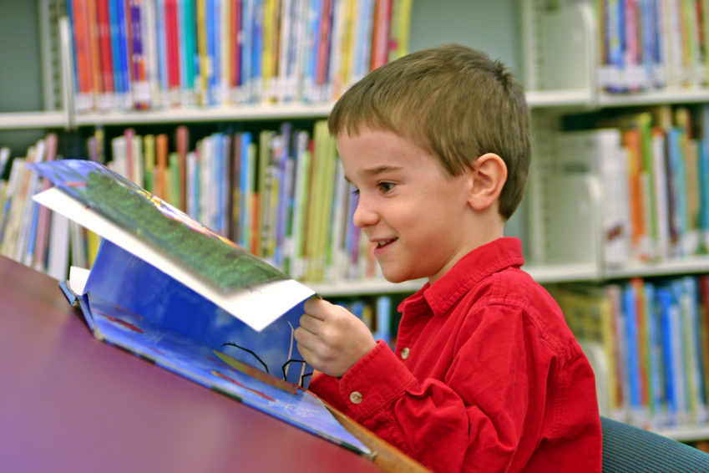
Rivas vaciamadrid – Educative services
Two municipal kindergartens and five dependents on the Community of Madrid with preschool students.
Private schools and private nurseries.
14 government primary schools.
Five high schools.
Official language school.
UNED.

Slide 29
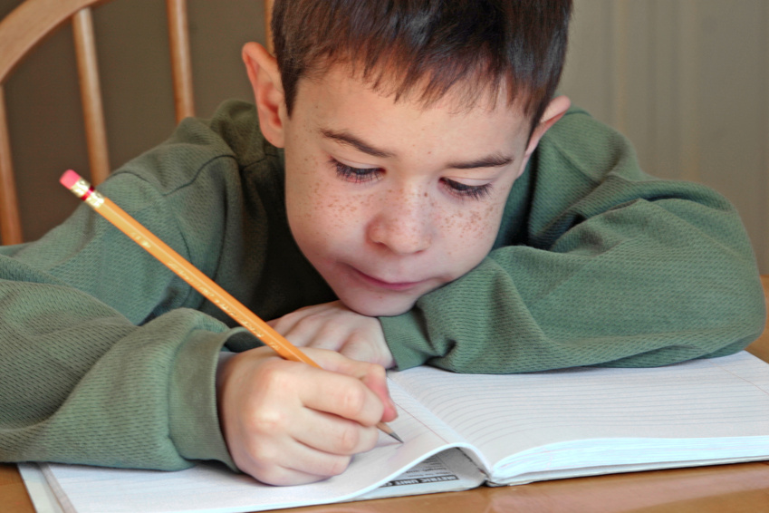
School context
CEIP “La Escuela” is situated 15 Km east of Madrid.
It lies in a residential area called Rivas Vaciamadrid.
The school was inaugurated in 1982 and it was the first school in the village.

Slide 30
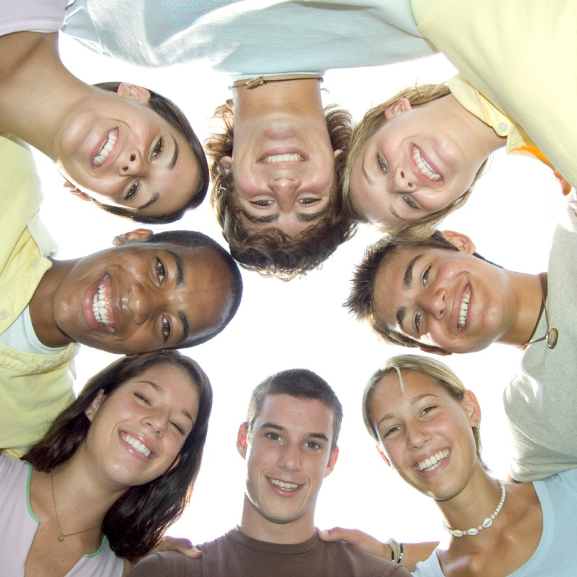
School context
Demographic structure:
-It has 400 pupils.
-It has 28 teachers.
-It has 16 other faculty.

Slide 31
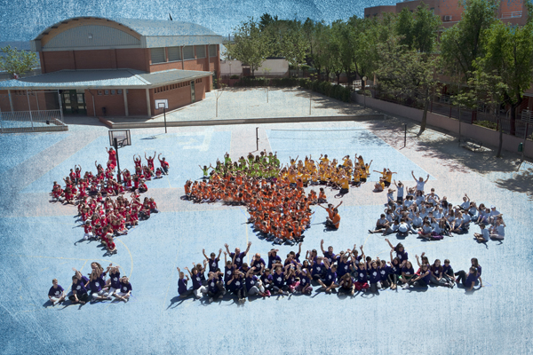
WELCOME TO OUR SCHOOL

Slide 32
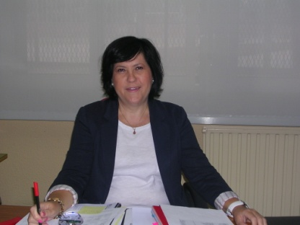
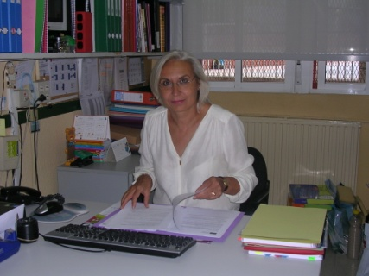
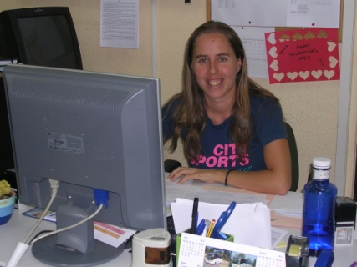
management team
Schoool Principal: Ms. Francisca Villar
Head teacher: Ms. Isabel Javier
Secretary: Ms. Laura Teresa

Slide 33
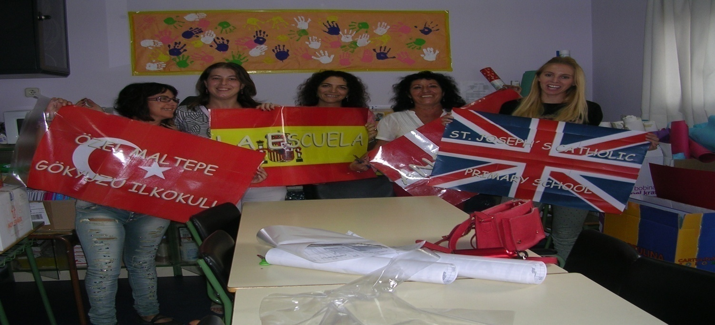
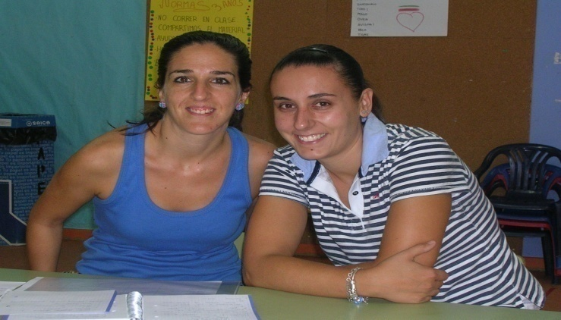
Preschool Education

Slide 34
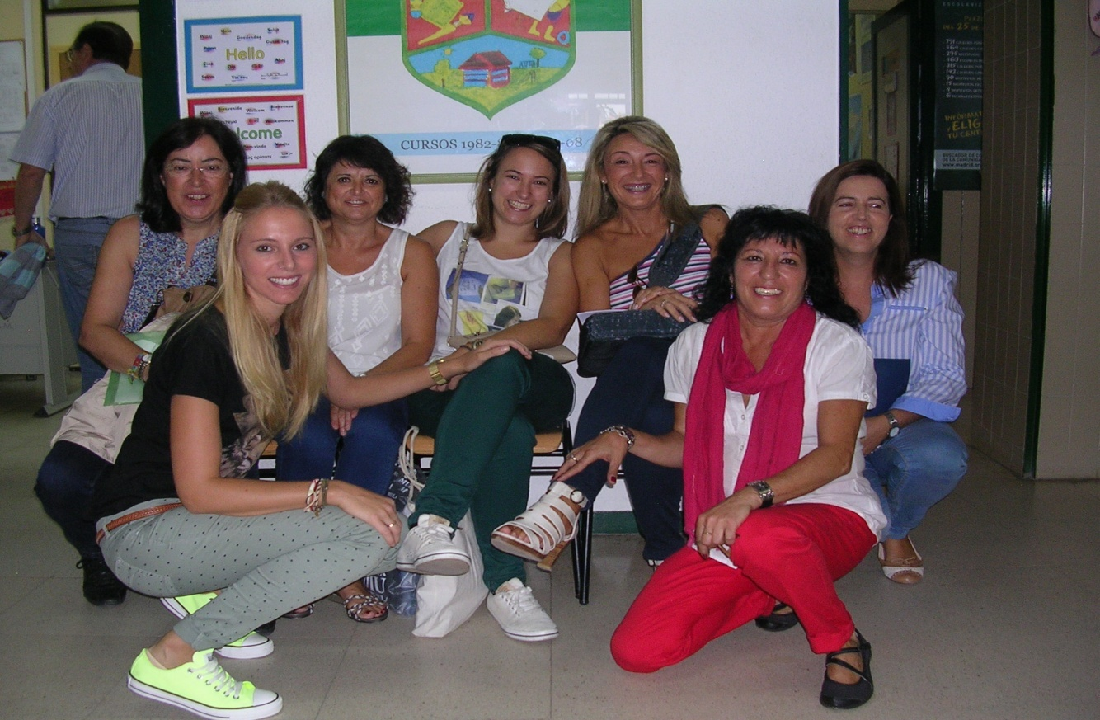
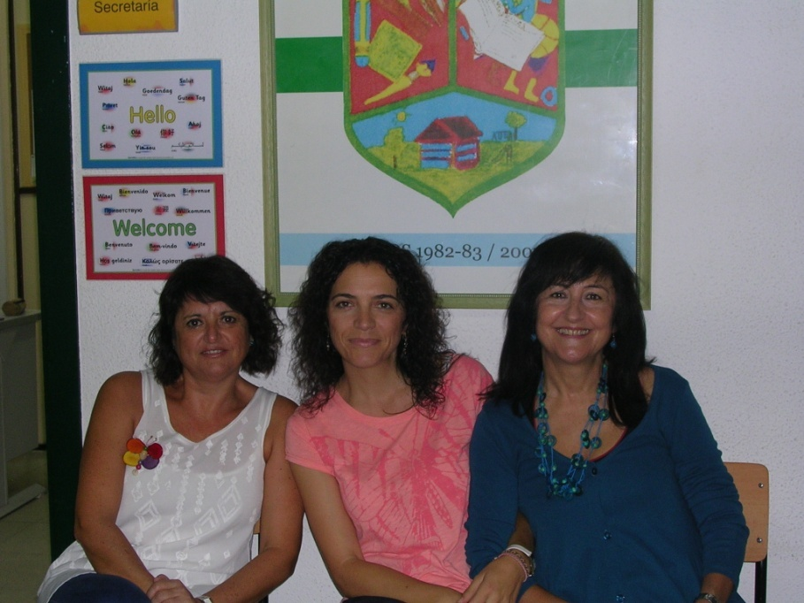
Primary education

Slide 35



School workers
Administrative staff, cooks, and caregivers.

Slide 36


School workers
The most senior staff: the concierge and caretakers.

Slide 37

our facilities
Infant Classroom
Primary Classroom
Conference Hall
Computer Classrooms

Slide 38

Our facilities
Dining room
Sports pavilion

Slide 39


Our facilities
Library and Music room

Slide 40

Olimpics games

Slide 41


Olimpics games

Slide 42


Olimpics games

Slide 43

Our parties: magic kings

Slide 44



Our parties: san isidro

Slide 45


