Slide 1
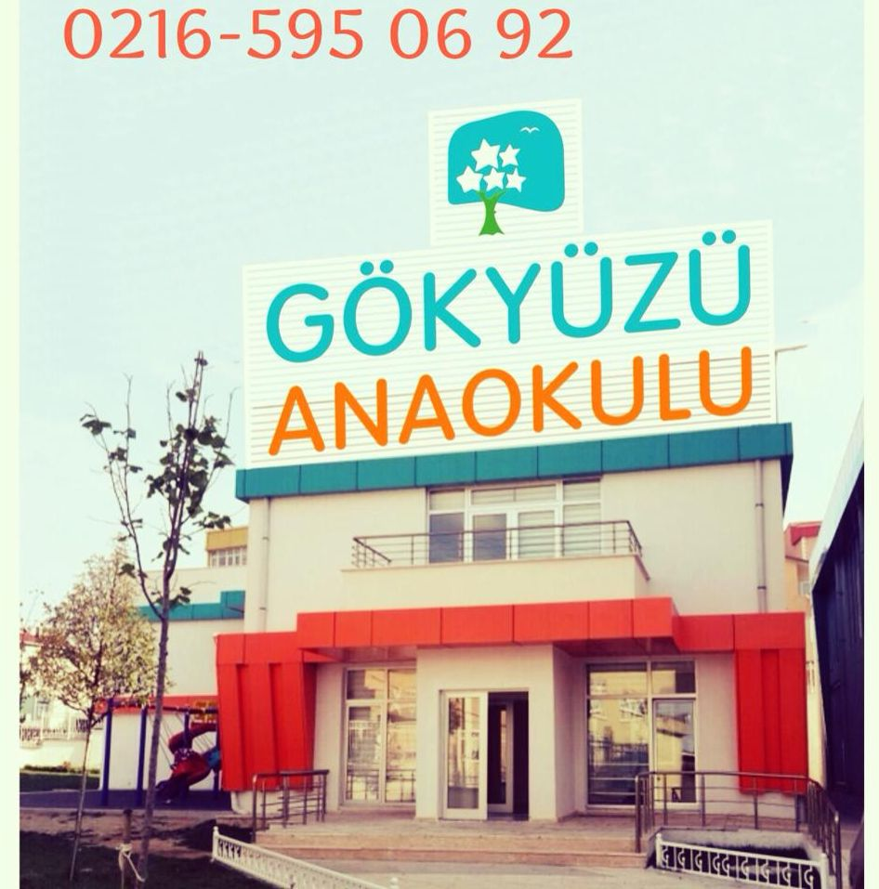
GÖKYÜZÜ PENDİK KINDERGARTEN

Slide 2
GÖKYÜZÜ has 3 Kindergartens, the Adatepe Kindergarten, the Maltepe Kindergarten and the Pendik Kindergarten. Their names are given according to their locations.
The Kindergarten in Pendik is the third Kindergarten of GÖKYÜZÜ.
The opening took place in 8th November 2014.

Slide 3
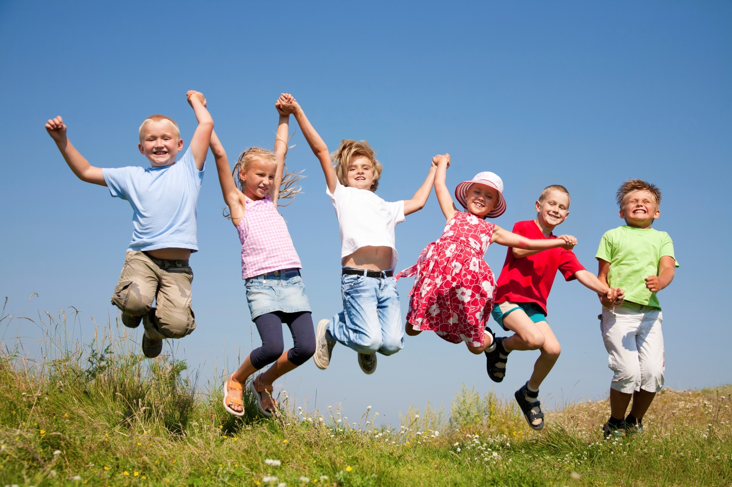
IN GÖKYÜZÜ PENDİK KINDERGARTEN;

Slide 4
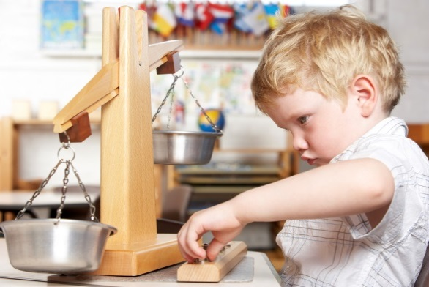
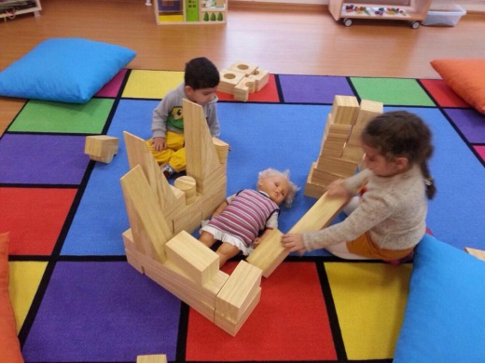
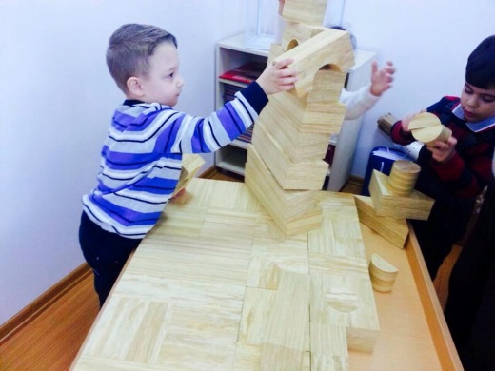
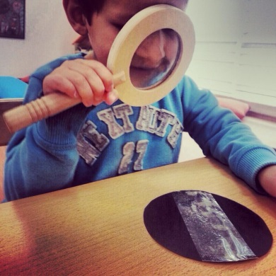
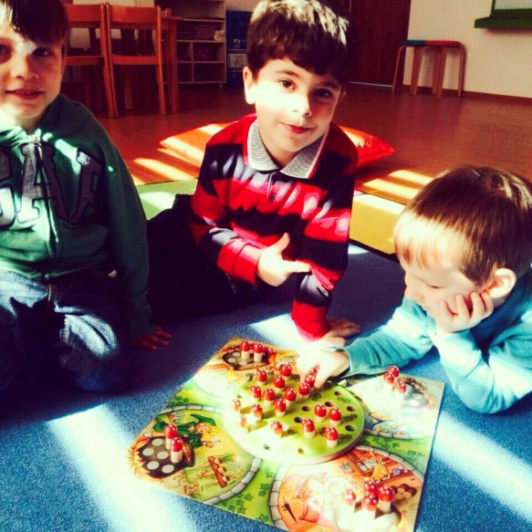
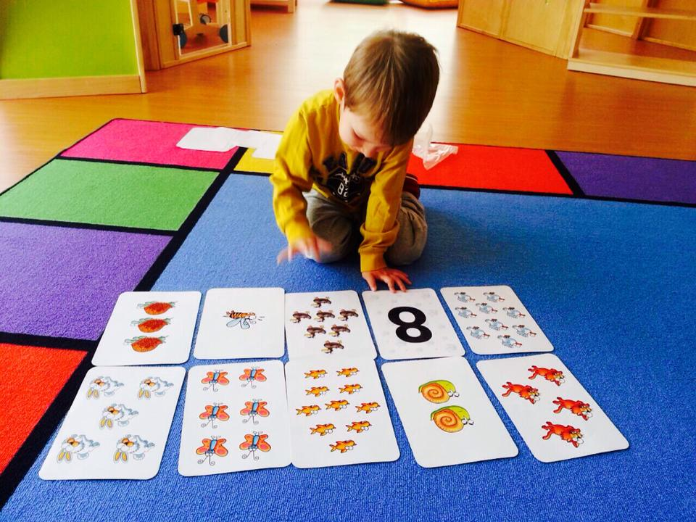
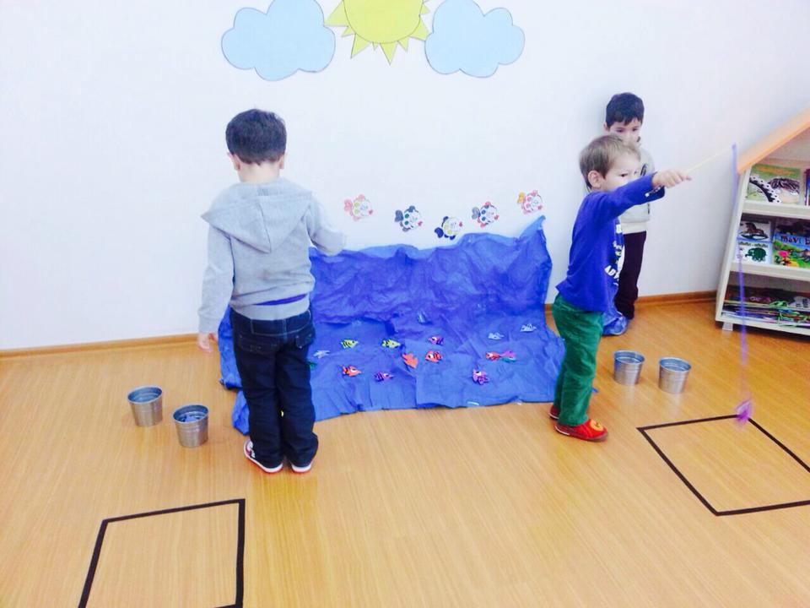
WE USE ALTERNATIVE EDUCATION METHODS

Slide 5
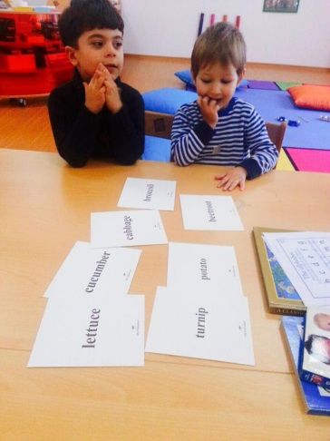
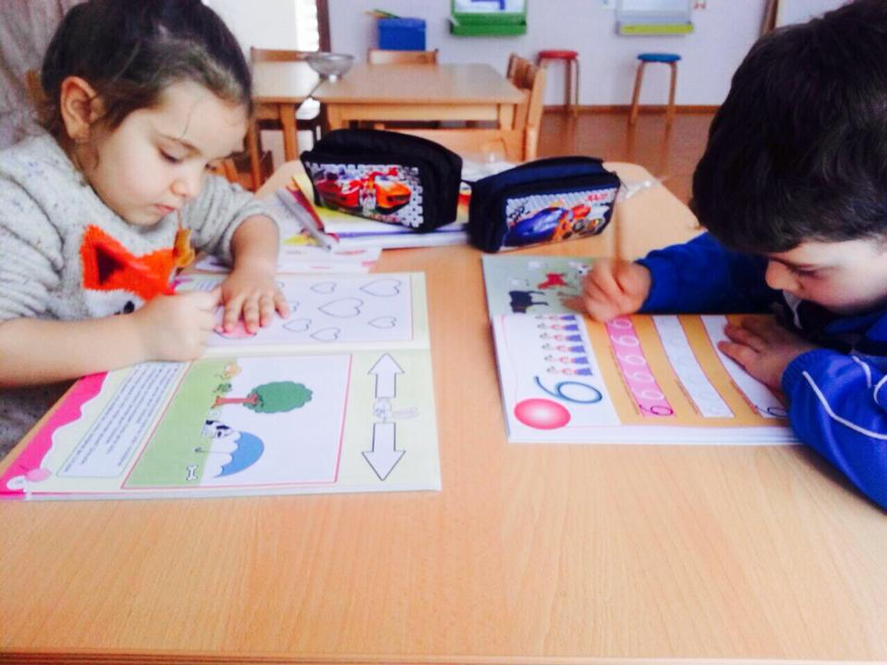
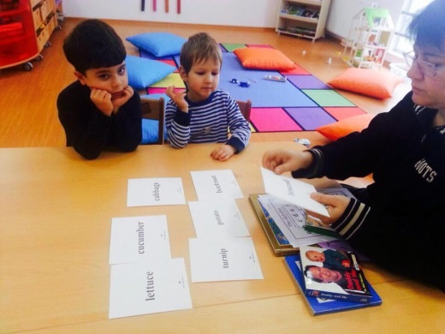
THEY LEARN ENGLISH WITH NATIVE TEACHERS

Slide 6
WE EDUCATE THE EMOTIONS

Slide 7
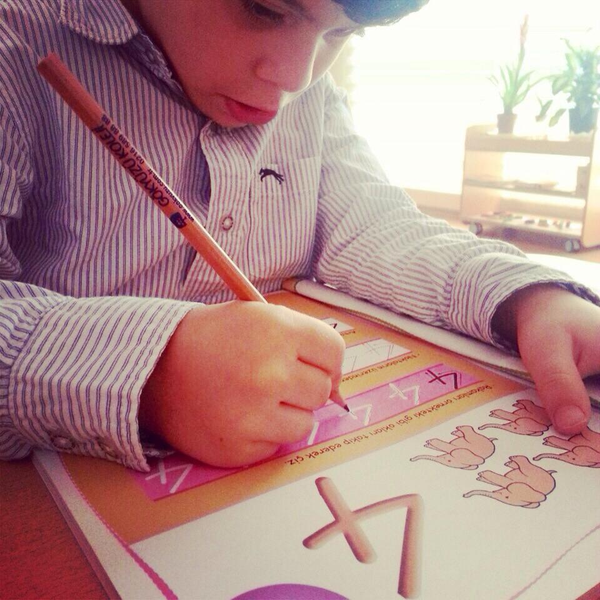
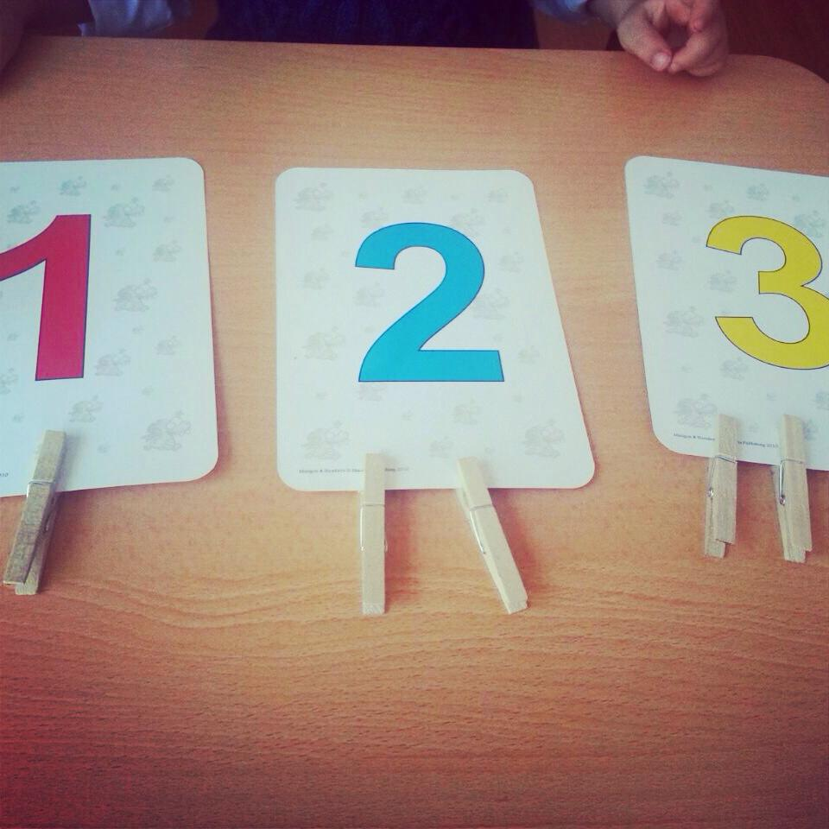
ENJOYABLE ARITHMETIC

Slide 8
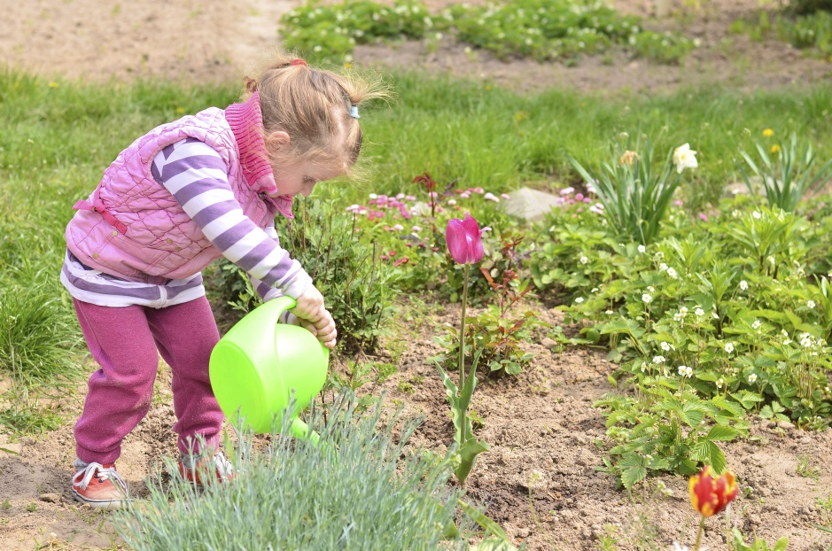
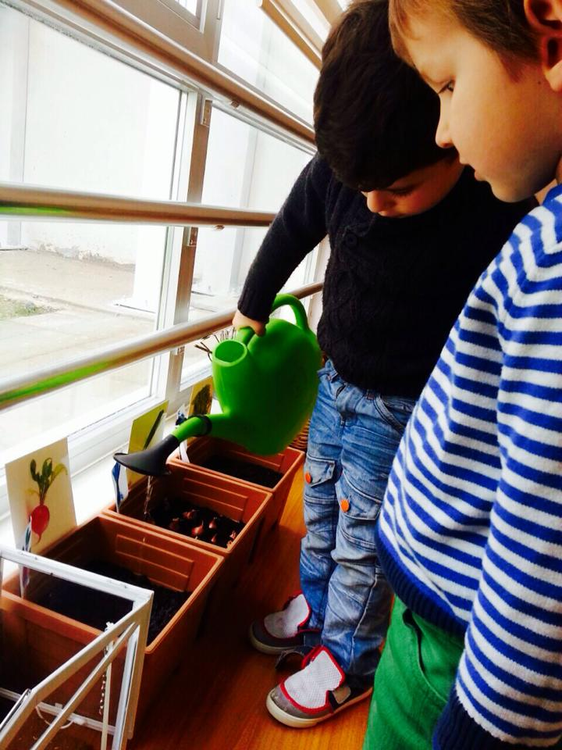
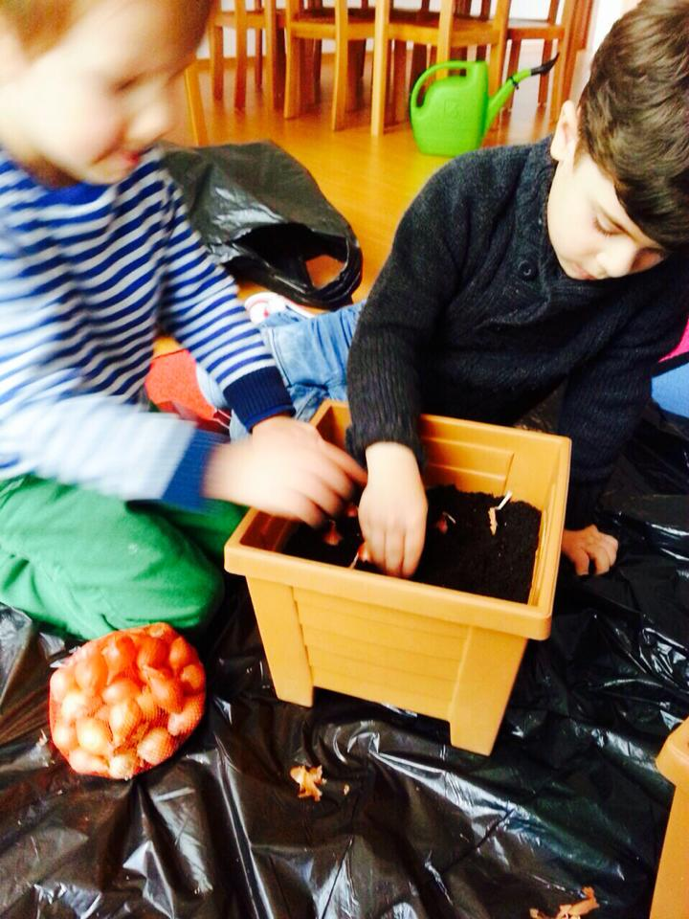
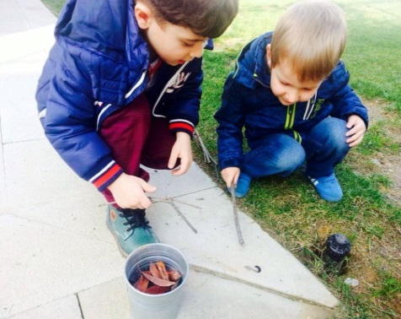
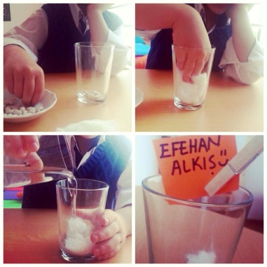
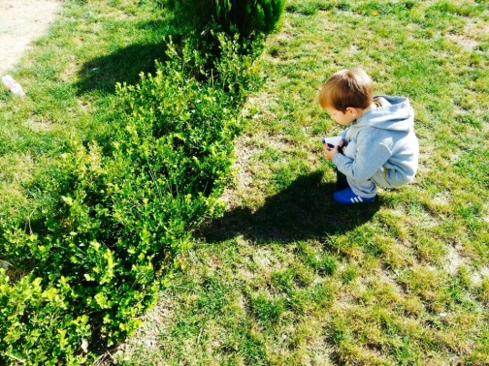
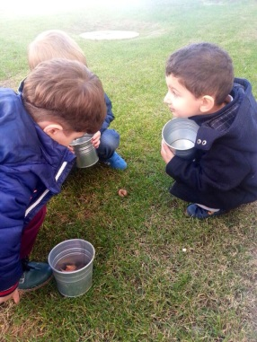
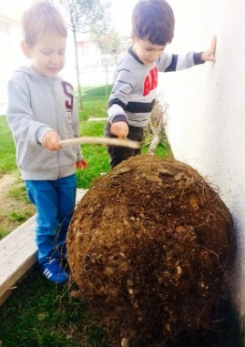
SCIENCE AND NATURE EXPERIMENT ACTIVITY

Slide 9
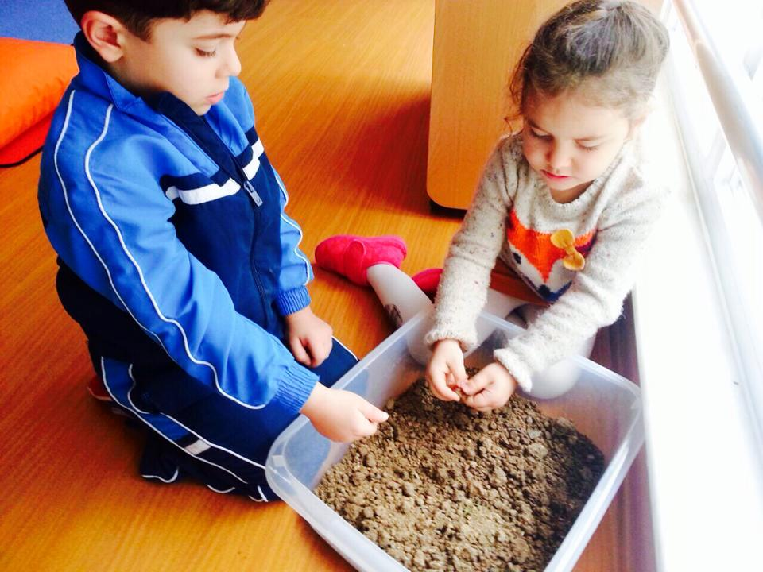
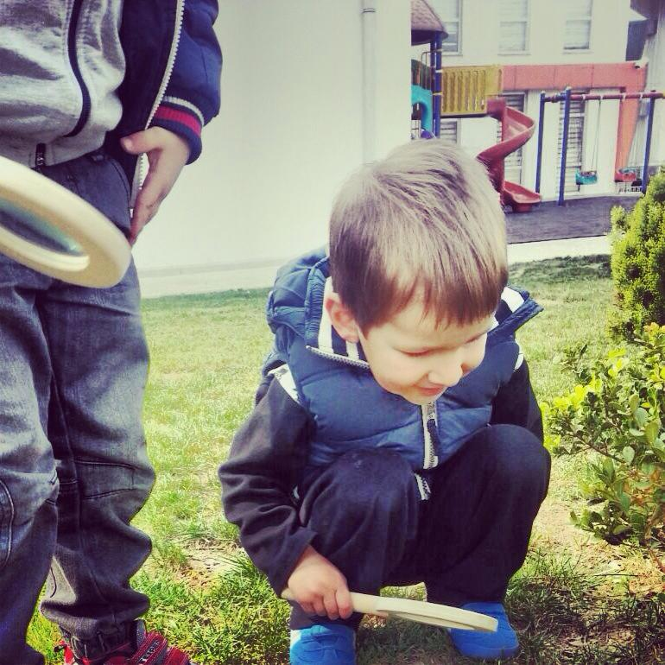
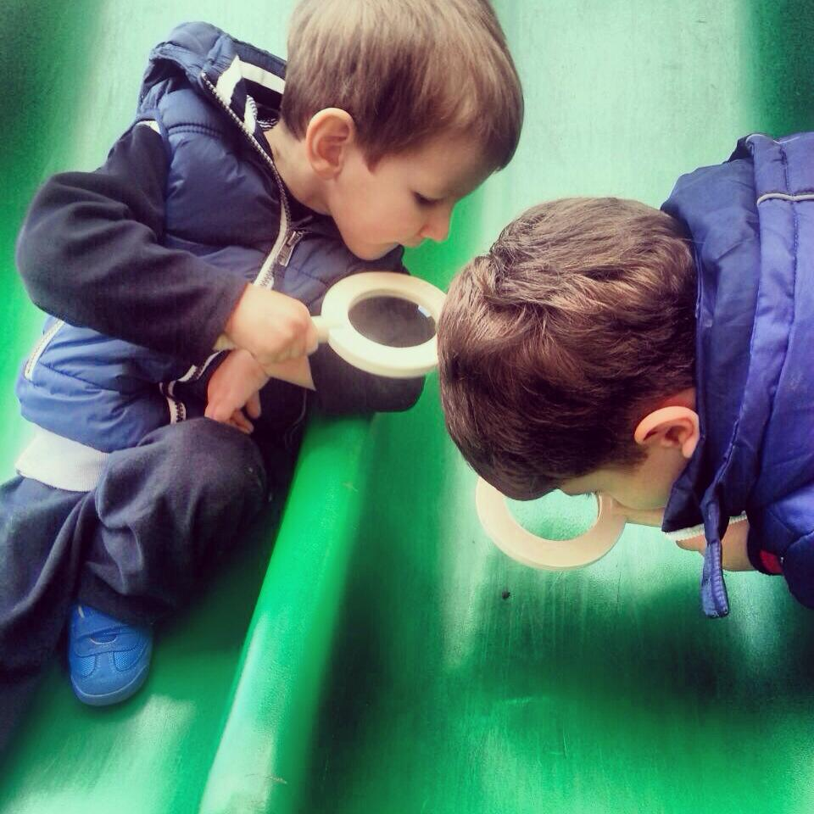
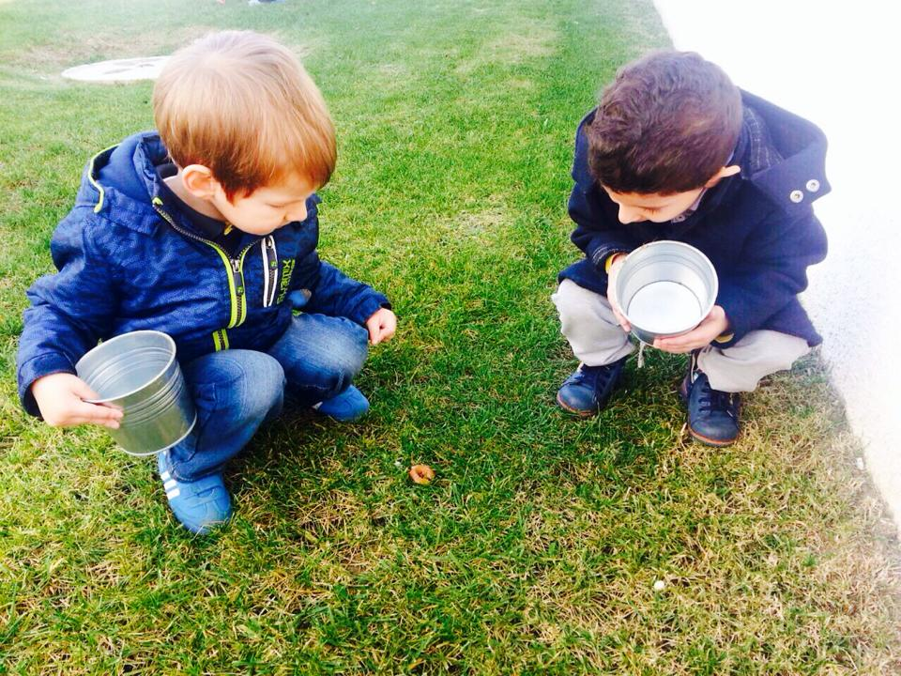
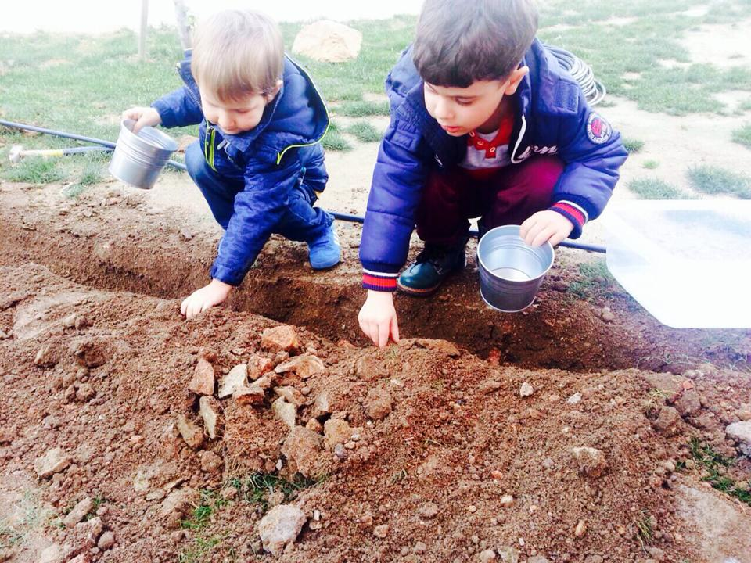
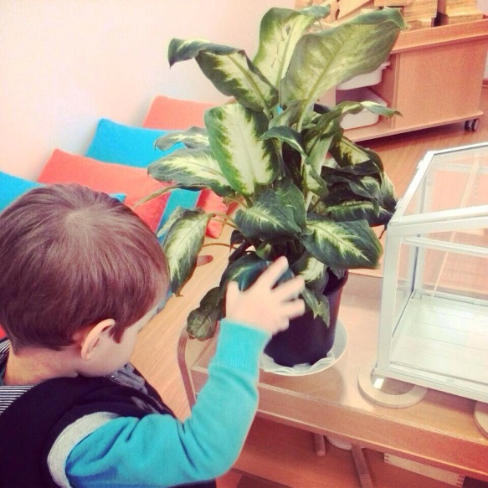

Slide 10
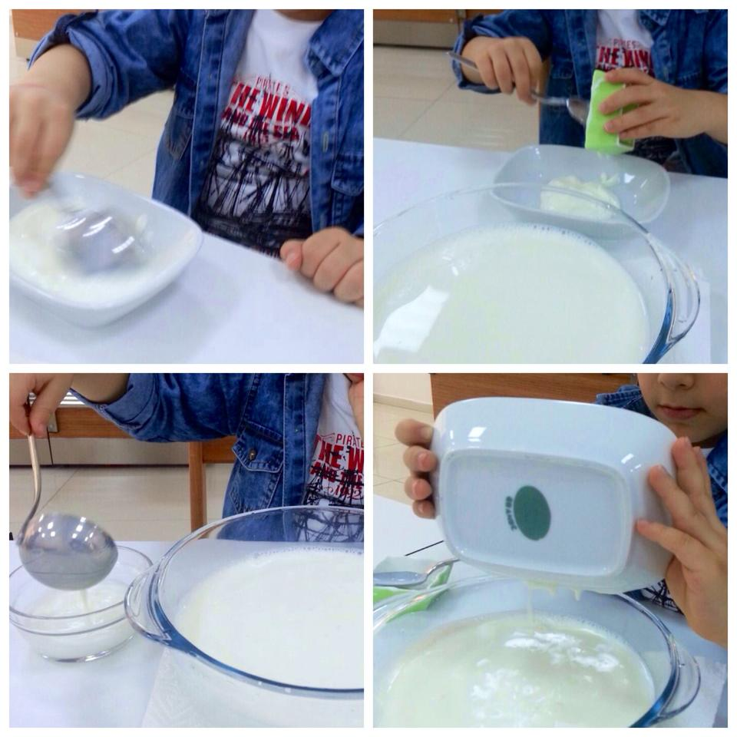
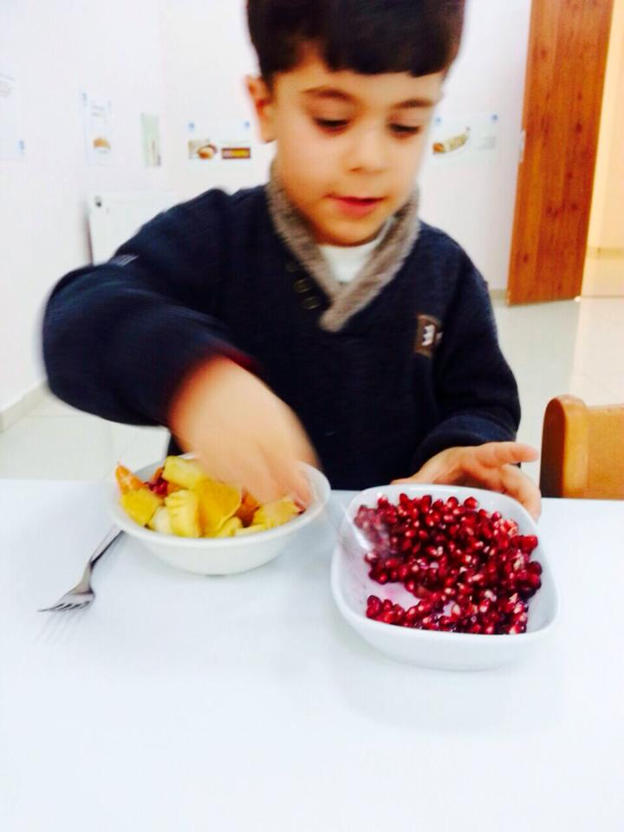
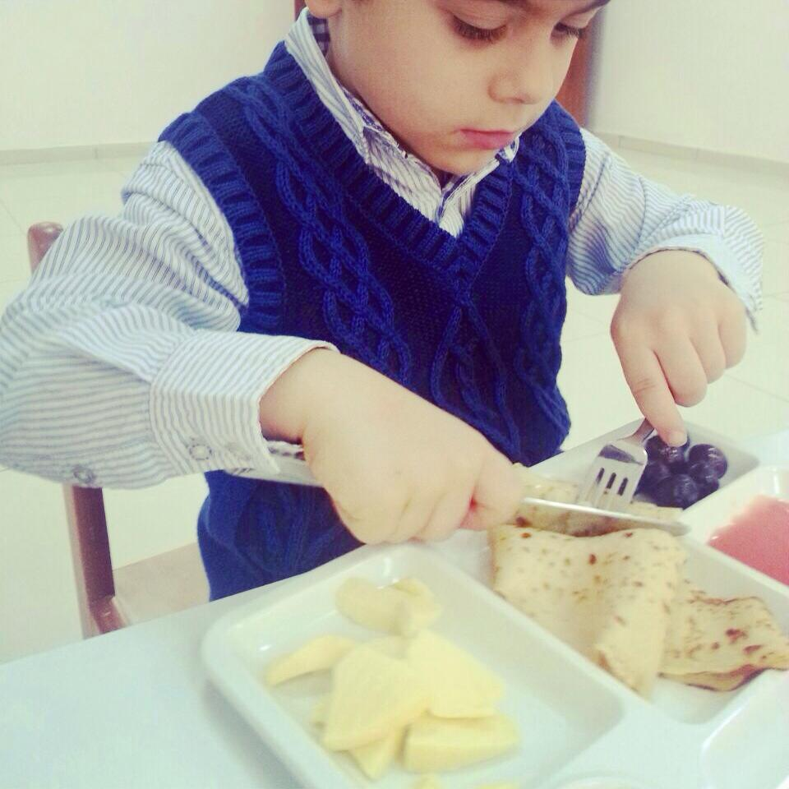
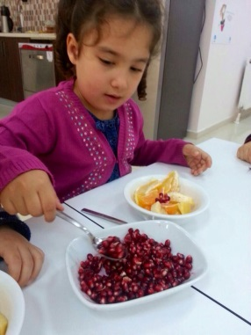
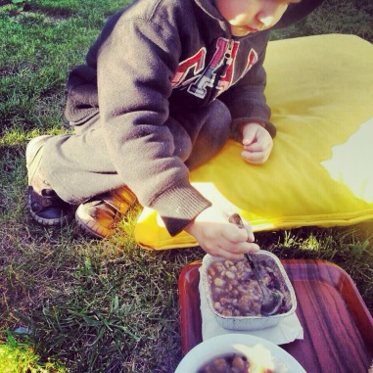
HEALTHY EATING

Slide 11
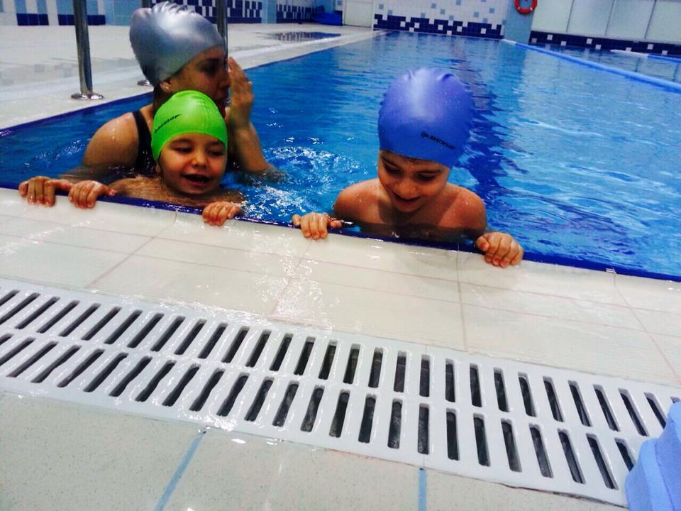
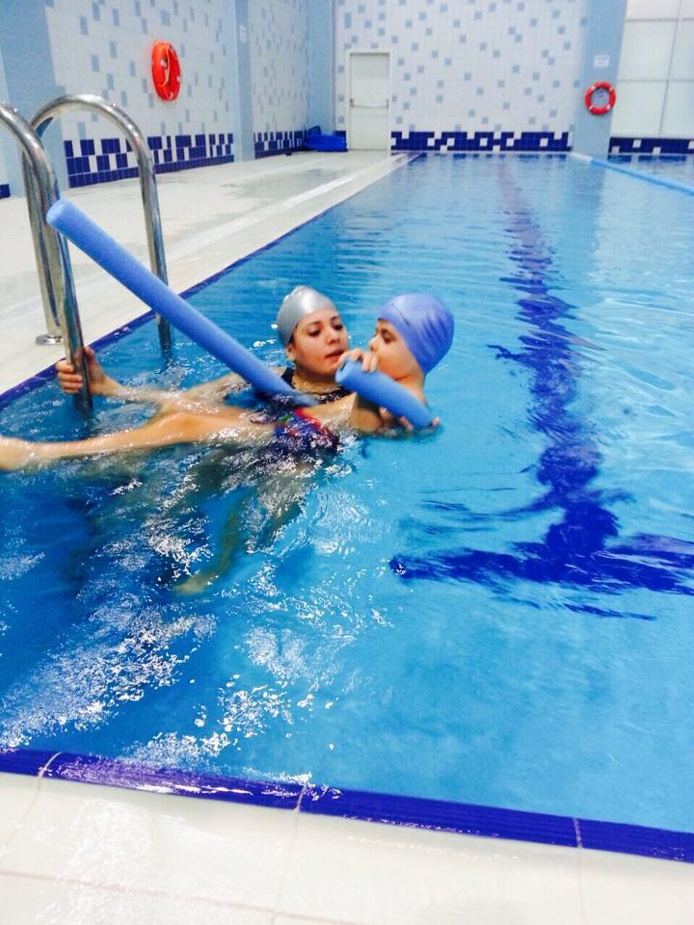
SWIMMING

Slide 12
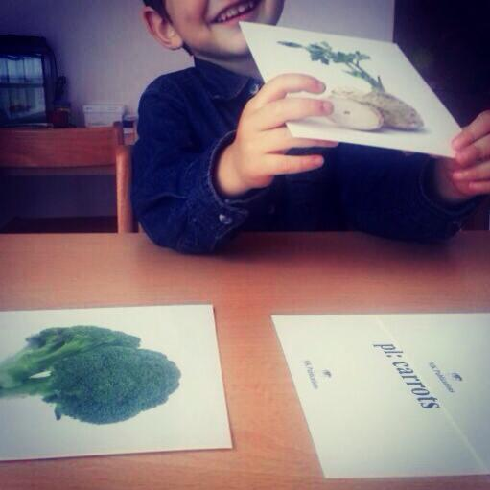
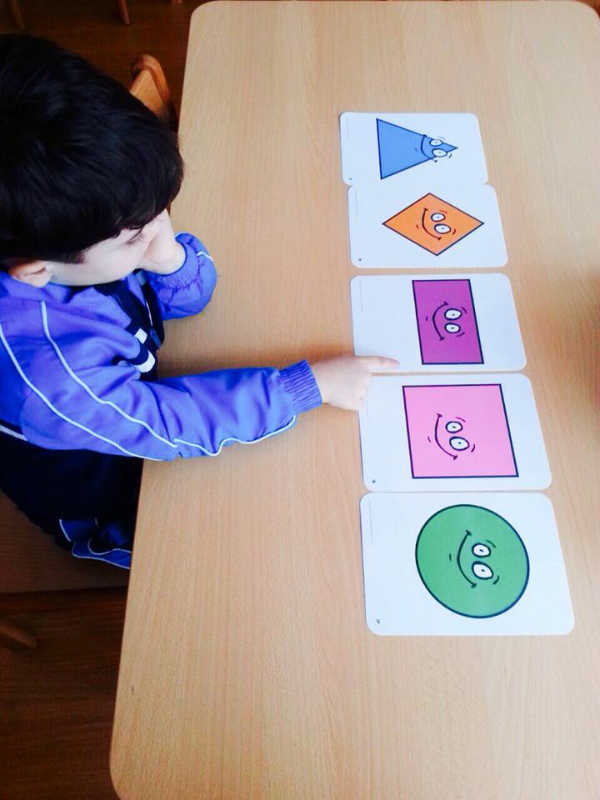
MONTESSORI EDUCATION

Slide 13
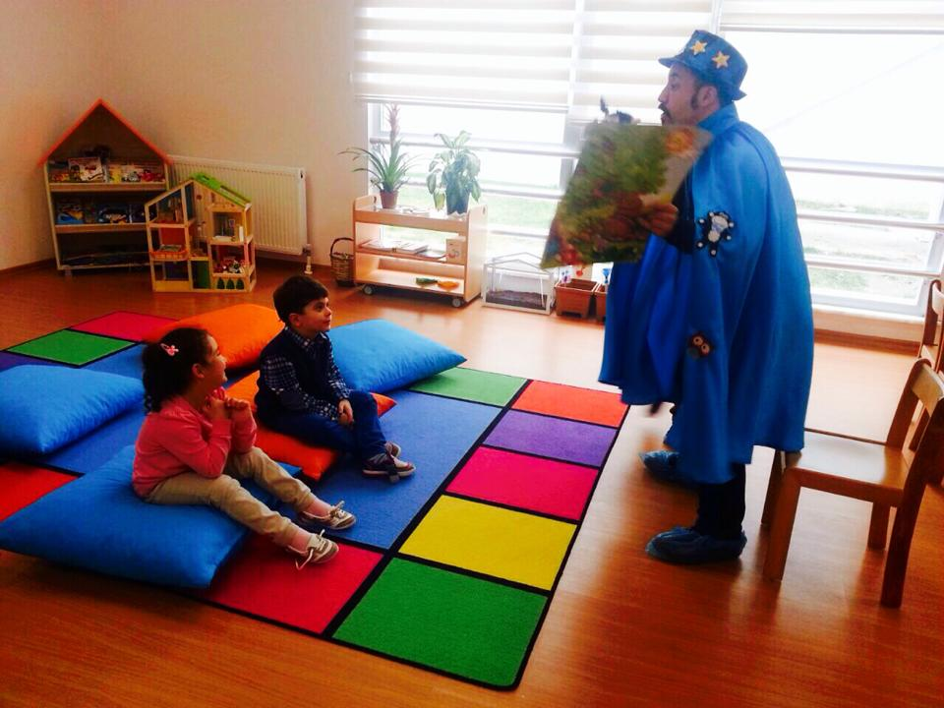
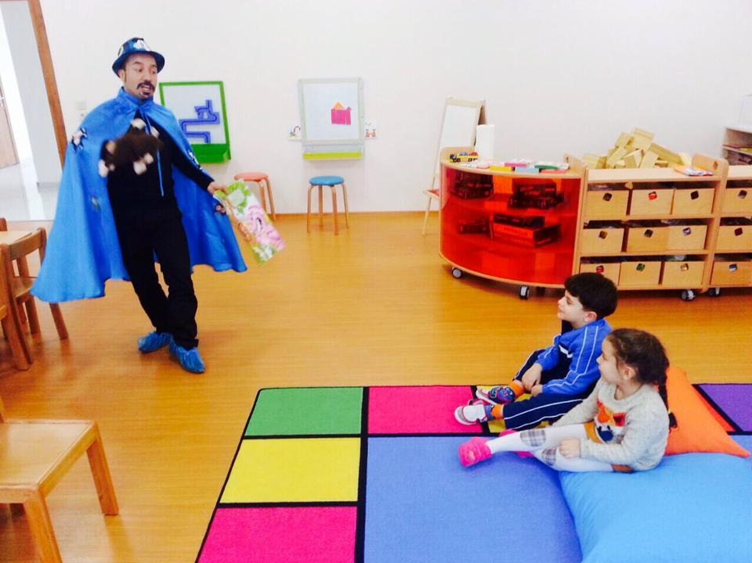
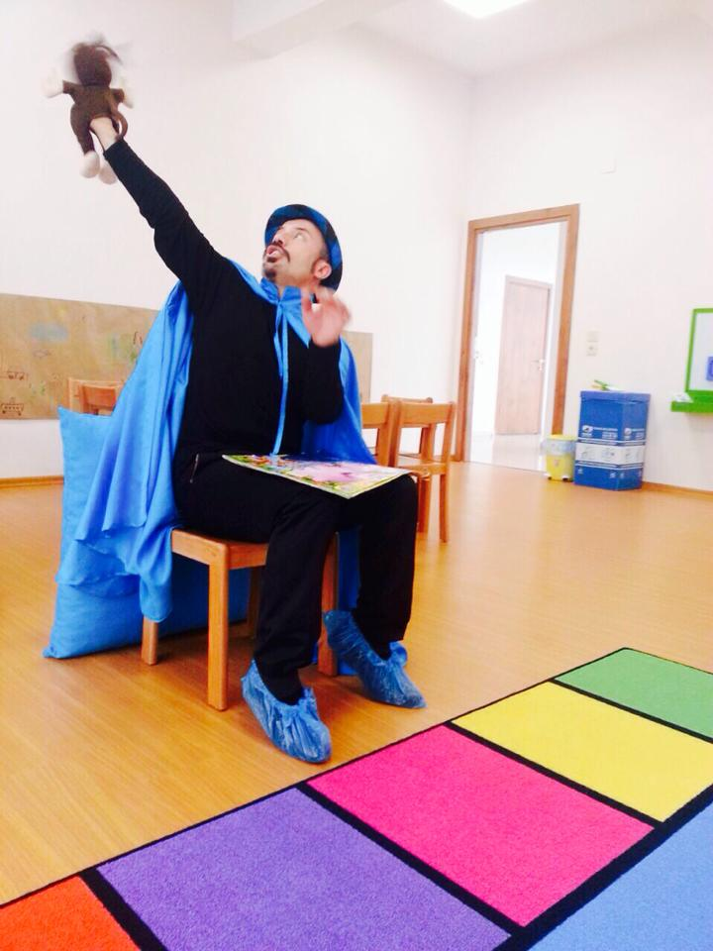
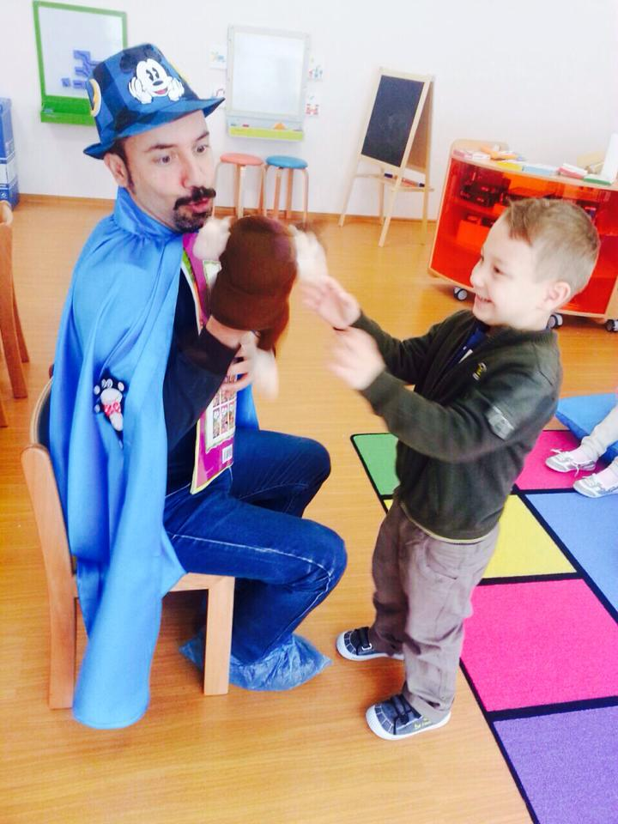
DRAMA ROOM

Slide 14
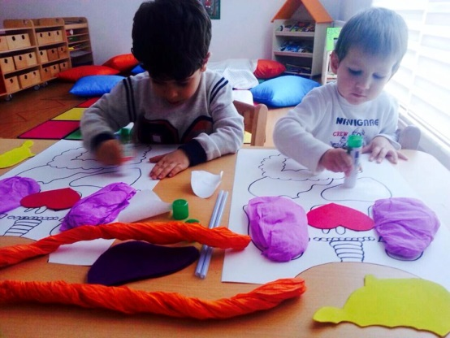
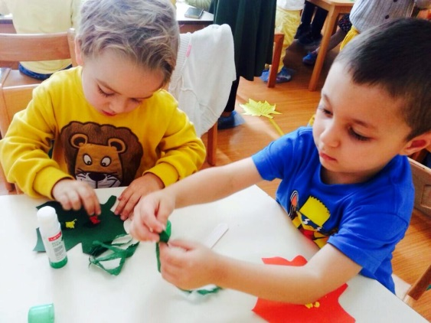
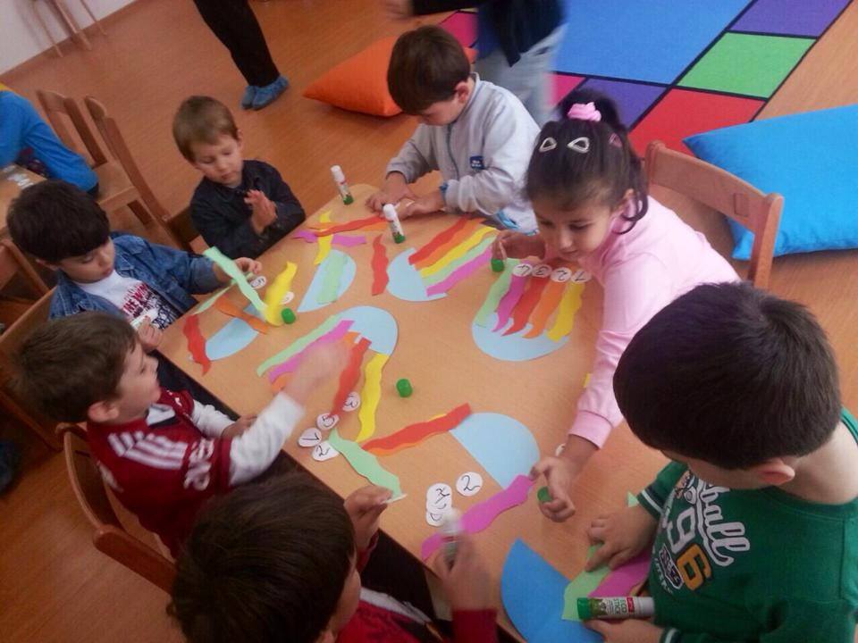
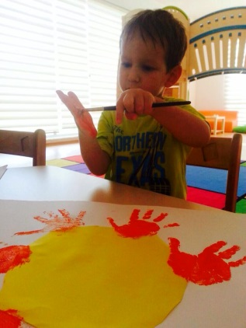
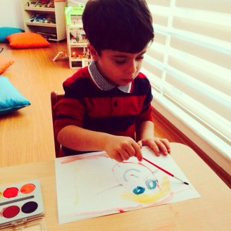
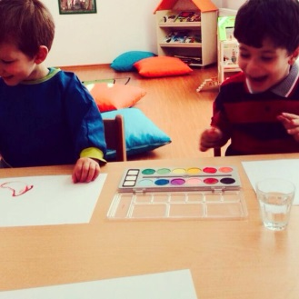
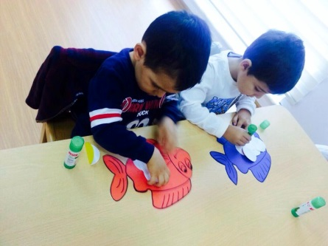
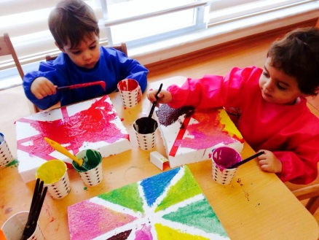
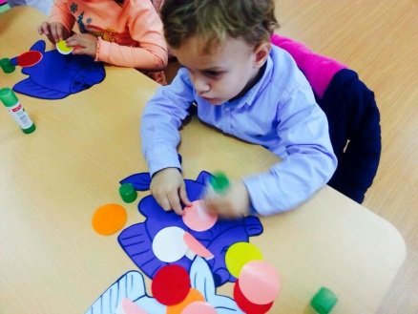
FINE ARTS

Slide 15
CHESS

Slide 16
CHILDREN’S FREEDOM

Slide 17
LEARNING AWARENESS

Slide 18
THEY DISCOVER THE WORLD ON THEIR OWN

Slide 19
OUR MISSION
It’s aimed to educate a " GOOD PERSON”.
Physically & spiritually talented, healthy, independent students who are useful for themselves and the others.

Slide 20
THE HIGH-SPEED TRAIN
Turkish State Railways high-speed rail service
“Ankara to Istanbul via Eskişehir”, “Ankara to Konya” and “Eskişehir to Konya”
only high-speed
service→ 250 km/h

Slide 21
March 2009 → Inaugural ceremony in Ankara
Turkish Prime Minister, Recep Tayyip Erdoğan, along with the President of Turkey, Abdullah Gül inaugurated the opening of the first phase of the project (Eskişehir-Ankara)
Before: Ankara-Istanbul → 7 h 30 minutes
Since 26 July 2014 : 3h 40 minutes

Slide 22
6 railroad cars
1 business class car, 1 café car and 4 economy class cars
business class car: 55 passengers
Economy class car: 89 passengers

Slide 23
TURKISH PRESIDENTIAL ELECTION
10 August 2014 in order to elect the 12th President of Turkey
the first presidential election in Turkey to be held nationally
Over 55 million citizens → vote

Slide 24
Recep Tayyip Erdoğan, the leader of the AKP who was elected Prime Minister in 2002, won the election with 51.79% of the vote

Slide 25
Recep Tayyip Erdoğan took over from Abdullah Gül in a handover ceremony on 28 August 2014

